Slide 1
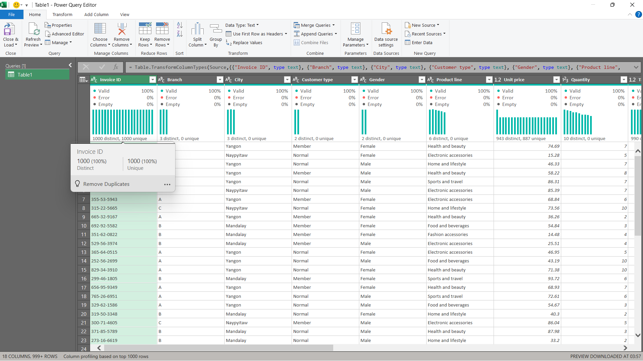
0.1 Checking if data is clean or not.

Slide 2
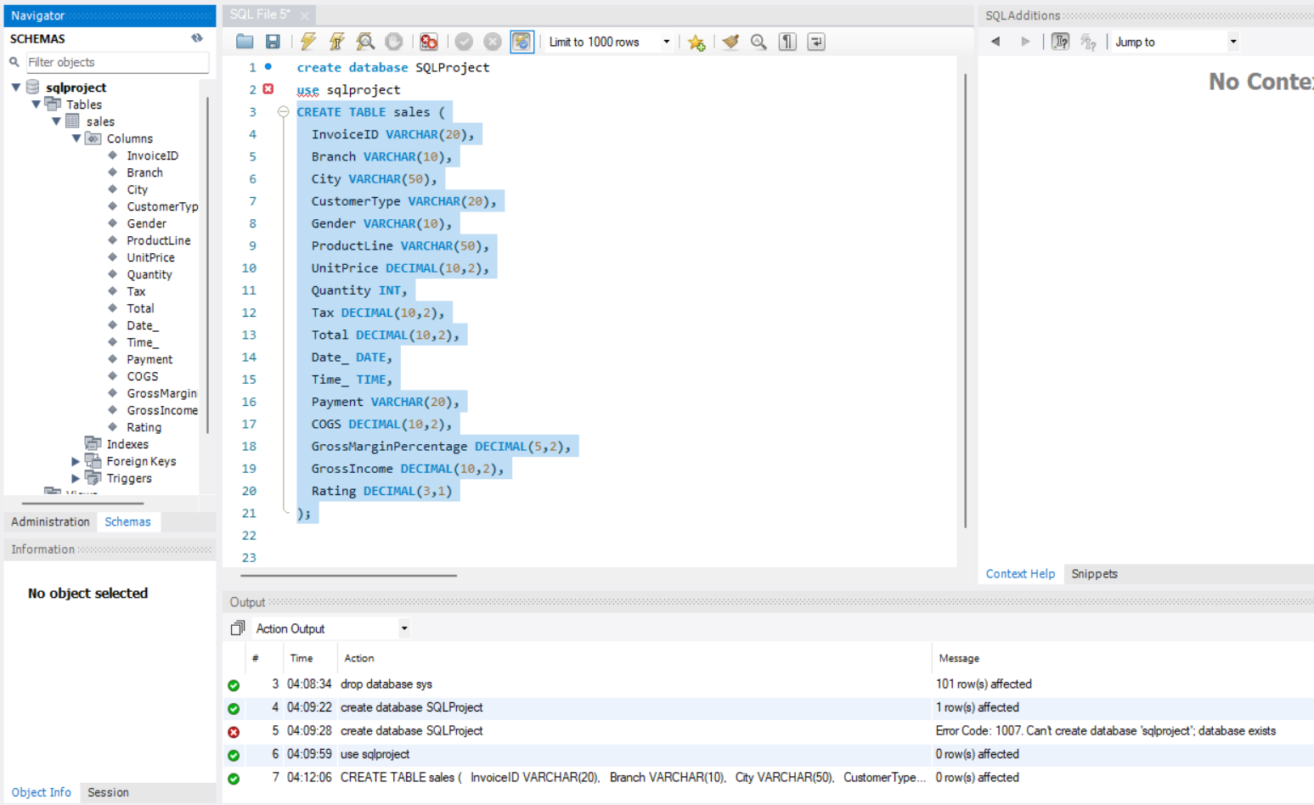
0.2 Creating Table to import data from excel

Slide 3
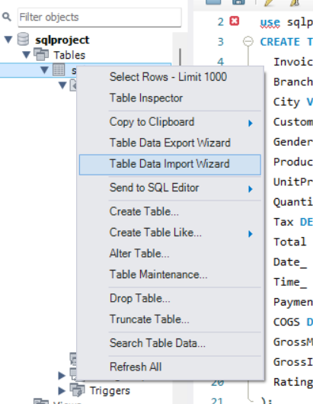
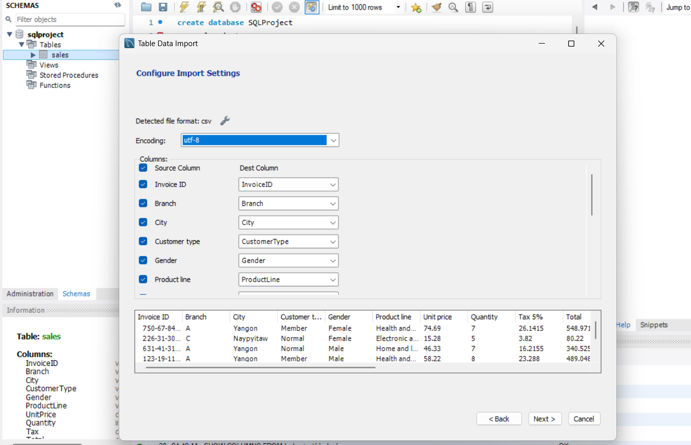
0.3 Importing data from excel

Slide 4
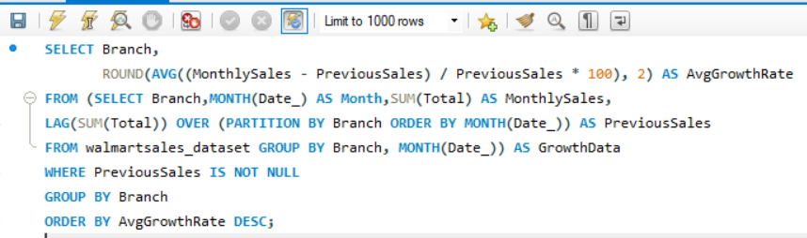
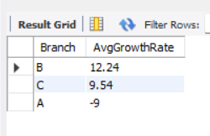
Task 1: Identifying the Top Branch by Sales Growth Rate
The top branch according to AvgGrowthRate is Branch B with 12.24% growth.

Slide 5
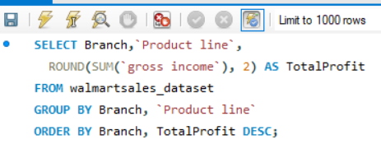
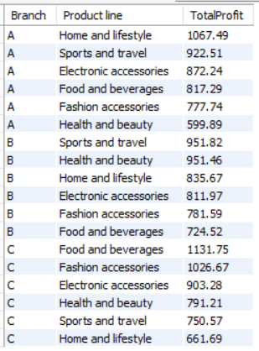
Task 2: Finding the Most Profitable Product Line for Each Branch.
The most profitable product lines are Home and lifestyle for Branch A, Sports and travel for Branch B, and Food and beverages for Branch C.

Slide 6
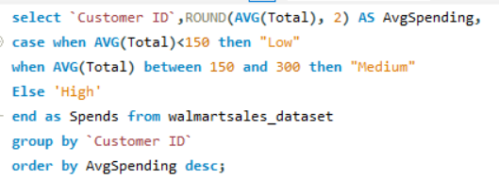
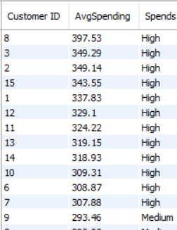
Task 3: Analyzing Customer Segmentation Based on Spending.
Customer 8, 3, 2, 15 and 1 stands out as the top spender, ideal for loyalty targeting and premium offers.

Slide 7
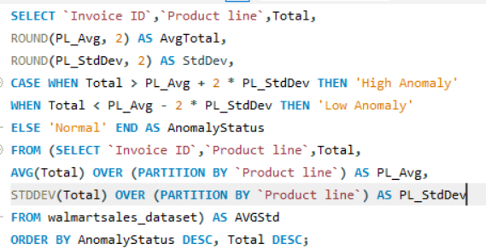
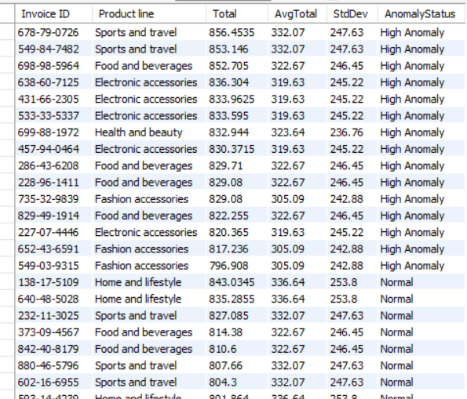
Task 4: Detecting Anomalies in Sales Transactions.
Using z-score logic, we flagged high anomalies in sales across six product lines, with Food and beverages shows the highest deviation at 12.23%.

Slide 8
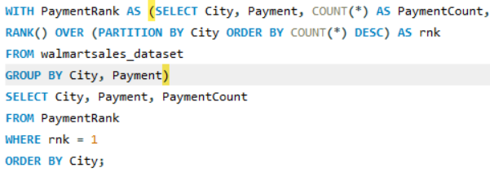
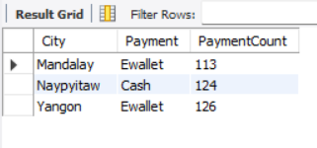
Task 5: Most Popular Payment Method by City.
Ewallet emerged as the most preferred payment method in Mandalay and Yangon, while Naypyitaw showed a strong preference for Cash.

Slide 9
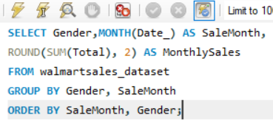
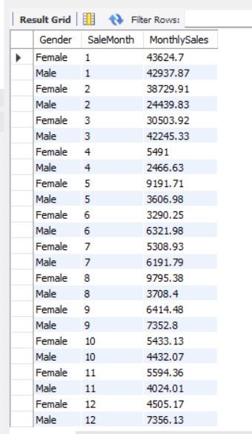
Task 6: Monthly Sales Distribution by Gender
Female customers dominated sales in January and March.
Male customers led in February and April.
Sales tapered off in later months, with gender preferences shifting.

Slide 10
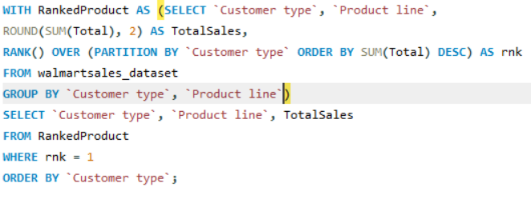
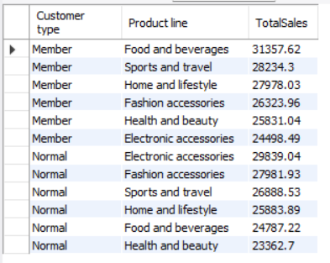
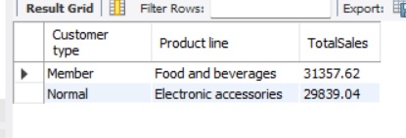
Task 7: Best Product Line by Customer Type
Members favored Food and beverages, while Normal customers spent most on Electronic Accessories with Total sales of 31357rs and 29839rs respectively.
All Product Line by Customer Type
Best Product Line by Customer Type

Slide 11
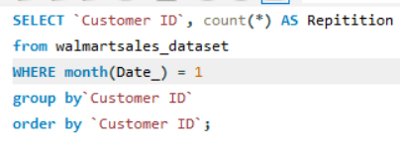
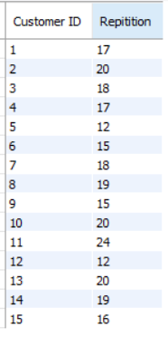
Task 8: Identifying Repeat Customers
These are the number of purchases made by all the customers in the month of January.

Slide 12
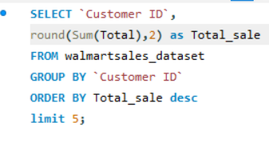
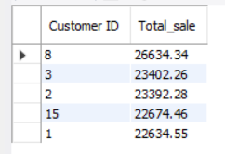
Task 9: Finding Top 5 Customers by Sales Volume
Customers 8, 3, 2, 15 and 1 are the top buyers in terms of Sales Volume.

Slide 13
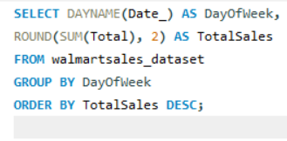
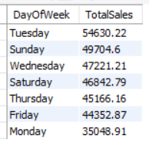
Task 10: Analyzing Sales Trends by Day of the Week
Between all the days, Tuesday brings the highest sales of all.

Slide 14
Project explanation Video
CTRL+CLICK

