Slide 1
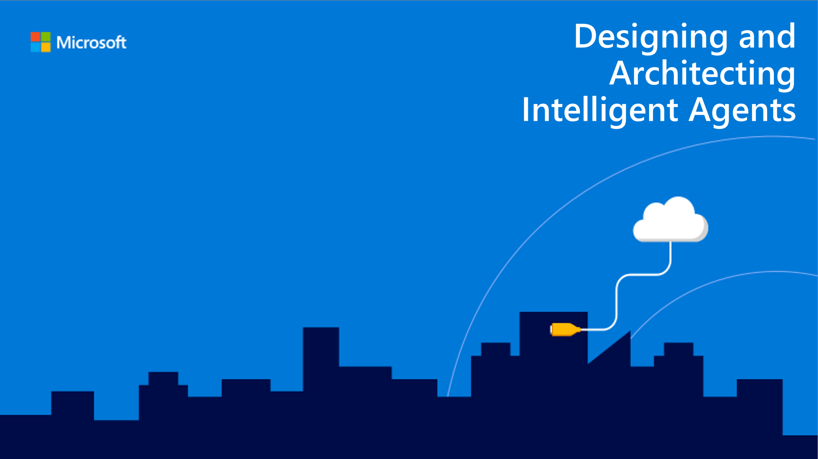
Introduction
Speaker name

Slide 2
Introduction
Welcome!
About the course
Audience
Prerequisites
Technologies
Notes:
Refer to the main readme for the course

Slide 3
Learning Objectives
At the end of this course, you should be able to…
Understand the basic principles of good bot design
Be able to efficiently and effectively design LUIS schema, especially with regards to well-established scenarios
Be able to decide the most appropriate architectural components for several common bot use-cases
For Cognitive Services, determine when to use what and how to combine multiple to increase the intelligence and capabilities of bots
Be able to use the prior four learning objectives to design and architect intelligent bot solutions

Slide 4
Agenda
8:00-9:00AM | Sign in
9:00-9:20AM | 1.1: Introduction
9:20-9:30AM | AI Ethics
9:30-10:00AM | 2.1: Bot Design Principles
10:00-10:30AM | 2.2: Lab (Discovery, Envisioning) – Designing Bots
10:30-10:45AM | Break
10:45-11:30AM | 3.1: LUIS Design Principles
11:30-12:00PM | 3.2: Lab (ADS/Wireframe) – Designing LUIS
12:00-1:00PM | Lunch
1:00-1:30PM | 4.1: Reference Architectures and Common Patterns
1:30-2:00PM | 4.2: Lab (POC) – Initial Architecture
2:00-2:15PM | Break
2:15-2:45PM | 5.1 - Integration with Cognitive Services
2:45-3:15PM | 5.2: Lab (Handoff) – Cognitive Services
3:15-3:30PM | Break
3:30-4:30PM | 6.1: Capstone Project (Discovery, Envisioning, ADS, POC, Implementation, Handoff and Follow-up)
4:30-5:00PM | Q&A and Feedback
Notes:
Key scenarios for bots – 10-15 minutes
Common patterns – 5-10 minutes
New Bot Framework SDK – 5-10 minutes
QnA – remaining time

Slide 5
Course resources
https://aka.ms/daaia

