Slide 1

Integration with Cognitive Services
Speaker name

Slide 2
Session objectives and takeaways
At the end of this session, you should be able to…
Understand how various Cognitive Services can add value in bot applications
Integrate Cognitive Services into bot applications
Leverage tools to manage conversations effectively and efficiently

Slide 3
Agenda
Cognitive Services
Adding Cognitive Services to bots
Other ways to make bots smarter
Notes:
Cognitive Services – 10-15 minutes
Adding Services to Bots – 5-10 minutes
Other ways to make bots smarter – 5-10 minutes
QnA – remaining time

Slide 4
Making bots smarter with Cognitive Services
Easy to implement – make API calls
Ready-to-use AI
Custom AI
LUIS
Custom Vision
Custom Speech
Add value
Notes:
Cognitive Services: https://azure.microsoft.com/en-us/services/cognitive-services/
Cognitive Services documentation: https://docs.microsoft.com/en-us/azure/cognitive-services/Welcome
Add intelligence to bots: https://docs.microsoft.com/en-us/azure/bot-service/bot-service-concept-intelligence

Slide 5
Making bots smarter with Cognitive Services
Language understanding
Knowledge extraction
Speech recognition and conversion
Web search
Image and video understanding
Notes:
Cognitive Services: https://azure.microsoft.com/en-us/services/cognitive-services/
Cognitive Services documentation: https://docs.microsoft.com/en-us/azure/cognitive-services/Welcome
Add intelligence to bots: https://docs.microsoft.com/en-us/azure/bot-service/bot-service-concept-intelligence

Slide 6
Language understanding
Language Understanding Intelligent Service (LUIS)
Extract intents and entities from natural language
Text Analytics
Determine language, key phrases and sentiment
Bing Spell Check
Correct spelling errors, recognize name differences/brands/slang/homonyms
Linguistic Analysis
Text structure analyses – being moved to text analytics modules in AML Studio
Web Language Model
Word breaking – being moved to text analytics modules in AML Studio
Translator Text
Real-time text translation
Cognitive Services
Notes:
LUIS: https://azure.microsoft.com/en-us/services/cognitive-services/language-understanding-intelligent-service/
Text analytics: https://azure.microsoft.com/en-us/services/cognitive-services/text-analytics/
Bing spell check: https://azure.microsoft.com/en-us/services/cognitive-services/spell-check/
Text analytics models in AML Studio: https://docs.microsoft.com/en-us/azure/machine-learning/studio/text-analytics-module-tutorial
Translator Text: https://azure.microsoft.com/en-us/services/cognitive-services/translator-text-api/

Slide 7
Knowledge extraction
Entity Linking Intelligence
Disambiguates entities from context and links text from your bot to additional information – project/labs
Knowledge Exploration
Quickly add interactive search to structured data – project/labs
Academic Knowledge
Help users find the academic resources they’re looking for – project/labs
QnA Maker
Quickly and easily create simple question and answer bots based on FAQ URLs, structured documents, or editorial content
Custom Decision Service
Uses reinforcement learning in a new approach for personalizing content
Cognitive Services
Notes:
*Project Entity Linking: https://labs.cognitive.microsoft.com/en-us/project-entity-linking
*Project Knowledge Exploration: https://labs.cognitive.microsoft.com/en-us/project-knowledge-exploration
*Project Academic Knowledge: https://labs.cognitive.microsoft.com/en-us/project-academic-knowledge
QnA Maker: https://qnamaker.ai/
Custom Decision Service: https://azure.microsoft.com/en-us/services/cognitive-services/custom-decision-service/
“Projects/labs provides early adopters with an early look at emerging Cognitive Services technologies. These technologies are still under development and do not have the same performance quality as generally available APIs, but don't let that stop you from discovering and trying the newest Cognitive Services technologies. Please try these new technologies and let us know what you think.” –Cognitive Services Labs

Slide 8
Speech recognition and conversion
Bing Speech
Convert speech-to-text and text-to-speech, understand intent
Custom Speech (CRIS)
Overcome speech recognition barrier such as speaking style, vocabulary, and background noise
Speaker Recognition
Identify individual speakers or use speech as a means of authentication
Translator Speech
Easily add speech translation to your bot
Cognitive Services
Notes:
Bing Speech: https://azure.microsoft.com/en-us/services/cognitive-services/speech/
Custom Speech Service: https://azure.microsoft.com/en-us/services/cognitive-services/custom-speech-service/
Speaker Recognition: https://azure.microsoft.com/en-us/services/cognitive-services/speaker-recognition/
Translator Speech: https://azure.microsoft.com/en-us/services/cognitive-services/translator-speech-api/

Slide 9
Web search
Bing Web Search
Conduct web searches within bots
Bing Image Search
Conduct image searches within bots
Bing Video Search
Conduct video searches within bots
Bing News Search
Conduct news searches within bots
Bing Autosuggest
Automated search suggestions – not applicable for a standard bot
Bing Entity Search
Bring rich context about entities (like people, places, things, etc.)
Bing Custom Search
Easy-to-use, ad-free, commercial-grade search tool that lets you deliver the results you want
Project Local Insights
Score the attractiveness of a location
Project Event Tracking
Find events associated with Wikipedia entities
Cognitive Services
Notes:
Bing web search: https://azure.microsoft.com/en-us/services/cognitive-services/bing-web-search-api/
Bing image search: https://azure.microsoft.com/en-us/services/cognitive-services/bing-image-search-api/
Bing video search: https://azure.microsoft.com/en-us/services/cognitive-services/bing-video-search-api/
Bing news search: https://azure.microsoft.com/en-us/services/cognitive-services/bing-news-search-api/
Bing autosuggest: https://azure.microsoft.com/en-us/services/cognitive-services/autosuggest/
Bing entity search: https://azure.microsoft.com/en-us/services/cognitive-services/bing-entity-search-api/
Bing custom search: https://azure.microsoft.com/en-us/services/cognitive-services/bing-custom-search/
Project local insights: https://labs.cognitive.microsoft.com/en-us/project-local-insights
Project event tracking: https://labs.cognitive.microsoft.com/en-us/project-event-tracking

Slide 10
Image and video understanding
Computer Vision
Obtain tags, descriptions, adult/racy scores, text, hand writing, celebrities, and more from images
Emotion
Recognize emotions in images – going away because Face API has same capability
Face
Detect faces and compare similar ones, organize similar images in groups, identify previously tagged people in images
Video Indexer
Unlock video insights – Video API ended
Custom Vision
Custom image classification models made easy
Content Moderator
Machine-assisted moderation of text and images
Project Gesture
Incorporate gesture-based controls into your apps - project/labs
Cognitive Services
Notes:
Computer vision: https://azure.microsoft.com/en-us/services/cognitive-services/computer-vision/
Emotion: https://azure.microsoft.com/en-us/services/cognitive-services/emotion/
Face: https://azure.microsoft.com/en-us/services/cognitive-services/face/
Video indexer: https://azure.microsoft.com/en-us/services/cognitive-services/video-indexer/
Custom vision: https://azure.microsoft.com/en-us/services/cognitive-services/custom-vision-service/
Content moderator: https://azure.microsoft.com/en-us/services/cognitive-services/content-moderator/
Project gesture: https://labs.cognitive.microsoft.com/en-us/project-gesture

Slide 11
Adding services to bots
Examples
QnA Maker
LUIS
Azure Search
Computer Vision

Slide 12
QnA Maker
public void ConfigureServices(IServiceCollection services)
{
services.AddBot<QnAMakerBot>(options =>
{
options.CredentialProvider = new
ConfigurationCredentialProvider(Configuration);
var qnaOptions = new QnAMakerMiddlewareOptions
{
SubscriptionKey = "xxxxxx",
KnowledgeBaseId = "xxxxxx"
};
var middleware = options.Middleware;
middleware.Add(new QnAMakerMiddleware(qnaOptions));
});
}
Adding services to bots
Notes:
QnA Maker sample: https://github.com/Microsoft/botbuilder-dotnet/tree/master/samples/Microsoft.Bot.Samples.Ai.QnA

Slide 13
QnA Maker
using System.Threading.Tasks;
using Microsoft.Bot.Builder;
using Microsoft.Bot.Schema;
namespace Microsoft.Bot.Samples.Ai.QnA
{
public class QnAMakerBot : IBot
{
public QnAMakerBot() { }
public async Task OnReceiveActivity(ITurnContext context)
{
switch (context.Activity.Type)
{
case ActivityTypes.Message:
if (context.Activity.Type == ActivityTypes.Message && context.Responded == false)
{
await context.SendActivity("No good match found in the KB.");
}
break;
case ActivityTypes.ConversationUpdate:
foreach (var newMember in context.Activity.MembersAdded)
{
if (newMember.Id != context.Activity.Recipient.Id)
{
await context.SendActivity("Hello and welcome to the QnA Maker Sample bot.");
}
}
break;
Adding services to bots
Notes:
QnA Maker sample: https://github.com/Microsoft/botbuilder-dotnet/tree/master/samples/Microsoft.Bot.Samples.Ai.QnA

Slide 14
LUIS
// This method gets called by the runtime. Use this method to add services to the container.
public void ConfigureServices(IServiceCollection services)
{
services.AddSingleton(_ => Configuration);
services.AddBot<PictureBot>(options =>
{
options.CredentialProvider = new ConfigurationCredentialProvider(Configuration);
var middleware = options.Middleware;
middleware.Add(new UserState<UserData>(new MemoryStorage()));
middleware.Add(new ConversationState<ConversationData>(new MemoryStorage()));
// Add Regex ability below
middleware.Add(new RegExpRecognizerMiddleware()
.AddIntent("search", new Regex("search picture(?:s)*(.*)", RegexOptions.IgnoreCase))
.AddIntent("share", new Regex("share picture(?:s)", RegexOptions.IgnoreCase))
.AddIntent("order", new Regex("order picture(?:s)*(.*)", RegexOptions.IgnoreCase))
.AddIntent("help", new Regex("help(.*)", RegexOptions.IgnoreCase)));
// Add LUIS ability below
middleware.Add(new LuisRecognizerMiddleware(
new LuisModel(“AppId", “AppPassword", new Uri(“LuisUri"))));
});
}
Adding services to bots
Notes:
Lab for sample discussed: https://github.com/Azure/LearnAI-Bootcamp/tree/master/lab02.2-building_bots

Slide 15
LUIS
public async Task<bool> ContinueTopic(ITurnContext context)
{
var conversation = ConversationState<ConversationData>.Get(context);
var recognizedIntents = context.Services.Get<IRecognizedIntents>();
switch (context.Activity.Type)
{
case ActivityTypes.Message:
switch (recognizedIntents.TopIntent?.Name)
{
case "search": //add search topic
case "share": //add share topic
case "order": //add order topic
case "help": //add help topic
default:
// adding app logic when Regex doesn't find an intent - consult LUIS
var result = context.Services.Get<RecognizerResult>(LuisRecognizerMiddleware.LuisRecognizerResultKey);
var topIntent = result?.GetTopScoringIntent();
switch ((topIntent != null) ? topIntent.Value.key : null)
{
case null: //add logic when there's no result
case "None": //add none logic
case "Greeting": //add greet topic
case "OrderPic": //add order topic
case "SharePic": //add share topic
case "SearchPics": //add search topic
default: //add default action
Adding services to bots
Notes:
Lab for sample discussed: https://github.com/Azure/LearnAI-Bootcamp/tree/master/lab02.2-building_bots

Slide 16
Azure Search
public async Task StartAsync(ITurnContext context)
{
ISearchIndexClient indexClientForQueries = CreateSearchIndexClient();
// Call the search service and store the results
DocumentSearchResult results = await
indexClientForQueries.Documents.SearchAsync(searchText);
await SendResultsAsync(context, results);
}
public ISearchIndexClient CreateSearchIndexClient()
{
string searchServiceName = “YourSearchService";
string queryApiKey = “YourSearchKey";
string indexName = “YourIndexName";
SearchIndexClient indexClient = new SearchIndexClient(searchServiceName, indexName, new SearchCredentials(queryApiKey));
return indexClient;
}
Adding services to bots
Notes:
Lab for the sample discussed: https://github.com/Azure/LearnAI-Bootcamp/tree/master/lab02.2-building_bots
More Azure Search samples: https://github.com/Azure-Samples/search-dotnet-getting-started/blob/master/DotNetHowTo/DotNetHowTo/Program.cs

Slide 17
Azure Search
public async Task SendResultsAsync(ITurnContext context, DocumentSearchResult results)
{
IMessageActivity activity = context.Activity.CreateReply();
if (results.Results.Count == 0)
{
await SearchResponses.ReplyWithNoResults(context, searchText);
}
else // this means there was at least one hit for the search
{
// create the response with the result(s) and send to the user
SearchHitStyler searchHitStyler = new SearchHitStyler();
searchHitStyler.Apply(
ref activity,
"Here are the results that I found:",
results.Results.Select(r =>
ImageMapper.ToSearchHit(r)).ToList().AsReadOnly());
await context.SendActivity(activity);
}
}
Adding services to bots
Notes:
Lab for the sample discussed: https://github.com/Azure/LearnAI-Bootcamp/tree/master/lab02.2-building_bots
More Azure Search samples: https://github.com/Azure-Samples/search-dotnet-getting-started/blob/master/DotNetHowTo/DotNetHowTo/Program.cs

Slide 18
Computer Vision API
<appSettings>
<add key = "MicrosoftVisionApiEndpoint" value="PUT-API-ENDPOINT-HERE" />
<add key = "MicrosoftVisionApiKey" value="PUT-YOUR-OWN-API-KEY-HERE" />
</appSettings>
namespace Microsoft.ProjectOxford.Vision.Contract
{
public class AnalysisResult
{
public AnalysisResult();
public Adult Adult { get; set; }
public Category[] Categories { get; set; }
public Color Color { get; set; }
public Description Description { get; set; }
public Face[] Faces { get; set; }
public ImageType ImageType { get; set; }
public Metadata Metadata { get; set; }
public Guid RequestId { get; set; }
public Tag[] Tags { get; set; }
}
}
Adding services to bots
Notes:
Sample Computer Vision bot: https://github.com/Microsoft/BotBuilder-Samples/tree/master/CSharp/intelligence-ImageCaption

Slide 19
Computer Vision API
/// <summary>
/// This method calls <see cref="IVisionServiceClient.AnalyzeImageAsync(Stream, string[])"/> and
/// returns the first caption from the returned <see cref="AnalysisResult.Description"/>
/// </summary>
public async Task<string> GetCaptionAsync(Stream stream)
{
var client = new VisionServiceClient(ApiKey);
var result = await client.AnalyzeImageAsync(stream, VisualFeatures);
return ProcessAnalysisResult(result);
}
private static string ProcessAnalysisResult(AnalysisResult result)
{
string message = result?.Description?.Captions.FirstOrDefault()?.Text;
return string.IsNullOrEmpty(message) ?
"Couldn't find a caption for this one" :
"I think it's " + message;
}
Adding services to bots
Notes:
Sample Computer Vision bot: https://github.com/Microsoft/BotBuilder-Samples/tree/master/CSharp/intelligence-ImageCaption

Slide 20
Other ways to make bots smarter
Managing state data
Dialogs vs. topics vs. ?
Using middleware to manage conversations

Slide 21
Managing state data
Enables your bot to store and retrieve state data
Uses
Determining where the user is in the conversation
Store and retrieve user data, conversation data, or a specific user’s data within the context of a specific conversation
Personalized conversations
Testing vs production
Making bots smarter
Notes:
Managing state data documentation: https://docs.microsoft.com/en-us/azure/bot-service/dotnet/bot-builder-dotnet-state
Saving state data with the v3 SDK: https://blog.botframework.com/2017/07/18/Saving-State-Azure-Extensions/
Middleware for managing state in the v4 SDK (.NET): https://github.com/Microsoft/botbuilder-dotnet/blob/master/libraries/Microsoft.Bot.Builder.Core.Extensions/BotState.cs
Example – Orchestrating multiple bots with multilingual support for Sage: https://www.microsoft.com/developerblog/2017/01/21/orchestrating-multiple-bots-with-multilingual-support/

Slide 22
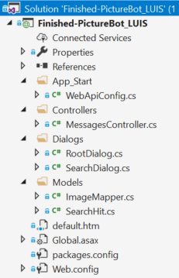
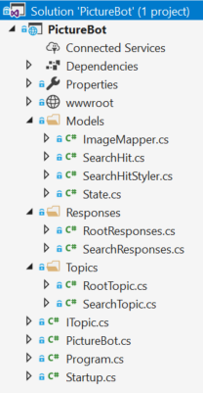
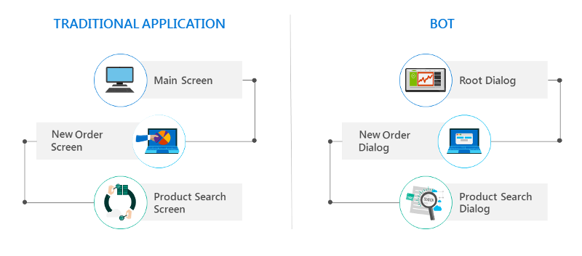
Dialogs vs. Topics vs. ?
“The SDK allows you to organize code in whatever way you want” -PG
Topics: business logic for editing the model
Models: objects being edited
Responses: defines output to user
Making bots smarter
Notes:
Manage conversation flow: https://docs.microsoft.com/en-us/azure/bot-service/dotnet/bot-builder-dotnet-manage-conversation-flow
Explanation of topics: https://github.com/Microsoft/botbuilder-dotnet/blob/master/samples/AlarmBot-Cards/README.md
Want to use dialogs with SDK v4? There’s a library for that: https://github.com/Microsoft/botbuilder-dotnet/tree/master/libraries/Microsoft.Bot.Builder.Classic

Slide 23
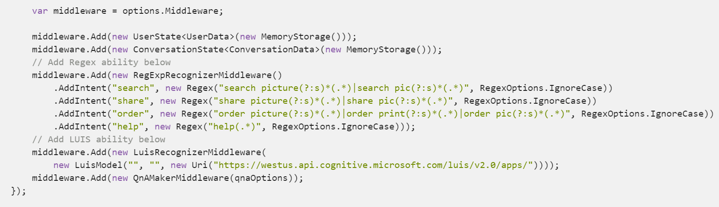
Middleware
Example: using middleware to manage conversations
Regular expressions > LUIS > QnA maker
Making bots smarter
Notes:
Creating middleware with the v4 SDK: https://github.com/Microsoft/botbuilder-dotnet/wiki/Creating-Middleware
Middleware and architecture for the v4 SDK: https://github.com/Microsoft/botbuilder-dotnet/wiki/Overview
QnA maker documentation: https://docs.microsoft.com/en-us/azure/cognitive-services/QnAMaker/Home

Slide 24
Additional resources
The full Learn AI Bootcamp: https://github.com/Azure/LearnAI-Bootcamp
Our team: http://learnanalytics.microsoft.com/
AI Learning Paths: https://aischool.microsoft.com/learning-paths

