Slide 1

Integration with Cognitive Services (and more)
Speaker name

Slide 2
Session objectives and takeaways
At the end of this session, you should be able to…
Understand how various Cognitive Services can add value in bot applications
Integrate Cognitive Services into bot applications
Leverage tools to manage conversations effectively and efficiently

Slide 3
Agenda
Cognitive Services
Adding Cognitive Services to bots
Other ways to make bots smarter

Slide 4
Making bots smarter with Cognitive Services
Easy to implement – make API calls
Ready-to-use AI
Custom AI
LUIS
Custom Vision
Custom Speech
Add value

Slide 5
Making bots smarter with Cognitive Services
Language understanding
Knowledge extraction
Speech recognition and conversion
Web search
Image and video understanding
Also - Cognitive Services Labs

Slide 6
Language understanding
Language Understanding Intelligent Service (LUIS)
Extract intents and entities from natural language
Text Analytics
Determine language, key phrases and sentiment
Bing Spell Check
Correct spelling errors, recognize name differences/brands/slang/homonyms
Translator Text
Real-time text translation
Content Moderator
Explicit or offensive content moderation for text, images, and videos
Cognitive Services

Slide 7
Knowledge extraction
QnA Maker
Quickly and easily create simple question and answer bots based on FAQ URLs, structured documents, or editorial content
Cognitive Services

Slide 8
Speech recognition and conversion
Speech
Convert speech-to-text and text-to-speech, understand intent
Speech to Text
Convert audio to text, part of Speech services
Text to Speech
Convert text to speech, part of Speech services
Custom Speech Service (CRIS)
Overcome speech recognition barriers such as speaking style, vocabulary, and background noise
Speech Translation
Easily add real-time speech translation to your bot
Speaker Recognition API
Identify individual speakers or use speech as a means of authentication
Cognitive Services

Slide 9
Web search
Bing Web Search
Conduct web searches within bots
Bing Image Search
Conduct image searches within bots
Bing Video Search
Conduct video searches within bots
Bing News Search
Conduct news searches within bots
Bing Autosuggest
Automated search suggestions – not applicable for a standard bot
Bing Entity Search
Bring rich context about entities (like people, places, things, etc.)
Bing Custom Search
Easy-to-use, ad-free, commercial-grade search tool that lets you deliver the results you want
Bing Visual Search
Search with images
Cognitive Services

Slide 10
Image and video understanding
Computer Vision
Obtain tags, descriptions, adult/racy scores, text, hand writing, celebrities, and more from images
Face
Detect faces and compare similar ones, organize similar images in groups, identify previously tagged people and emotions in images
Video Indexer
Unlock video insights – Video API ended
Custom Vision
Custom image classification and object detection models made easy
Content Moderator
Machine-assisted moderation of text and images
Cognitive Services

Slide 11
Cognitive Services Labs
Project Gesture
Incorporate gesture-based controls into your apps
Project Local Insights
Score the attractiveness of a location
Project Event Tracking
Find events associated with Wikipedia entries
Project Entity Linking
Disambiguate entities from context
Project Knowledge Exploration
Quickly add interactive search to structured data
Project Academic Knowledge
Help users find academic resources
Project Ink Analysis
Recognize digital handwriting, shapes, layouts
Project Answer Search
Present relevant results instead of links
Project URL Preview
Quickly provide a webpage preview
Project Anomaly Finder
Use ML to understand abnormal events in data
Project Conversation Learner
Tech conversations through example interactions
Project Personality Chat
Enhance conversations easily with personas and small talk
Project Custom Decision
Use reinforcement learning in a new approach for personalizing content
Cognitive Services

Slide 12
Adding services to bots
This is not a coding course
Examples provided cover how to integrate
QnA Maker
LUIS
Azure Search
Bing Search
Text Translator
Video Indexer
Text Analytics

Slide 13
Other ways to make bots smarter
Managing data
Managing dialogs

Slide 14
Managing state data
Enables your bot to store and retrieve state data
Uses
Determining where the user is in the conversation
Store and retrieve user data, conversation data, or a specific user’s data within the context of a specific conversation
Personalized conversations
Testing vs production
Making bots smarter
Notes:
Managing state data documentation: https://docs.microsoft.com/en-us/azure/bot-service/dotnet/bot-builder-dotnet-state
Saving state data with the v3 SDK: https://blog.botframework.com/2017/07/18/Saving-State-Azure-Extensions/
Middleware for managing state in the v4 SDK (.NET): https://github.com/Microsoft/botbuilder-dotnet/blob/master/libraries/Microsoft.Bot.Builder.Core.Extensions/BotState.cs
Example – Orchestrating multiple bots with multilingual support for Sage: https://www.microsoft.com/developerblog/2017/01/21/orchestrating-multiple-bots-with-multilingual-support/

Slide 15
Managing historical data
Why?
Determine what users actually use the bot for
Collect data for ML (e.g. recommendation engine based on what users search for frequently)
Monitor performance
V4 SDK makes collecting and storing historical data easier
Making bots smarter

Slide 16
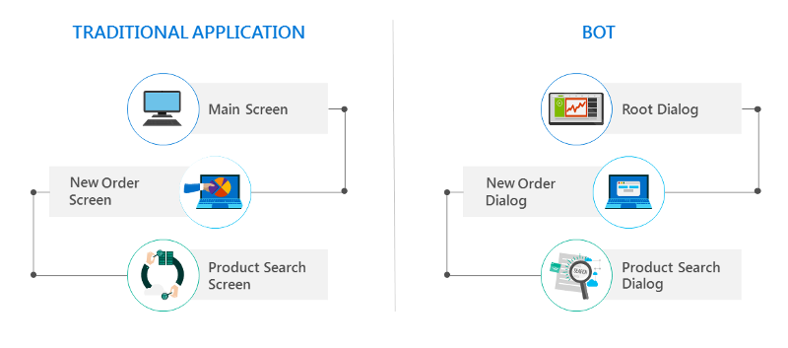
Managing dialogs
“The SDK allows you to organize code in whatever way you want” -PG
Making bots smarter

Slide 17
Microsoft.Bot.Builder.Dialogs Library
Combining dialogs via modular bot logic
Create a bunch of dialogs
Use a Dialog Set to merge dialogs into one master dialog
The Dialog Set will repeat, end, switch, continue, and restart dialogs as needed
Makes cross referencing and sharing possible
Making bots smarter

Slide 18
Additional resources
The full Learn AI Bootcamp: https://github.com/Azure/LearnAI-Bootcamp
Our team: http://learnanalytics.microsoft.com/
AI Learning Paths: https://aischool.microsoft.com/learning-paths

