Slide 1

CMPE-252-03 Fall 2021
Final Project Presentation
LunarLander-v2 Implementation Using DQN and Actor Critic Algorithms
Group-5
Akhil Dooliganti
Srikara Mohana Sai Sachin Nekkanti
Sudheer Tati

Slide 2
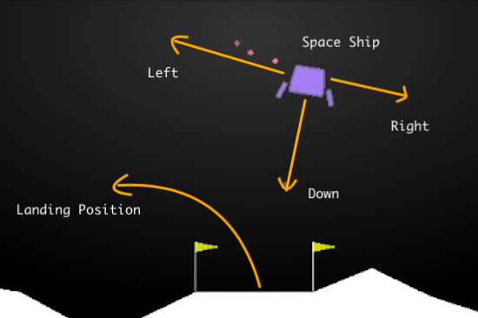
Note:- View this slide in Presentation mode to watch the video content

Slide 3
Project Description
Environment
We are implementing a reinforcement learning agent that solves the OpenAI Gym’s Lunar Lander environment.
This environment consists of a lander that, that learns how to control 4 different actions:
0 - Idle
1 - Fire left engine
2 - Fire Down Engine
3 - Fire Right Engine
The agent has to land safely on a landing pad with both legs touching the ground. A successfully trained agent should be able to achieve a score equal to or above 200 on average over 100 consecutive runs.

Slide 4
Proposed Solution
Deep Q-Learning
We are using an implementation of a Deep Q-Network (DQN) to solve the Lunar Lander environment. This implementation is inspired in the DQN described in (Mnih et al., 2015) where it was used to solve classic Atari 2600 games.
Model Architecture
We are using 3 Fully connected layers with Relu activation function.
Replay Buffer= 1000000, Optimizer= Adam, Learning rate= 0.0075, Discount factor=0.99, Steps=500, Steps between target network update=100.
We are exploring the different decisions to construct a successful implementation, how some of the hyperparameters were selected, and the overall results obtained by the trained agent.
Notes:
The Lunar Lander environment has an infinite state space across 8 continuous dimensions, which makes the application of standard Q-learning not possible unless the space is discretized —which is inefficient and not practical for this problem,Instead, a DQN uses a Deep Neural Network (DNN) for approximating the Q*(s, a) function getting around the limitation of the standard Q-learning algorithm for infinite state spaces.

Slide 5
Actor-Critic
Model Architecture
We are using Actor Critic Algorithm to solve the problem. Actor and Critic, we have used 2 dense layers of neural network(1 Input layer and 1 output layer) for this model with ReLU activation function . We have used the Huber-optimizer and the loss function is MSE(mean square error). We have run the model for 500 episodes.
Hyper Parameters
Training examples: 1000000(max)
Epochs: 10000(converge with in 8500)
Discount Factor: 0.99
Batch size (experience replay): 32
Learning rate: 0.01
Max steps per episode: 10000

Slide 6
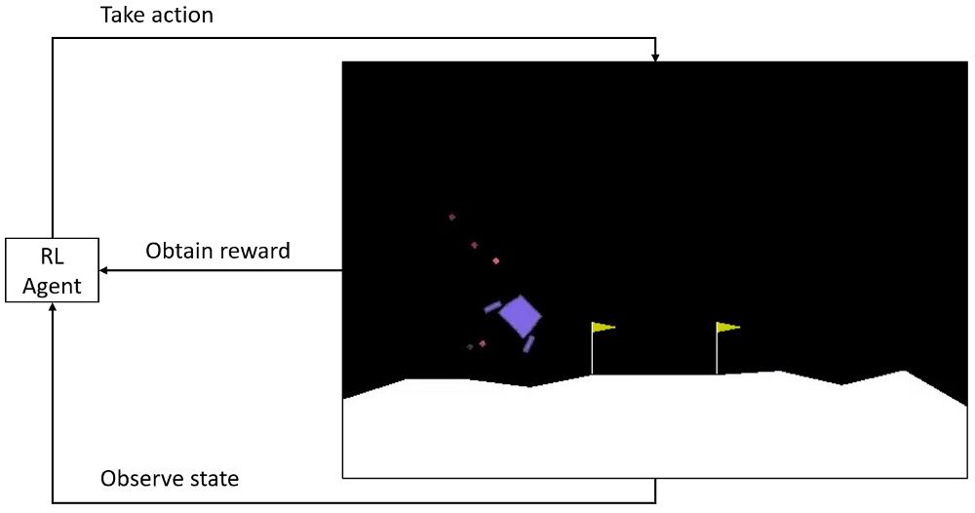

Slide 7
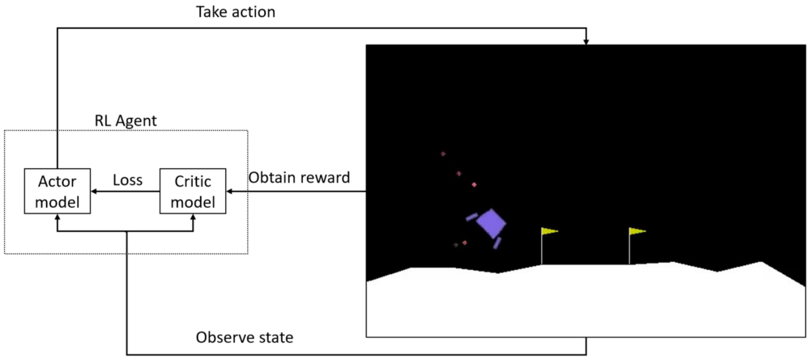
Actor Critic Model

Slide 8
Results
In General the lunar Lander problem is considered to be solved if average reward is maintained over 200 consistently for 100 iterations. With the DQN Algorithm we are able to stabilize the model with only 500 episodes and with respective Actor Critic we managed to stabilize the model with 8500 episodes.
The number of episodes taken by Actor Critic was very high when compared to the DQN,but surprisingly the training time was very less for the Actor critic.

Slide 9
Results
During the testing both models were able to achieve more reward than 200 in each episode.By using DQN the Lunar Lundar was landing quickly with the reason being firing the engine very less,but while we were using the Actor Critic the engine was firing more frequently therefore consuming more time to land.
The DQN is taking less number of episodes,the reason behind it is that when a model gives a positive reward from there on more frequently positive reward is given by the model which in result helping the model to stabilize very quickly,but with respect to Actor critic the model was consuming more time to stabilize because the rewards are constantly fluctuating from episode to episode.

Slide 10
Task Assignment
DQN Modelling - Sudheer, Sachin
DQN Training and Hyper parameter search- Sudheer, Akhil
Actor Critic Modelling- Sachin, Akhil
Actor Critic Training and Hyper parameter search-Sudheer, Sachin
Model comparison-Sudheer, Sachin, Akhil
Project Report-Sudheer, Sachin, Akhil

Slide 11

Comparison
Actor-Critic
DQN
Note:- View this slide in Presentation mode to watch the video content

Slide 12
Conclusion
From the above observations we can conclude that both the Actor-Critic and the DQN agents perform well on the original lunar lander problem.
However,the DQN model performs better than Actor-Critic Algorithm in terms of time taken(more time taken= more fuel consumption ) to land.
The Actor-critic also takes more number of episodes to converge than the DQN model.
However,model training for DQN is taking more time than Actor-Critic.

Slide 13
THANK YOU

