Slide 1
Retail Sales & Customer Analytics
SQL + Excel Project | Data Analyst Portfolio Case Study
Dataset: Online Retail II (UCI ML Repository) • 1,027,017 cleaned transactions • Dec 2009 - Dec 2011

Slide 2
Business Problem
A mid-size online gift-ware retailer needs to know which customers, countries, and products actually drive profitable revenue — and where cancellations or discount-heavy sales are quietly eroding it.
Which customers matter most?
Where is revenue concentrated?
Where is the business losing orders?
A small segment may drive most of the revenue — or the business may be dangerously broad and shallow.
Over-reliance on one market is a risk leadership needs visibility into.
Cancellation patterns by country point to real operational gaps.

Slide 3
Dataset & Tools
1,067,371
1,027,017
5,878
43
Raw transaction rows
Rows after cleaning
Unique customers
Countries
Tools Used
Data Quality Issues Found & Fixed
SQLite — data modeling & all analytical queries
Python (Pandas, Matplotlib, Seaborn) — cleaning + EDA
Excel (openpyxl) — KPI dashboard, pivots, what-if simulator
4,382 rows missing product description — dropped
6,207 rows with zero/negative price — dropped
34,335 exact duplicate rows — dropped
19,494 cancelled orders — kept & flagged, not dropped

Slide 4
Approach
1
2
3
4
Clean & Load
SQL Analysis
Python EDA
Excel Dashboard
Documented cleaning decisions, loaded into SQLite with indexes on customer, invoice, date, country
12 queries: basic aggregation → window functions (LAG, RANK, NTILE) → CTE-based RFM segmentation
Validated SQL findings independently in Pandas, generated all visualizations
Formula-driven KPIs, pivots, charts, and a discount what-if simulator for stakeholders

Slide 5
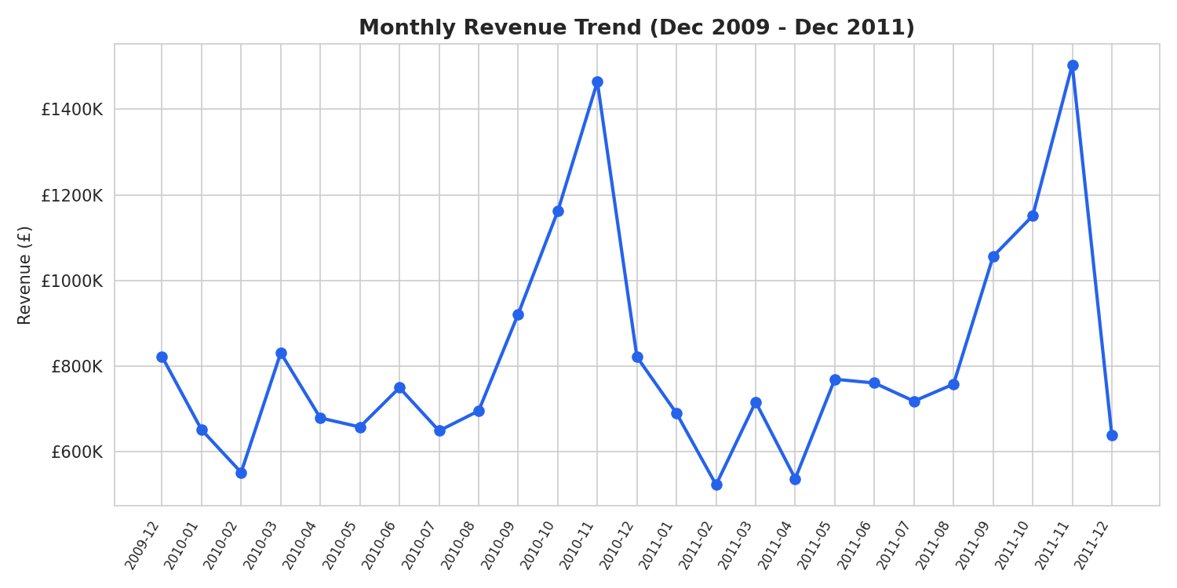
Key Performance Indicators
£20.48M
40,077
5,878
£511
Total Revenue
Total Orders
Total Customers
Avg Order Value

Slide 6
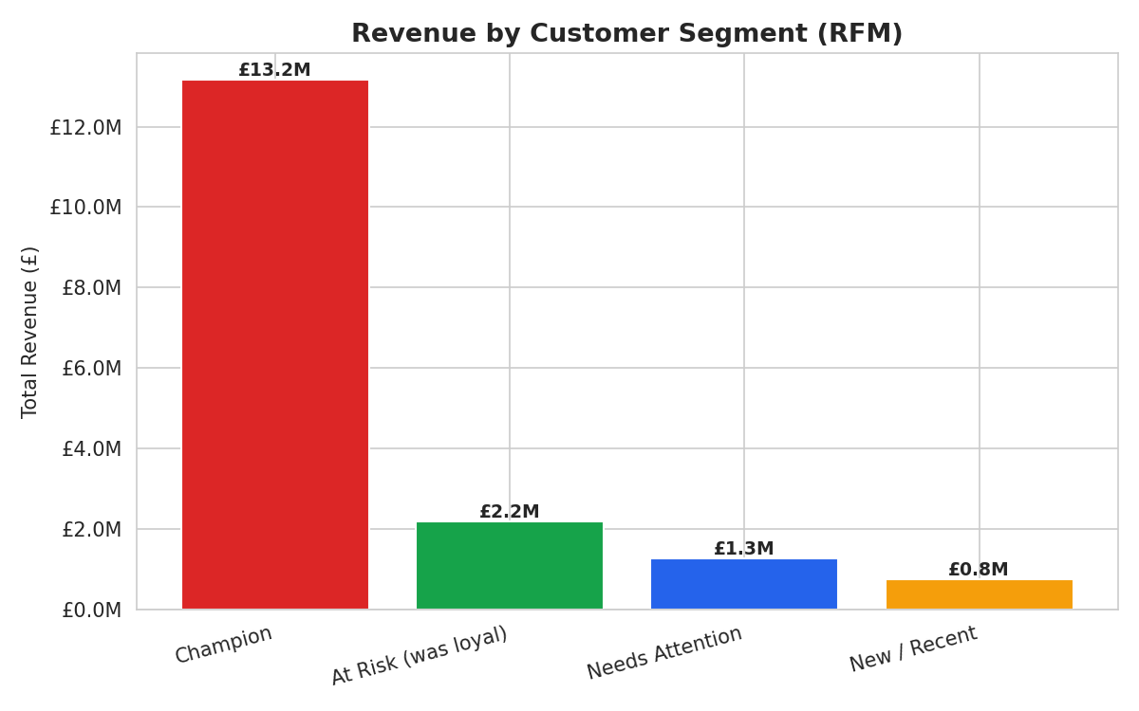
Insight: A Small Segment Drives Most Revenue
1,814 Champion customers
(31% of customer base) generate ~64% of total revenue
(£13.2M of £20.5M).
This is a classic Pareto pattern — the business is more concentrated and more fragile than a flat revenue number suggests.

Slide 7
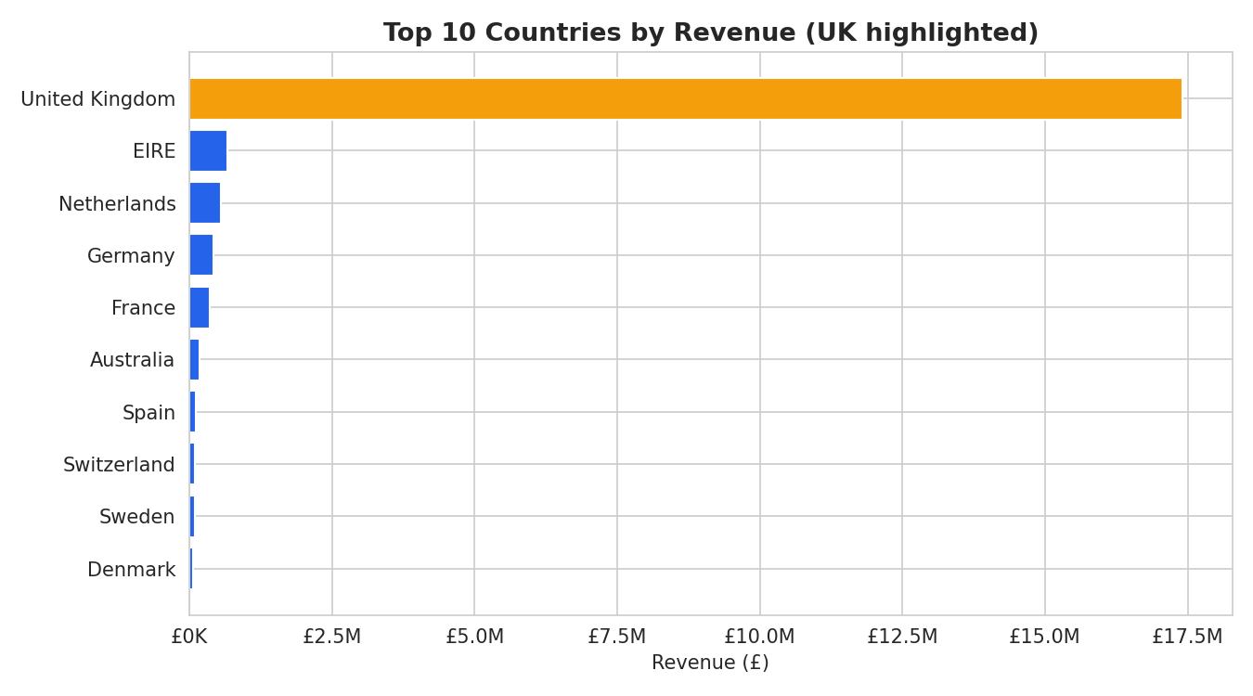
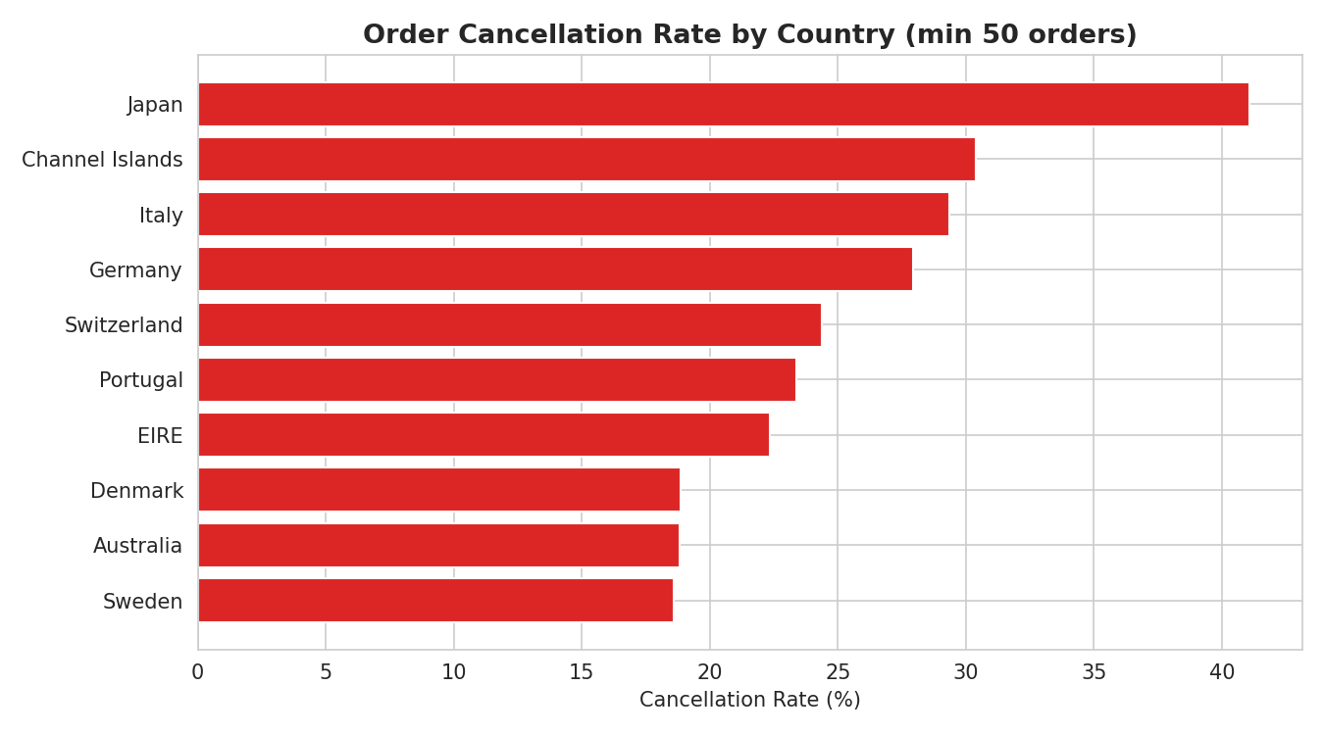
Insight: Revenue Concentration & Cancellation Risk
UK = 85% of revenue (concentration risk) | Japan, Channel Islands & Italy cancel 29-41% of orders (2x+ average)

Slide 8
Recommendations
1
Protect the Champion segment
Launch a retention/loyalty program for the 1,814 customers generating £13.2M — higher ROI than broad acquisition spend.
2
Fix fulfilment in high-cancellation markets
Investigate Japan, Channel Islands & Italy (29-41% cancellation) — could recover an est. £15-20K in lost orders.
3
Re-time campaigns
Shift send schedules to Wed/Thu, 10am-3pm — the consistently highest-engagement window.
4
Reduce UK concentration risk
Pilot a deliberate push into Netherlands/Germany, which already show organic demand.

Slide 9
What This Project Demonstrates
Advanced SQL: CTEs, window functions (LAG, RANK, NTILE), conditional aggregation
Real-world data cleaning judgment — every decision documented and defensible
RFM customer segmentation from first principles, cross-validated in SQL and Python
A formula-driven Excel deliverable (not hardcoded numbers) with a working what-if simulator
Business framing throughout — every chart ties to a specific, quantified recommendation

