Slide 1
ZOMATO BANGALORE RESTAURANTS
Exploratory Data Analysis — Key Findings & Recommendations
51,660 restaurants analyzed | Python (Pandas, Matplotlib, Seaborn) | September 2026

Slide 2
Agenda
What this presentation covers
01
Project Overview & Objectives
02
Data & Methodology
03
Key Findings: Ratings, Service Features & Geography
04
Key Findings: Cuisine, Pricing & Popularity
05
Business Recommendations
Zomato Bangalore Restaurants — EDA Project
2

Slide 3
Project Overview
Understanding Bangalore's restaurant market through data
Bangalore hosts one of India's largest and most competitive restaurant markets. This analysis explores what separates high-rated restaurants from the rest — examining service features, geography, cuisine, and pricing — to generate insight for restaurant owners, aggregator platforms, and investors.
51,660
3.7 / 5
Restaurants Analyzed
Average Rating
93
2,723
Localities Covered
Cuisine Combinations
Zomato Bangalore Restaurants — EDA Project
3

Slide 4
Data & Methodology
Source
Clean
Engineer
Analyze
Zomato Bangalore listings scrape
(51,717 raw rows, 17 fields)
Parsed ratings & cost fields, standardized flags, removed duplicates, validated ranges
Derived primary cuisine, cuisine count, review count, and restaurant format features
Univariate, bivariate & correlation analysis using pandas, matplotlib, seaborn
→
→
→
Full reproducible pipeline: 01_clean_data.py → 02_eda_analysis.py → zomato_clean.csv + 12 charts
Zomato Bangalore Restaurants — EDA Project
4

Slide 5
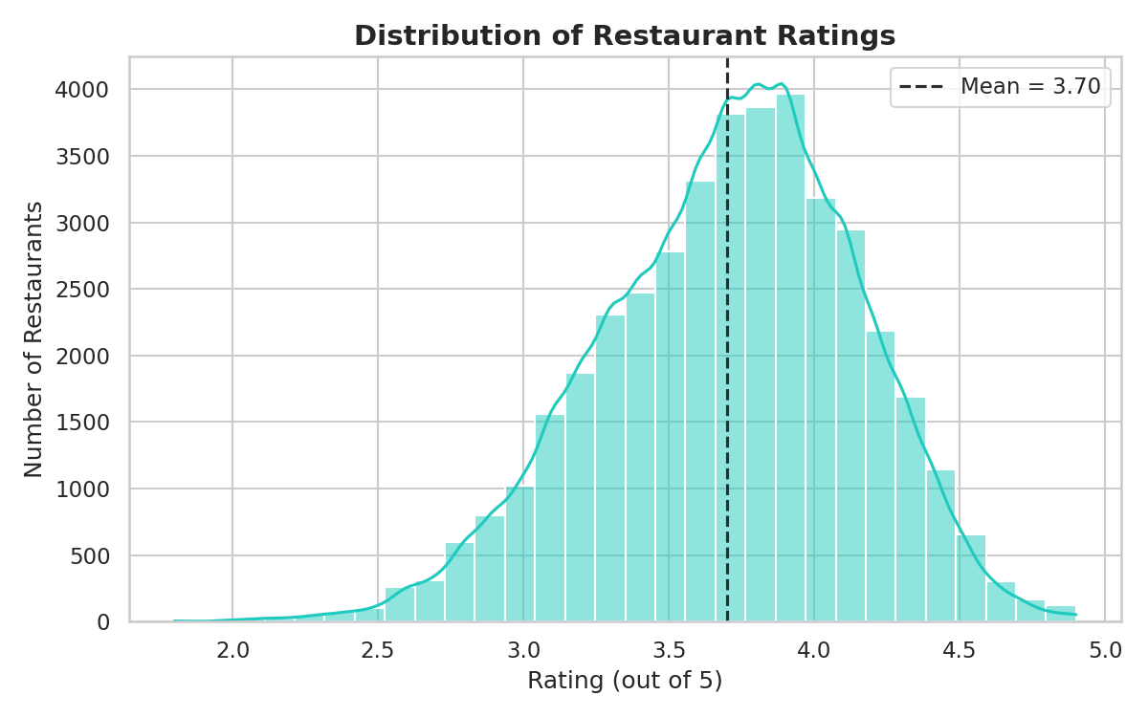
Ratings Cluster Around 3.7
Most restaurants fall in the 3.3–4.2 'decent to good' band
3.7 / 5
Average Rating | Median: 3.7
80.6% of listings have a numeric rating; the rest are new or unrated.
Zomato Bangalore Restaurants — EDA Project
5

Slide 6
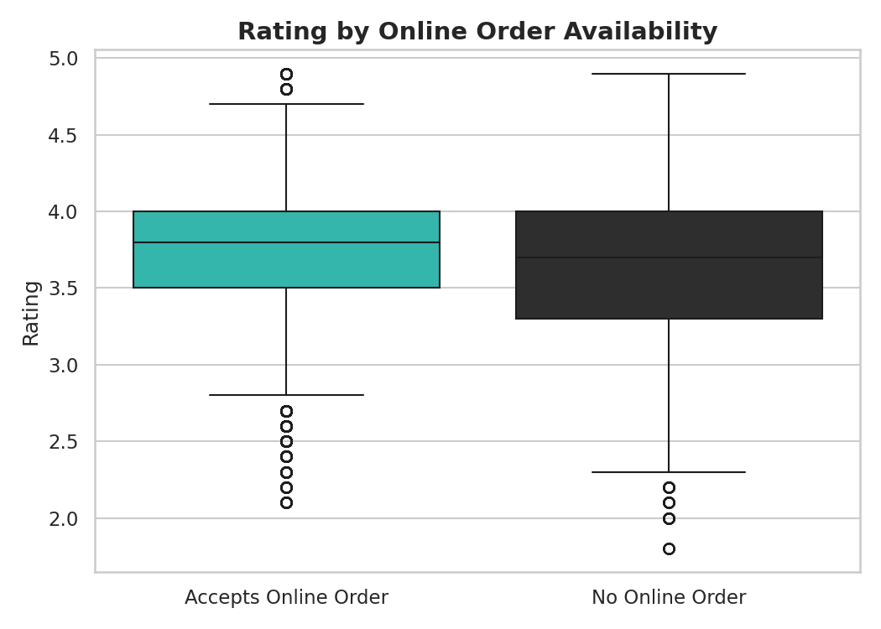
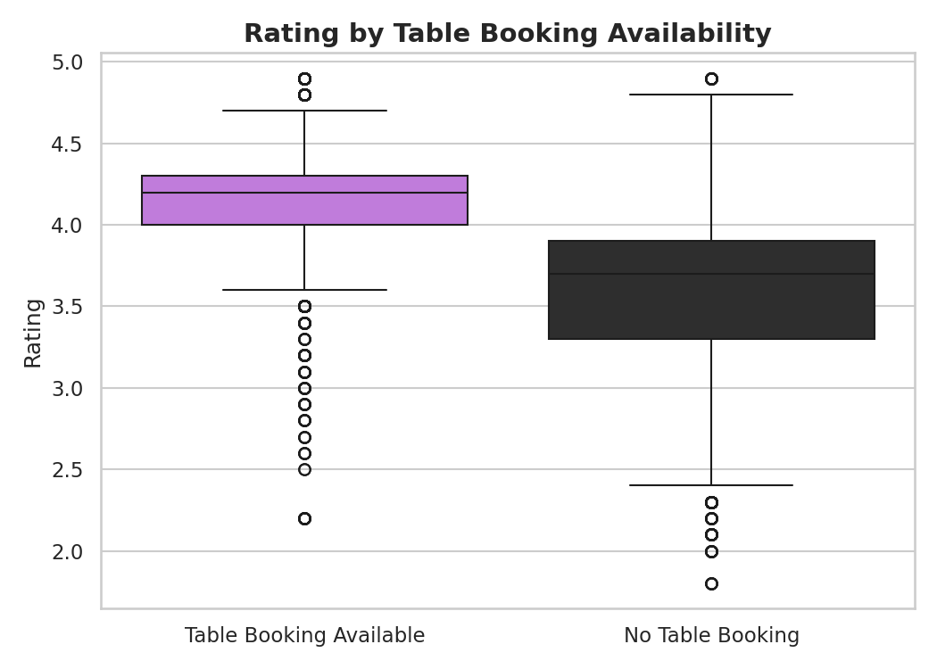
Table Booking Is the Strongest Quality Signal
Comparing online ordering and table booking against rating
Online order: 3.72 vs 3.66 | Table booking: 4.14 vs 3.62 (only 12.5% of restaurants offer it)
Zomato Bangalore Restaurants — EDA Project
6

Slide 7
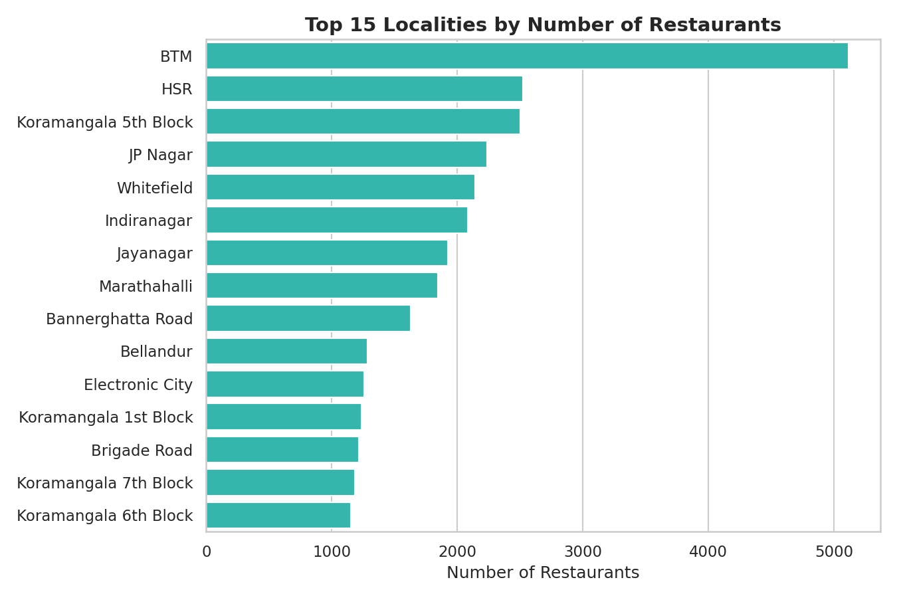
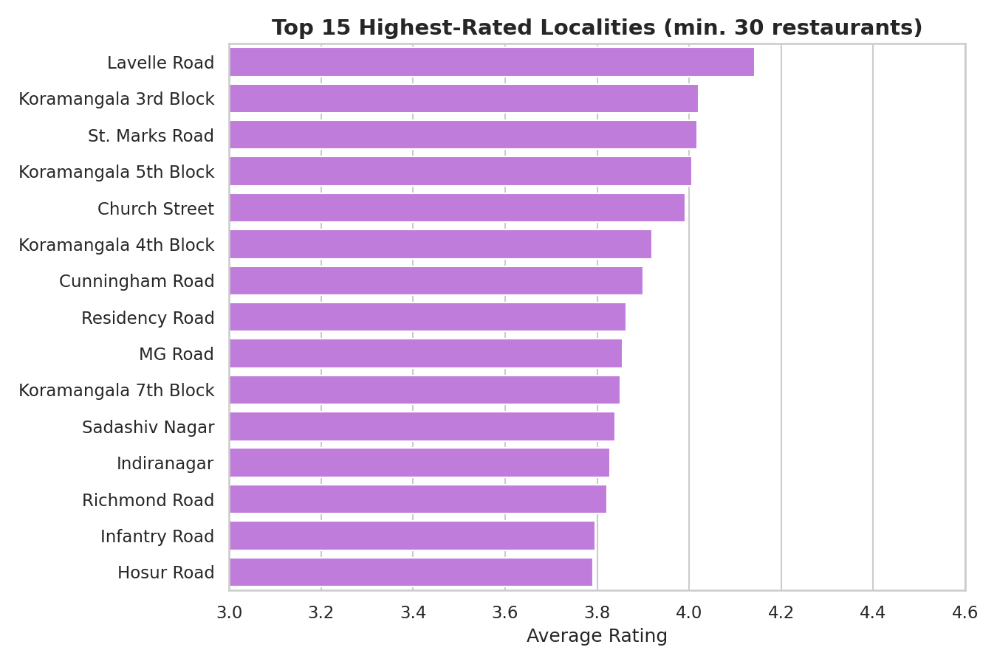
Restaurant Supply Is Highly Concentrated
BTM alone hosts 5,114 listings
Zomato Bangalore Restaurants — EDA Project
7

Slide 8
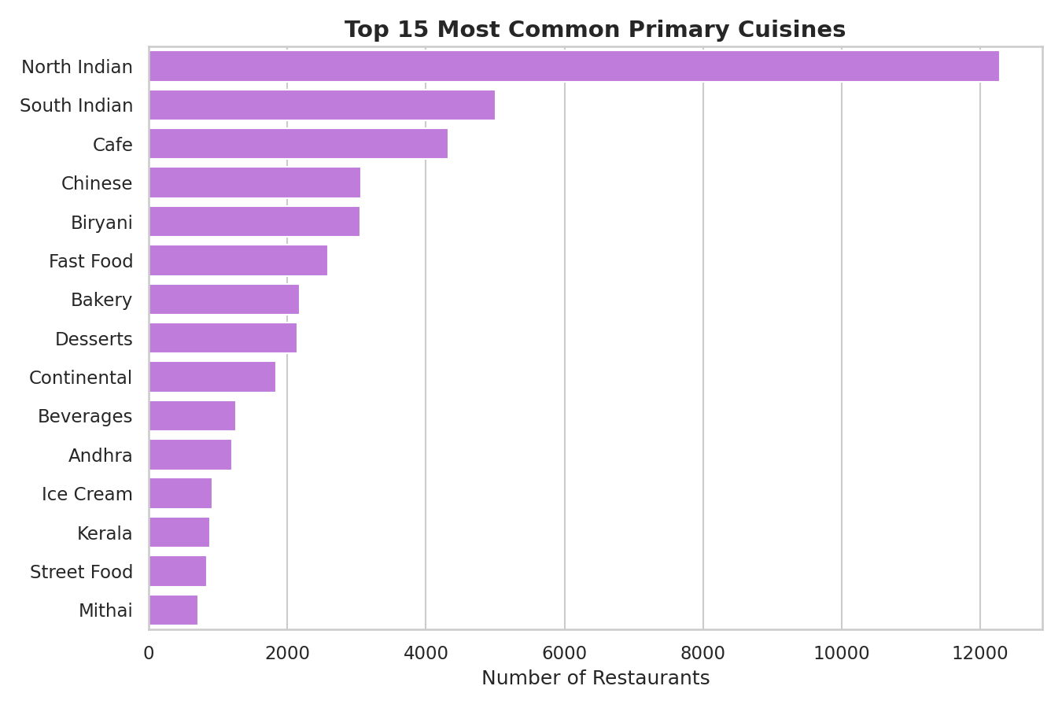
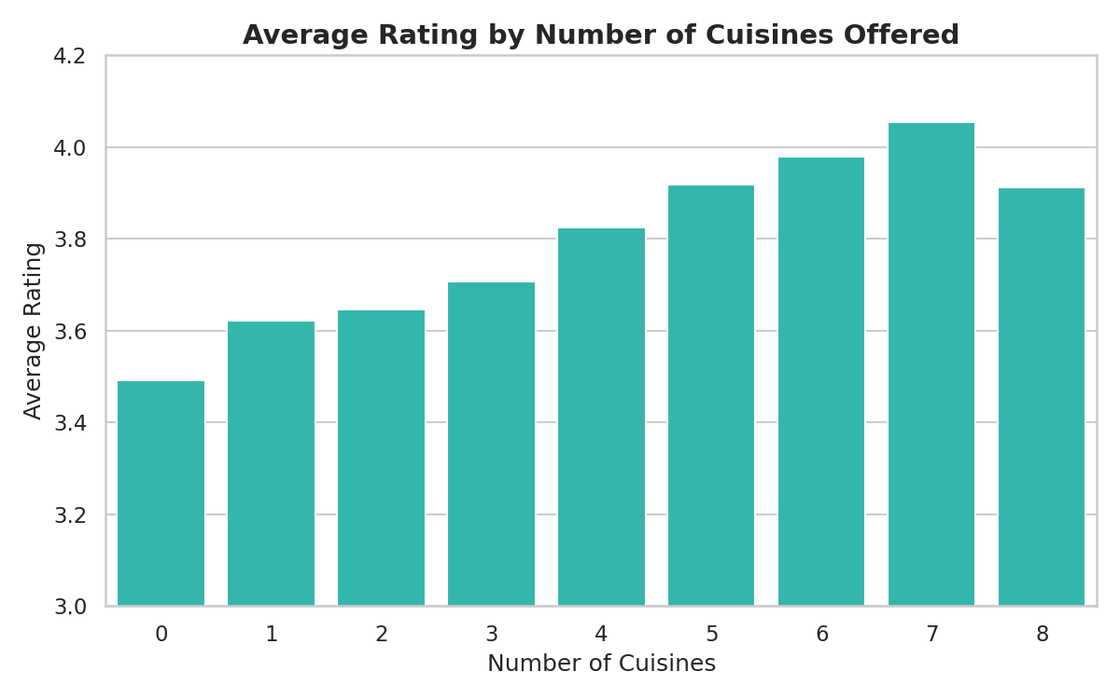
North Indian Leads, But Blended Menus Rate Best
2,723 distinct cuisine combinations found
Restaurants offering 2–4 cuisines rate slightly higher than single-cuisine or overly broad menus.
Zomato Bangalore Restaurants — EDA Project
8

Slide 9
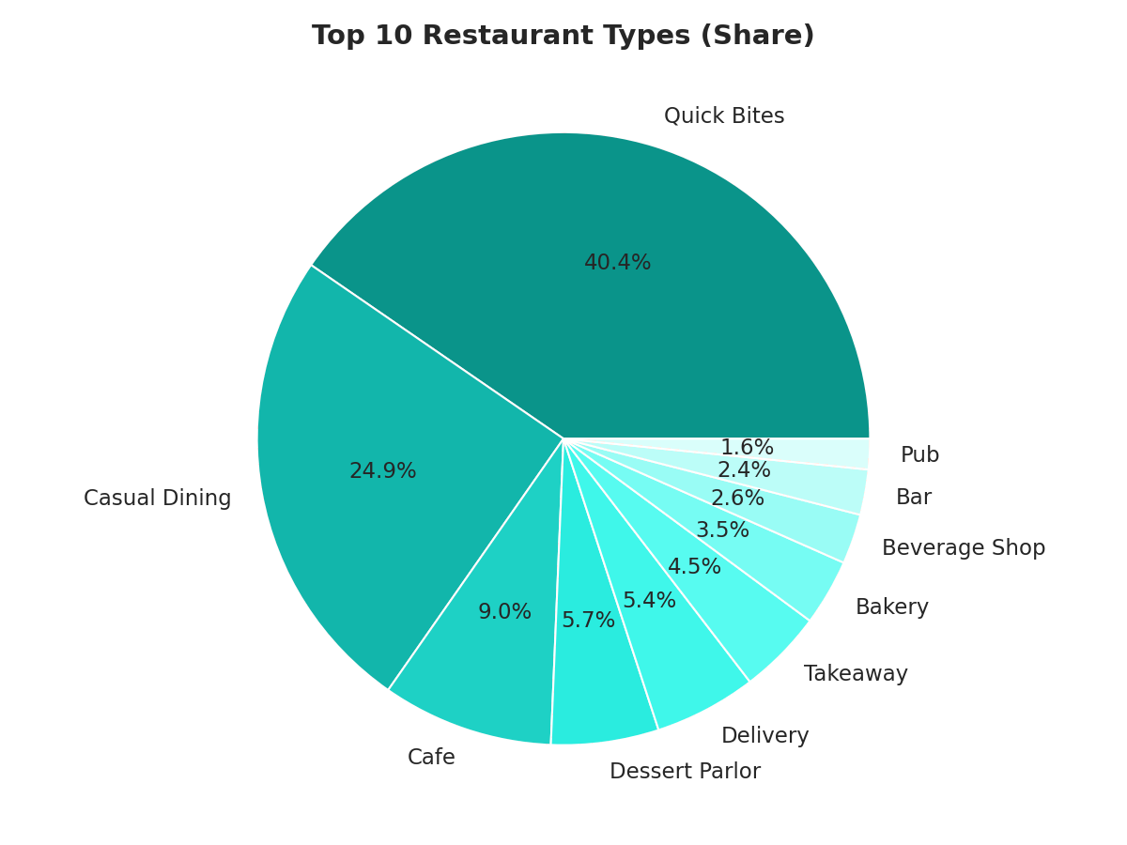
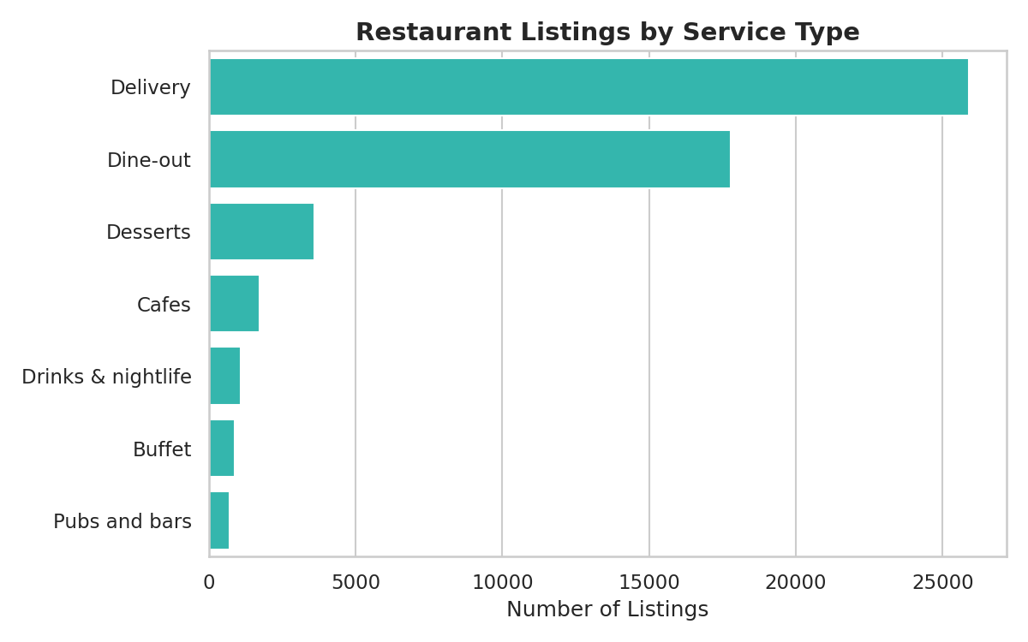
Quick Bites Dominate the Format Mix
Bangalore's dining culture favors convenience
Zomato Bangalore Restaurants — EDA Project
9

Slide 10
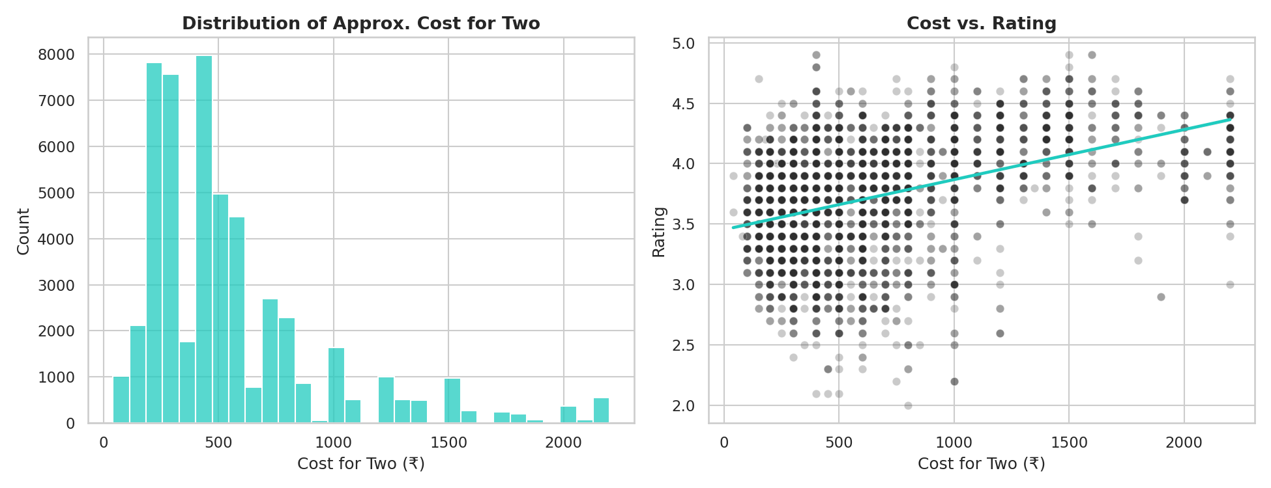
Price Tracks (Loosely) With Quality
Avg. cost for two: ₹555 | Correlation with rating: r = 0.399
Zomato Bangalore Restaurants — EDA Project
10

Slide 11
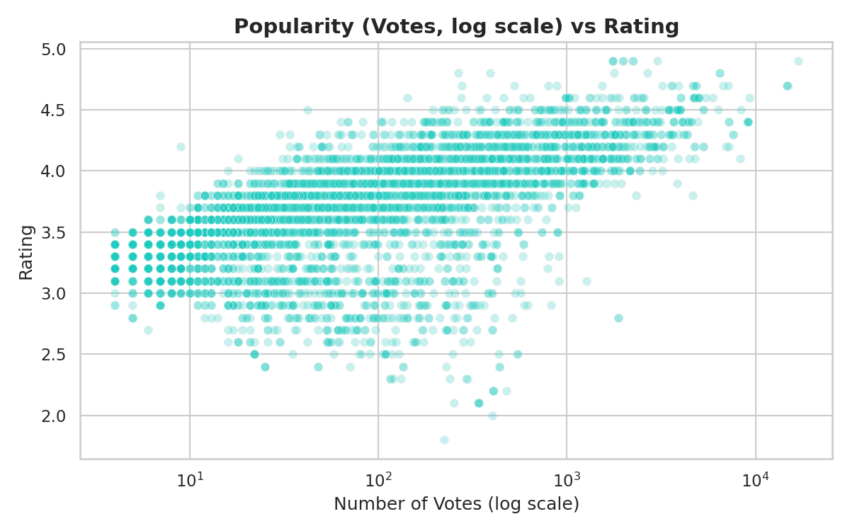
Popularity Predicts Quality Better Than Price
Votes vs. rating correlation: r = 0.434
Well-loved restaurants accumulate votes over time — a reinforcing cycle of quality and popularity.
Low-vote restaurants show much higher rating volatility.
Zomato Bangalore Restaurants — EDA Project
11

Slide 12
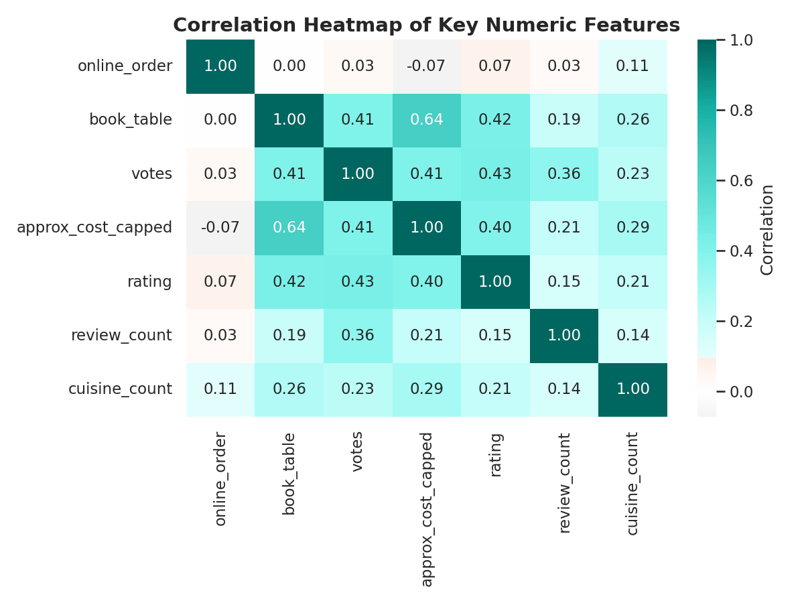
Correlation Summary
Votes and cost are the strongest numeric predictors of rating
Zomato Bangalore Restaurants — EDA Project
12

Slide 13
Recommendations
Restaurant Owners
Zomato / Platforms
Investors
Enable table booking; treat online ordering as baseline; keep menus to 2–4 complementary cuisines; consider high-rated, lower-density localities for expansion.
Weight vote count in ranking algorithms; flag low-review restaurants for rating confidence; support differentiation in saturated hubs.
Favor table-booking-enabled formats in high-rated micro-markets over the most saturated quick-bite segments.
Zomato Bangalore Restaurants — EDA Project
13

Slide 14
Thank You
Questions & Discussion | Full report, code and data available alongside this deck

