Slide 1
HR ANALYTICS
Job Change of Data Scientists — Power BI Dashboard Project
21,287 candidates analyzed | Python data prep + Power BI | September 2026

Slide 2
Agenda
01
Project Scope: 3 Files, 1 Unified Dataset
02
Data Preparation & Power BI Data Model
03
Key Insight: Who Is Looking to Change Jobs?
04
Dashboard Design (4 Pages)
05
Recommendations
HR Analytics — Job Change of Data Scientists | Power BI Project
2

Slide 3
One Project, Three Files
aug_train.csv + aug_test.csv + sample_submission.csv, unified for Power BI
The three files form a single HR analytics initiative: labeled training data, an unlabeled test set, and a prediction template. All were combined in Python into one Power BI-ready star schema, enabling a single interactive dashboard covering the full candidate pool.
19,158
2,129
Training Rows (Labeled)
Test Rows (Unlabeled)
123
24.9%
Cities
Job-Change Intent Rate
HR Analytics — Job Change of Data Scientists | Power BI Project
3

Slide 4
Power BI Data Model
Dim_City
Dim_Experience_Sort
Star schema: 1 fact table + 4 dimension tables
Fact_Candidates
(21,287 rows x 23 cols)
Dim_Education_Sort
Dim_CompanySize_Sort
Prepared in Python (01_prepare_powerbi_data.py) and imported via Get Data > Excel Workbook. 15+ DAX measures and full setup guide included.
HR Analytics — Job Change of Data Scientists | Power BI Project
4

Slide 5
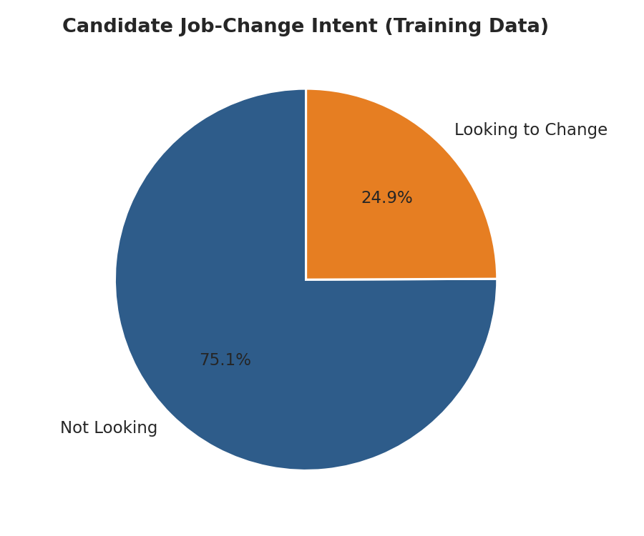
Nearly 1 in 4 Candidates Intend to Change Jobs
Job-change intent rate: 24.9% (training data)
HR Analytics — Job Change of Data Scientists | Power BI Project
5

Slide 6
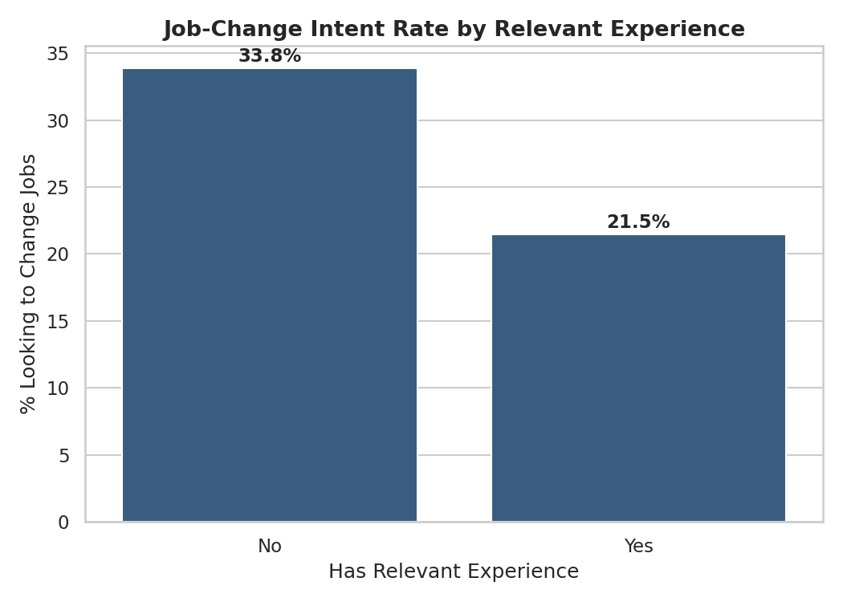
Relevant Experience Is the Clearest Differentiator
33.8% vs 21.5% job-change intent rate
Candidates without relevant professional experience are roughly 1.6x more likely to be actively job-seeking than experienced peers — the single clearest behavioral split in the data.
HR Analytics — Job Change of Data Scientists | Power BI Project
6

Slide 7
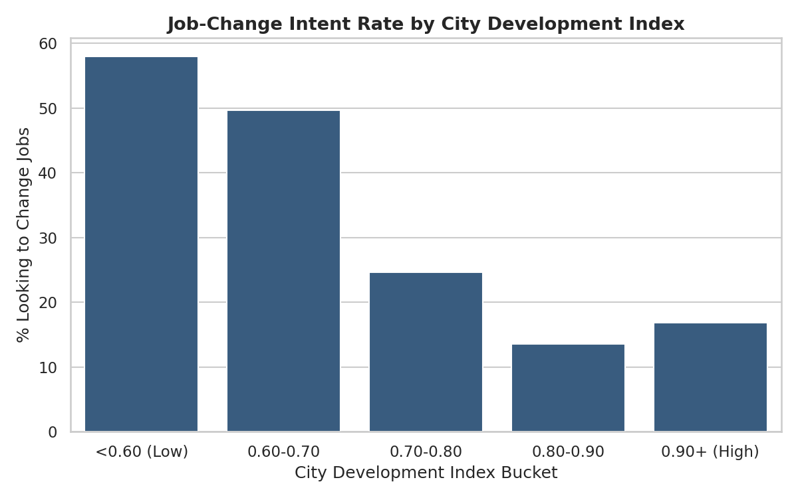
City Development Index: the Strongest Predictor
Correlation with job-change intent: r = -0.342
HR Analytics — Job Change of Data Scientists | Power BI Project
7

Slide 8
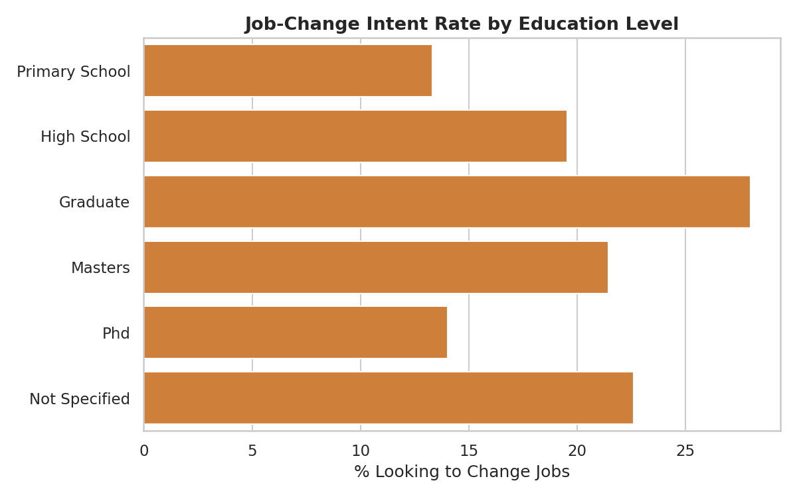
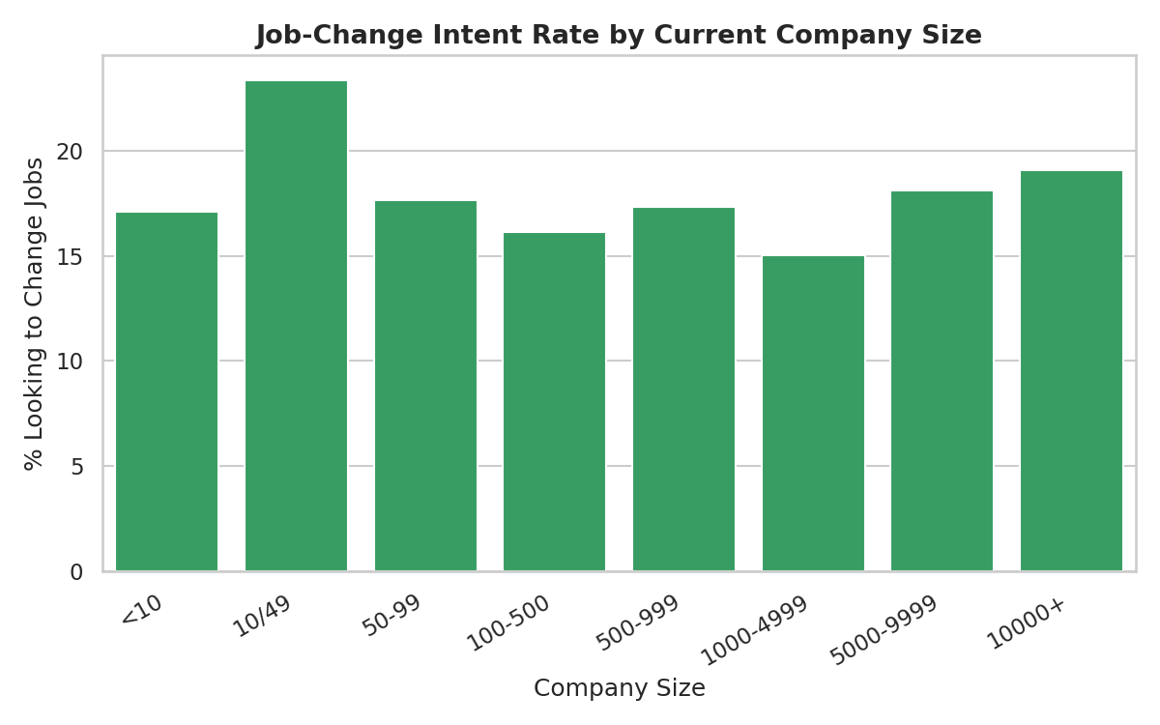
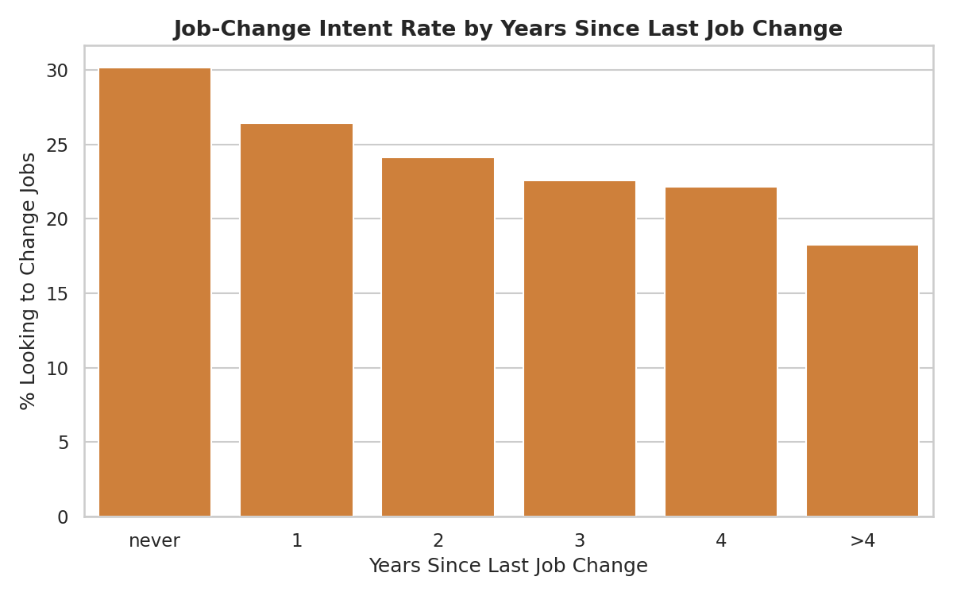
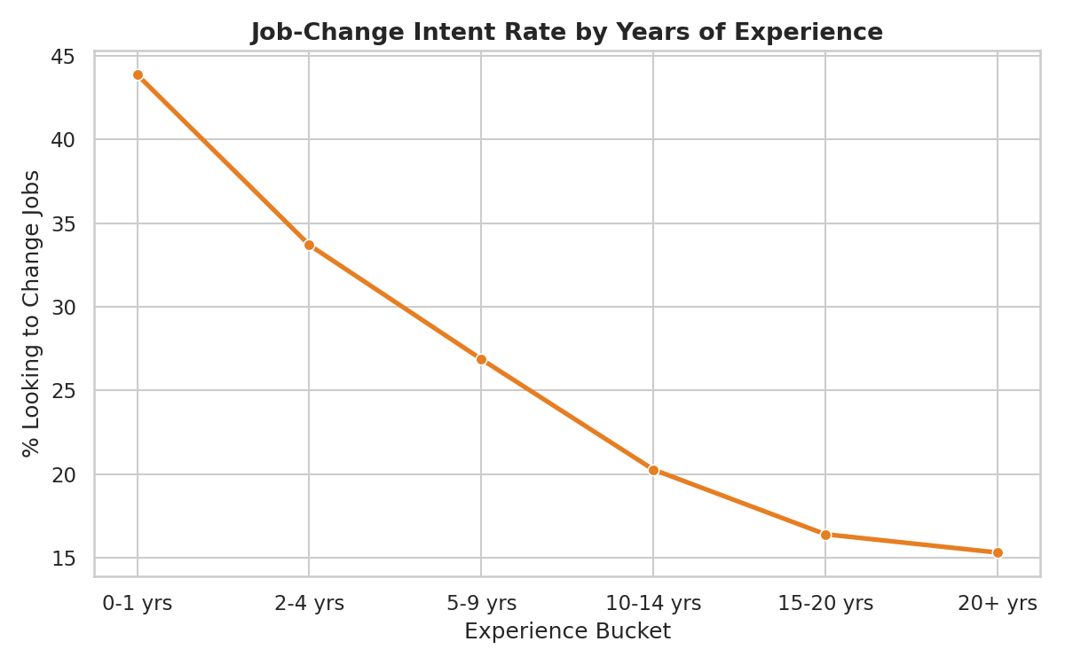
Other Attrition Drivers
Education, company size, and tenure since last job change
HR Analytics — Job Change of Data Scientists | Power BI Project
8

Slide 9
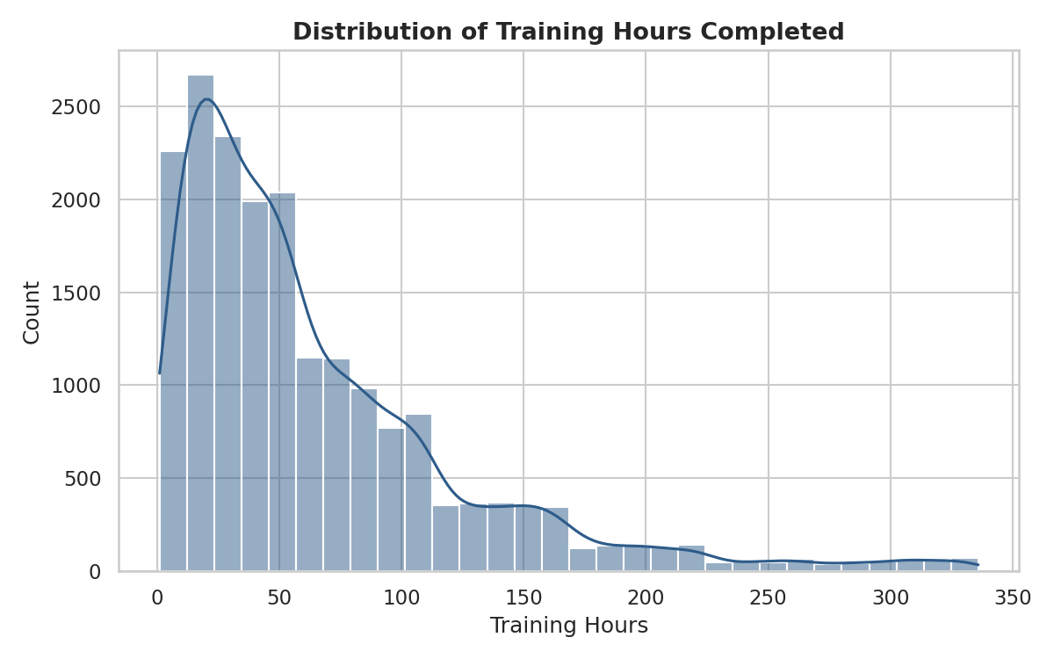
Training Hours Are Not a Strong Retention Signal
Correlation with job-change intent: r = -0.022
HR Analytics — Job Change of Data Scientists | Power BI Project
9

Slide 10
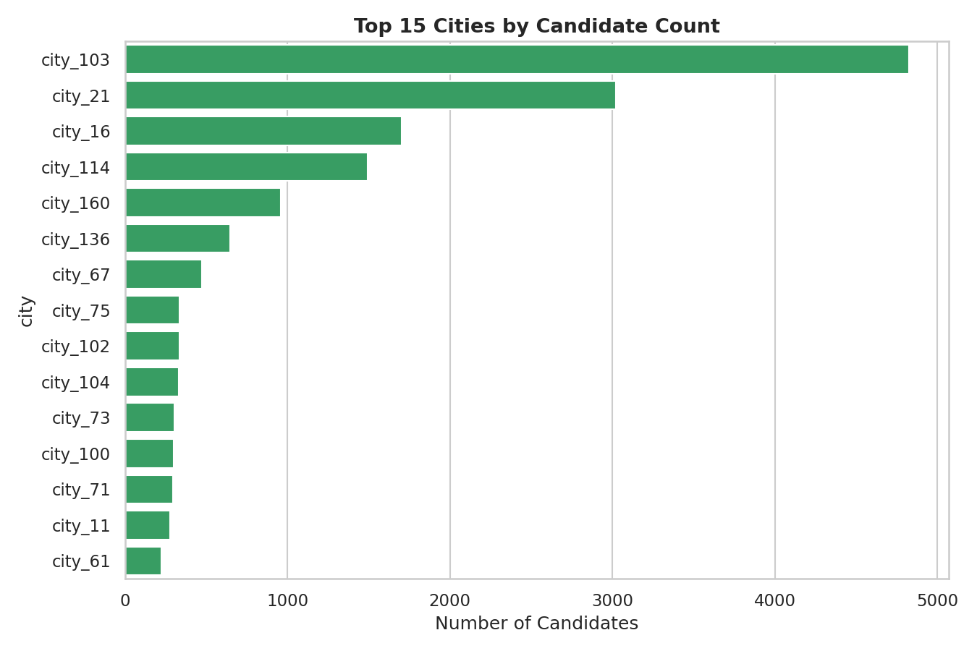
Candidate Sourcing Is Geographically Concentrated
city_103 leads with 4,828 candidates
HR Analytics — Job Change of Data Scientists | Power BI Project
10

Slide 11
Dashboard Design — 4 Pages
1. Executive Overview
2. Candidate Demographics
KPI cards, job-change intent donut, train/test split
Gender, education, discipline, top cities
3. Attrition Drivers
4. City Deep-Dive
Experience, CDI, company size, tenure — the risk factors
Drill-through table + city-level filtering
HR Analytics — Job Change of Data Scientists | Power BI Project
11

Slide 12
Recommendations
Talent / HR Teams
Prioritize candidates lacking relevant experience in low-development cities for retention outreach; use the City Deep-Dive page to localize efforts.
Training Providers
Design targeted upskilling tracks for high-risk segments; training volume alone will not predict who stays.
Analytics Teams
Refresh via the Python pipeline as new cohorts arrive; the cleaned fact table is also ML-ready for a future prediction model.
HR Analytics — Job Change of Data Scientists | Power BI Project
12

Slide 13
Thank You
Questions & Discussion | Power BI file, DAX measures & setup guide available alongside this deck

