Slide 1

Content_Scheduling_for_Maximizing_Engagement
Business Context​:
OTT (Over-the-Top) streaming platforms operate in a fast-paced, highly competitive market. To stay ahead, platforms must ensure that content is not only engaging but also released at the right time and tailored to the right audience. Viewer retention, engagement, and satisfaction directly impact subscription revenue and ad monetization. Therefore, optimizing content scheduling, marketing strategies, and personalized recommendations is essential.​

Slide 2

Problem Statement
The OTT platform aims to maximize viewer engagement and retention by optimizing content scheduling based on audience behavior, content performance, and market competition. The platform faces challenges in determining the ideal time slots, target audience, and content types that drive the most engagement and repeat views.​
Key Business Questions:​
When should new content be scheduled to achieve the highest viewership?​
What content types or genres perform best with different demographic groups?​
How does competitor content impact viewership on our platform?​
What factors drive content virality (likes, shares, watch time)?​
Which users are at risk of disengagement or churn?​

Slide 3
Data Availability
Columns Name​ | Description ​
Content ID​ | Unique identifier for each content piece​
Content Type​ | Category (Movie, Series, Documentary)​
Genre​ | Drama, Comedy, Action, etc.​
Release Date​ | Date when the content was released​
Duration (mins)​ | Total length of content in minutes​
Viewership​ | Total number of views received​
Average Watch Time​ | Average time spent by viewers on content​
Peak Viewership Time​ | Time of day when the highest views occur​
Likes​ | Number of likes​
Shares​ | Number of times content was shared​
Comments​ | Number of comments on content​

Slide 4
Columns Name​ | Description ​
User Ratings​ | Average rating given by viewers​
Time of Day​ | When the content is scheduled to be available​
Day of the Week​ | Scheduled release day​
Viewer Age​ | Age range of viewers watching the content​
Viewer Gender​ | Gender distribution of the viewers​
Viewer Location​ | Geographic location of the viewers​
Seasonality​ | Trends related to holidays/events​
Content Popularity​ | Historical performance metrics​
Competitor Content​ | Performance of similar content on other platforms​
Promotion Data​ | Information on marketing efforts​
Subscription Data​ | Active subscriber behavior and viewing trends​

Slide 5
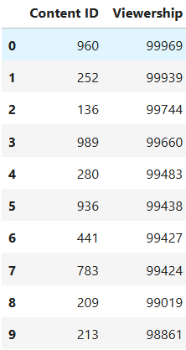
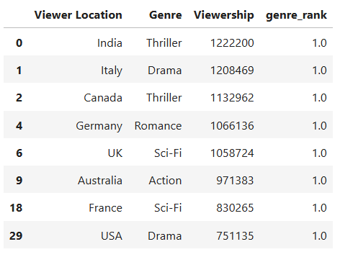
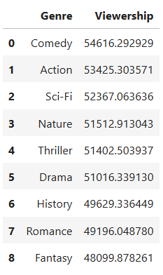
Descriptive Analysis​
What are the top 10 most
viewed content pieces overall?​
What are the most-watched
genres in each region?​
Which genre has the highest
average watch time?​

Slide 6


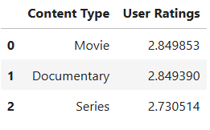
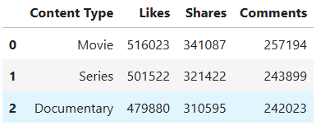
What time of day has the
highest viewer engagement?
Which days of the week drive
the most views?​
What is the average user rating
for different content types (Movies vs Series)?​
How many likes, shares, and comments are generated per content type?​

Slide 7
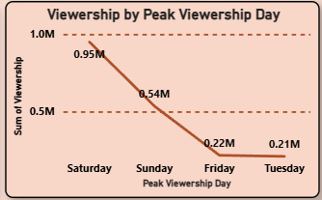


Diagnostic Analysis​
Why did the viewership for "Thriller" genre spike on weekends?​
These are the evidences for concluding that there is a spike for the viewership for the thriller genre on weekends.
Viewership for thriller content on weekend
Viewership for thriller content on weekend

Slide 8
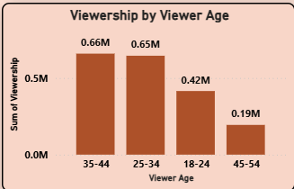
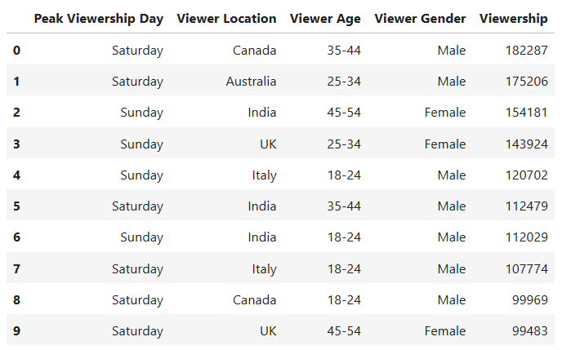
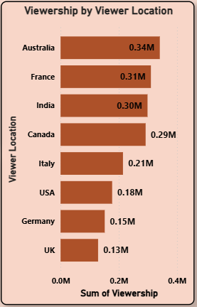
My observations on spike in viewership for thriller on weekends
From these images we can conclude that viewership for the thriller spike on the weekend because of the viewers in the Australia are watching more thriller content and the viewers with the age (35-44,25-34) are watching more thriller content on the weekends.

Slide 9








Why did Content A perform better than Content B even with similar ratings?​
From the below values we can conclude that the Content A performs better than the Content B with similar ratings in the terms of the Views, Shares, Likes, Comments
Views
Comments
Likes
Shares

Slide 10
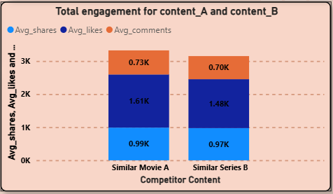
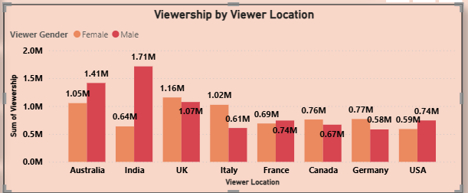
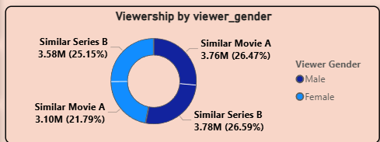
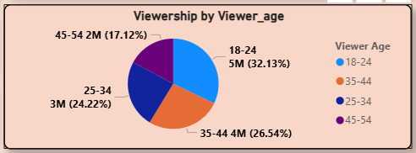
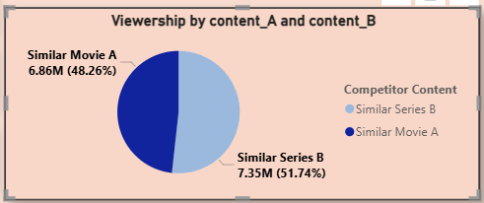
My observations on why did Content A perform better than Content B even with similar ratings
Here are some of the findings I have seen why the content A performs better than the content B even with the same ratings is the engagement for the content A is slightly good when compared to content B (Likes, Shares, Comments)

Slide 11
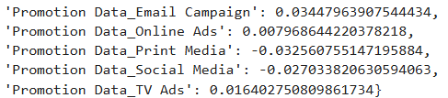
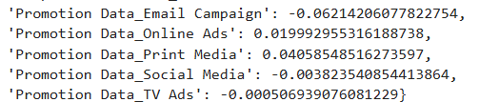
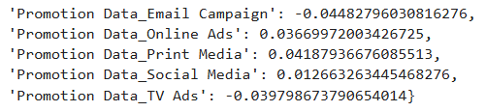
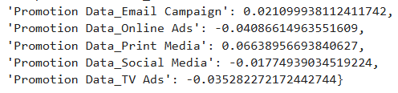
Does promotional effort correlate with viewership or engagement?​
Here I find the correlation between the shares and the promotion related variables.
Here I find the correlation between the shares and the promotion related variables.
Here I find the correlation between the shares and the promotion related variables.
Here I find the correlation between the shares and the promotion related variables.

Slide 12
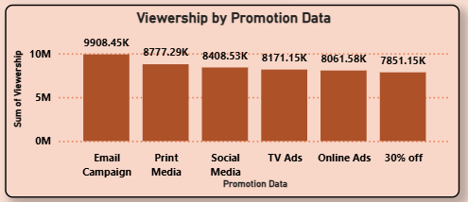
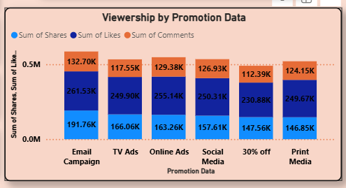
My observations on how promotional effect correlate with the views and engagement
Here what observed in the data is the email campaign has huge number of engagement (Views, Shares, Likes, Comments)

Slide 13
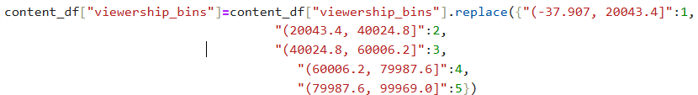
Is there a relationship between content duration and completion rate?​
Since the value is positive, it means as film duration increases, average watch time also tends to increase. But because 0.34 is not close to 1, the relationship is not strong
Are poor-performing contents linked to certain times or days?​
For this analysis I have made a five bins for Viewership, Shares, Likes, Comments. The bins structure as follows:
Bins for Viewership variable: -37.907, 20043.4 : 1,
20043.4, 40024.8 : 2,
40024.8, 60006.2 : 3,
60006.2, 79987.6 : 4,
79987.6, 99969.0 : 5

Slide 14
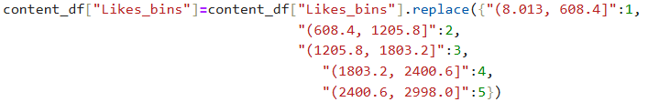
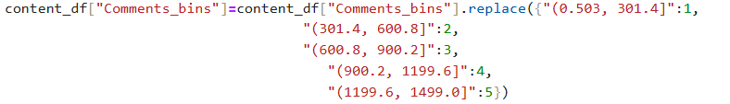
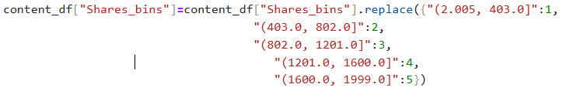
Bins for Likes variable:
8.013, 608.4 : 1,
608.4, 1205.8 : 2,
1205.8, 1803.2 : 3,
1803.2, 2400.6 : 4,
2400.6, 2998.0 : 5
Bins for Comments variable:
0.503, 301.4 : 1,
301.4, 600.8 : 2,
600.8, 900.2 : 3,
900.2, 1199.6 : 4
1199.6, 1499.0 : 5
Bins for Shares variable:
2.005, 403.0 : 1,
403.0, 802.0 : 2,
802.0, 1201.0 : 3,
1201.0, 1600.0 : 4,
1600.0, 1999.0 : 5

Slide 15
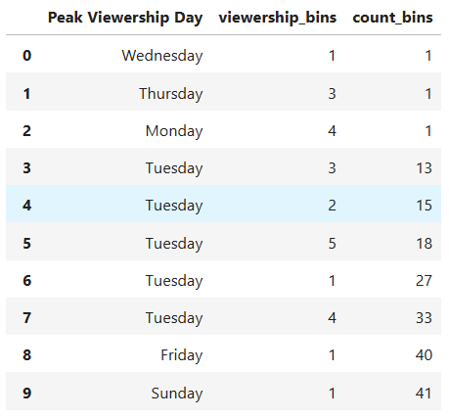
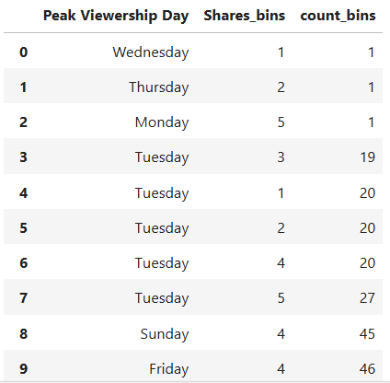
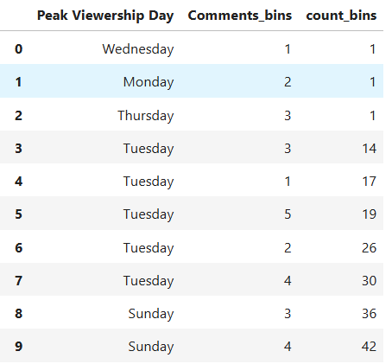
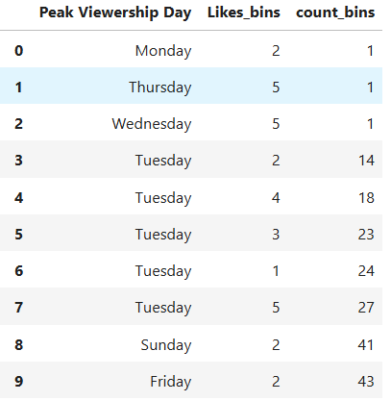
My Observation:
Here in most of the engagement types we are getting low value of responses on weekdays

Slide 16
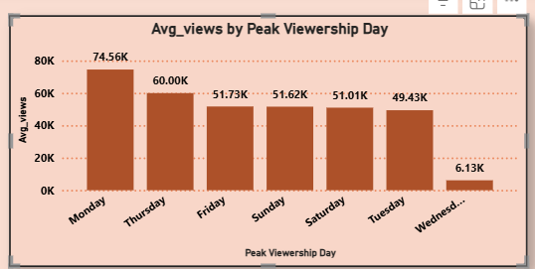
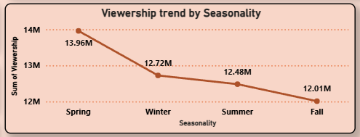
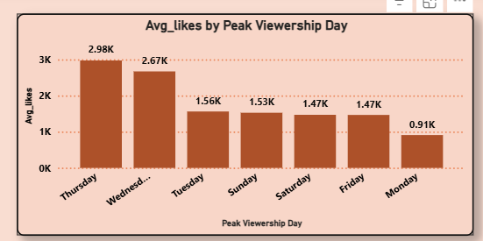
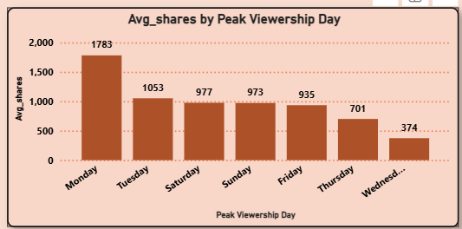
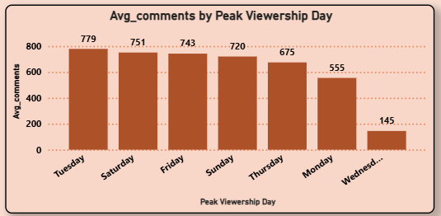
My Observation:
Here from the below images I can get to know that Wednesday has poor engagement from the viewers (Views, Shares, Comments)
And also Fall has lower viewership when compared to the other seasons.

Slide 17
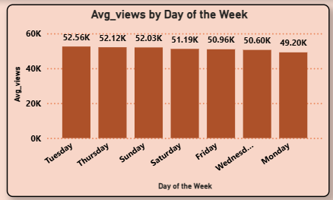
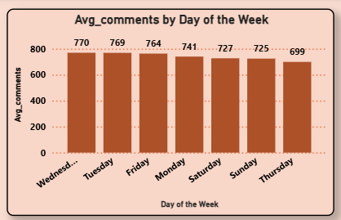
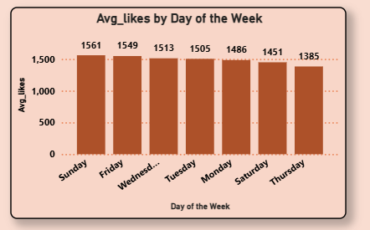
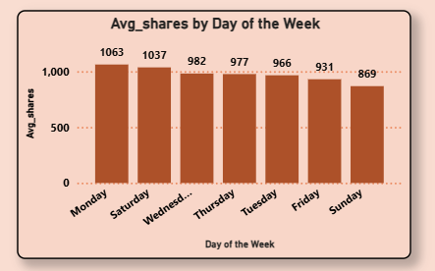
Is content released on weekends performing better than weekdays?​
We did not observe any significant impact of release day on performance. In fact, some content released on weekdays performed just as well as, or even better than, weekend releases.

Slide 18
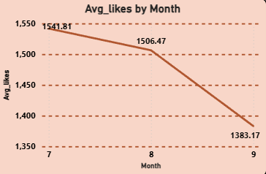
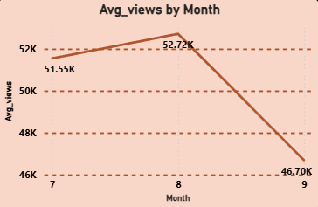
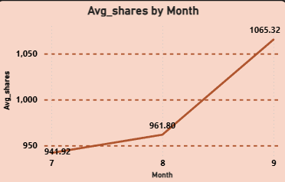
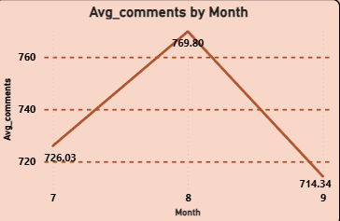
Why did engagement drop in a specific region or age group?
From this graphs we can get to know that there is a significant dip in the engagement of the viewers(Views, Comments, Likes).
This graph the covers engagement of the viewers in 3 months in 4 ways.
Except in Shares There is a dip in other engagement ways.

Slide 19
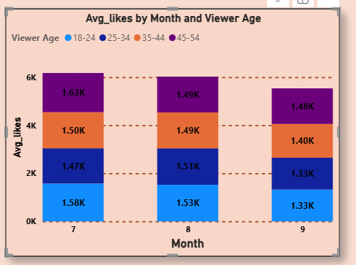
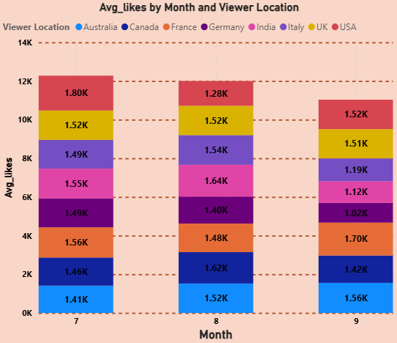
Here from the below the graphs we can get to know there is a significant dip of the views from the month July to month September and from some locations also.

Slide 20
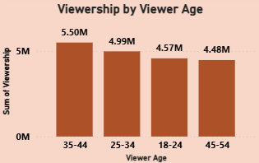
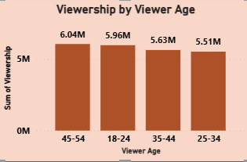
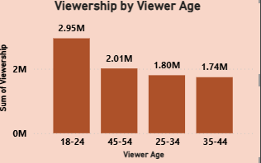
My Observation:
Here there is a significant difference in the viewership among 3 months.

