Slide 1
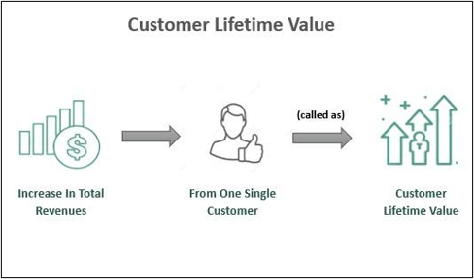
Customer Lifetime Value
Problem Statement​
Customer Lifetime Value (LTV) for FinTech customers based on their transaction history , demographics, and engagement patterns. The goal is to help financial service providers identify high-value customers

Slide 2
Dataset Details​
Feature​ | Description​
Customer_ID​ | Unique identifier for each customer​
Age​ | Age of the customer (18-70 years)​
Location​ | Geographical location (Urban, Suburban, Rural)​
Income_Level​ | Income classification (Low, Middle, High)​
Total_Transactions​ | Total number of transactions made by the customer​
Avg_Transaction_Value​ | Average value of each transaction (in Rupees)​
Total_Spent​ | Total amount spent by the customer (in Rupees)​
Max_Transaction_Value​ | Highest single transaction value (in Rupees)​
Min_Transaction_Value​ | Lowest single transaction value (in Rupees)​
Active_Days​ | Number of days the customer has been active on the platform​

Slide 3
Feature​ | Description​
Last_Transaction_Days_Ago​ | Days since the customer’s last transaction​
Loyalty_Points_Earned​ | Total loyalty points earned by the customer​
Referral_Count​ | Number of new customers referred by the user​
Cashback_Received​ | Total cashback received (in Rupees)​
App_Usage_Frequency​ | Frequency of app usage (Daily, Weekly, Monthly)​
Preferred_Pa yment_Method​ | Most frequently used payment method​
Support_Tickets_Raised​ | Number of support tickets raised​
Issue_Resolution_Time​ | Average time taken to resolve customer issues (in hours)​
Customer_Satisfaction_Score​ | Customer satisfaction score (1-10)​
LTV (Target Variable)​ | Estimated Lifetime Value of the customer (in Rupees)​

Slide 4

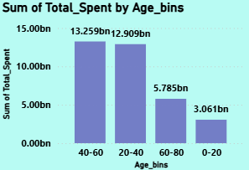
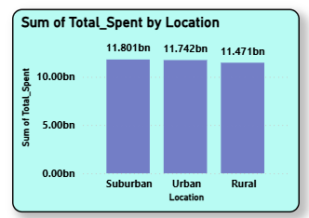
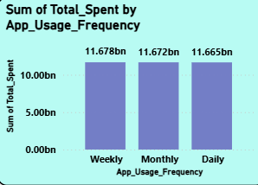
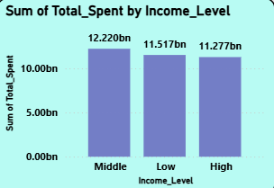
Descriptive Analysis
Amount Spent:
Total amount spent by the all type of customers
Here the person ages between the 40 to 60 are spending more.
Here almost in every location spent amount is same.
Here almost in all categories spent amount is same.
Here the middle income-level customers are spending a bit more.

Slide 5
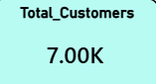
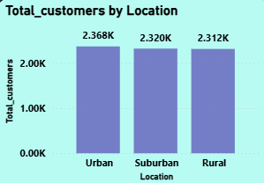
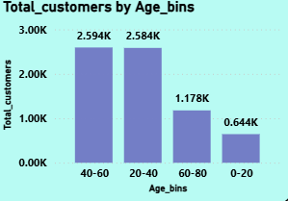
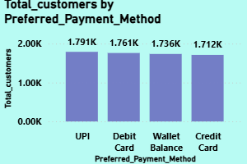
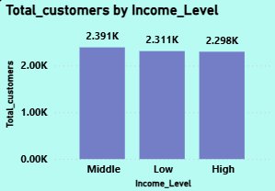
Customers overview:
Total customers as per the dataset is 7000
Here there is equal proportion of the customers are there from each location.
Here The customers in the age bins from 20-40 and
40-60 are more when compared to 0-20 and 60-80
Here there is no significant difference in the payment methods preferred by the customers
Here the customers are more in the category of middle income-level when compared to others

Slide 6
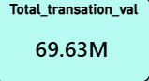
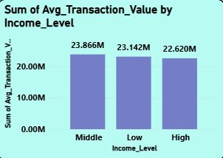
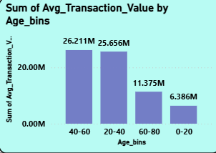
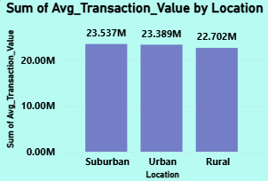
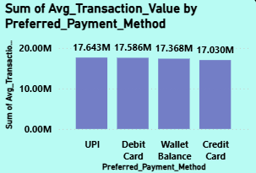
Transactions Value Overview:
Total transaction value done by the customers
There is a spike in the average transactions done by the middle income level compared to the other income level
The customers between the age 20 to 60 are having the more transaction value compared to the other age groups
There is small significant spike in the transaction value in the suburban location when compared to the other locations
There is no significant difference in the transaction value by the payment methods.

Slide 7
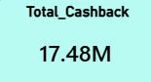
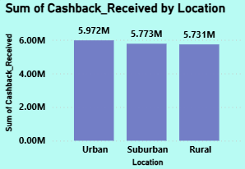
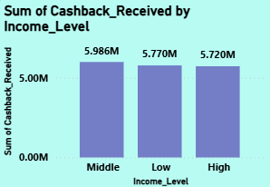
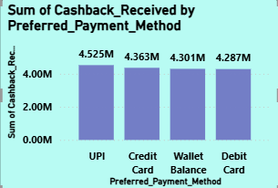
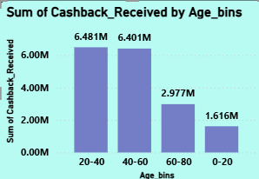
Cashback Overview:
Total cashback received by the customers
The customers which are in the urban received more cashback then the customers in the suburban and rural locations.
The customers which are from the middle income-level are getting more cashback than the other income levels
The customers who are using the UPI payment method are getting more cashback than the users of other payment modes.
The customers are getting more cashbacks in the 20-60
Age group as they are doing more transactions.

Slide 8
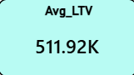
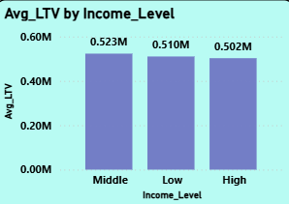
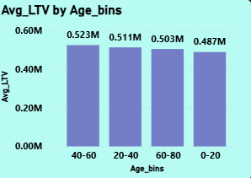
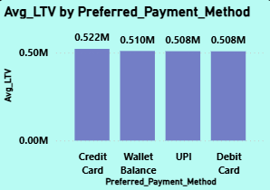
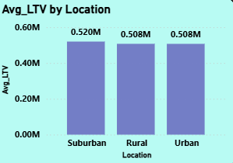
LTV Overview:
Average LTV(Lifetime Value) received by the customers in the dataset.
The middle income level having more LTV compared to the other income level groups
The customers between the ages 20 to 40 are having more LTV when compared to the other ages groups.
There is a bit spike in the LTVs of the customers Who are using Credit Card with regards to the payment method
The LTV is more for the suburban group people when compared to the other groups

Slide 9
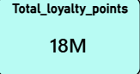
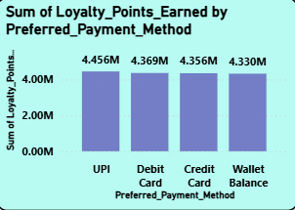
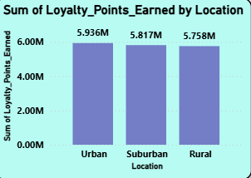
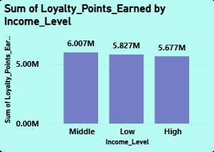
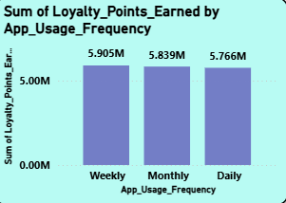
Loyalty Points Overview:
Total loyal points earned by the customers
The customers are earning more loyalty points who are using the UPI payment mode
The customers in the Urban location are earning more loyalty points compared to other locations
The middle income level customers are earning more loyalty points than others
There is no significant relation between the loyalty points and the app usage frequency

Slide 10
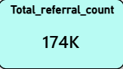
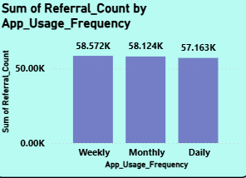
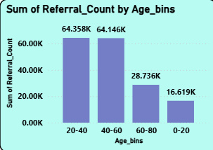
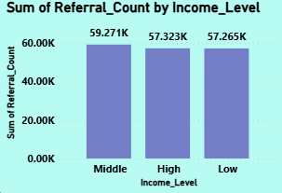
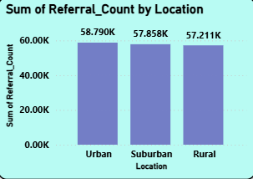
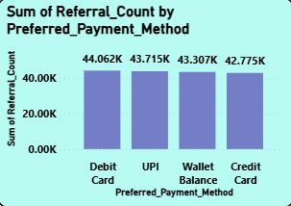
Referral Overview:
Total referral given by the present customers to the other persons.
There is no significant difference I observed in the referral count with regards to the payment method, app usage frequency, Income level and Location but the customers between the age 20-40and 40-60 are giving more referrals when compared to the other age group.

Slide 11
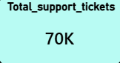
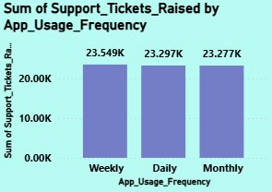
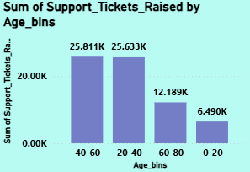
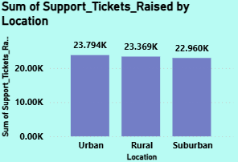
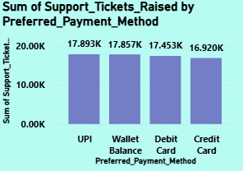
Support Tickets Overview:
Total number of tickets raised by the customers for the support.
The customers who are in the age between the 20 – 60 are raising tickets as they are doing more transactions.
The customers in the Urban location are raising more tickets when compared to the others in the different locations.
The customers are raising more tickets who are UPI, Wallet Balance, Debit Card when compared to the Credit Card users.

Slide 12
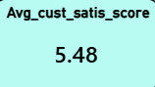
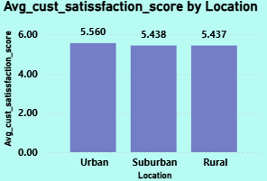
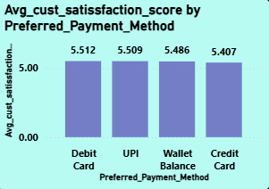
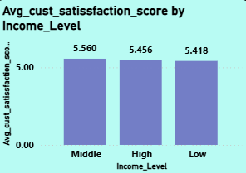
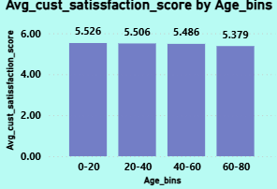
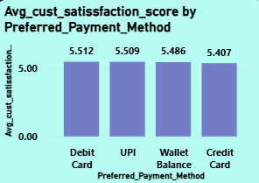
Customer Satisfaction Overview:
The average satisfaction score given by the customers
Here from all the diagrams in this slide we can conclude that the more customers are giving rating 5 to 6 regardless of their payment method, age, location.

Slide 13
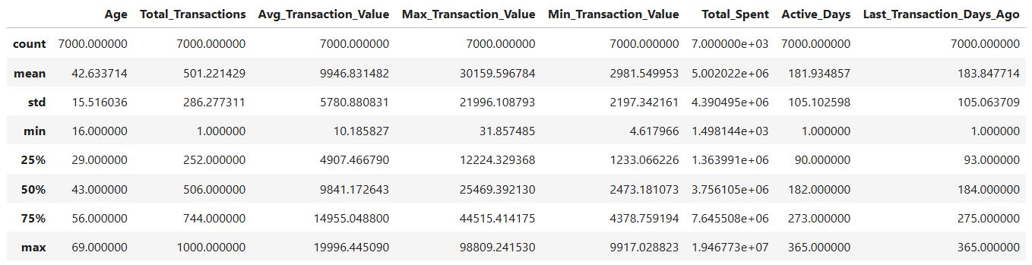
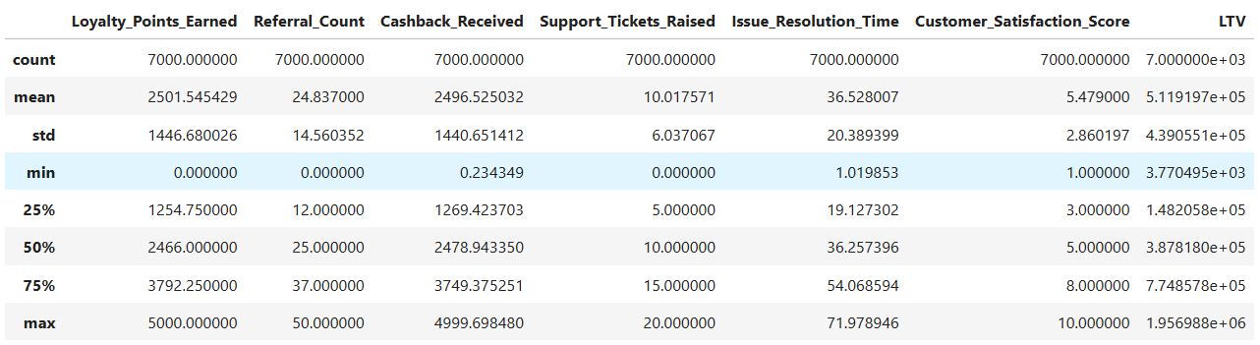
Five point summary for continuous variables

Slide 14
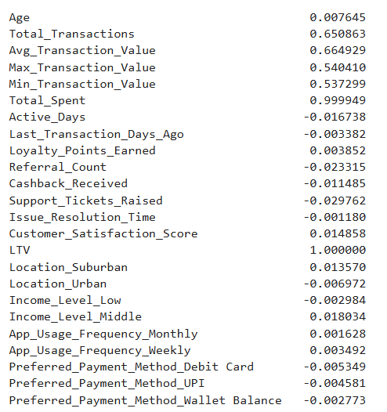
Descriptive Analysis
Correlation Analysis:
Why is LTV higher for some users?
Here I find the correlation between all the variables against LTV.
What I have observed is there is strong positive correlation between the total spent variable and LTV variable.
Here we can conclude that the customers who are spending more are having more LTV.

Slide 15


Is Loyalty Points Earned related to Total Spent?​
digi_wallet['Loyalty_Points_Earned'].corr(digi_wallet['Total_Spent’])
Here I find the correlation between the loyalty points and the total amount variables.
What I observed is There is strong negative correlation between the two variables.
Average transaction value vs LTV
Here from the graph, we can conclude that the LTV is more for the customers who are transferring more money.

