Slide 1

Multi Lingual Sign
Language Interpreter
EnTC C Batch 1 (Gp. 5) Date: 27/03/2023
Guide : Puja Cholke Ma’am
OPP Course Project
End semester review
17. Atharv Mali (12110714 )
18. Shubham Mali (12110360)
20.Gitesh Mane (12110610)
21. Pratik Masani (12111038)

Slide 2
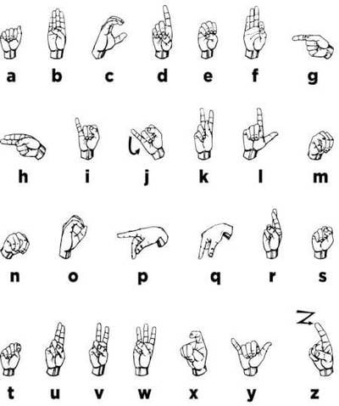
Introduction
What is Sign language ?
American Sign Language has predominantly used sign language.
As we know that most deaf people in India tend to use sign language but still, it is not widely used for teaching purposes in schools.
In this project will will try to detect sign language and convert it into multiple languages after that detected sign will convert into speech format.

Slide 3
Literature Survey
Name | Author | Methodology
Real Time Sign Language Detection. International Journal for Modern Trends in Science and Technology. 8. 32-37. 10.46501/IJMTST0801006. | Pathak, Aman & Kumar|priyam|priyanshu, Avinash & Chugh, Gupta|gunjan & Ijmtst, Editor. (2022). | Convolutional Neural Network (ConvNet/CNN) TensorFlow,Object Detection API
A New Data Glove Approach for Malaysian Sign Language Detection | Ahmad Zaki Shukor, Muhammad Fahmi Miskon, Muhammad Herman Jamaluddin | data-glove approach used.The data glove is outlined with ten flex sensors,accelerometer,tilt sensors.
Translation of Gesture-Based Static Sign Language to Text and Speech | Sabitha Gauni* , Ankit Bastia, B Sohan Kumar, Prakhar Soni, and Vineeth Pydi | CNN used. A CNN architecture contains a convolutional layer, a max-pooling layer, also, a fully connected dense layer/hidden layer.

Slide 4
Problem Statement
To reduce Communication Gap between deaf and normal population
Sign language recognition would help break down the barriers for sign language users in society.

Slide 5
Objectives
To make an easy to access application that can be used to easily interpret all the different sign languages which makes it easy to communicate with the specially abled.
After the literature review we have analyze that in the currently available models there are no multi language translator available but we plan to make a multi language translator using google APIs.
For Example: when the sign language is interpreted it translates it and will be available to us in multiple language according to our need.

Slide 6




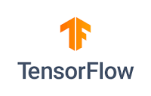
Technologies used
Java
Tensorflow
Python
Opencv
Mediapipe
Android studio

Slide 7
Project Flow
Created model using custom dataset of three classes for this
Ex: like,dislike ,hello
Using tensorflow model we train model then we converted into tflite model.
Imported tflite model in android app
1
Using camera signed language detection
u
jzjkk
Capture using camera
After classifying image whose confidence among the classes it will convert into speech format.
Real time capture

Slide 8
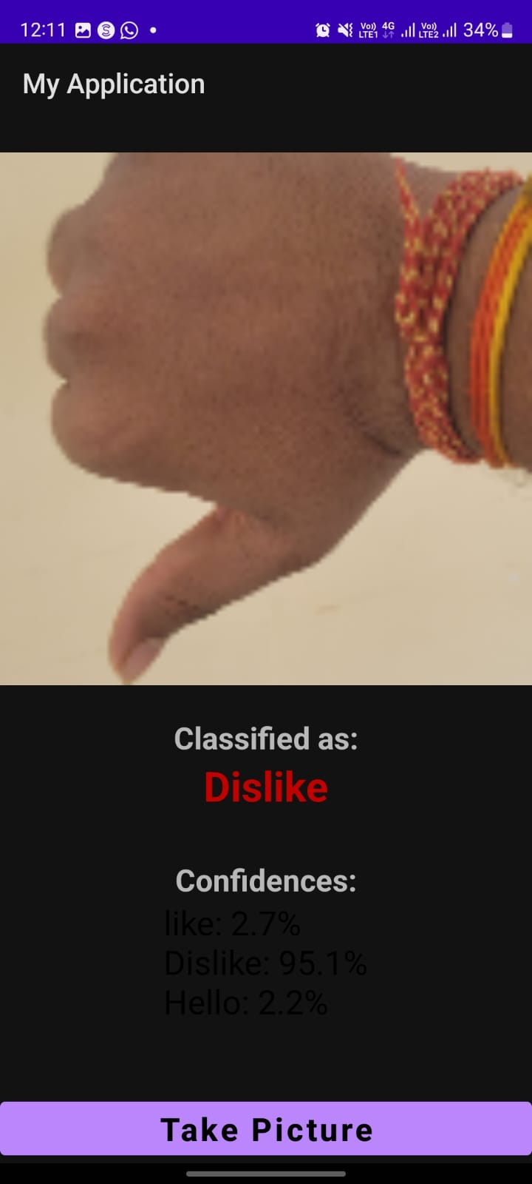
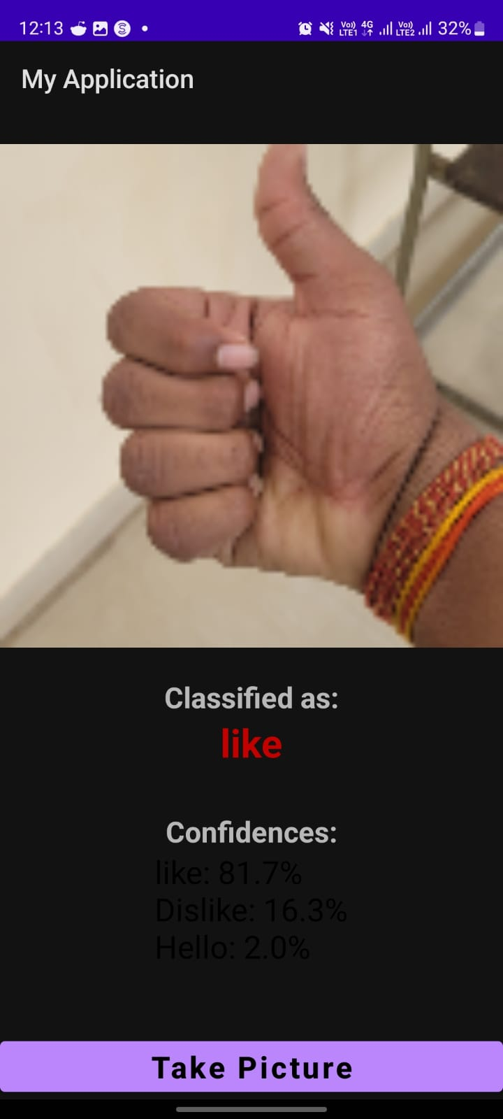
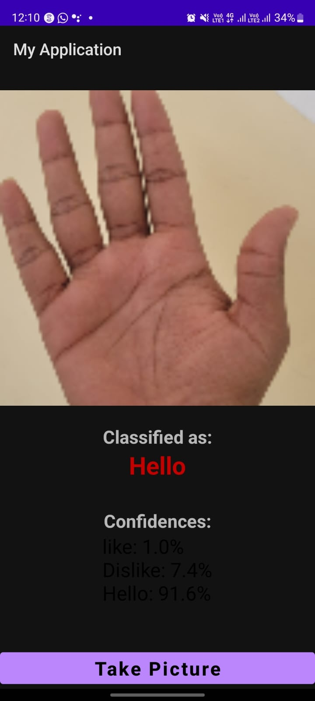
Outputs

Slide 9
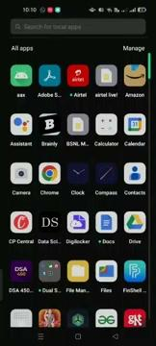
Using real time camera signed language detection

Slide 10
References
A. Kumar, K. Thankachan and M. M. Dominic, "Sign language recognition," 2016 3rd International Conference on Recent Advances in Information Technology (RAIT), Dhanbad, India, 2016, pp. 422-428, doi: 10.1109/RAIT.2016.7507939.
V. H. Iyer, U. M. Prakash, A. Vijay and P. Sathishkumar, "Sign Language Detection using Action Recognition," 2022 2nd International Conference on Advance Computing and Innovative Technologies in Engineering (ICACITE), Greater Noida, India, 2022, pp. 1682-1685, doi: 10.1109/ICACITE53722.2022.9823484.
Kurz, M. J., Boring, S., Trausner, C., & Prinz, W. (2020). Using augmented reality to provide sign language interpretation in a museum setting. ACM Transactions on Accessible Computing, 13(1), 1-24.
Sharma, S., Singh, S., & Dey, S. (2021). Sign language recognition using deep learning for Indian Sign Language. SN Computer Science, 2(4), 1-12.

Slide 11
THANKS!

