Slide 1
NEURAL MACHINE TRANSLATION
English to Hindi
4C. IISc CCE Project
Akhil Munjal
Aditi Dankar
Rakshith Rao

Slide 2

PROBLEM STATEMENT
Choose a pair of Indian languages and implement Neural Machine Translation from scratch using Multi-Head Attention

Slide 3
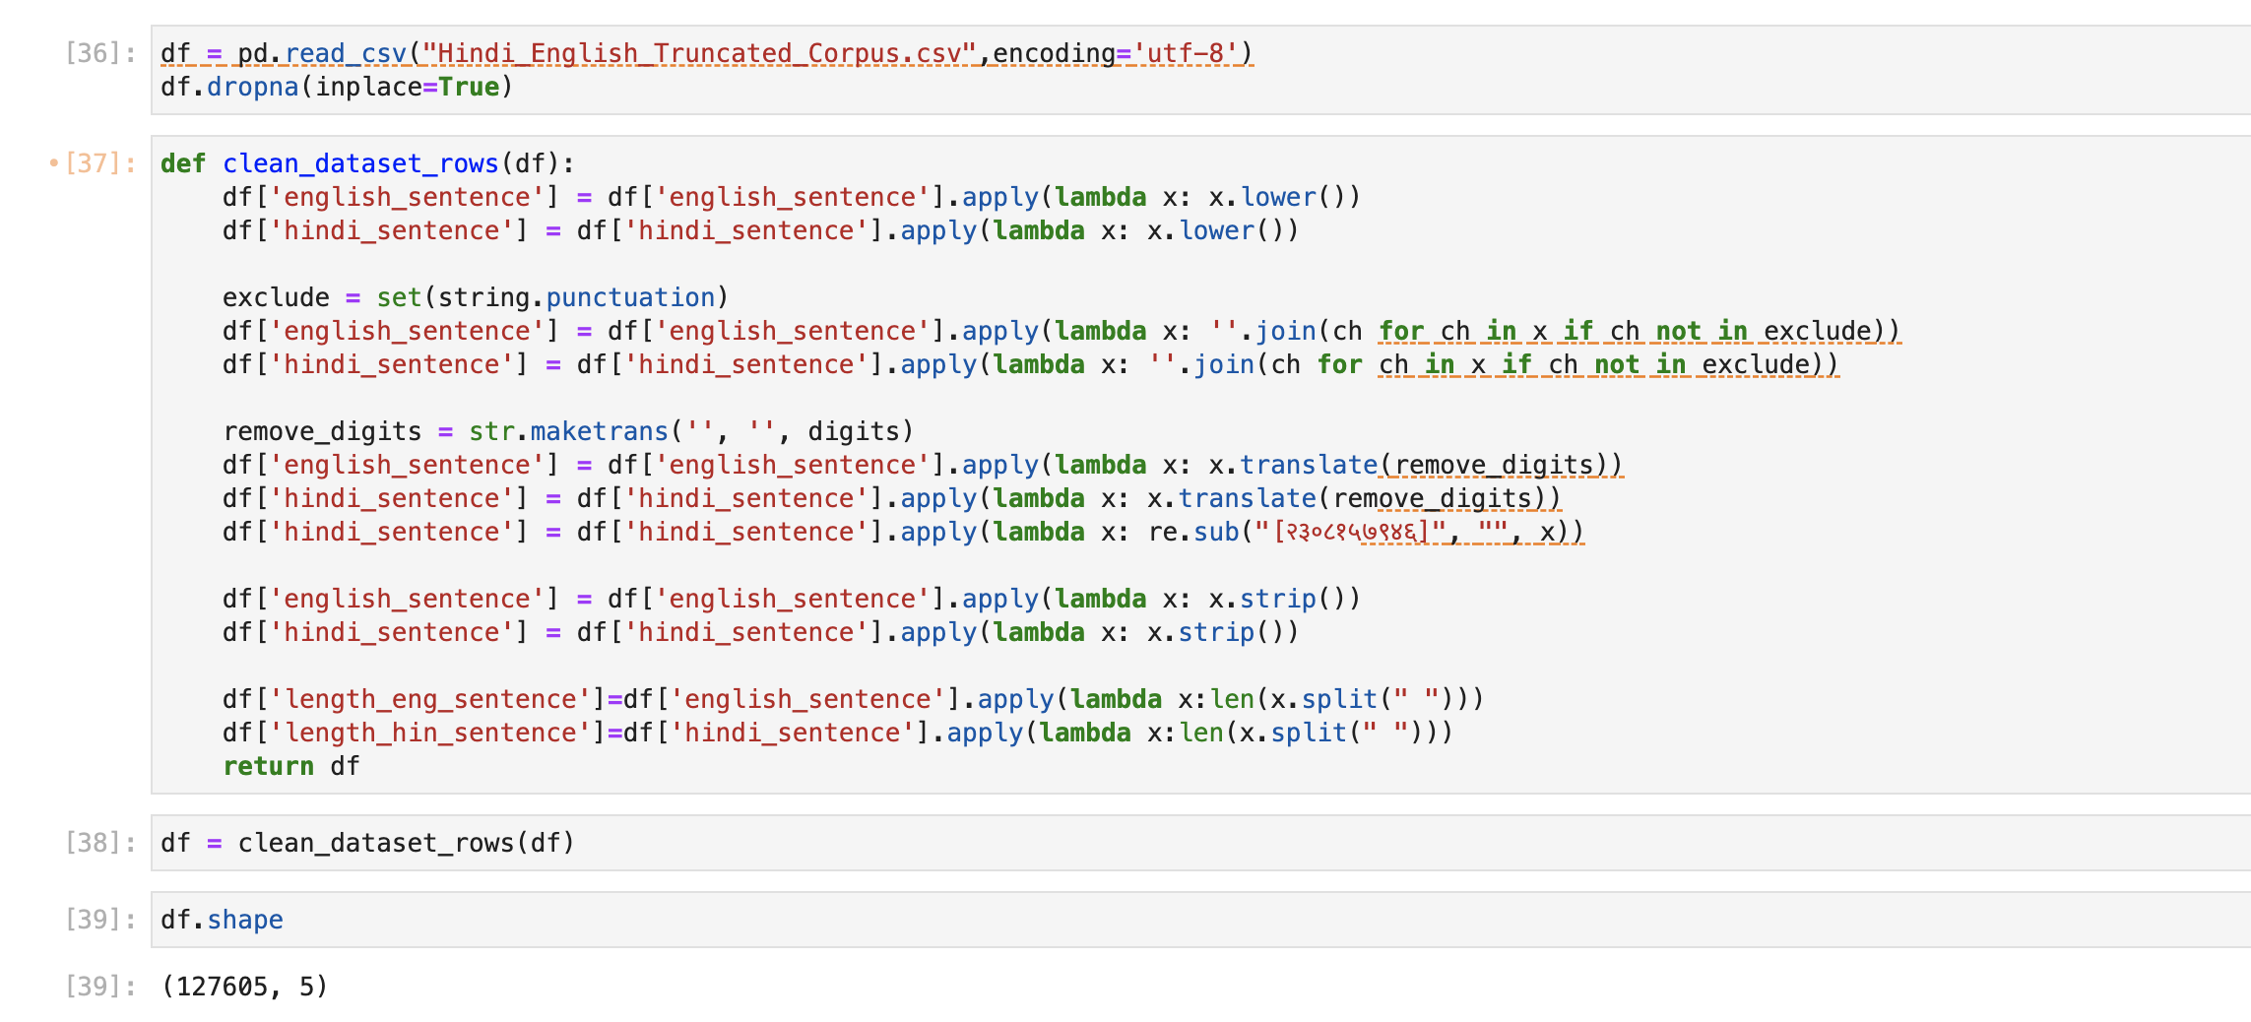
Data Preparation

Slide 4
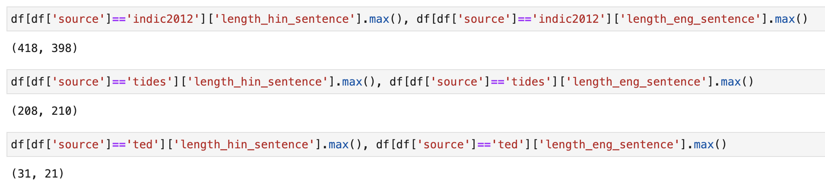
Filtering dataframe on source = ‘ted’ such that GPU doesn’t run out of space for higher sequence lengths. Also, the trainable parameters increase with sequence length.

Slide 5
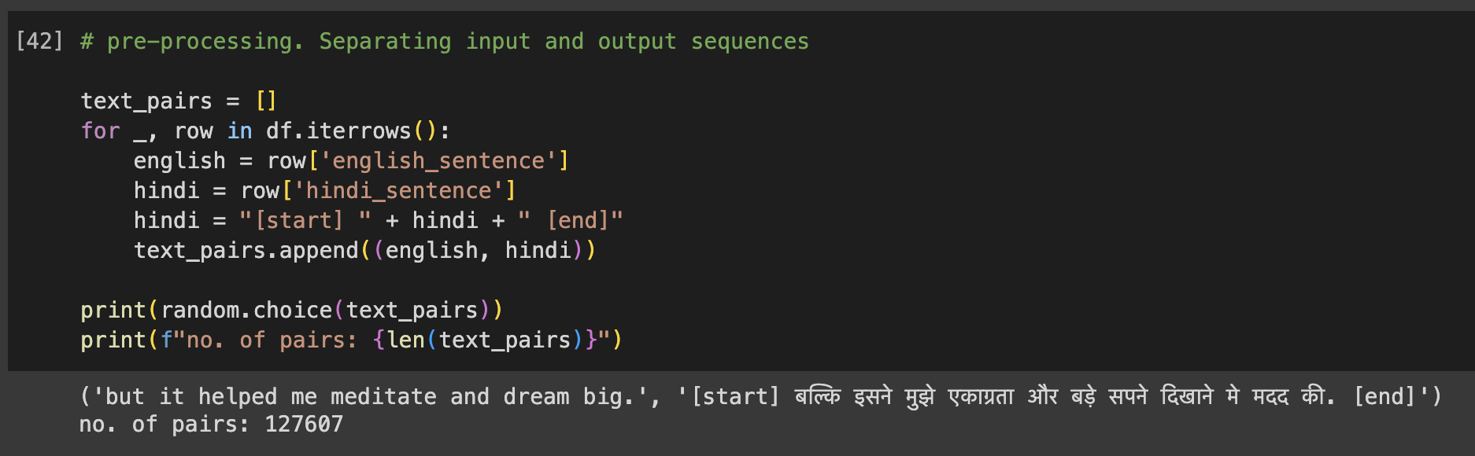
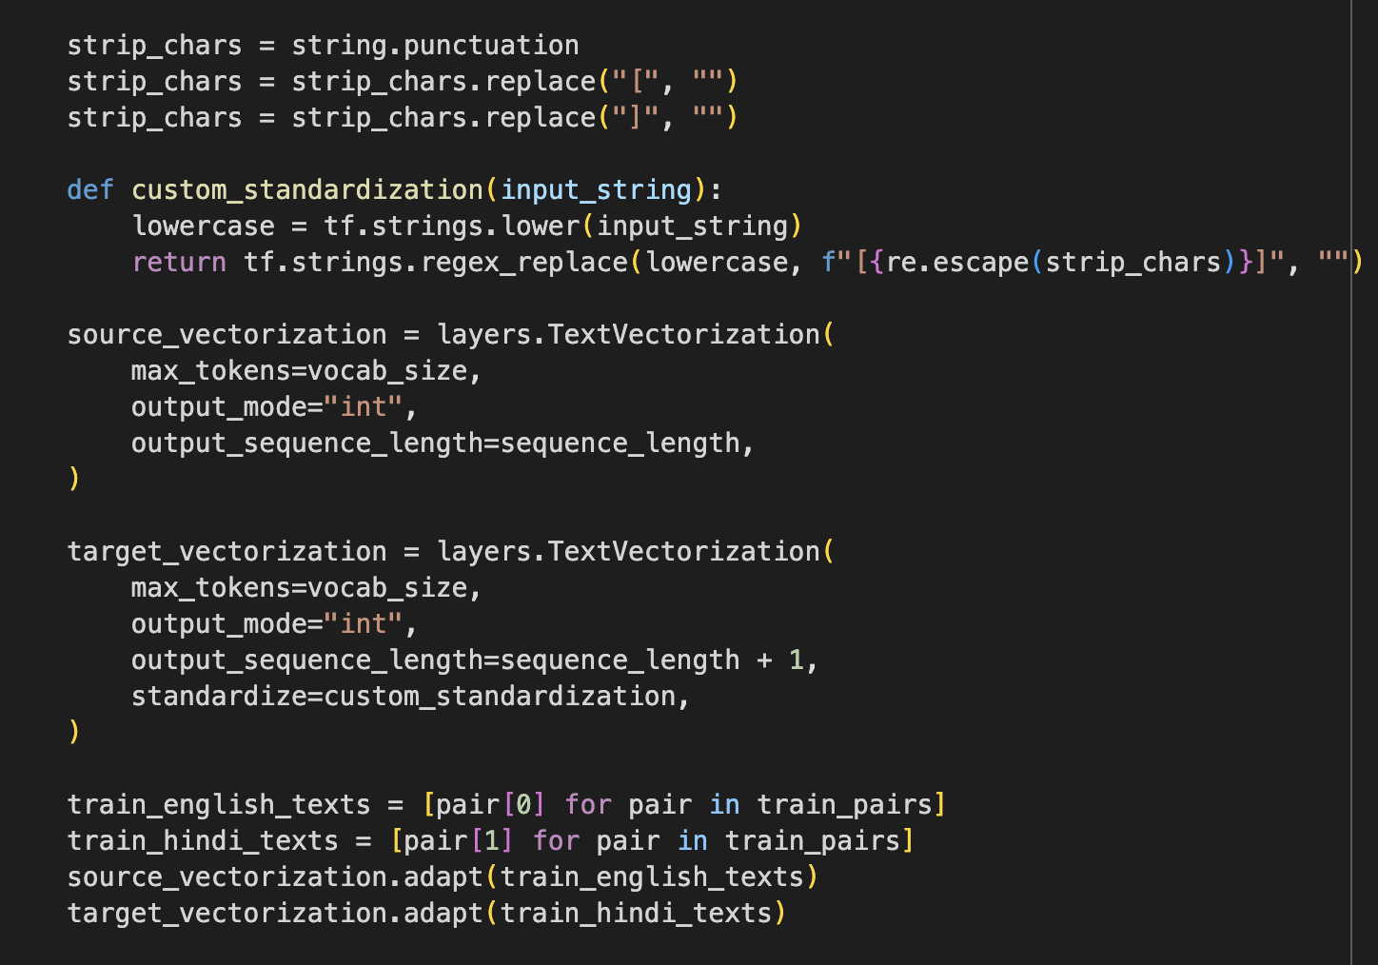

Slide 6
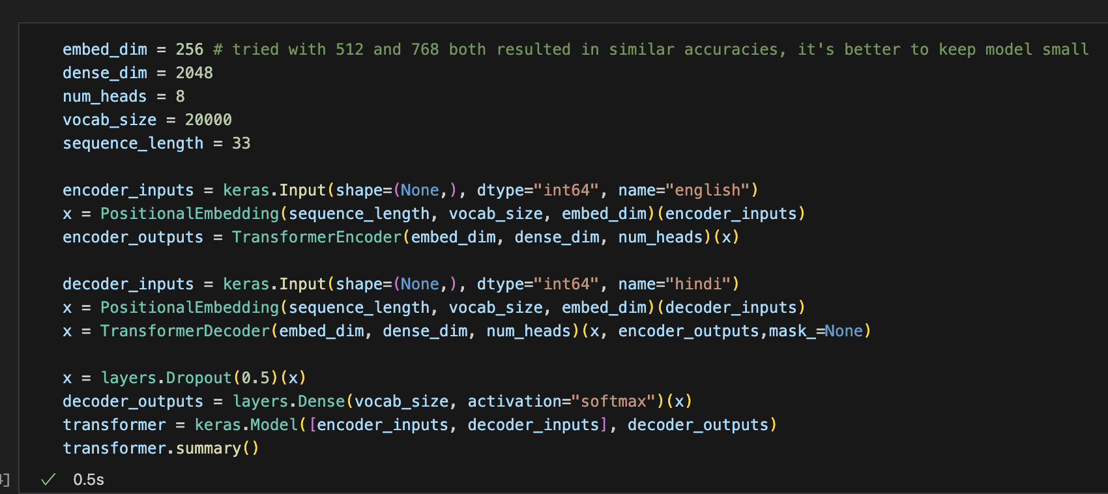
MODEL

Slide 7
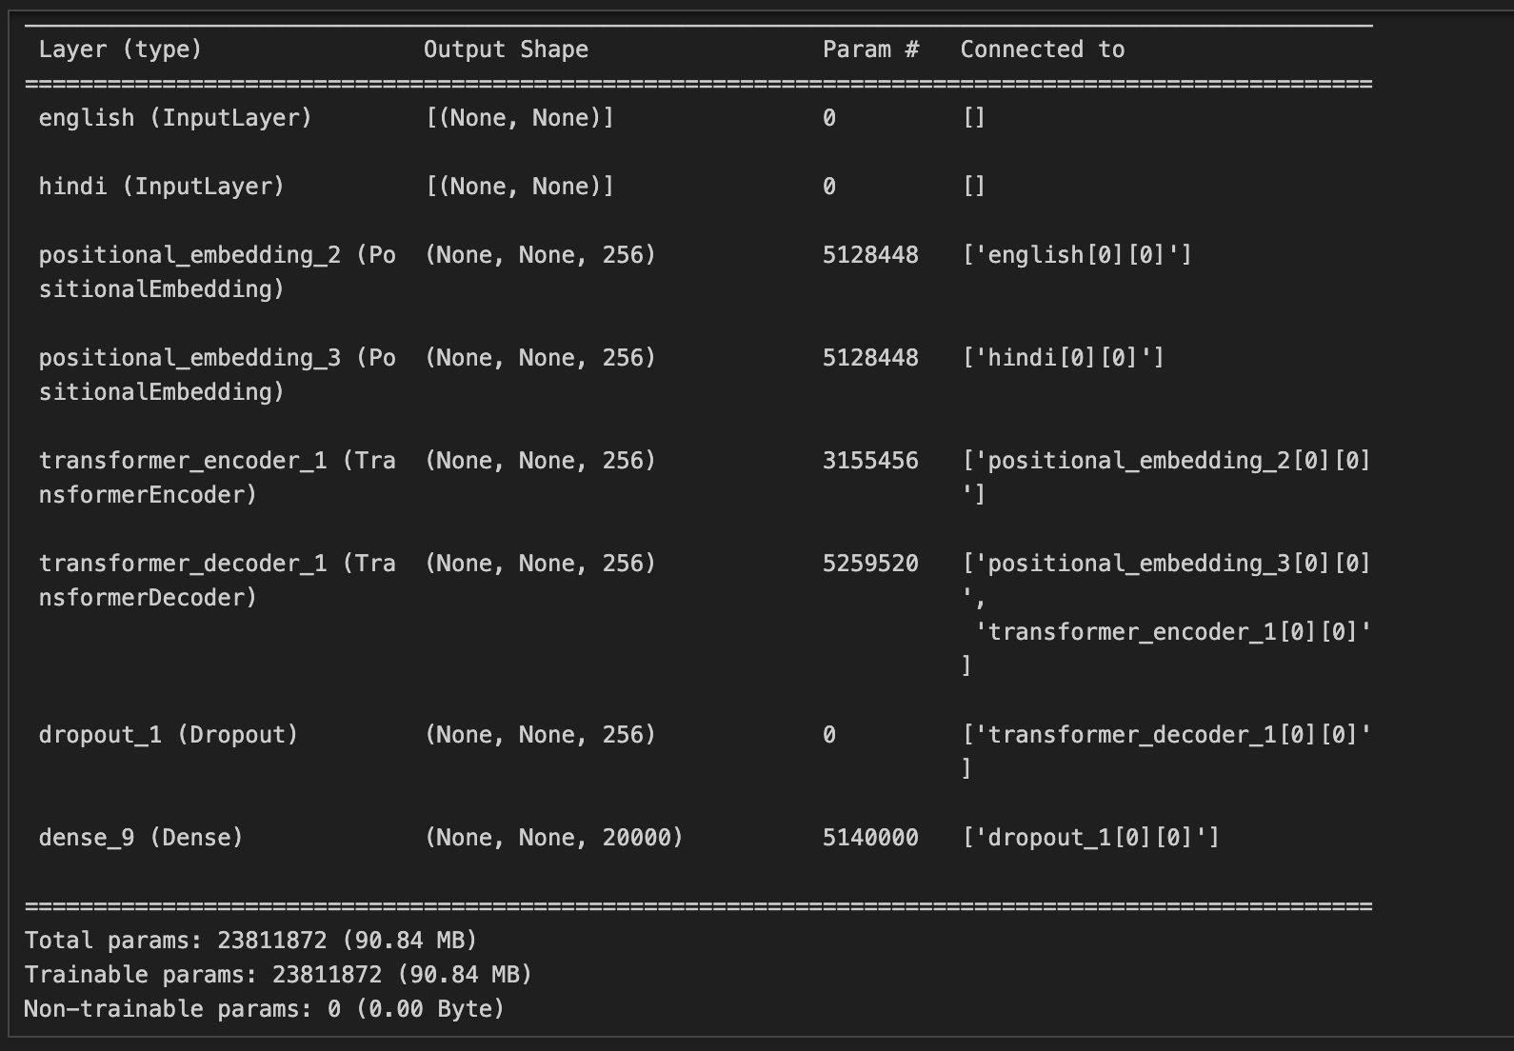
MODEL

Slide 8
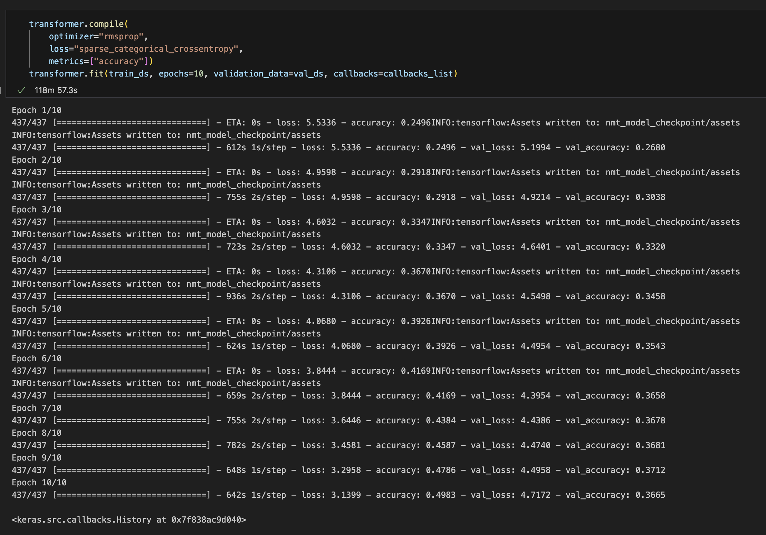
MODEL TRAINING

Slide 9
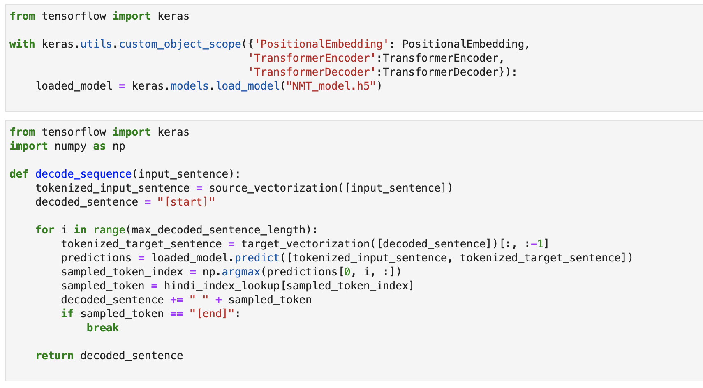
Inference with Saved Model

Slide 10
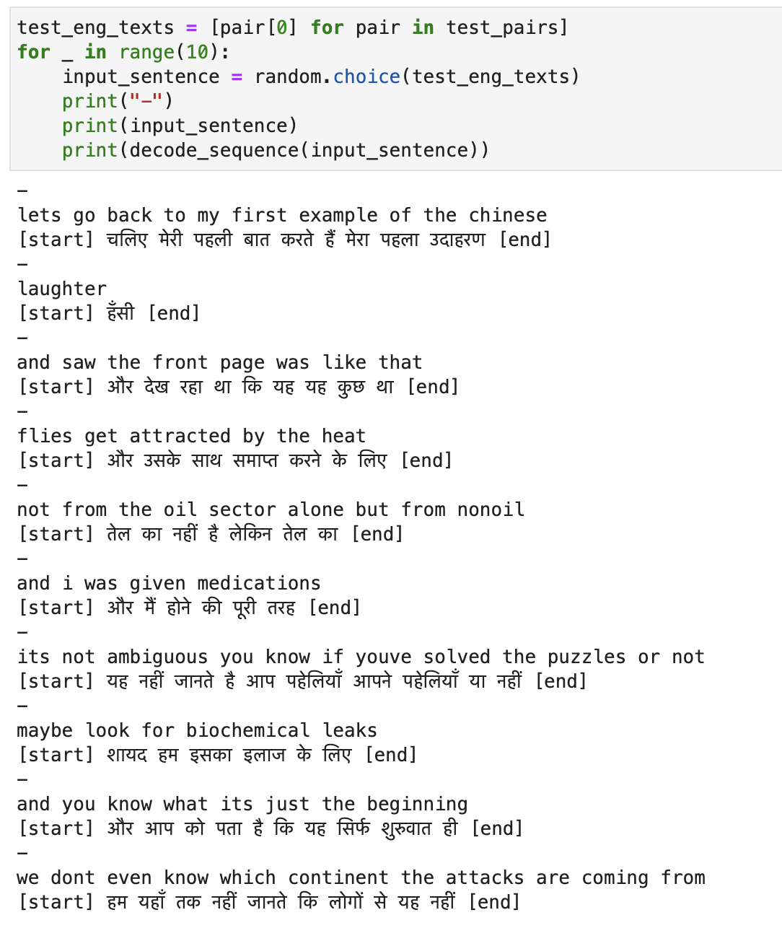
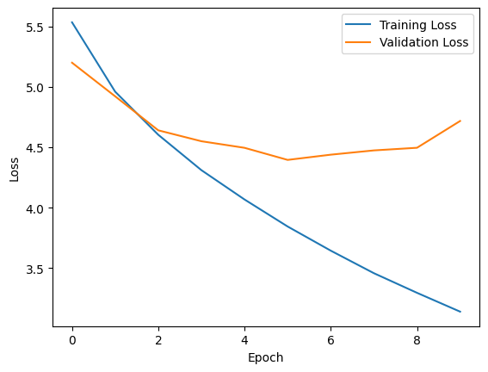
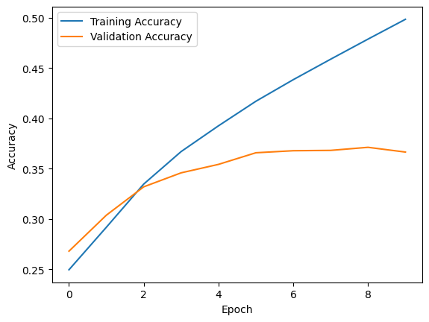


Slide 11
GitHub Notebook :
https://github.com/AkhilMunjaal/NMT/blob/main/eng_hindi_NMT.ipynb

