Slide 1
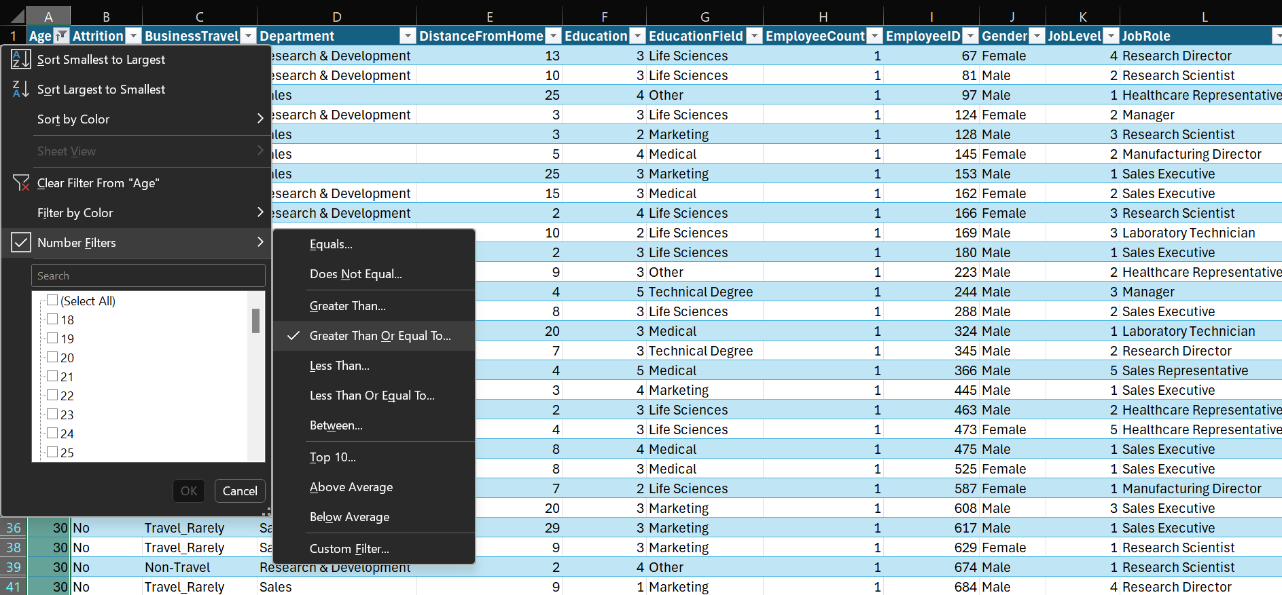
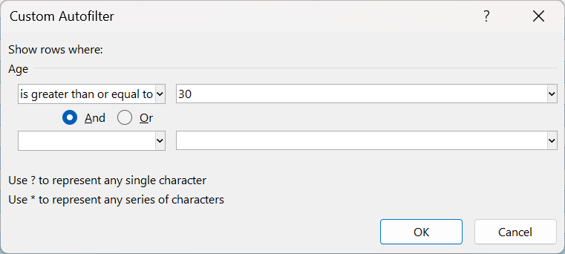
1. Using Excel, how would you filter the dataset to only show employees aged 30 and above?
Click on Filter dropdown for Age column.
Click on Number Filters and select Greater than or equal to.
In custom Autofilter window box enter value = 30 and click ok.

Slide 2
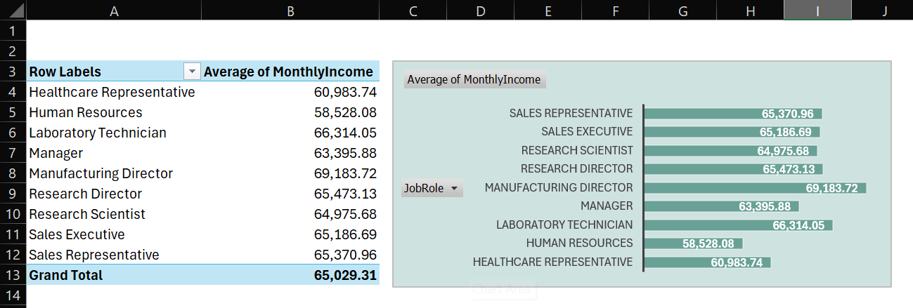
2. Create a pivot table to summarize the average Monthly Income by Job Role.

Slide 3
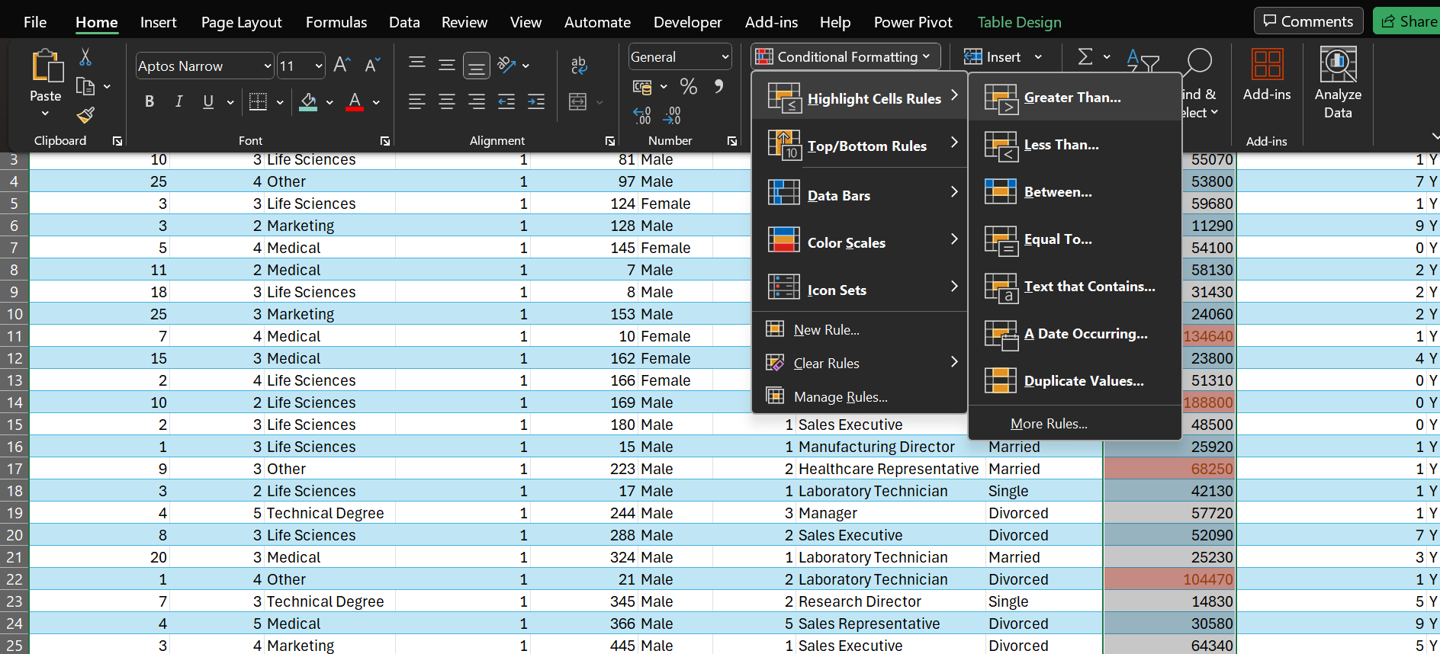
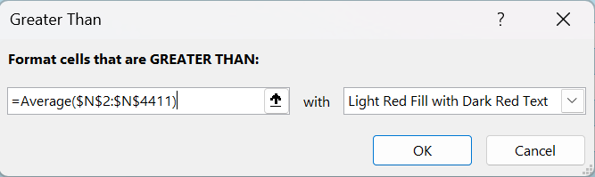
3. Apply conditional formatting to highlight employees with Monthly Income above the company's average income.
Select all values from monthly income column.
In Home ribbon select conditional formatting > Highlight cell rules > Greater than.
In the window box provide formula =Average($N$2:$N$4411)

Slide 4
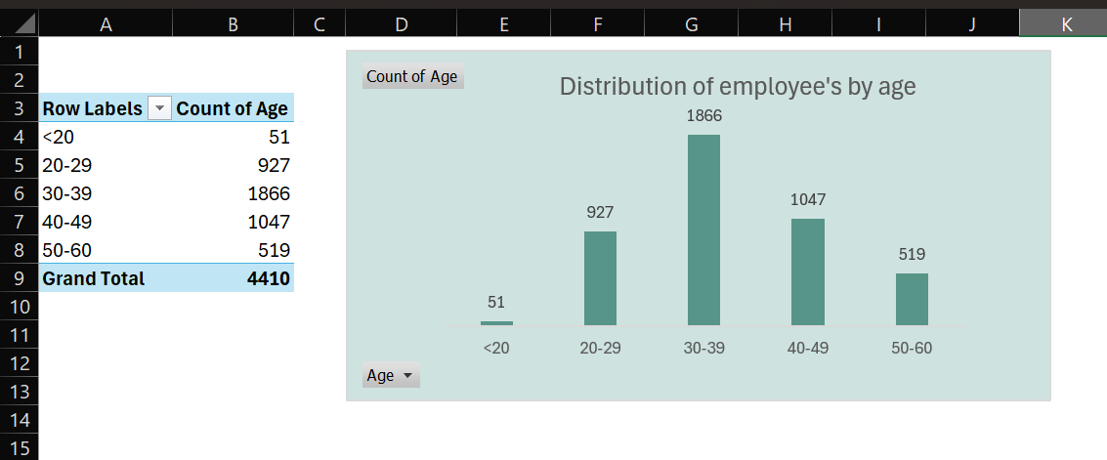
4. Create a bar chart in Excel to visualize the distribution of employee ages.

Slide 5
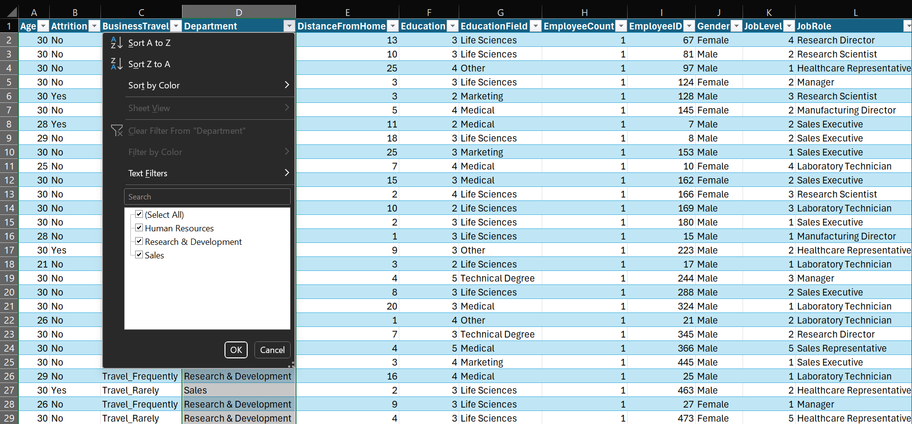
5. Identify and clean any missing or inconsistent data in the "Department" column.
There is no missing or inconsistent data in Department column.

Slide 6
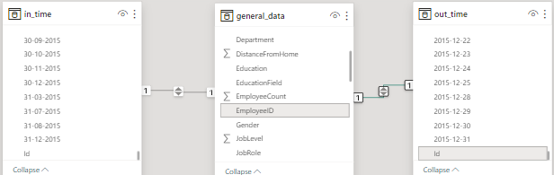
6. In Power BI, establish a relationship between the "EmployeeID" in the employee data and the "EmployeeID" in the time tracking data.
Established 1-to -1 relationship with primary key column “Id” from Dimension tables in_time and out_time, with reference foreign key column “EmployeeID” from Fact table general_data.

Slide 7
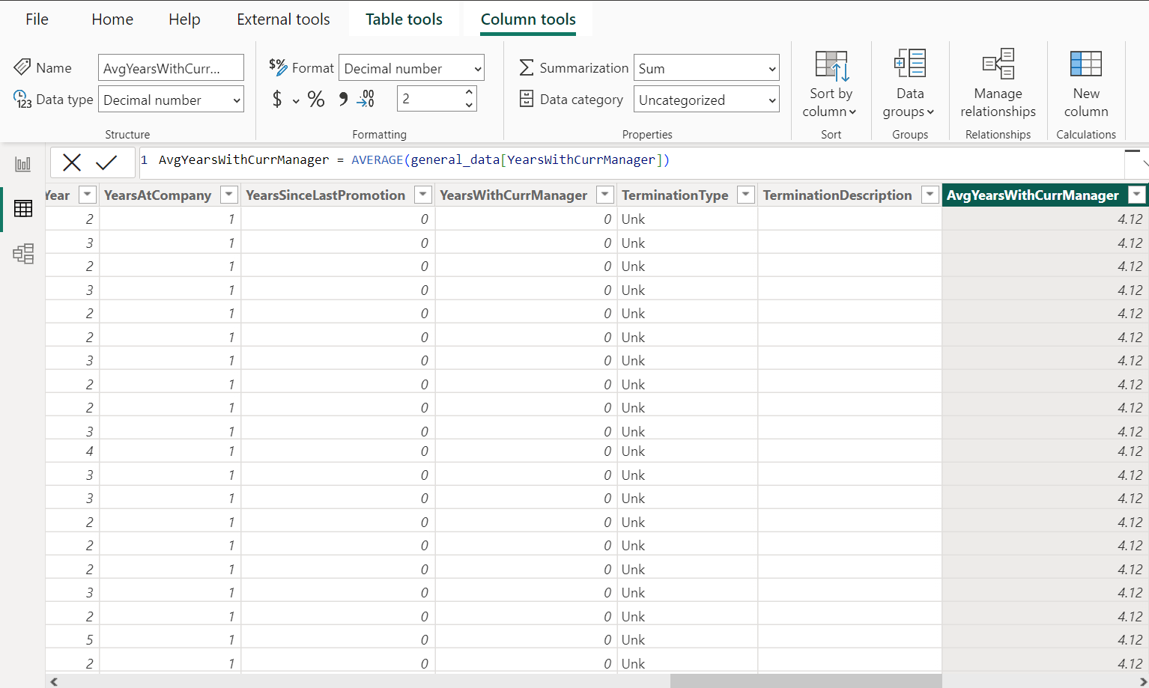
7. Using DAX, create a calculated column that calculates the average years an employee has spent with their current manager.
AvgYearsWithCurrManager = Average(general_date[YearsWithCurrManager])
AvgYearsWithCurrManager = 4.12

Slide 8
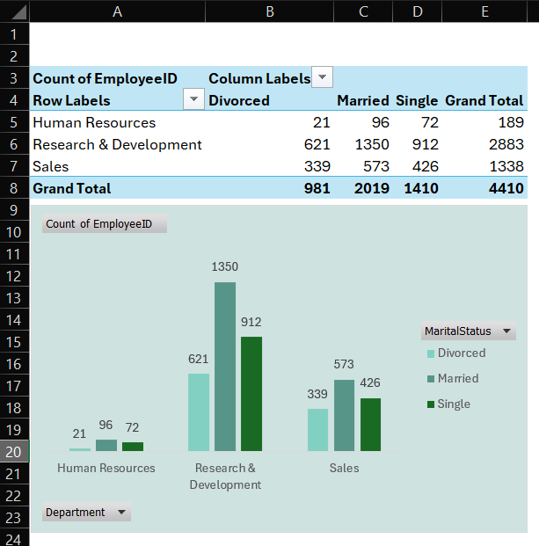
8. Using Excel, create a pivot table that displays the count of employees in each Marital Status category, segmented by Department.

Slide 9
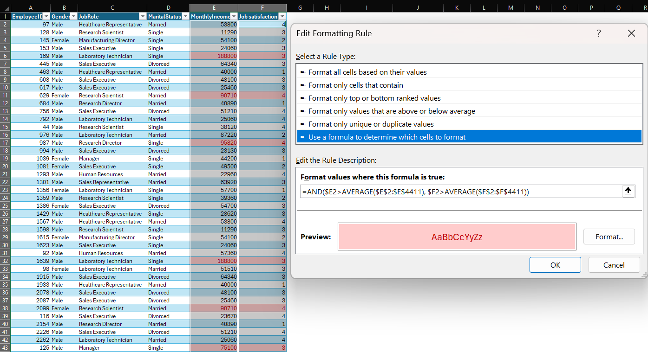
9. Apply conditional formatting to highlight employees with both above-average Monthly Income and above-average Job Satisfaction.
Average of MonthlyIncome is 65,030 and Average of Job satisfaction rating is 2.72.
Select column ranges of MonthlyIncome and Job satisfaction columns.
From Home ribbon > Conditional Formatting > New Rule > Use a formula to determine which cells to format.
Formula = AND($E2>Average($E$2:$E$4411), $F2> Average($F$2:$F$4411) )

Slide 10
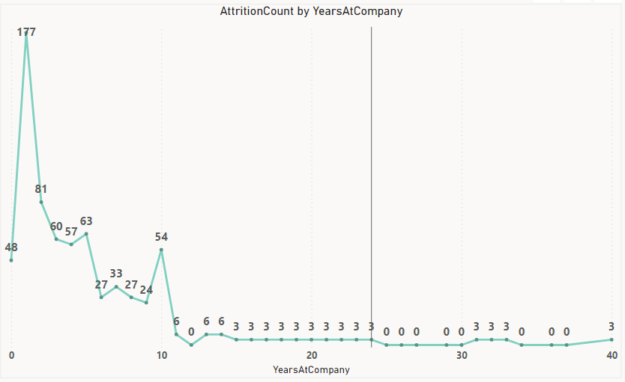
10.In Power BI, create a line chart that visualizes the trend of Employee Attrition over the years.

Slide 11
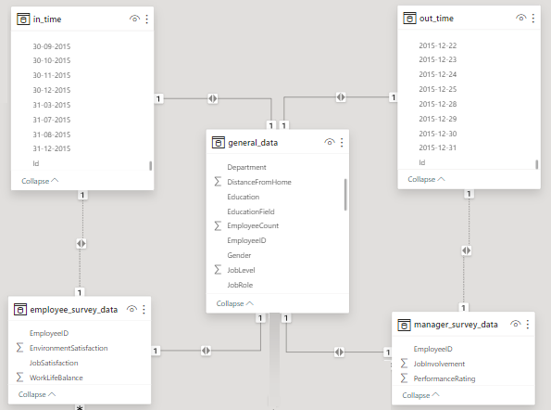
11. Describe how you would create a star schema for this dataset, explaining the benefits of doing so.
Identify fact table i.e. general_data table.
Identify dimension tables i.e. in_time, out_time, employee_survey_data, manager_survey_data.
Pick Primary key column (unique identifier) from dimention table for which there is reference foreign key column in fact table.
Established 1-to-1 relationships between fact table and dimention tables using the common key columns.
Load the fact and dimension tables into Power BI.
Benefits:
Data model is intuitive, it is easier to understand and analyze.
Easy to add new dimension tables or measures without disrupting existing structures.
Improved query performance with faster data retrieval.
Easy to navigate through the data model, focusing on relevant dimensions and measures for analysis.

Slide 12
12. Using DAX, calculate the rolling 3-month average of Monthly Income for each employee.
Rolling_3-Month_Avg =
CALCULATE( AVERAGE(‘general data’[MonthlyIncome]),
DATESINPERIOD(‘general data’[Date], LASTDATE(‘general data’[Date]), -3, Month))

Slide 13
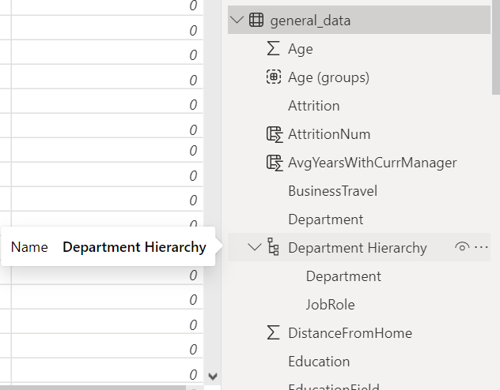
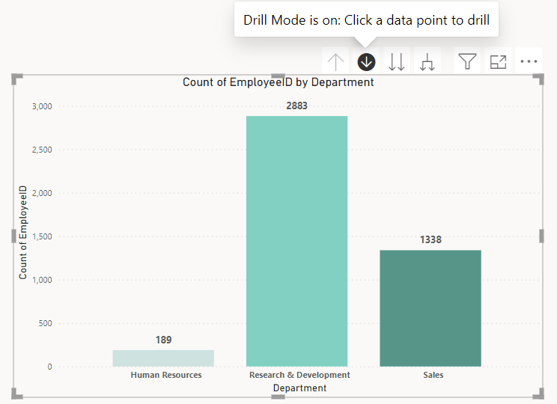
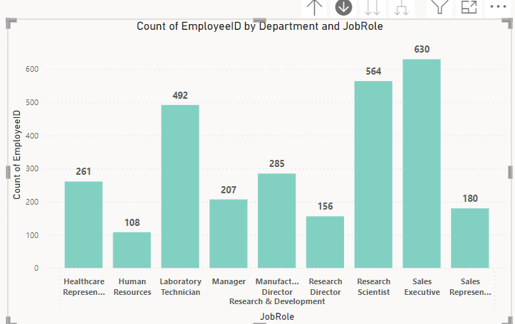
13. Create a hierarchy in Power BI that allows users to drill down from Department to Job Role to further narrow their analysis.
To create a department hierarchy, right click on Department field from data pane and select create hierarchy.
Right click on JobRole and click add hierarchy and select department, this allows to create hierarchy of visuals from Department to JobRole.
Similarly Drill down allows to step ahead into visual of selected department.

Slide 14
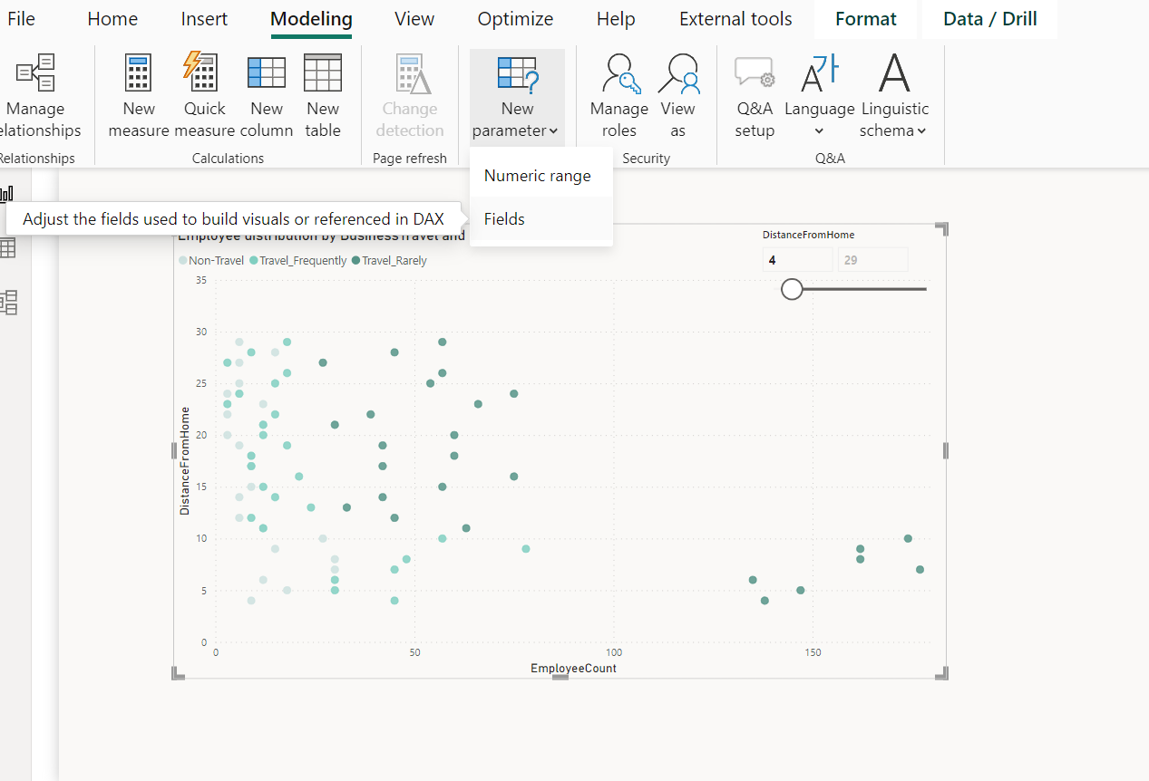
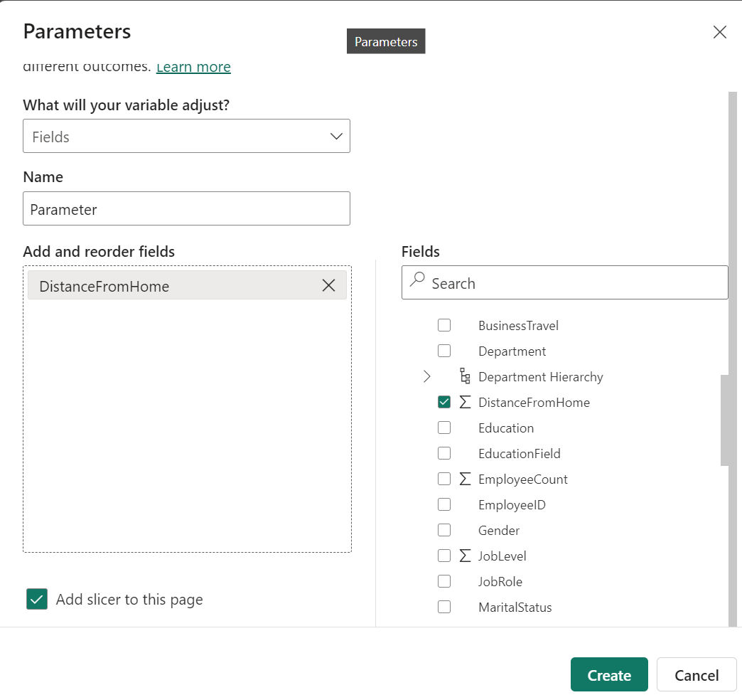
14. How can you set up parameterized queries in Power BI to allow users to filter data based on the Distance from Home column?
Modelling ribbon > New parameter > Fields > Add Fields > Create.
Creates slicer which allows to filter data dynamically based on movement of slicer bar.
Slicer

Slide 15
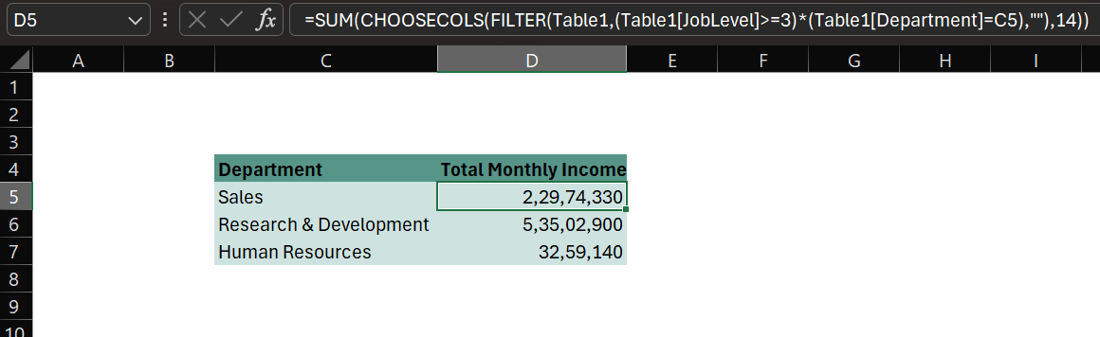
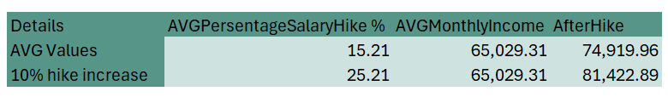
15. In Excel, calculate the total Monthly Income for each Department, considering only the employees with a Job Level greater than or equal to 3.
Used Filter function to apply condition on table1.
Applied Choosecols functions which facilitates to extract desired columns.
Finally applied sum function to calculate Total Monthly Income by department.
SUM(CHOOSECOLS(FILTER(Table1,(Table1[JobLevel]>=3)*(Table1[Department]=C5),""),14))
16. Explain how to perform a What-If analysis in Excel to understand the impact of a 10% increase in Percent Salary Hike on Monthly Income.

Slide 16
17. Verify if the data adheres to a predefined schema. What actions would you take if you find inconsistencies?
Data profiling:
Analyze the data distribution, patterns, and outliers.
Schema validation:
Compare the data structure against the predefined schema.
Check if all required fields are present and have the correct data types.
Identify any missing values, duplicates, or anomalies.
Error reporting:
Generate reports highlighting inconsistencies and errors.
Document the nature and location of discrepancies within the data.
Data cleansing:
Correct errors, inconsistencies, and missing values.
Standardize data formats and values to align with the predefined schema.
Documentation updates:
Update documentation to reflect any changes made to the schema or data cleansing procedures.
Communication:
Communicate findings and resolutions with relevant stakeholders.
Collaborate with data owners or domain experts to resolve complex inconsistencies.
Monitoring and maintenance:
Implement regular checks to ensure data adheres to the predefined schema over time.
Continuously monitor data quality and address any new inconsistencies promptly.

Slide 17
INSIGHTS
Emploee Distribution:
Total active employees count is 3699, out of which 59.5% are Males.
65.7% employees are from Research & Development department.
43.3% of the employees belong to age group bracket of 31-40.
Attrition:
Total Attrition count is 711 employees, at a rate of 16.1.
Research & Development department has highest Attrition of 64%.
177 employees got Attritioned when YearsAtCompany is 1. Rate of attrition is 68.4% for YearsAtCompany is <=5.
Rate of attrition is 48.9% for age group bracket of 26-35.
I terms of JobRole sales executive has highest Attrition of 165 employees.
Monthly Income:
Average Monthly Income of the company is 65,030 and 40% of employees have above-average Monthly Income.
36% of employees fall under Monthly Income of <40K.
Job level 4 has highest average Monthly Income of 77k.
Rating & Hike%: NOTE: Employee_survey = (Job ,Environment) Satisfaction/Work life balance rating
Average of Employee_survey Rating is 2.72.
Job role sales representative has lowest Employee_survey rating of 2.64.
Job role sales executive has highest no of 3+ Employee_survey ratings which is 579.
20% is Highest percentage of hike for YearsAtCompany is 30.
23.7% of employees has both above-average Monthly Income and above-average Job Satisfaction.

