Slide 1
AI-POWERED · ENTERPRISE · EDUCATION
Centralized Curriculum Management System
The Neural Operating System for Modern Institutions
Centralized Curriculum · AI-Driven Intelligence · Enterprise Scheduling
Presented by: Akhil Kumar

Slide 2
The Vision & Problem Statement
02
❌The Old Way
✅ Centralized Curriculum Management Project
Fragmented spreadsheets & paper records
No unified curriculum tracking
Manual timetable scheduling
Zero AI-assisted teaching support
Data silos across departments
No real-time student analytics
Unified Intelligence-First orchestration
Neural Curriculum Studio with hierarchy
AI-powered enterprise auto-scheduling
Full AI Teacher & Student support suite
Centralized cloud resource hub
Real-time analytics & insights
→

Slide 3




Technical Architecture — The Stack
03
FRONTEND
BACKEND
React 18
Django REST Framework
Framer Motion · Tailwind CSS · Dark/Light Mode
SimpleJWT Auth · RESTful APIs · Scalable Architecture
DATABASE
AI ENGINE
PostgreSQL
Google Gemini Pro
Persistent Storage · Relational Model · Optimized Queries
Neural Intelligence · Content Generation · Analytics
Scalable
Secure
Real-time

Slide 4


Role-Based Intelligence Dashboards
04
ADMIN
TEACHER
STUDENT
Institutional Control
Academic Studio
Learning Hub
Full system oversight
User & role management
Global analytics
Institutional configuration
Curriculum builder
AI lesson planner
Quiz generator
Timetable management
Course materials
AI mentor support
Study plan generator
Assignment assistance

Slide 5

Neural Curriculum Studio
05
CURRICULUM HIERARCHY
Multi-Tier Hierarchy
🎓 DEGREE
Degree → Branch → Course → Unit structured taxonomy
🌿 Branch
📘 Course
📄 Unit - 1
Studio Intelligence
📄 Unit - 2
Dynamic drag-and-drop syllabus architecture builder
📘 Course
📄 Unit - 1
📄 Unit - 2
AI Optimize ✦
🌿 Branch
Analyzes curriculum gaps & suggests industrial relevance improvements

Slide 6



Enterprise Resource Hub
06
CENTRALIZED STORAGE
ROLE-BASED ACCESS CONTROL
👨‍🏫 TEACHERS
Upload · Edit · Manage Resources
📄 PDF Documents
👩‍🎓 STUDENTS
🎬 Video Lectures
View · Download · Consume Content
📝 Handouts & Notes
Unit-Level Contextual Uploads
Security: SimpleJWT + Role Enforcement on every endpoint

Slide 7

AI Teacher Suite
07
Powered by Google Gemini Pro Neural Engine
AI Lesson Planner
Automated Quiz Generator
Generate structured, outcome-aligned lesson plans in seconds from topic inputs
Create MCQ, short-answer, and scenario-based assessments automatically
Bloom's Taxonomy Analyzer
AI Generated Content
Evaluate & tag learning objectives across all 6 cognitive levels
Generate full structured content per topic

Slide 8

Smart Enterprise Scheduler
08
Drag-and-Drop Interface
MON
TUE
WED
THU
FRI
Interactive timetable powered by FullCalendar.js
9AM
10AM
AI Strategy Engine
11AM
Auto-scheduling based on faculty workload analysis
12PM
98% Scheduling Efficiency
1PM
Conflict resolution & optimal resource utilization
⚡ Powered by FullCalendar.js + Google Gemini Pro

Slide 9
AI Student Mentor — 24/7 Support
09
AI STUDENT MENTOR
Concept Clarification
Can you explain Dijkstra's algorithm?
Explain any topic in curriculum with depth and examples
Assignment Help
Sure! Dijkstra's finds shortest paths by greedily choosing the nearest unvisited node...
Guided assistance for problem-solving & coding tasks
Create a 7-day study plan for OS exam
Personalized Study Plans
AI-generated revision schedules based on syllabus
Here's your personalized plan: Day 1 — Process Management...
Always Available
Ask anything about your studies...
24/7 support — no waiting, instant intelligent responses

Slide 10



UI/UX & Premium Design System
10
"Billion-Dollar SaaS" Feel
Dark / Light Mode
Framer Motion Animations
Fully Responsive
Full theme toggle with system preference detection
Fluid page transitions & micro-interaction effects
Pixel-perfect across desktop, tablet and mobile
Premium Toast System
Glassmorphism Cards
Clean Typography
Elegant contextual notifications for all actions
Modern glass-effect UI with backdrop blur layers
Consistent font hierarchy with visual rhythm

Slide 11
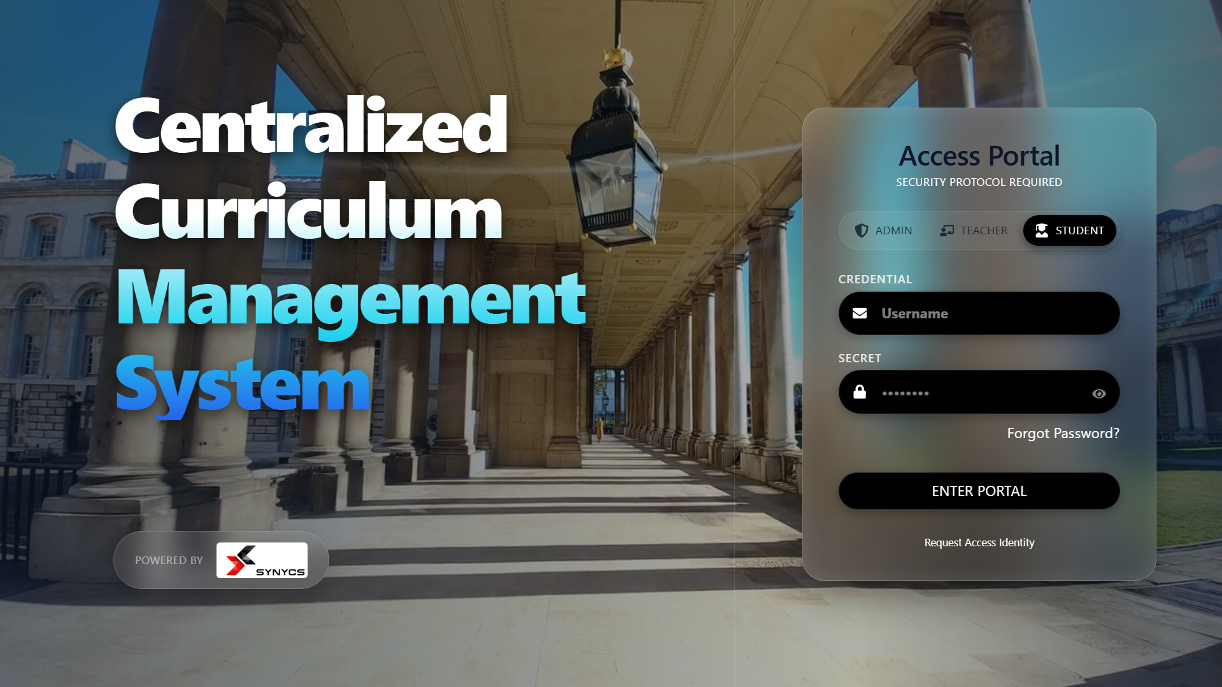
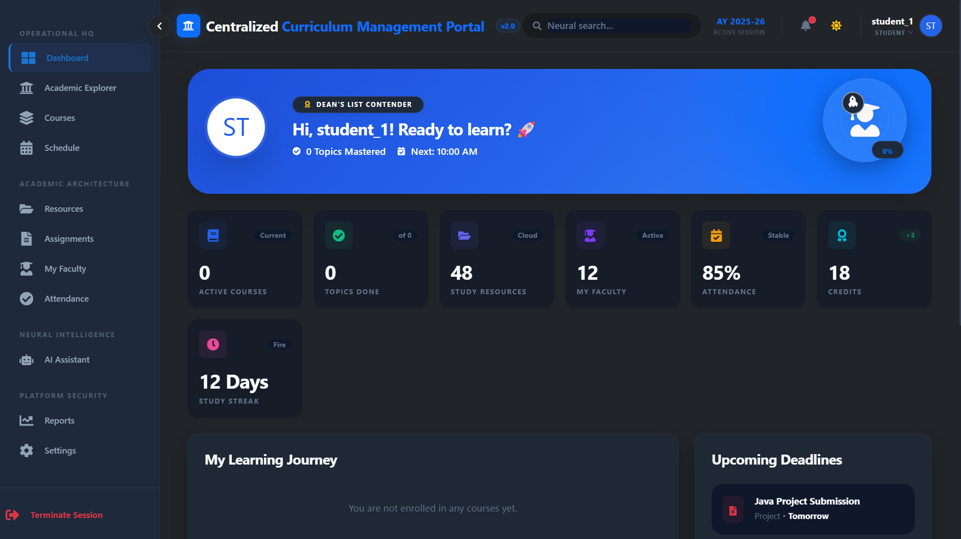
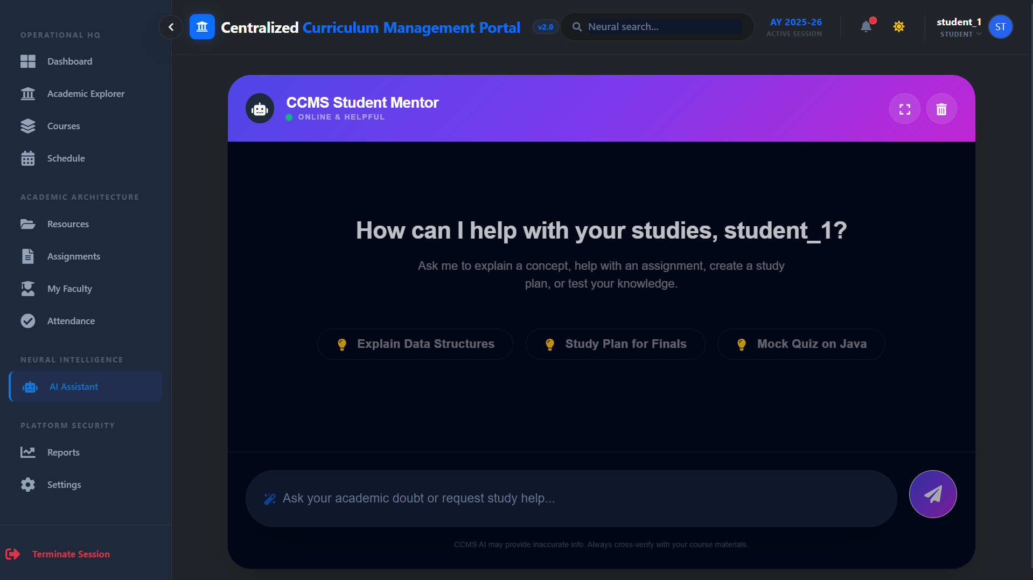
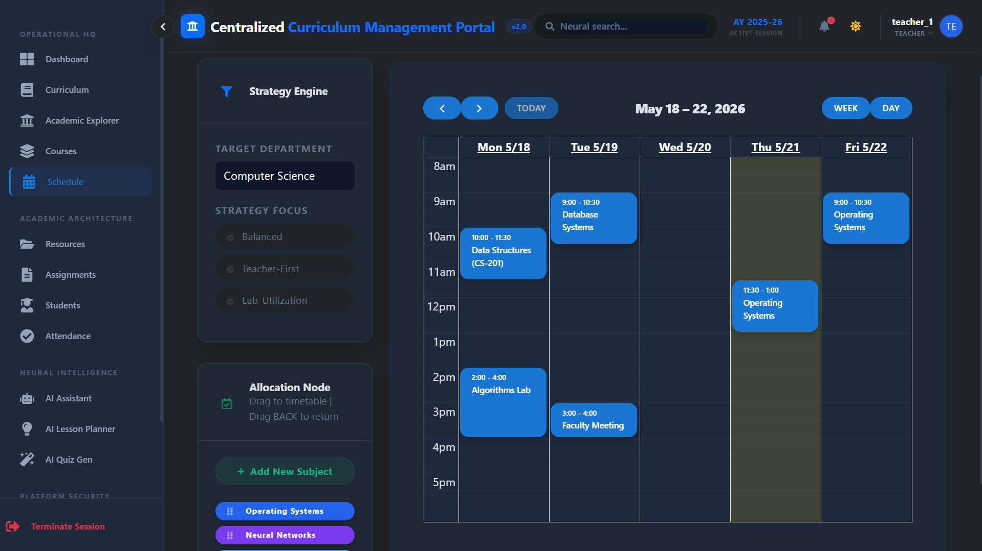
Project Gallery
11

Slide 12

Future Roadmap
12
PHASE 1 — Q3 2025
Blockchain Certificates
Tamper-proof, decentralized academic certificate verification on distributed ledger
PHASE 2 — Q1 2026
Face-ID Attendance
Real-time biometric attendance tracking using AI facial recognition technology
PHASE 3 — Q3 2026
Predictive Placement Analytics
AI-driven career forecasting & placement probability scoring for each student

Slide 13
13
Centralized Curriculum Management System
is not just a tool — it's the future of education.
Centralized Curriculum · AI Intelligence · Enterprise Scale
🙋 Q & A
📧 Contact: akhil.megavath03@gmail.com
💻 GitHub: github.com/akhilkumar
Presented by Akhil Kumar | SYNYCS

