Slide 1
Enhancing NSGA-II for Multi-Objective Combinatorial Optimization Problem : Balanced Squad for IPL
Presenter’s Name: Chittireddy Akhil Reddy
Roll Number: 20MA20019
Supervisor: Prof. Adrijit Goswami
Institute: Indian Institute of Technology Kharagpur
Date: November 13, 2024

Slide 2
Introduction
Context: The Indian Premier League (IPL) is known for its intense competition and high stakes, where every franchise aims to build the most balanced and powerful squad. Selecting a team that can excel in both batting and bowling, while adhering to budget and role-based constraints, is a challenging multi-objective problem that requires a data-driven approach.
Problem: Franchises face a complex problem when building their squads. They need to balance multiple objectives—maximizing batting and bowling strengths—while managing constraints like salary caps, player roles, and league regulations. Traditionally, squad selection relies on subjective judgment, which doesn’t always lead to the most optimal teams.
Objective: The goal of this project is to enhance the NSGA-II algorithm for multi-objective optimization to select IPL squads systematically. By maximizing both batting and bowling performance within constraints, we aim to help teams achieve better balance and performance on the field.

Slide 3
Motivation
Challenges: Building an IPL squad involves balancing multiple conflicting goals:
Role Balance: Ensuring an optimal mix of batters, bowlers, and all-rounders.
Performance Metrics: Maximizing batting and bowling efficiency based on historical data.
Budgetary Constraints: Staying within the franchise's budget cap while acquiring top players.
Current Approaches: Traditionally, squad selection relies heavily on intuition, experience, or scouting reports. These approaches don’t adequately consider the multi-dimensional trade-offs needed for optimal squad composition, often leading to imbalances in the team.
Solution Offered: By applying a data-driven optimization method, specifically an Enhanced NSGA-II algorithm, we can systematically address these challenges. This approach allows us to generate a variety of optimal squad configurations, providing franchise decision-makers with clear trade-offs to build balanced and high-performing teams.

Slide 4
NSGA-II Algorithm Basics
What is NSGA-II?
NSGA-II (Non-dominated Sorting Genetic Algorithm II) is a popular multi-objective optimization algorithm.
It’s well-suited for problems that require trade-off analysis across multiple objectives, making it ideal for complex, combinatorial optimization tasks like squad selection.
Core Concepts of NSGA-II:
Non-dominated Sorting: Organizes solutions into Pareto fronts based on dominance. Solutions in the first front are the best, with each subsequent front representing lower-ranked solutions.
Crowding Distance: A measure to maintain diversity within each front by keeping solutions spread out, avoiding premature convergence.
Genetic Operators: Uses crossover and mutation to evolve a population of solutions, balancing exploration and exploitation for optimal performance.
Why NSGA-II for IPL Squad Selection?
Allows simultaneous optimization of batting and bowling performance while considering budget and player role constraints.
Generates diverse squads, helping decision-makers evaluate different balanced squad options.

Slide 5


Enhancements to NSGA-II
Why Enhance NSGA-II for IPL Squad Selection?
Traditional NSGA-II lacks specific mechanisms to handle constraints unique to IPL, like budget, player roles, and franchise preferences.
We developed two enhanced NSGA-II variants: BNSGA-II (Binary NSGA-II) and INSGA-II (Integer NSGA-II)
Key Enhancements Introduced:
1) Chromosome Representation:
BNSGA-II uses a binary representation where each gene denotes whether a player is selected.
INSGA-II employs integer values for direct player selection, making constraint handling simpler.

Slide 6
2) Specialized Operators:
BNSGA-II: Uses two-point crossover and swap mutation for genetic variation.
INSGA-II: Uses partially mapped crossover and random mutation for a diverse population.
3) Constraint Handling & Repair Mechanism:
Maintains feasible solutions by repairing chromosomes that violate constraints.
Ensures balanced squads with the right mix of batters, bowlers, and all-rounders.
Goal of Enhancements: To create feasible, optimized squads that represent a range of balanced trade-offs across performance, cost, and player roles.

Slide 7

Problem Formulation
The IPL squad selection problem can be formulated as a multi-objective Knapsack problem, where the objective is to maximize the overall team performance by selecting a set of players subject to budget and selection constraints.
Each squad represents a "Knapsack" with Maximum salary cap (Knapsack Capacity) where each player represents an "item" with a "weight" (auction price) and "profit" (performance value).
Objective: Maximize batting and bowling performance while adhering to IPL regulations.
Batting Performance Factor (BPF):
Combines batting average and strike rate using a weighted formula:
Allows prioritization of either average or strike rate based on chosen weight α.
We used α = 0.6 because the batting strike rate is considered more important than the batting average in the IPL.
Combined Bowling Rate (CBR):
Uses bowling average, economy and strike rate for a holistic evaluation:

Slide 8
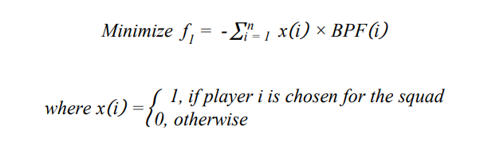
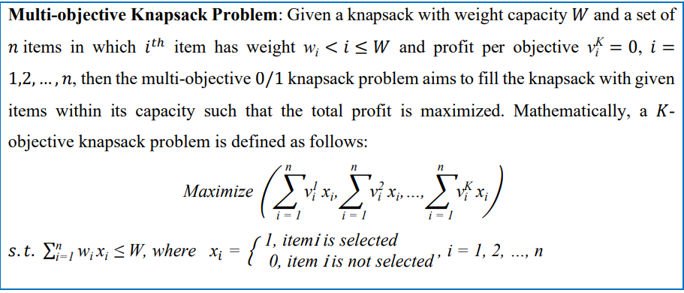
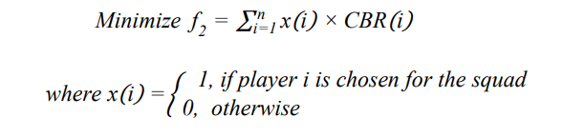
Objective f1​ is to minimize the negative of the Batting Performance Factor (BPF), effectively maximizing batting strength.
Objective f2​ is to minimize the Combined Bowling Rate (CBR), optimizing the bowling strength.

Slide 9
Constraints:
General IPL Constraints:
Salary Cap: Total cost of squad ≤ Rs.95 Cr
Squad Size: Number of players at least 18 and maximum of 25
Overseas Players: Max 8 per squad
Role Requirements: At least one captain and one wicketkeeper
Expertise Bounds (Case 1):
Sum of batters and batting all-rounders ≥ 6
Sum of bowlers and bowling all-rounders ≥ 5
Expertise-Specific Bounds (Case 2):
Pure batters ≥ 5
Pure bowlers ≥ 4​
All-rounders ≤ 5​
Star pure batters ≥ 2
Star pure bowlers ≥ 2
Star all-rounders ≥ 1​
The first case validates the efficiency of the proposed algorithms, and the second case compares the cases of a balanced squad.

Slide 10
Methodology
1. Data Collection:
Auction Data: Collected IPL 2024 auction prices for 244 players participated.
Player Stats: Gathered T20I and IPL data, including batting averages, strike rates, bowling economy, and wickets.
Categorization: Classified players into batters, bowlers, and all-rounders, with further designation of "star players" based on performance thresholds.
2. Player Categorization:
Defined star players by thresholds:
Star Batters: ≥ 1,000 runs in T20I or ≥ 2,000 runs in IPL.
Star Bowlers: ≥ 30 wickets in T20I or ≥ 60 wickets in IPL.
Star All-Rounders: ≥ 300 runs and ≥ 15 wickets in T20I, or ≥ 600 runs and ≥ 30 wickets in IPL.
3. Algorithm Application
Enhanced NSGA-II Variants: Implemented BNSGA-II (Binary NSGA-II) and INSGA-II (Integer NSGA-II).
Steps:
Initialized population based on IPL constraints.
Applied crossover, mutation, and repair mechanisms.
Iterated through generations to evolve diverse trade-off squads.
Output: A set of optimized IPL squads with balanced player roles and adherence to all constraints.

Slide 11
Results
1. Algorithm Performance Comparison
Algorithms Tested: BNSGA-II, INSGA-II, MNSGA-II, RNSGA-II.
Performance Metrics:
Hypervolume (HV): Measures the extent of the Pareto front coverage. Higher HV indicates better diversity and convergence.
Inverted Generational Distance (IGD): Measures the distance between the solutions found and the true Pareto front, indicating convergence quality.
Number of Pareto Solutions (NPS): Reflects diversity within solutions by counting unique Pareto-optimal squads.
Computation Time: Assesses the computational efficiency of each algorithm.
2. Case Comparisons
Case 1: Flexible constraints allowed more all-rounders, resulting in cost-effective and versatile squads.
Case 2: Specific role-based constraints (pure batters, bowlers, and all-rounders) achieved more balanced squads but at a potentially higher cost.

Slide 12
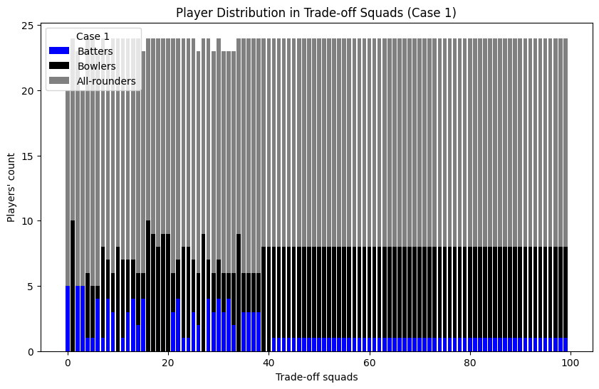
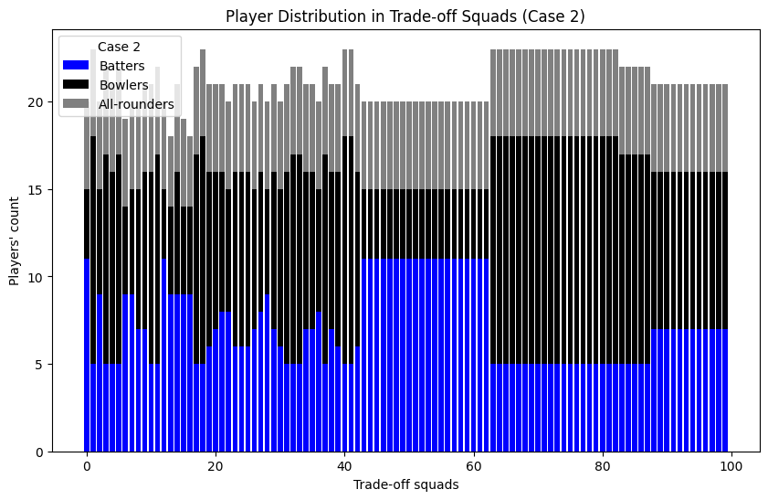

Slide 13
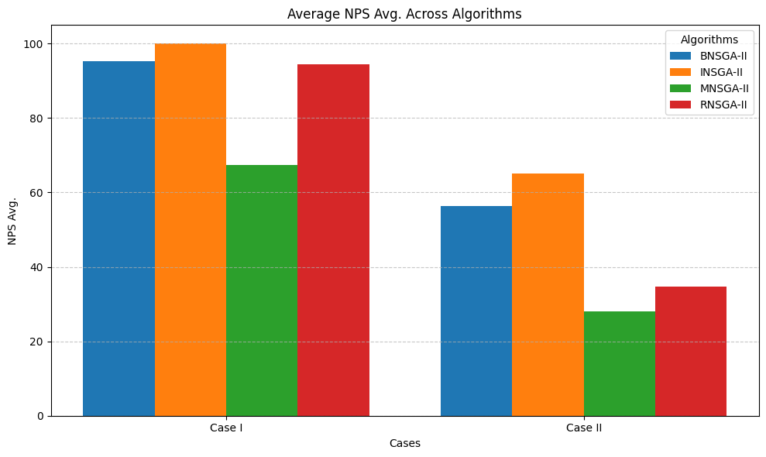
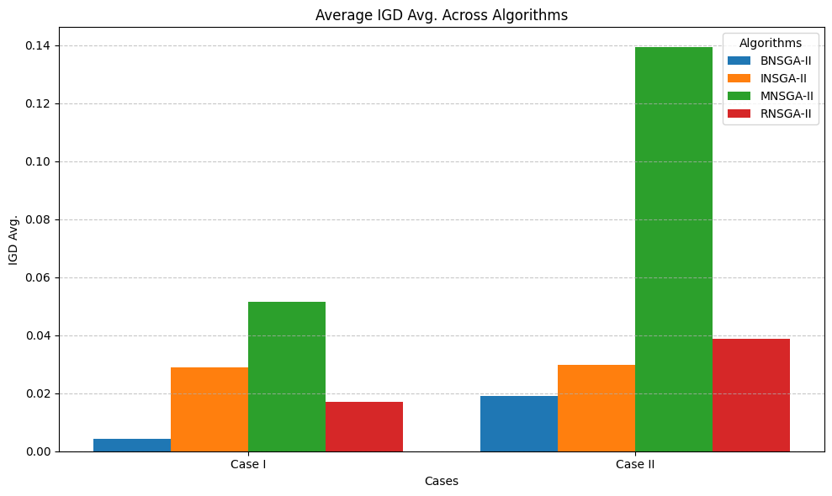
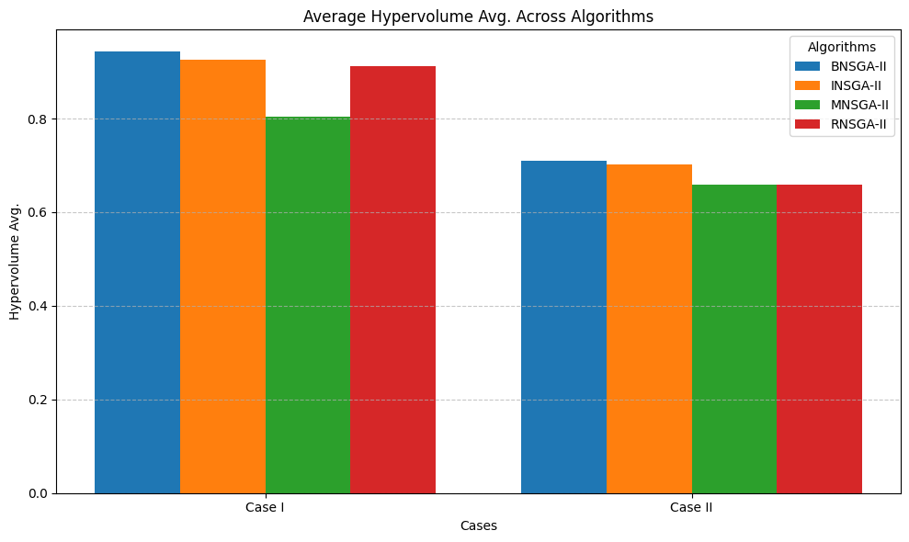
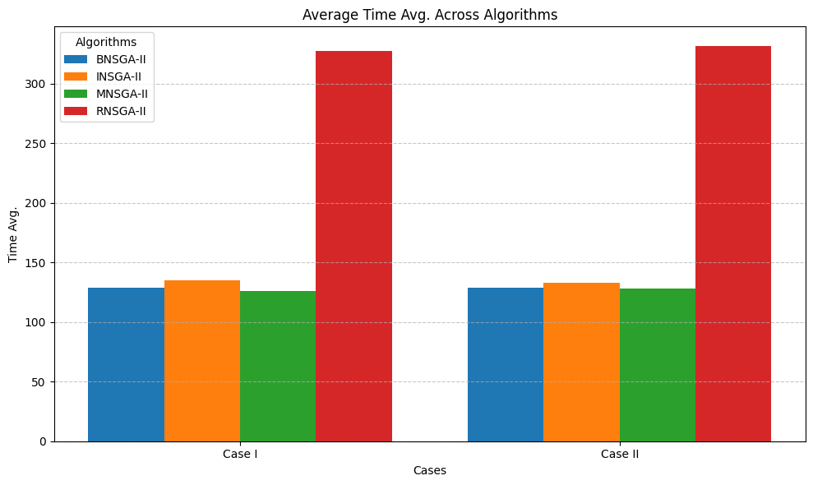

Slide 14
3. Key Observations
Diversity and Convergence: BNSGA-II consistently achieved the highest diversity (NPS) and strong convergence, particularly under flexible constraints (Case I), making it a robust choice for diverse solutions.
Algorithm Efficiency: INSGA-II demonstrated balanced performance across metrics, providing good diversity and convergence with moderate computation time, especially in Case I. However, it struggled slightly with more complex constraints in Case II.
Computation Trade-offs: MNSGA-II had the fastest computation times in simpler cases but offered lower diversity, while RNSGA-II showed reliable convergence under both cases but required the longest computation time, especially with increased constraints.

Slide 15
Squad Composition & Analysis
1. Trade-Off Squads Overview
High Priced Squads: Balanced batting and bowling performances, with a stronger focus on high-profile players.
Low Priced Squads: Prioritizes strong bowling with a limited budget, still meeting all role and performance constraints.
2. Star Player Impact
Squads with higher budget allocations often include more star players, boosting performance metrics due to their superior experience and skills.
Cost-effective squads can still achieve competitive performance by strategically selecting lesser-known players who contribute solidly to batting and bowling.
3. Insights
Case 2 squads, though more costly, align better with traditional team compositions and maintain competitive performance.
Case 1 squads demonstrate flexibility in cost and adaptability with higher all-rounder selection, suitable for diverse game strategies.

Slide 16
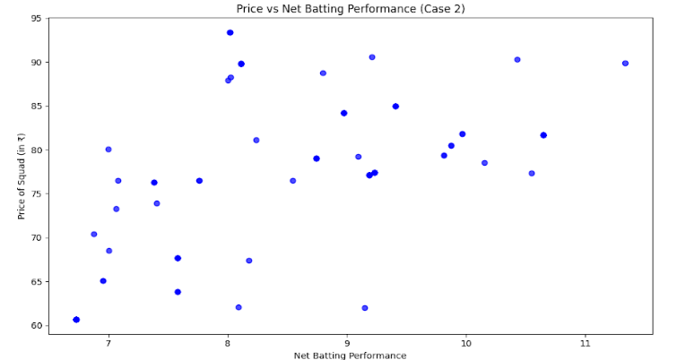
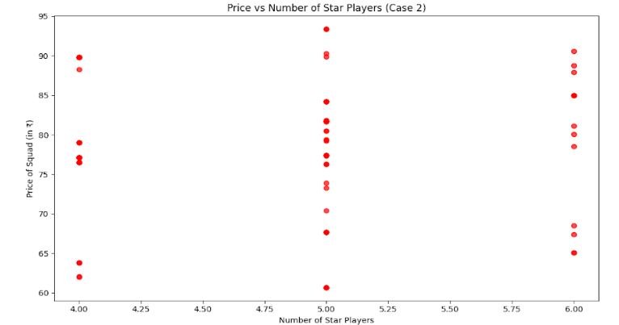
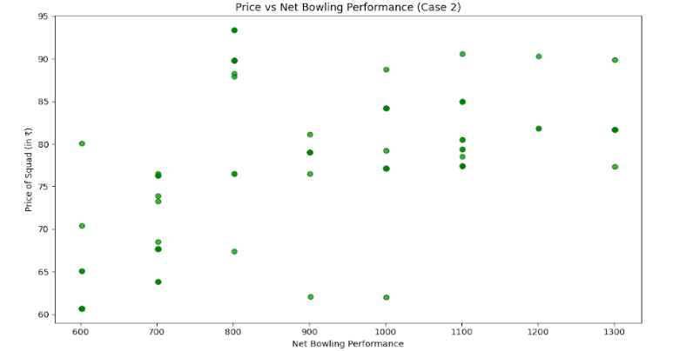

Slide 17
Trade-Off Squads with Preferred Players
Preferred Players Included:
To showcase the flexibility of BNSGA-II, we enforced the inclusion of two high-profile players, Rohit Sharma and Jasprit Bumrah, as fixed members in all final trade-off squads for Case 2. This simulates real-life scenarios where franchises prioritize certain players regardless of their cost.
Example Squads:
Highest Cost Squad:
Players: Rohit Sharma, Jasprit Bumrah, Shreyas Gopal, Mitchell Marsh, Glenn Maxwell, Anuj Rawat, Will Jacks, Suyash Prabhudessai, Rajat Patidar, Prashant Solanki, Shaik Rasheed, Shubman Gill, Vijay Shankar, Mujeeb Ur Rahman, Rinku Singh, Angkrish Raghuvanshi, Harshit Rana, Arshad Khan, Jonny Bairstow, Jitesh Sharma, Shivam Singh, Jos Buttler, Yashasvi Jaiswal, Abhishek Sharma, Nitish Kumar Reddy
Batting Strength: 10.54
Bowling Strength: 1200.85
Total Cost: ₹94.6 crore
Lowest Cost Squad:
Players: Rohit Sharma, Jasprit Bumrah, Tilak Varma, Jason Behrendorff, Arjun Tendulkar, Shreyas Gopal, Mitchell Marsh, Vicky Ostwal, Dinesh Karthik, Suyash Prabhudessai, Sameer Rizvi, Rajvardhan Hangargekar, Prashant Solanki, Tushar Deshpande, Vijay Shankar, Mujeeb Ur Rahman, Vaibhav Arora, Angkrish Raghuvanshi, Harshit Rana, Mohsin Khan, Harpreet Brar, Shashank Singh, Shivam Singh, Yashasvi Jaiswal, Abhishek Sharma
Batting Strength: 6.10
Bowling Strength: 901.28
Total Cost: ₹74.05 crore

Slide 18
Conclusion
1. Summary of Findings
The BNSGA-II algorithm with Case 2 effectively optimizes IPL squad selection, balancing batting and bowling strengths while adhering to budget, player role, and expertise constraints.
Both BNSGA-II and INSGA-II variants demonstrate competitive performance across key metrics, with BNSGA-II achieving better diversity and convergence.
2. Key Insights
Balanced Performance: Squads with strategic role distributions, even on lower budgets, achieve strong results—indicating flexibility in squad composition.
Case Comparisons:
Case 1 emphasizes all-rounders, allowing versatile line-ups with fewer pure specialists.
Case 2 yields traditional role distribution, providing balanced squads with designated batters, bowlers, and all-rounders.
Cost-Effective Strategies: Lower-budget squads can remain competitive by focusing on emerging players rather than high-cost stars.

Slide 19
3. Future Directions
Refinement & Adaptation: Apply this approach to other sports leagues or team selection scenarios.
Incorporate Dynamic Data: Integrate real-time performance data to adapt squads across different IPL seasons or tournaments.
Additional Player Metrics: Explore deeper performance analytics for more refined selections.
4. Closing Statement
The Enhanced NSGA-II approach provides IPL franchises with a robust, data-driven tool for assembling cost-efficient, high-performing squads, paving the way for more objective team-building strategies in professional sports.

Slide 20
References
[1] S. Verma, Enhancing NSGA-II for Multi-Objective Combinatorial Optimization Problems, Ph.D. Thesis, Department of Applied Mathematics and Scientific Computing, Indian Institute of Technology Roorkee, Roorkee, India, April 2024.
[2] K. Deb, A. Pratap, S. Agarwal, and T. Meyarivan, “A fast and elitist multiobjective genetic algorithm: NSGA-II,” IEEE Trans. Evol. Comput., vol. 6, no. 2, pp. 182–197, Apr. 2002.
[3] V. Lunawat, Sport and development in India: Professional sport league systems, Routledge, 2021.
[4] N. Riquelme, C. Von Lücken, and B. Barán, “Performance metrics in multi-objective optimization,” in 2015 Latin American Computing Conference (CLEI), 2015, pp. 1–11.
[5] F. Ahmed, K. Deb, and A. Jindal, “Multi-objective optimization and decision making approaches to cricket team selection,” Appl. Soft Comput. J., vol. 13, no. 1, pp. 402–414, Jan. 2013.
[6] S. Chand, H. K. Singh, and T. Ray, “Team Selection Using Multi-/ManyObjective Optimization with Integer Linear Programming,” in 2018 IEEE Congress on Evolutionary Computation (CEC), 2018, pp.
[7] G. D. I. Barr and B. S. Kantor, “A criterion for comparing and selecting batsmen in limited overs cricket,” J. Oper. Res. Soc., vol. 55, no. 12, pp. 1266–1274, Dec. 2004.
[8] K. Deb, A. Pratap, S. Agarwal, and T. Meyarivan, “A fast and elitist multiobjective genetic algorithm: NSGA-II,” IEEE Trans. Evol. Comput., vol. 6, no. 2, pp. 182–197, Apr. 2002.
[9] S. Martello and P. Toth, Knapsack Problems: Algorithms and Computer Implementations, John Wiley Sons, 1990.

Slide 21
THANK YOU

