Slide 1
Git & It’s Usage

Slide 2
What is Git?
Git is a software that is used for Version Control. Version control systems are a category of software tools that help a software team manage changes to source code over time. Version control software keeps track of every modification to the code in a special kind of database. If a mistake is made, developers can turn back the clock and compare earlier versions of the code to help fix the mistake while minimizing disruption to all team members.
There are two types of VCS:
Centralized Version Control System (CVCS)
Distributed Version Control System (DVCS)
Git is a free and open source distributed version control system designed to handle everything from small to very large projects with speed and efficiency.

Slide 3
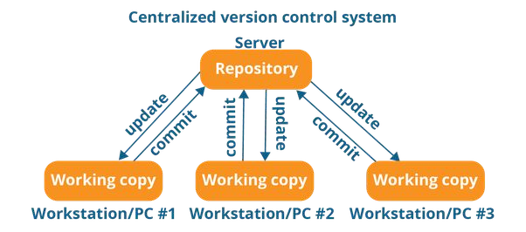
CENTRALIZED VERSION CONTROL SYSTEM

Slide 4
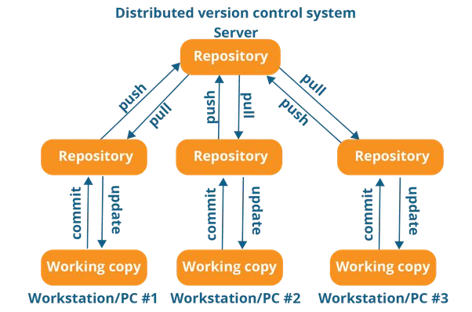
DISTRIBUTED VERSION CONTROL SYSTEM

Slide 5
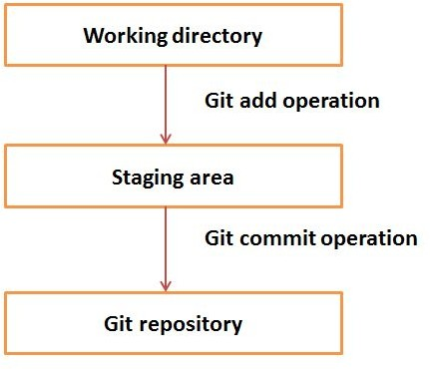

Slide 6

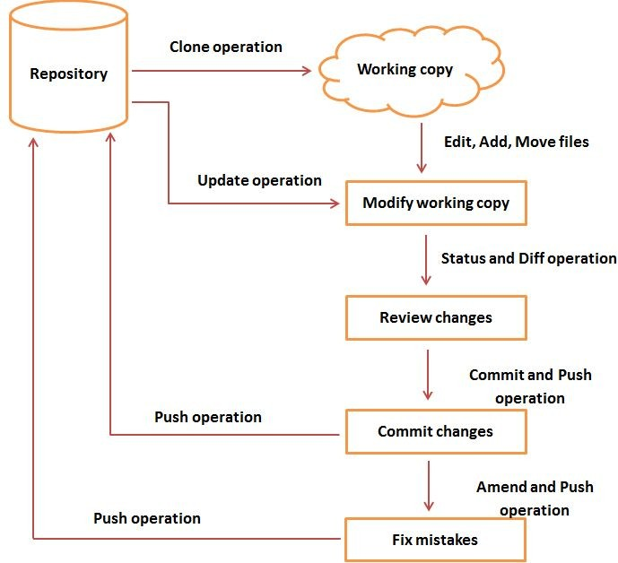

Slide 7
GUI Clients
Git comes with built-in GUI tools for committing (git-gui) & git-bash, but there are several third-party tools for users looking for platform-specific experience.
Other Tools:
SourceTree ---popularly used
GitHub Desktop ---popularly used
TortoiseGit ---popularly used
Git Extensions
GitKraken
SmartGit
Tower
GitEye
Gitg
Ungit
Few more….
Notes:
https://git-scm.com/download/gui/windows

Slide 8
BASIC OPERATIONS IN GIT
Initialize
Add
Commit
Pull
Push
Merge

Slide 9
Git configuration commands
Config is used to customize your Git environment.
To set your user name and email address.
$ git config --global user.name “akhil”
$ git config --global user.email “akhil.bommarapu@ggktech.com”
● To check your settings.
$ git config --list

Slide 10
Git Cheat Sheets
https://education.github.com/git-cheat-sheet-education.pdf
https://gist.github.com/hofmannsven/6814451
https://www.atlassian.com/git/tutorials/atlassian-git-cheatsheet
Ref url to practice git commands without real git account:
https://try.github.io/levels/1/challenges/3

Slide 11
To create a new repository
Create a directory :
$ mkdir name
Then initialize it to git repository
$ git init
Otherwise,
$ git init [project-name]

Slide 12
Cloning the Remote Repository
Initialize an existing directory as a Git repository
$ git init
To clone the repository from remote :
$ git clone <repository Url> Ex: git clone https://github.com/ns-poc/fit-track.git

Slide 13
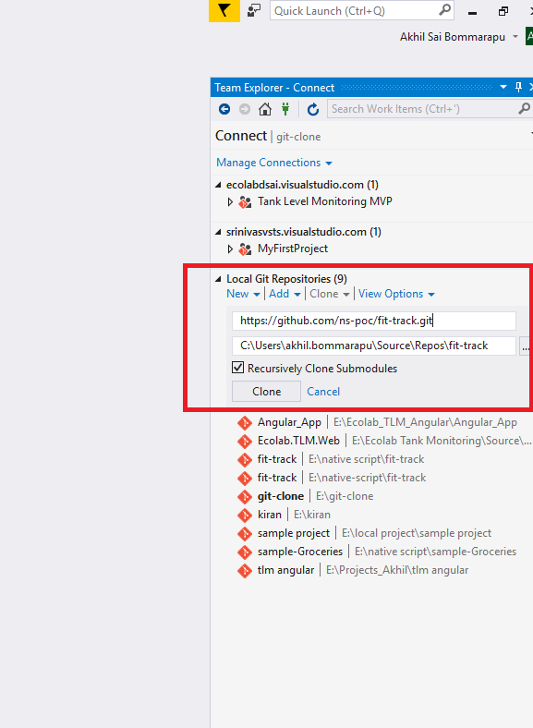
Clone the Project from Git Repository using VS
Steps to Clone the Repository using VS:
Select Team Explorer Menu in VS
Select Clone Operations from “Local Git Repositories” Menu.
Write/Paste the Git URL Link and select the path where to clone the project.

Slide 14
Fetching a remote repository
To grab a complete copy of another user's repository
$ git clone [url]
To retrieve new work done by other people without merging those changes into your own branches.
$ git fetch remotename/branchname
Merging combines your local changes with changes made by others.
$ git merge remotename/branchname
Pull is a convenient shortcut for completing both fetch and merge in the single command:
$ git pull remotename branchname

Slide 15
Branch commands
Branching is the way to work on different versions of a repository at one time
Creating a new branch
$ git branch [branch-name]
Switches to the specified branch and updates the working directory
$ git checkout [branch-name]
To create a new branch and switches to the new branch
$ git checkout -b [branch-name]
Lists all local branches in the current repository $ git branch
Rename a branch
$ git branch -m branchname new_branchname or $ git branch --move branchname new_branchname

Slide 16
Staging and Commit
Staging files from directory
$ git add [filename]
$ git add .
$ git reset [file]
to add specific file to add all files
Unstage the file, but preserve its contents
To Commit:
$ git status Lists all new or modified files to be committed.
$ git commit -m "[descriptive message]"

Slide 17
Merge & delete branch
Shows content differences between two branches
$ git diff [first-branch]...[second-branch]
Combines the specified branch’s history into the current branch
$ git merge [branchname]
Deletes the specified branch
$ git branch -d [branch-name]

Slide 18
To create and edit file
Create a single (empty) file in the current directory:
$ touch FileName
To open and edit a file
$ start FileName

Slide 19
Review history commands
Lists version history for the current branch
$ git log
Lists version history for a file $ git log --follow [file]
Show working tree status and ignore untracked files
$ git status

Slide 20
Undo commands
Go back to commit: git revert 073791e7dd71b90daa853b2c5acc2c925f02dbc6
Soft reset (move HEAD only; neither staging nor working dir is changed): git reset --soft 073791e7dd71b90daa853b2c5acc2c925f02dbc6
Undo latest commit: git reset --soft HEAD~
Mixed reset (move HEAD and change staging to match repo; does not affect working dir): git reset --mixed 073791e7dd71b90daa853b2c5acc2c925f02dbc6
Hard reset (move HEAD and change staging dir and working dir to match repo): git reset --hard 073791e7dd71b90daa853b2c5acc2c925f02dbc6
Undoes all commits after [commit] preserving changes locally
$ git reset [commit]

Slide 21
Stash commands
The command saves your local modifications away and reverts the working directory to match the HEAD commit.
$ git stash
To list modifications stashed .
$ git stash list
To inspect stash
$ git stash show
To restore modifications
$ git stash apply

Slide 22
Misc
Source Tree
Patch and apply
Auto Merge, Merge Conflicts
Diff Merge
Points to remember
Check box: Push changes immediately

Slide 23


