Slide 1
SCRAPY
HTTP & HTTPS

Slide 2
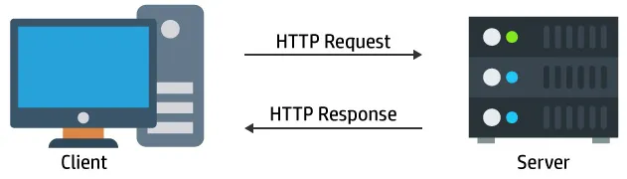
HTTP
HTTP stands for Hypertext Transfer Protocol.
HTTP is used to transfer files & data on www (World Wide Web).
HTTP communication usually takes place through TCP/IP
HTTP is used to make communication between client and server.

Slide 3
HTTP
HTTP is connectionless. So both client and server know about each other during the current request and response only.
HTTP is media independent. HTTP can deliver any sort of data, as long as the two computers can read it.
HTTP is stateless. The client and server just know about each other just during the current request.
The standard port for HTTP is 80 and first version is HTTP/0.9
HTTP does not have any security.

Slide 4
HTTP METHODS
GET - It is used to retrieve data from server
POST - It is used to send data to the server
PUT - It is used to update the data which is already exist on the server
DELETE - It is used to delete data from the server

Slide 5
HTTP STATUS CODES
1xx - Informational
2xx- The request was successful
3xx- The client is redirected to a different source
4xx- The request contains an error or incorrect syntax
5xx- The server encountered an error fulfilling the request

Slide 6
HTTPS
HTTPS stands for Hypertext Transfer Protocol Secure.
HTTPS provides encrypted communication between client and server by using SSL (Secure Socket Layer) or TLS (Transport Security Layer)
The standard port for HTTPS is 443 and first version is HTTP/1.1
Both TLS and SSL uses asymmetric encryption system. Asymmetric encryption uses a public key (encryption key) and private key (decryption key).
Public key is used to encrypt message and private key is used to decrypt message.

Slide 7
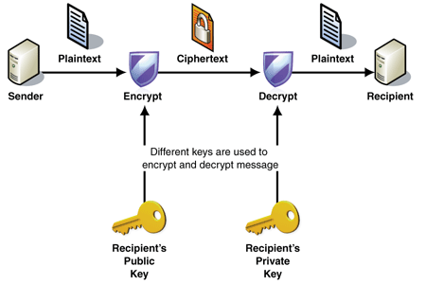
HTTPS
By using this technique we can protect data from MITM (Man In The Middle) attacks

Slide 8
SCRAPY
Scrapy is a high-level & fast application framework used for web crawling and web scraping.
It can be used for wide range of purposes from data mining to data monitoring and automated testing.
Scrapy was originally designed for web scraping, but it can also be used to extract data using APIs.
Scrapy is maintained by Zyte (former Scrapinghub)
https://docs.scrapy.org/en/latest/index.html

