Slide 1
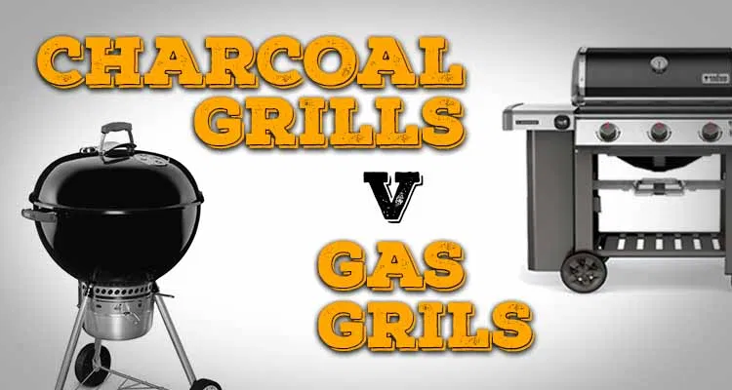
Case study
- Akhil Somalanka

Slide 2
Naming of Files
Sheet A – Grill Overview
Sheet B – Different food grills and overview
Sheet C – Sample Tastings

Slide 3
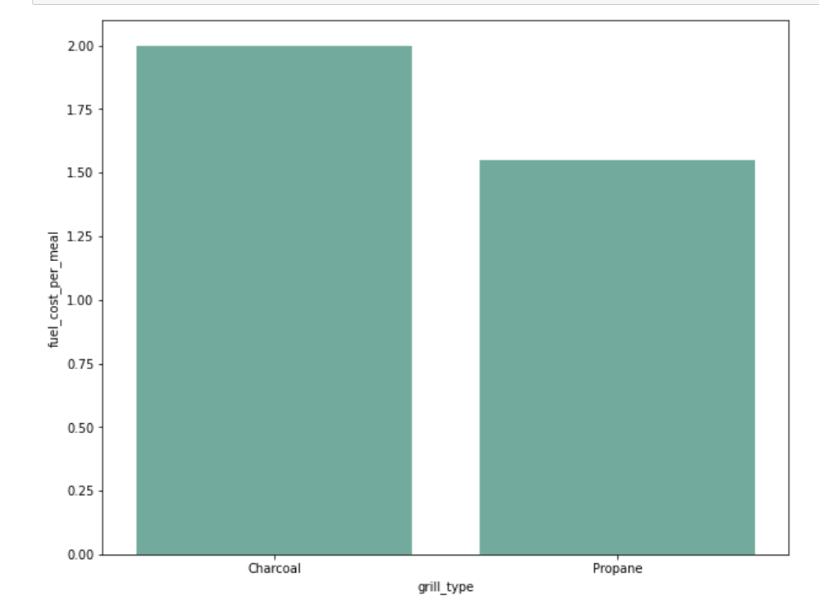
Fuel Efficient grillrill
Based on the visualization, we can directly infer that Propane Grill type is more fuel efficient than Charcoal. Propane is more efficient and saves 0.45 per meal.
We can conclude that even though the difference is negligible per meal, it would affect the user in the long run.

Slide 4
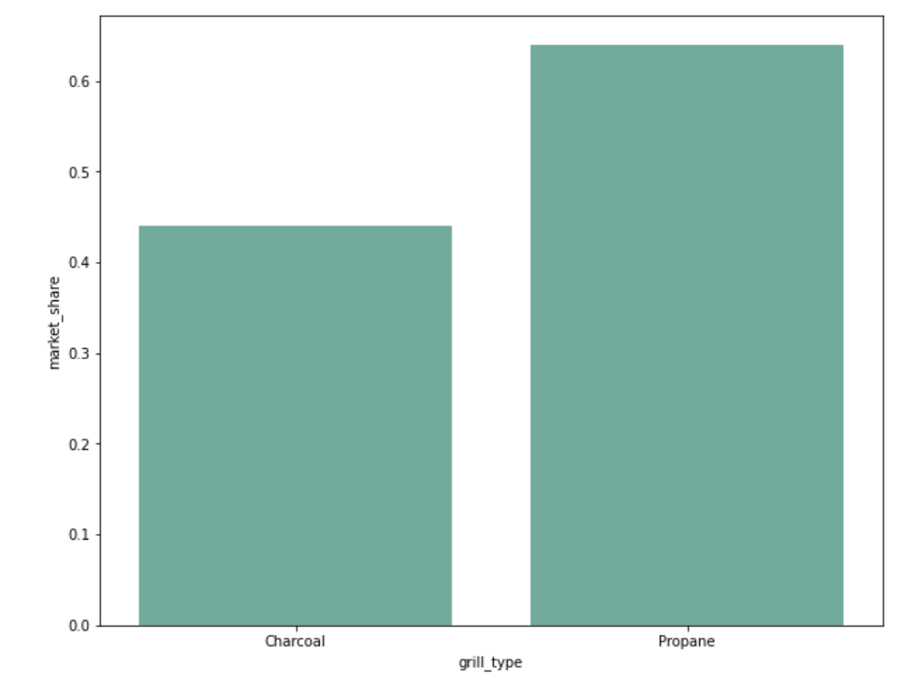
Better market share grillket Share Grill
Based on the given data, and direct relation between grill_type and market_share we can infer, Propane has the larger market share. (0.64)
The above inference can also be made from the video, where it’s mentioned, 64% of the sample data would use Propane.

Slide 5
Fuel cost on long run
Based on the cookoff data, it wasn’t clear to infer.
So, I have transformed the data, such that I have done groupby item_material and found out the mean for each grill type, i.e. I have found out the mean for fuel_cost for Ground Beef Patty in Grill type – Charcoal.
After this transformation, I compared each individual item_material against it’s different grill_type, i.e. fuel_cost(Ground Beef Patty, Grill = Charcoal) v/s fuel_cost(Ground Beef Patty, Grill = Propane)

Slide 6
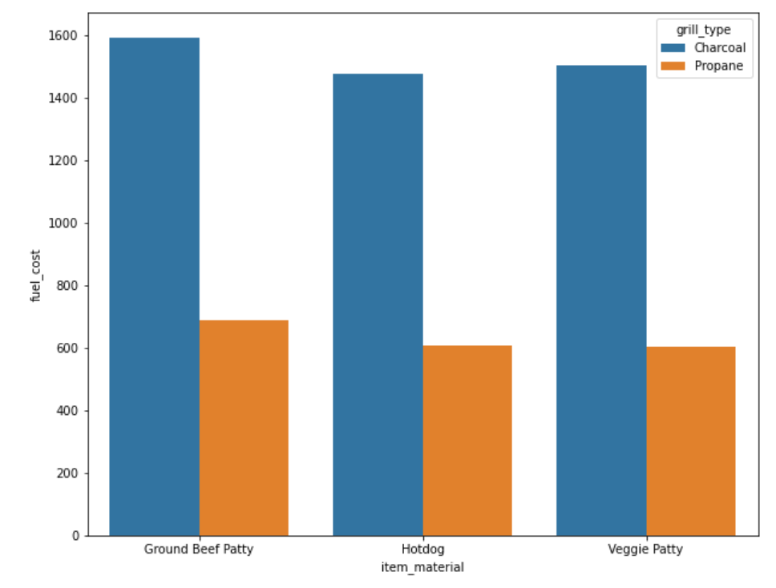
So, instead of generalizing, I have compared each item_material and inferred fuel cost on long run.
Assuming the only items that are grilled are – Ground Beef Patty, Hotdog, Veggie Patty, Charcoal grill will give us better fuel cost

Slide 7
Grill | Fuel Cost Per meal | Initial Investment
Charcoal | 2$ | 91$
Propane | 1.55$ | 139$
After 107 meals assuming, by given data
Grill | After 107 meals
Charcoal | 2*107 + 91 = 305
Propane | 1.55 * 107 + 139 = 304.85
By the given data, a normal American Household would grill 107 meals over a span of 6.5 years

Slide 8
Smarter investment?
Considering the average American buys new grill every 3 years, the initial investment, Charcoal is lower- 91$, but the food per meal - Charcoal, i.e. 2$.
And, by the given information we know we would be needing 107 meals, so the two grills breakeven, else Charcoal would cost less.
By the given data, a normal American household cooks on grill during weekends, and it would take 6.5 years to cook 107 meals, so going by the stats, we can say for a normal American Household if he changes grill every 3 years, Propane would cost more.
Else, if the household cooks 107 meals in less than 3 years, then it would be better to go with Propane.

Slide 9
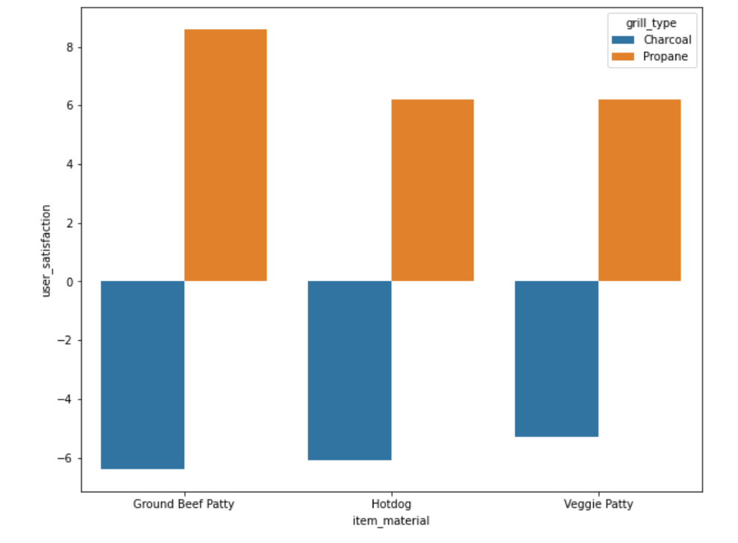
User satisfaction
Performing similar transformations, calculating the mean of user_satisfaction for individual item_material according to the grill type and comparing it with different grill type.

Slide 10
Recommendations
Yes, the recommendations are different. I would suggest the Charcoal manufacturers to make sure to improve the easy of use, and to come up with a lower fuel cost per meal.
I would recommend the user to buy accordingly for a long term grilling or short term, i.e. if they plan on using it on weekends and once in a month, Charcoal would cost them lower, where taste is subjective.

Slide 11
Technologies used
Python – Scripts
Seaboran, pyplots, excel –visualization
Transformations – Python
Aggregation - Python

