Slide 1
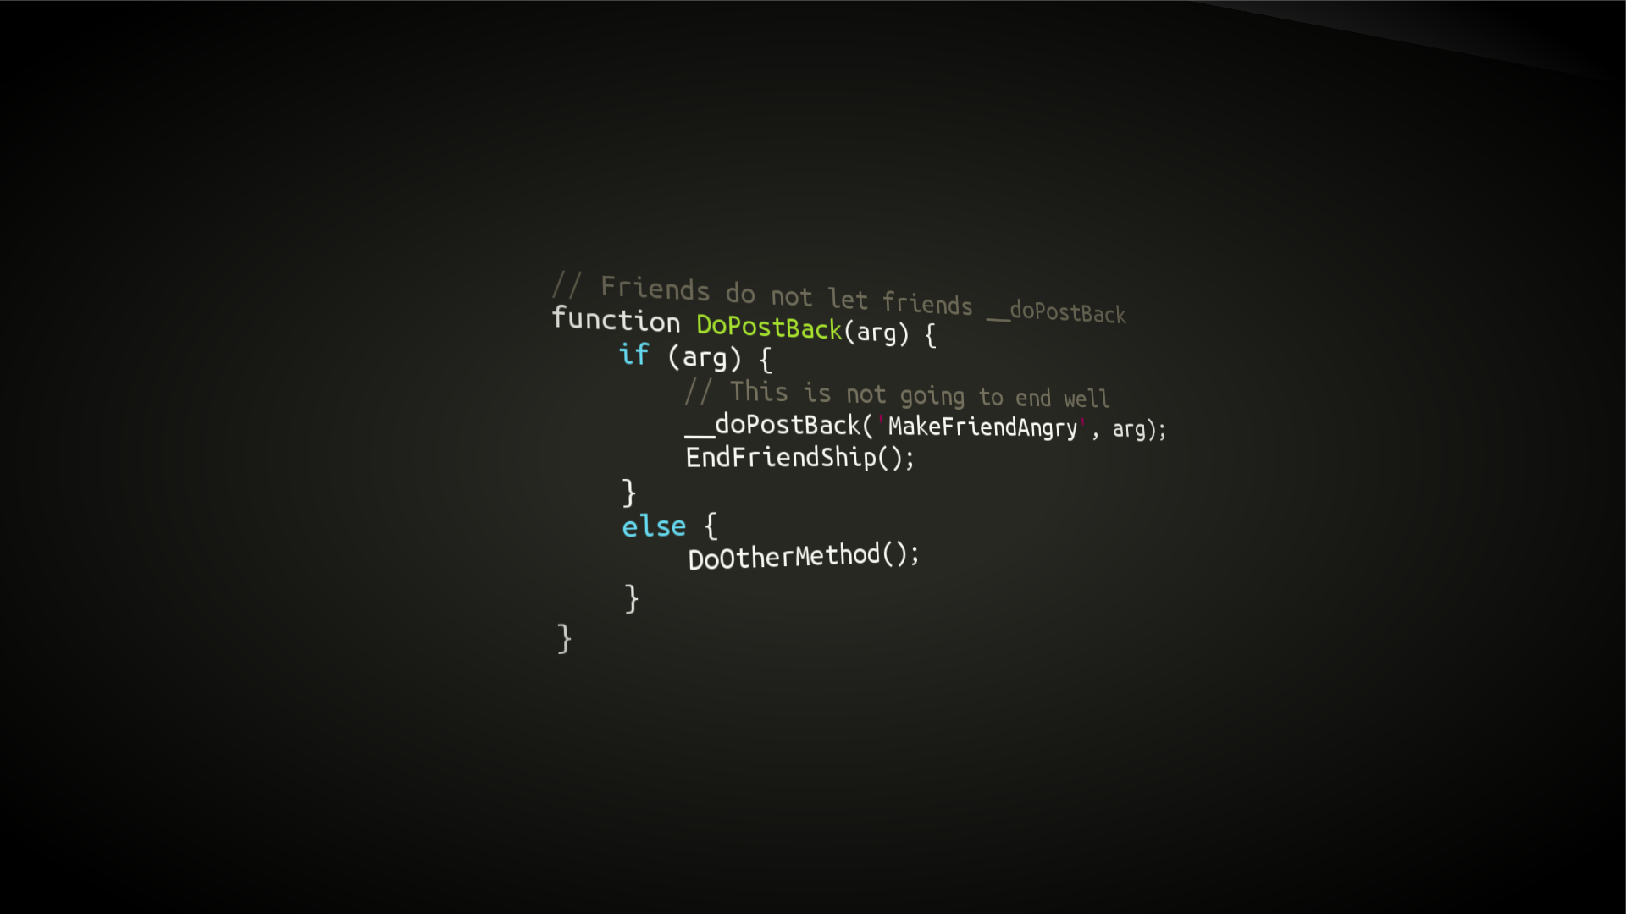
Programming
This is what it looks like :)

Slide 2
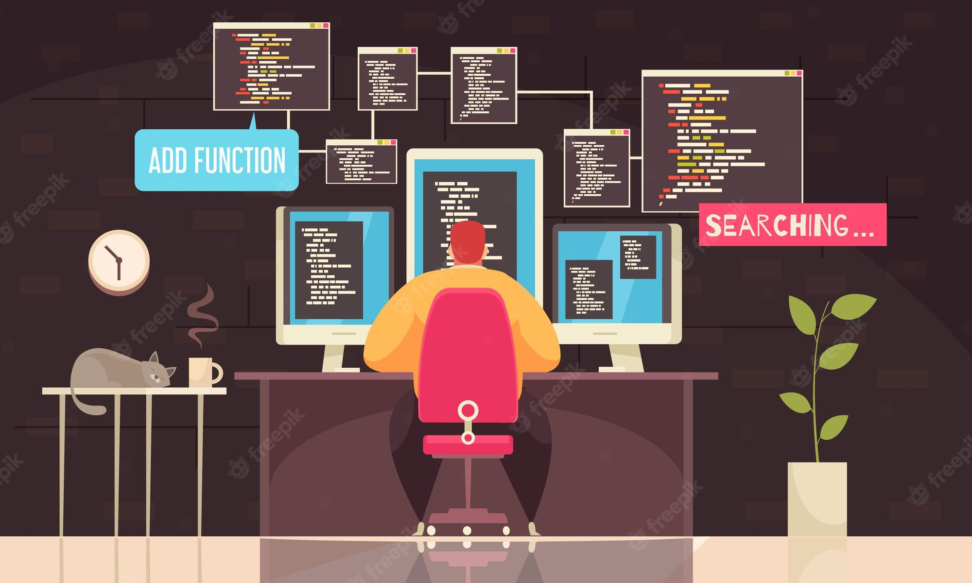
What is programming ?
Writing a set of instruction for a computer to process and give an output.
Every instructions is holding data as numbers.
A Computer understands a set of instructions as machine code.

Slide 3

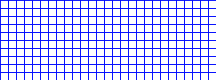
How Numbers ?

Slide 4
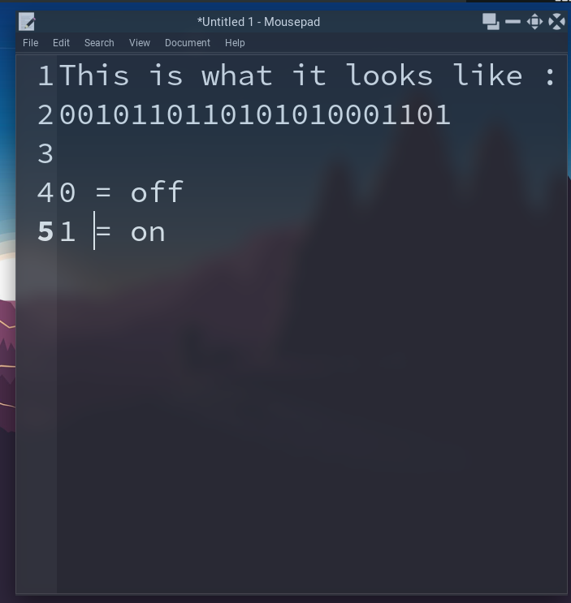
How does it understand ?
The Processing is done by the CPU/Processor.
A processor has billions of tiny registers.
each register can read ‘on’ and ‘off’ signal.
the combination of on/off signal gives an output number.
Each computer program has to be compiled before use.
A compiler converts human readable code into machine code.
The most popular and most used compiler is GCC (GNU C compiler).

Slide 5
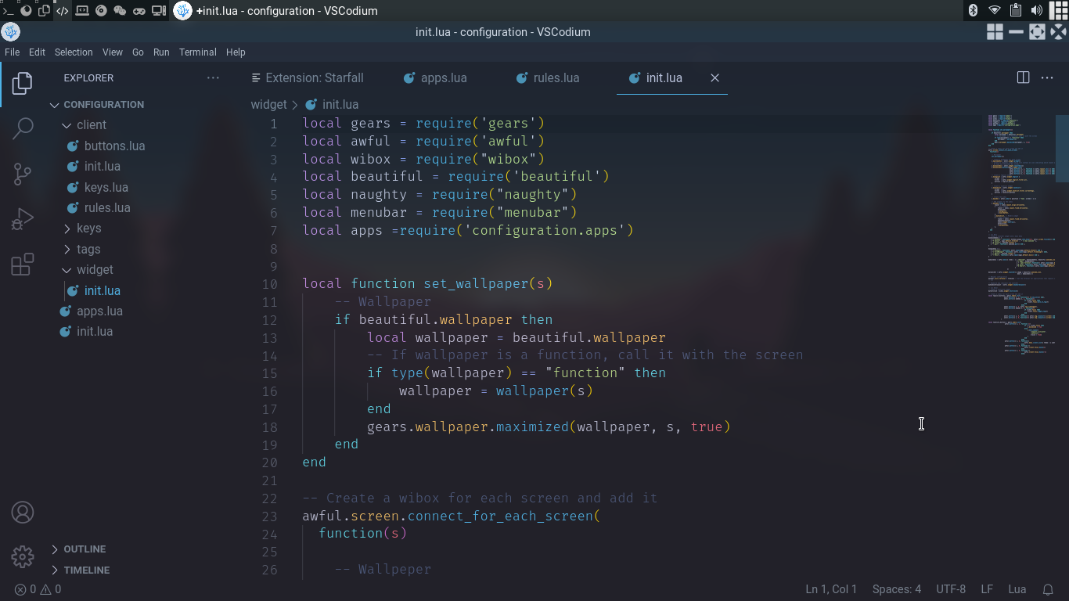
Basics

Slide 6
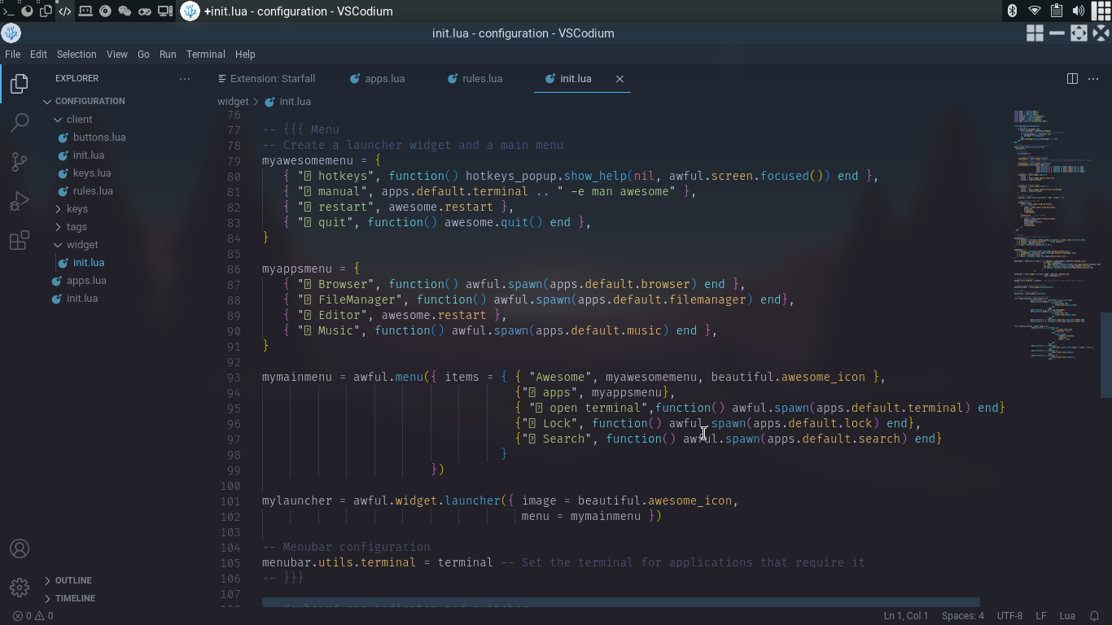
Basics #2

Slide 7
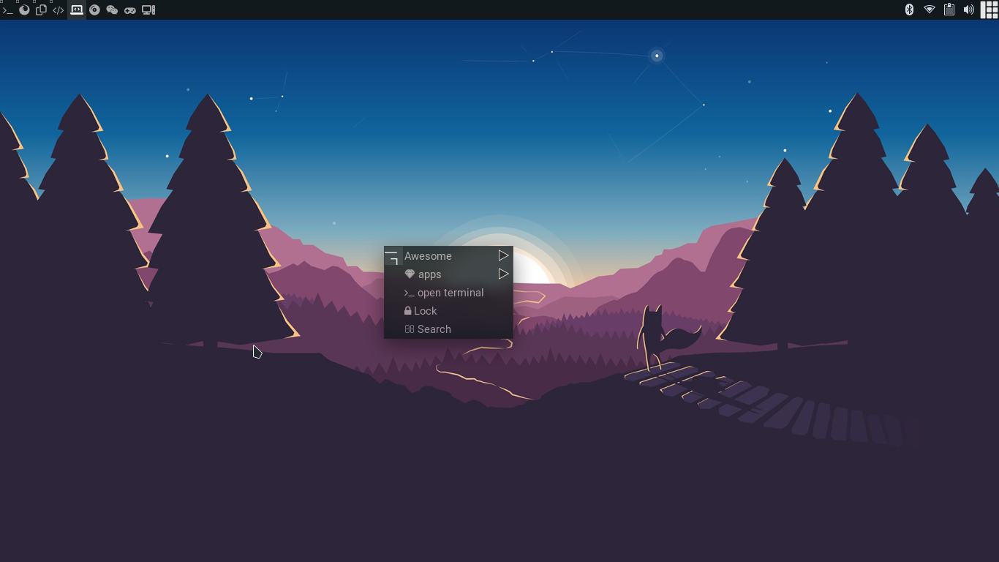
Output

Slide 8
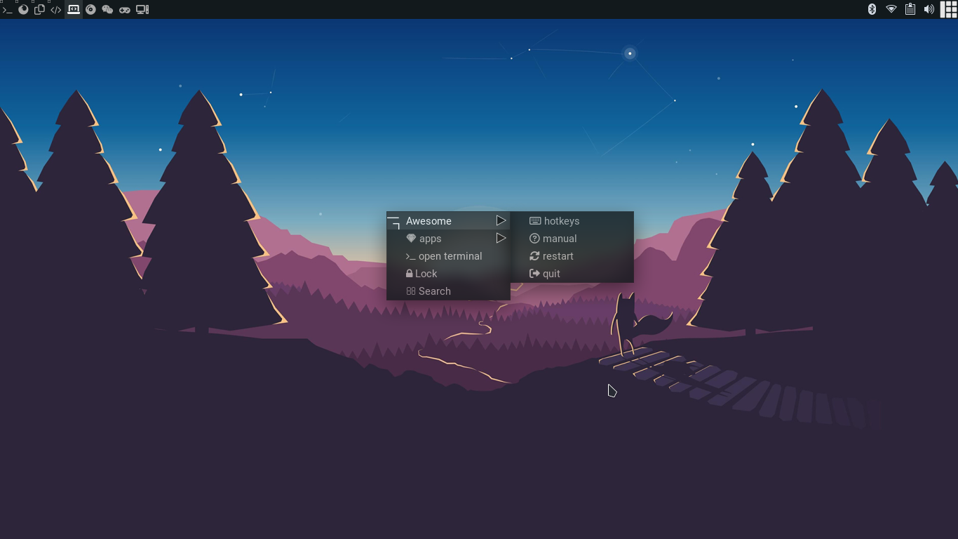
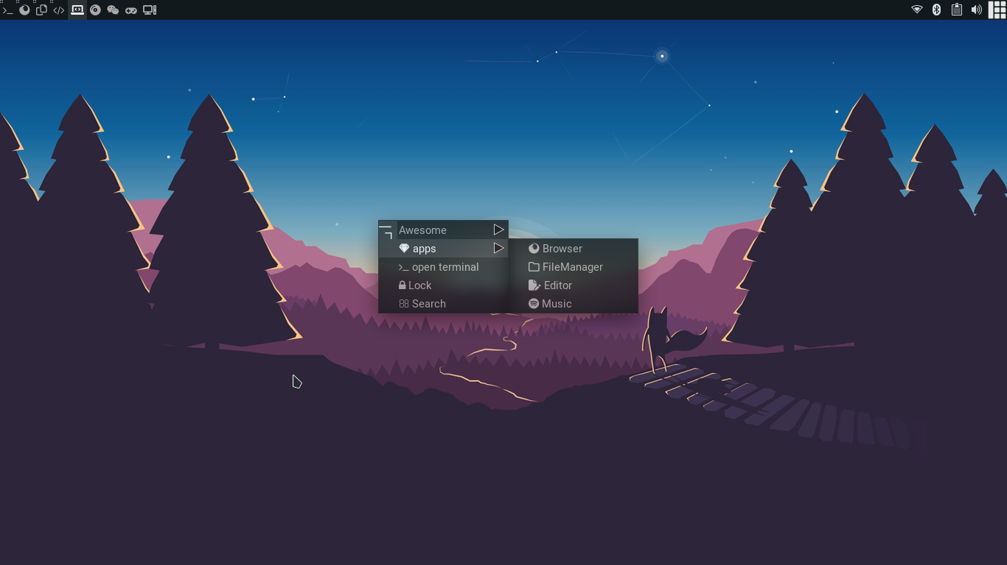
Output #2

Slide 9
Recommendation
For Beginners C#
For Game development Unity Game Engine and C#
For making apps (PC apps only) Lua
For web development JavaScript, CSS and html
Whichever you choose some day later you have to learn C
My Recommendation is learn the unity game engine and C#.

Slide 10
Useful
Game Development
Search for a youtuber called Brackyes.
The are a team of professional game developers and probably the best game development youtuber.
They make very informative, detailed and beginner-friendly videos about making games in in the unity game engine.
Learning about new languages
Search for a youtuber called fireship.
They make short 100s videos about different coding languages and share some experience and thoughts on it.

Slide 11

Thank you
This is my favorite wallpaper
Make my Akhilesh
Akhilesh is the best :)

