Slide 1



Twitter Sentiment Analysis for Predicting Stock Market Trends
Team Purple :​
Akhilteja Jampani​
Chaturya Gajula​
Santosh Kumar Velgapuri​
Siddhidhatri Rohith Reddy Jaggari

Slide 2
Recollecting Business Statement
We see much news on Twitter; many people comment and talk about different things. It needs to be clarified if these things affect the companies involved. In our project, we look at tweets to see what people say about different companies. Later, we do a sentimental analysis of those tweets to find out how people feel about those companies. The next step is to see if these tweets change the price of a company's stock. If they are making a difference, we will see if there is a clear pattern. In other words, the main goal of our project is to find out if there is a link between what people are saying on Twitter and how the stock market moves.

Slide 3
Recollecting Objectives
Collecting a large dataset of tweets related to specific stocks or the overall stock market.
Preprocessing the text data using Pyspark's NLP libraries to clean text data.
Developing a sentiment analysis model using Pyspark's machine learning libraries, such as MLlib or TensorFlow, to classify tweets as positive, negative, or neutral.​
Creating visualizations to present the sentiment analysis results and stock market trends using tableau.
Developing a predictive model using Pyspark's machine learning libraries to forecast stock market trends based on the sentiment analysis results.​
Evaluating the accuracy and reliability of the predictive model using cross-validation and other techniques provided by Pyspark's ML libraries.​
Added one new objective:
Comparing and understanding various ML Model performances.

Slide 4
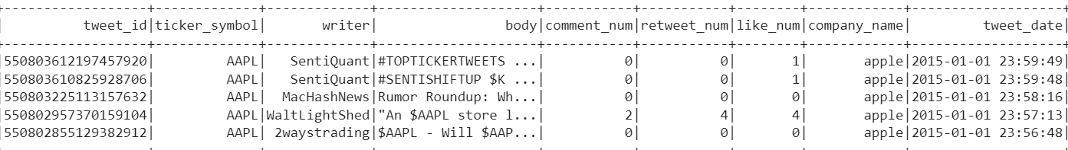
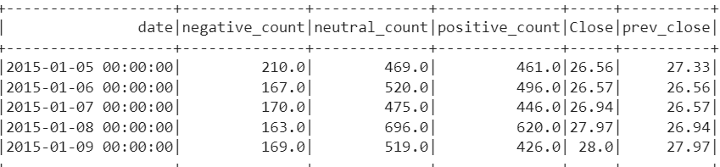
Results and Observations

Slide 5
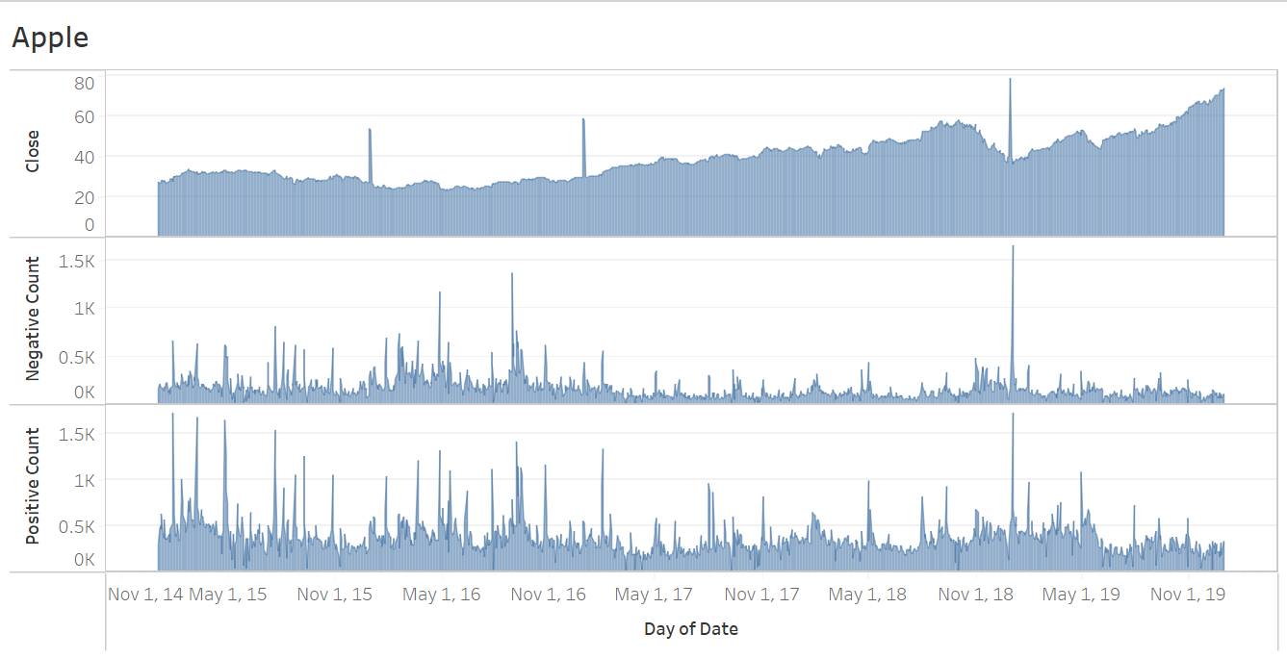
Apple

Slide 6
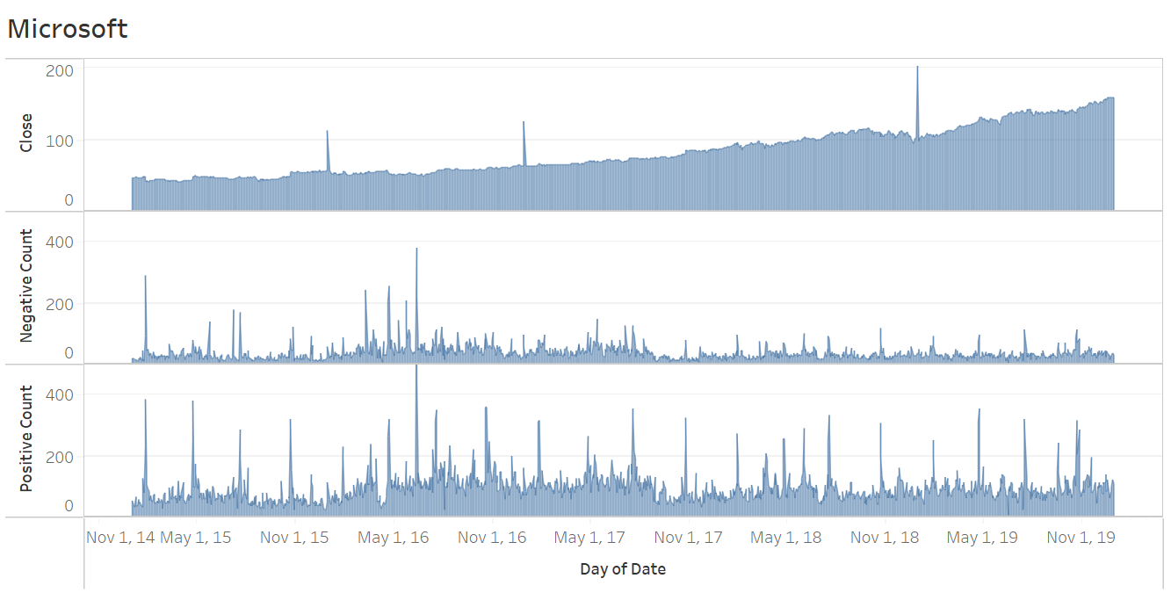
Microsoft

Slide 7
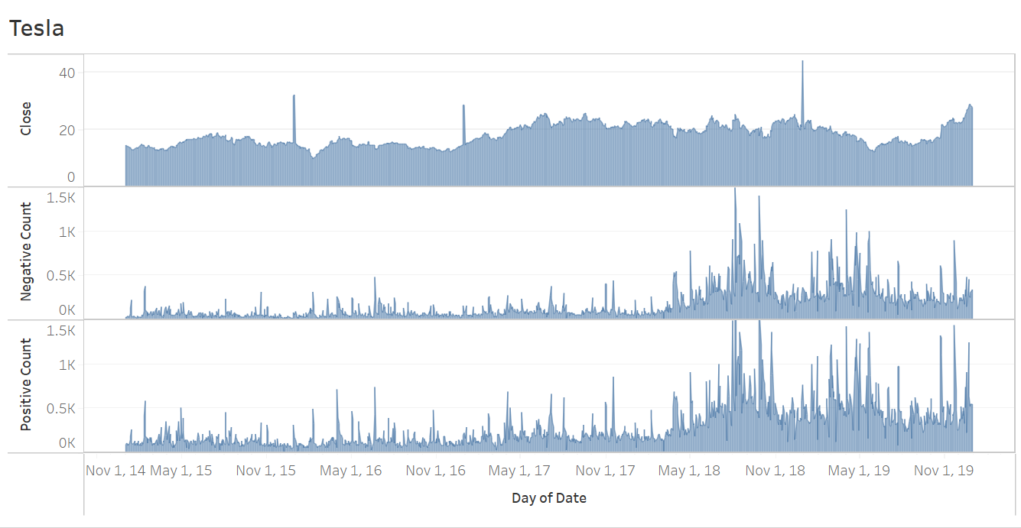
Tesla

Slide 8
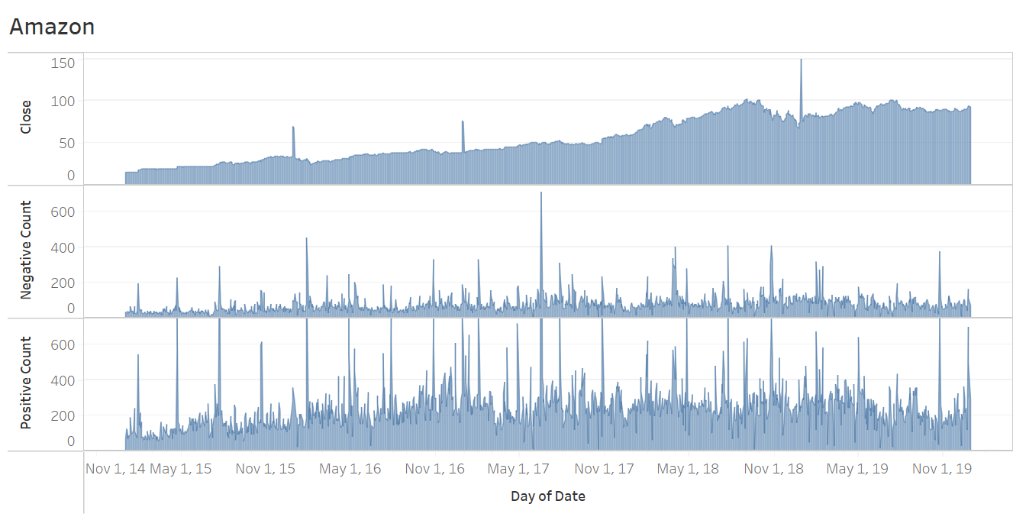
Amazon

Slide 9
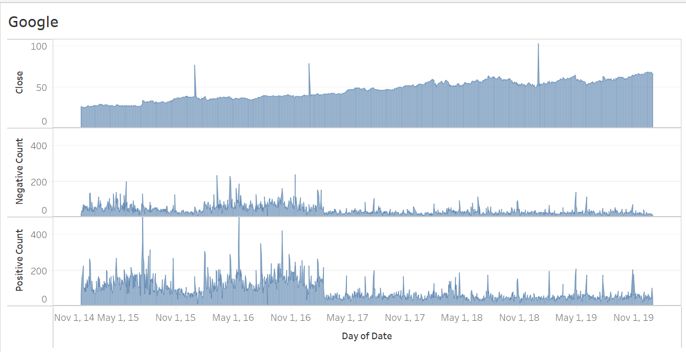
Google

Slide 10
Tesla
Models | Train r2 Score | Test r2 Score | Train RMSE | Test RMSE
Linear Regression | 0.994772614097202 | 0.9830506795185335 | 0.6336236172297024 | 1.1218927693568141
Lasso Regression(L1) | 0.9946950468318985 | 0.9825854067535639 | 0.6383073605447979 | 1.1371869592993888
Ridge Regression(L2) | 0.9946931544300285 | 0.9763783867433299 | 0.6384212000358395 | 1.3244329615297128
Decision Tree Regressor | 0.993047025908115 | 0.6374335193722065 | 0.7307593500630499 | 5.188825058954258
Random forest Regressor | 0.9984652846145816 | 0.5107446493885122 | 0.34332307902574016 | 6.027580166557075
Gradient boost Regressor | 0.9945407485283293 | 0.624014070295468 | 0.6475236352553474 | 5.283977987000315
Xgboost Regressor | 0.9999194320971497 | 0.7225146760271697 | 0.0786629274945896 | 4.539366125787609

Slide 11
Why Classifier Regressors have less Test r2 Score
Previous Stock Price < 40
Negative Count > 200
Positive Count < 200
Negative Count < 200
Positive Count > 100
Positive Count > 200
Positive Count < 100
Rather than splitting the data randomly for training and testing, we used 2015 to 2018 as our training data and 2019 as our testing data. This decision was made in consideration of real-world scenarios.
Due to this, tree-based regressors are getting imbalanced.
Developing an incremental learning model can help address these issues.
Yes
No

Slide 12
Microsoft
Models | Train r2 Score | Test r2 Score | Train RMSE | Test RMSE
Linear Regression | 0.9947042213414082 | 0.9839078959557717 | 1.143784423655566 | 1.8966318764377934
Lasso Regression(L1) | 0.997183072571696 | 0.9838973077643883 | 1.1438837888118345 | 1.8972557413773554
Ridge Regression(L2) | 0.9972754191310467 | 0.9837249440912273 | 1.124977735392936 | 1.9073828528504384
Decision Tree Regressor | 0.9954975285343433 | -1.4190369964091452 | 1.4461707073396879 | 23.25401159663493
Random forest Regressor | 0.9989785708596359 | 0.5349676224517566 | 0.6888080242423317 | 25.769046254145017
Gradient boost Regressor | 0.9961842032742693 | -1.9705949001105996 | 1.331332982692281 | 23.353027752280145
Xgboost Regressor | 0.9998734109468372 | 0.6311500823759656 | 0.09854976714453159 | 5.245352333632036

Slide 13
Apple
Models | Train r2 Score | Test r2 Score | Train RMSE | Test RMSE
Linear Regression | 0.994772614097202 | 0.9830506795185335 | 0.6336236172297024 | 1.1218927693568141
Lasso Regression(L1) | 0.9946950468318985 | 0.9825854067535639 | 0.6383073605447979 | 1.1371869592993888
Ridge Regression(L2) | 0.9763783867433299 | 0.9662783865433299 | 1.3244329615297128 | 1.2325455879661212
Decision Tree Regressor | 0.993047025908115 | 0.6374335193722064 | 0.7307593500630499 | 5.188825058954258
Random forest Regressor | 0.998415471860017 | 0.5107446493885122 | 0.34885026197985247 | 6.027580166557075
Gradient boost Regressor | 0.9945407485283293 | 0.6240140702954681 | 0.6475236352553474 | 5.283977987000315
Xgboost Regressor | 0.9999194320971497 | 0.7225146760271697 | 0.0786629274945896 | 4.539366125787609

Slide 14
Amazon
Models | Train r2 Score | Test r2 Score | Train RMSE | Test RMSE
Linear Regression | 0.9977352850272805 | 0.9264089498571311 | 1.0847009017930667 | 1.3904432153889468
Lasso Regression(L1) | 0.9977348823481661 | 0.9263796360887004 | 1.0847973304805056 | 1.3907201177583979
Ridge Regression(L2) | 0.9978891155943628 | 0.9276369633852154 | 1.047214028256501 | 1.378793250309327
Decision Tree Regressor | 0.9953388288829776 | 0.8183817830984561 | 1.5561474624459268 | 2.1843411175360647
Random forest Regressor | 0.9988084696405458 | 0.6371204887948125 | 0.7867844749825897 | 3.0876067456753837
Gradient boost Regressor | 0.9958809839274604 | 0.8307904927458776 | 1.4628505820337239 | 2.1084006310853587
Xgboost Regressor | 0.9998929333622574 | 0.6797249070240642 | 0.09063263549612545 | 4.887777219272095

Slide 15
Google
Models | Train r2 Score | Test r2 Score | Train RMSE | Test RMSE
Linear Regression | 0.9951351506978419 | 0.9343690412757508 | 0.7075758993949217 | 1.0502203415865632
Lasso Regression(L1) | 0.9340854467526429 | 0.9340854467526429 | 1.0524869219798973 | 1.0524869219798973
Ridge Regression(L2) | 0.9948526506901533 | 0.9341031783436955 | 0.7278303424618953 | 1.052345348366663
Decision Tree Regressor | 0.9935582623747606 | 0.706743380818305 | 0.8142164120145065 | 2.21998460822302
Random forest Regressor | 0.9985167512860081 | 0.5435342313853804 | 0.3907017229701044 | 2.7696835959730075
Gradient boost Regressor | 0.9943179135773776 | 0.7136637973736185 | 0.7647020486306539 | 2.1936340675296795
Xgboost Regressor | 0.9998897266924701 | 0.7667972388445928 | 0.10653039484364897 | 1.979670428170727

Slide 16
Challenges
Collecting data
Running code takes too much time because for each company was built with different algorithm to understand the model’s performance.

Slide 17
Conclusion
We fulfilled all our objectives.
We observed that Twitter has some kind of influence on stock market fluctuations. And we build predictive models for each company.
We performed a comparative study on various algorithms.
From the graphs, we observed that negative tweets impacted the stock market fluctuations rather than positive ones.
However, we cannot determine that it is the sole influencer.

Slide 18
Future improvements
We can use incremental learning techniques to avoid low test r2 scores for classification regressors like decision trees, random forests, etc.
We made daily predictions for stock prices, but by utilizing spark streaming technology, we can make predictions hourly or minute-by-minute.
In order to improve our results, it is necessary to determine a method for measuring the impact of a single tweet on the stock price.

Slide 19

Thank you….

