Slide 1

B.Tech. - BCSE497J Project-I
Deep Learning-Based Classification of Standard and Non-Standard Intrapartum Ultrasound Images
Team member:
Morisetty Venkata Sai Akhil Teja (23BCB0135)
Faculty guide:
Dr. Mythili. T
Professor Grade 2
School of Computer Science and Engineering

Slide 2
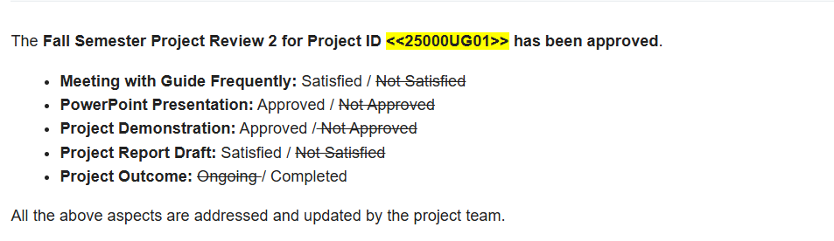
Approval Mail From Guide
Get the approval for the following points from your guide through mail before 01-09-2026.(sample attached below)

Slide 3
Aim
To build a deep learning classifier that decides whether an intrapartum transperineal ultrasound frame is a standard plane, i.e. whether the pubic symphysis and fetal head are resolved well enough to measure the angle of progression.
To use that classifier to settle a methodological question the literature leaves open: does frame sampling density itself improve performance, or is the reported advantage of video data simply the effect of having more training samples?

Slide 4
Abstract
Standard-plane selection during labour is manual, operator-dependent and performed under time pressure.
Prior work reports that dense video frames beat curated images, but changes the corpus and the sample count together, so the cause is unidentifiable.
Both arms are built from one corpus (IUGC 2024, 774 videos, 65,531 frames), varying only frames drawn per video, so probe, anatomy, scanner and annotator are constant by construction.
ResNet-18 trained under 13 sampling conditions; ResNet-18 + BiLSTM for the temporal arm; all scored on the same 8,665-frame official test set.
Result: no density effect. The best single model used 434 training frames. Across three seeds the matched-budget comparison reverses sign, so seed variance exceeds the effect.

Slide 5
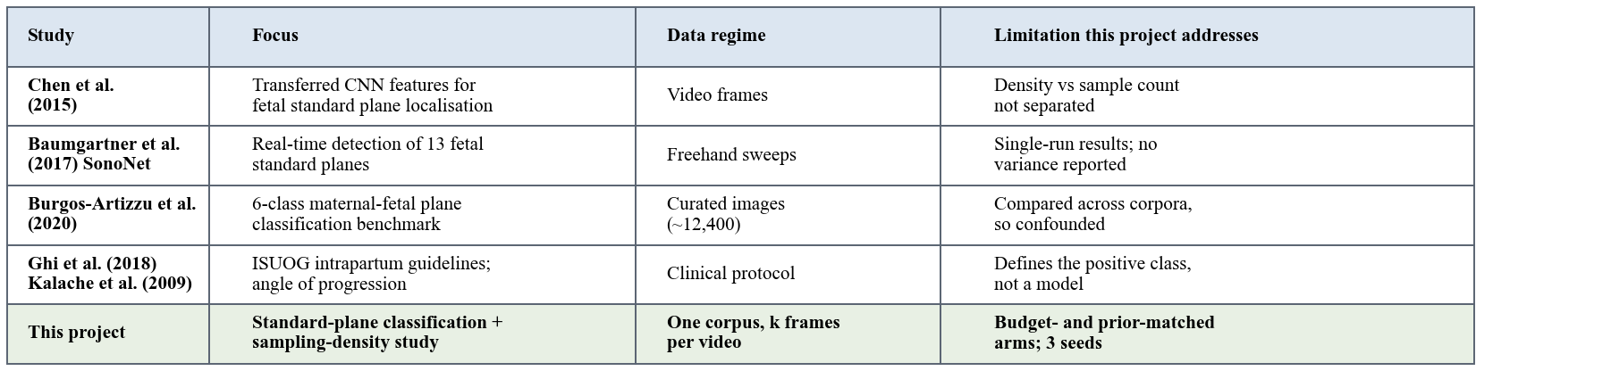

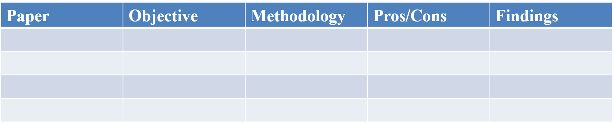
Literature Review

Slide 6
Research Gap
Gap 1 - Sampling density is never isolated from sample count. No prior work reports a budget-matched comparison where both arms receive the same number of training frames.
Gap 2 - Temporal models are compared against unsmoothed baselines. Standard planes occur in contiguous runs, so a zero-parameter moving average already recovers much of that structure.
Gap 3 - Run-to-run variance is not reported. On corpora of a few hundred patients, results come from a single training run; if seed variance is comparable to the effect, the comparison cannot support its conclusion.

Slide 7
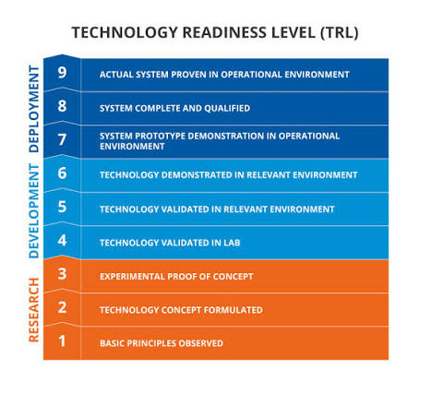

Objectives
Build a verified frame-level dataset from IUGC 2024 (label join rate 1.0, integrity checks as assertions).
Train and evaluate a ResNet-18 standard-plane classifier on the official held-out test split.
Quantify sampling density over 13 conditions, and separate density from sample count with budget- and prior-matched arms.
Test temporal modelling against a smoothed frame-wise baseline, not an unsmoothed one.
Measure seed-to-seed variance; deploy the classifier as a verified browser demonstrator.
Identified: Sustainable Development Goal 3 - Good Health and Well-being Outcomes: Conference (Scopus) / Product (open-source classifier and browser demonstrator)

Slide 8
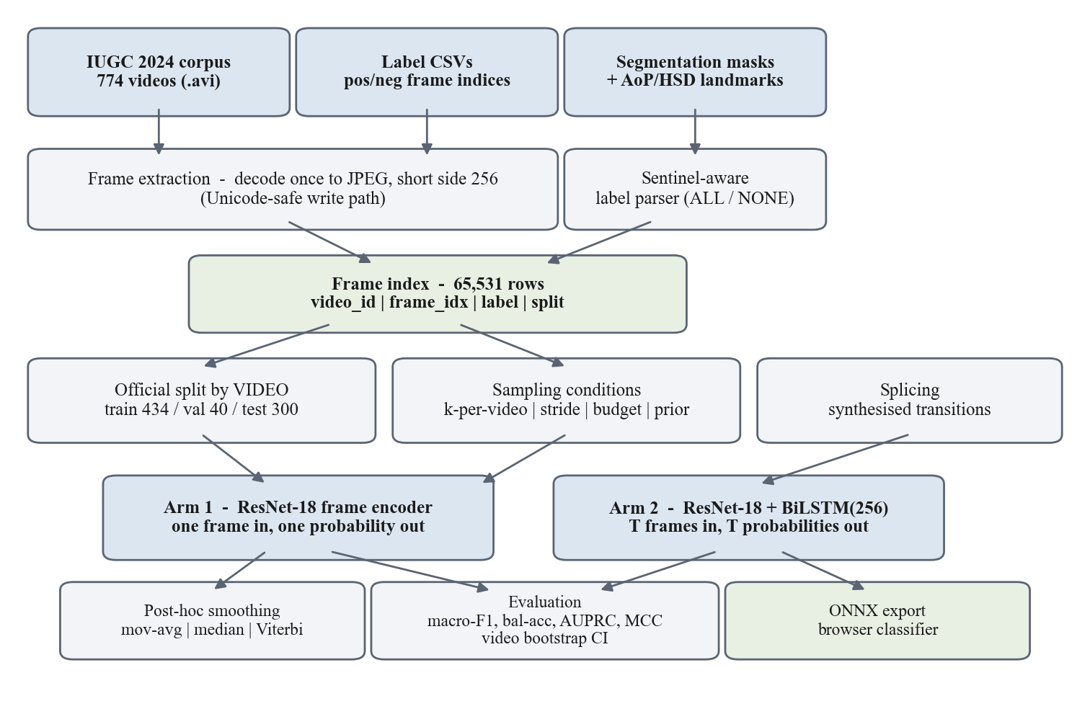
Framework/Architecture/Block Diagram

Slide 9
Functional Requirements
Frame extraction - decode each video once to pre-resized frames through a Unicode-safe write path.
Label parsing - handle per-video index lists and the ALL / NONE whole-video sentinels; fail loudly, never silently.
Index construction - one frame-level index; refuse to write it if the label join rate is below 1.0.
Video-level splitting - partition by video, never by frame; assert no video appears in two splits.
Sampling conditions - build a training set for any k per video, stride, frame budget or target class prior.
Training and evaluation - one trainer for both arms; report macro-F1, balanced accuracy, AUPRC and MCC with video-level bootstrap intervals.
Inference - return the standard-plane probability and the decision at the frozen threshold for a submitted frame.

Slide 10
Modules
Data preparation - extract_frames, build_index: decoding, sentinel-aware label parsing, integrity assertions.
Splitting - splits: video-level official split, leakage assertions, label-transition diagnostics.
Sampling - sampling: k-per-video, stride, budget matching, prior matching. This module is the study's independent variable.
Datasets - datasets: frame and clip views, ultrasound-specific augmentation, transition splicing for the temporal arm.
Models - models: one shared ResNet-18 encoder, two heads (frame-wise and BiLSTM).
Training and evaluation - engine, metrics, smoothing: shared trainer, imbalance-aware metrics, post-hoc smoothing baseline.
Deployment - export_onnx and a static page running onnxruntime-web for local, in-browser inference.

Slide 11
Experiments and Results
Arm 1, 13 conditions, seed 0: sparse arm 0.588-0.687 macro-F1 over 434 to 8,638 frames; dense arm 0.506-0.637 over 6,840 to 53,996 frames. No trend in either. Best result: 434 frames.
Arm 2, same dense condition: frame-wise 0.5785 raw, 0.5453 smoothed; BiLSTM 0.6695 with splicing, 0.6496 without. The temporal arm wins, but the ablation shows splicing is not why.
Three seeds: budget-matched delta -0.106 / +0.013 / -0.093; prior-matched -0.168 / +0.121 / -0.045. Both reverse sign; both standard deviations exceed their means.
One condition varies by 0.231 macro-F1 across seeds on identical data with an identical recipe.
Post-hoc smoothing hurt in 12 of 13 conditions: it is tuned on validation, where runs are long (median 33 frames), and applied to test, where they are short (median 12).

Slide 12
Conclusion
Frame sampling density produced no measurable benefit on this corpus. The strongest single model was trained on 434 frames, one per video, against 53,996 for the dense arm.
The matched-budget result does not replicate across seeds, so Protocol B is unresolved rather than answered.
The principal finding is a measurement one: at 434 training videos with this train-test shift, seed variance reaches about +/-0.12 macro-F1, exceeding any density effect. Single-run comparisons at this scale cannot support conclusions about density - and that is what prior work reports.
Remaining work: Grad-CAM anatomical attention check, leave-one-centre-out split, paired video bootstrap, and AoP/HSD downstream error using the corpus landmark annotations.

Slide 13
References
[1] C. F. Baumgartner et al., "SonoNet: Real-time detection and localisation of fetal standard scan planes in freehand ultrasound," IEEE Trans. Med. Imaging, vol. 36, no. 11, pp. 2204-2215, 2017.
[2] H. Chen et al., "Standard plane localization in fetal ultrasound via domain transferred deep neural networks," IEEE J. Biomed. Health Inform., vol. 19, no. 5, pp. 1627-1636, 2015.
[3] X. P. Burgos-Artizzu et al., "Evaluation of deep convolutional neural networks for automatic classification of common maternal fetal ultrasound planes," Sci. Rep., vol. 10, p. 10200, 2020.
[4] T. Ghi et al., "ISUOG Practice Guidelines: intrapartum ultrasound," Ultrasound Obstet. Gynecol., vol. 52, no. 1, pp. 128-139, 2018.
[5] K. He, X. Zhang, S. Ren and J. Sun, "Deep residual learning for image recognition," in Proc. IEEE CVPR, 2016, pp. 770-778.
[6] IUGC 2024 dataset, Zenodo, doi: 10.5281/zenodo.17655183, CC-BY-4.0.

