Slide 1
Cloud Computing (MIS 6363.003) Project Presentation
Group 5:
Aditya Emmanuel (AXE200024)
Shweta Sudam Kallapur (SXK210175)
Rohit Krishna Karumanchi (RXK200042)
Akhil Veluru (VXA210023)
Srishti Vinaik (SXV210063)

Slide 2
Industry: E-commerce
Business Objective: To build an e-commerce website that sells used cars using AWS Cloud Services.
Functional Business Requirements:
A website with an option to add desired cars to cart or to save for later purchase.
Login authentication for both buyers and sellers.
Database that stores vehicle, buyer and seller information.
Dashboard that displays metrics related to the vehicles sold.
Payment platform that is enabled with refund option.
Display whether the seller is trusted, contact details etc., in a coherent manner.
Discount deals on cars displayed clearly to the customer.
Separate sections in the website dedicated to customer reviews, delivery options, car accessories etc.
AI chatbot as well as customer representative for efficient customer service.

Slide 3
Non-Functional Business Requirements
24/7 availability across the entire United States.
Transactional database for seller related data.
Secure payment pathway considering the expensive nature of the payments.
Verification of authentic sellers.
Archiving of data older than 5 years.
Real time updation of cars newly added and the cars sold.
Data encryption for the customer and seller data.
Serverless computing engine for processing.
Using a VPC for establishing secure connections between services.

Slide 4
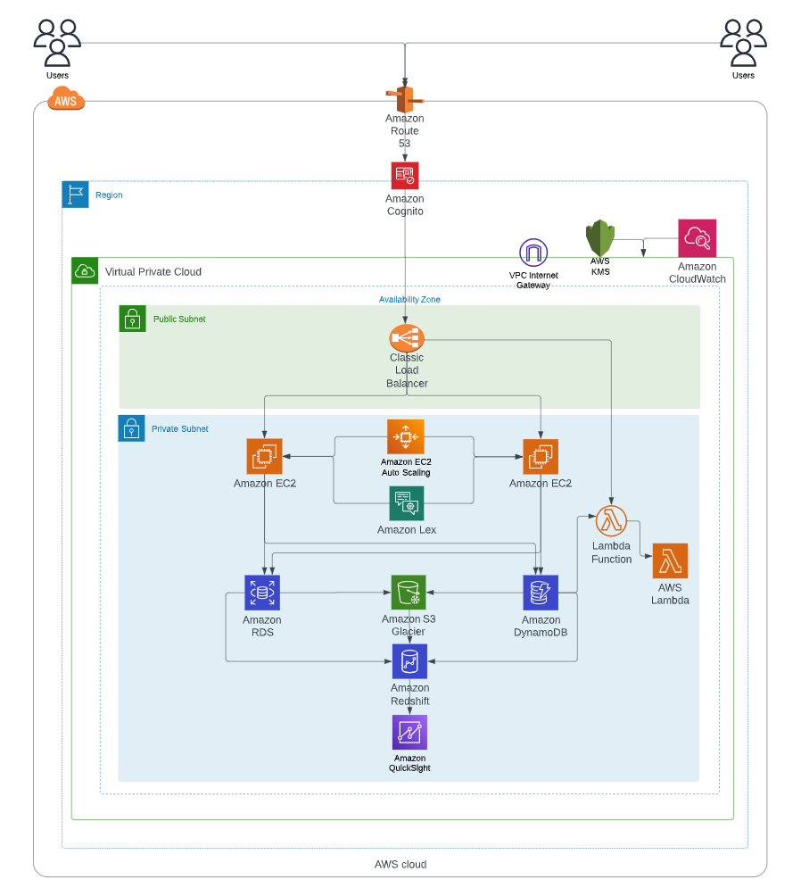
AWS Architecture:

Slide 5
Components of AWS Architecture
Amazon Route 53 (to connect user requests to the application) is used in conjunction with Amazon Cognito for the purpose of login authentication.
Classic load balancer distributes the incoming application traffic across multiple EC2 instances in multiple Availability Zones.
Amazon EC2 provides scalable virtual machines to act as a webserver to interact with users and vendors.
Amazon RDS is used to store structured data, using MySQL server.
Amazon DynamoDB is used to store unstructured data, using NoSQL.
AWS Lambda is used for various features such as displaying trusted sellers, discount deals etc.

Slide 6
Components of AWS Architecture
Amazon S3 Glacier is used to archive the data that is older than 5 years.
Amazon RedShift is used to analyze and create a data warehouse in order to visualize the data in Quicksight
Amazon QuickSight is used to display key metrics related to the car sales.
AWS Lex is used for implementation of the AI chatbot.

Slide 7
Alternative for AWS Components
Amazon Aurora - RDS

Slide 8
Six Pillars of AWS Well Architecture Framework
Operational Excellence Pillar
Structured and Unstructured data
24/7 availability across United States

Slide 9
Six Pillars of AWS Well Architecture Framework

