Slide 1
A Simple Shiny App
for Simple Linear Regression
Tian (Luke) Qi
10/01/2018

Slide 2
Agenda
What is R Shinny?
Why use it?
How to build R Shinny App?
How to launch it?

Slide 3
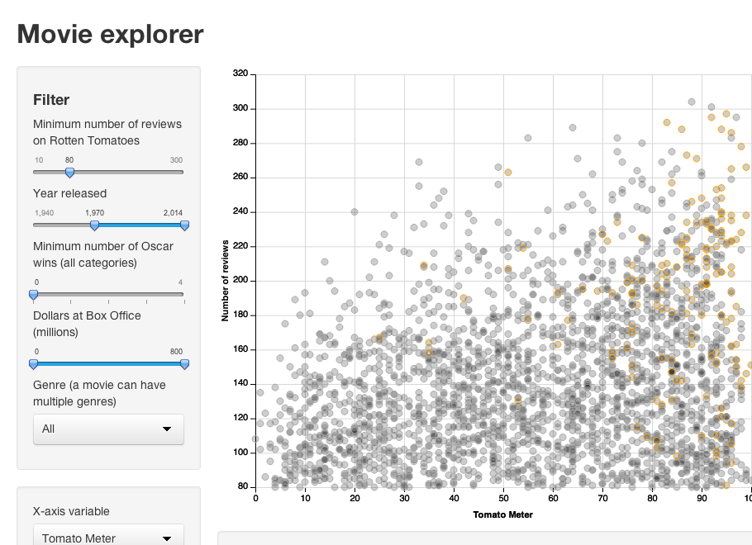
What is R Shiny?
An R package
Provides an elegant
and powerful
framework for building interactive Web application using the R language
A server side app
library(shiny)

Slide 4


Why R Shiny?
Which one do you prefer?
Reference: https://techcrunch.com/2016/05/10/please-dont-learn-to-code/
Notes:
Pre-built output widgets for displaying plots, tables, and printed output of R objects.
Uses a reactive programming model that eliminates messy event handling code, so you can focus on the code that really matters.
Outputs change instantly as users modify inputs, without requiring a reload of the browser.
Shiny user interfaces can be built entirely using R, or can be written directly in HTML, CSS, and JavaScript for more flexibility.

Slide 5
How to build your Shiny App an example of linear regression
ui.py
shinyUI(fluidPage=
titlePanel(title = "Simple Linear Regression "),
sidebarLayout( sidebarPanel(
h1("Prediction"), p("Input the value "),
numericInput(inputId = "mileage", label = "Mileage", value=20000,min = 200, max = 50000, step = 50),
selectInput(inputId = "type", label = "Type",
choices = list("Convertible","Wagon","Sedan”..")),
mainPanel(
h4("Linear regression model Prediction"),
textOutput(outputId = "Prediction")
server.py
shinyServer( function(input, output) {
kelly <- read_csv("KelleyBlueBookData.csv")
lm1 <- reactive({lm(Price ~ Mileage+Type, kelly)})
Mileage<-reactive({input$mileage})
Type<-reactive({input$type})
newdata <-reactive({data.frame(Mileage=Mileage(),Type=Type())})
#generate output
output$Prediction <- renderText({predict(lm1(),newdata())})
For full code:Github:tqi2tqi2/Shinnyapp4Biz-Com-FinalPre
Shiny App: https://luke-qi.shinyapps.io/shinyapp/
Notes:
Code are almost same as your homework code, except here we need reactive({}) function which create
expressions that can read reactive values and call other reactive expressions.

Slide 6

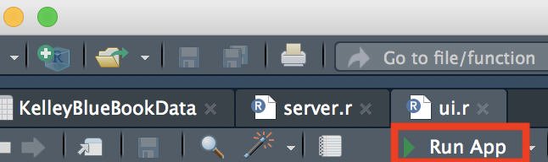
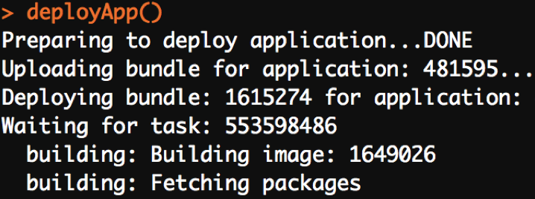
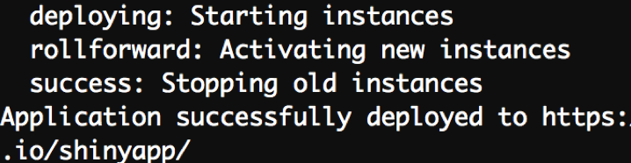
How to launch it
On Local Machine
shiny::runApp()
Publish to Web
Create a new account at R Studio
Package: rsconnect
rsconnect::setAccountInfo()
rsconnect::deployApp()
Notes:
#to get your account info
#use the info given by R when you create the account
#push it to your webpage

Slide 7
Summary
An package can be installed easily
Any R script or visualization can be made interactive
using shinny
Shiny apps can be hosted online and be shared with the
word easily
There is no need to learn HTML or JavaScript

Slide 8
Thank you!
Reference: https://www.linkedin.com/learning/creating-interactive-presentations-with-shiny-and-r/why-use-shiny

