Slide 1
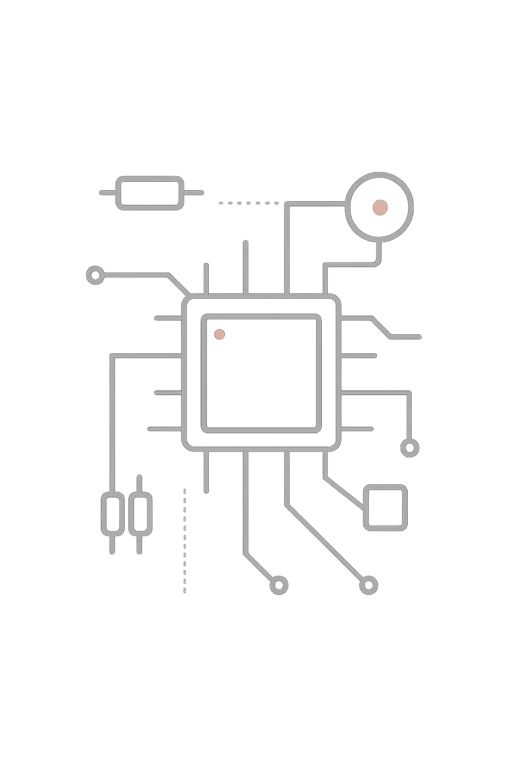
The Evolution of Reconfigurable Logic
Designing Advanced CLB Architectures with SRAM-LUTs

Slide 2
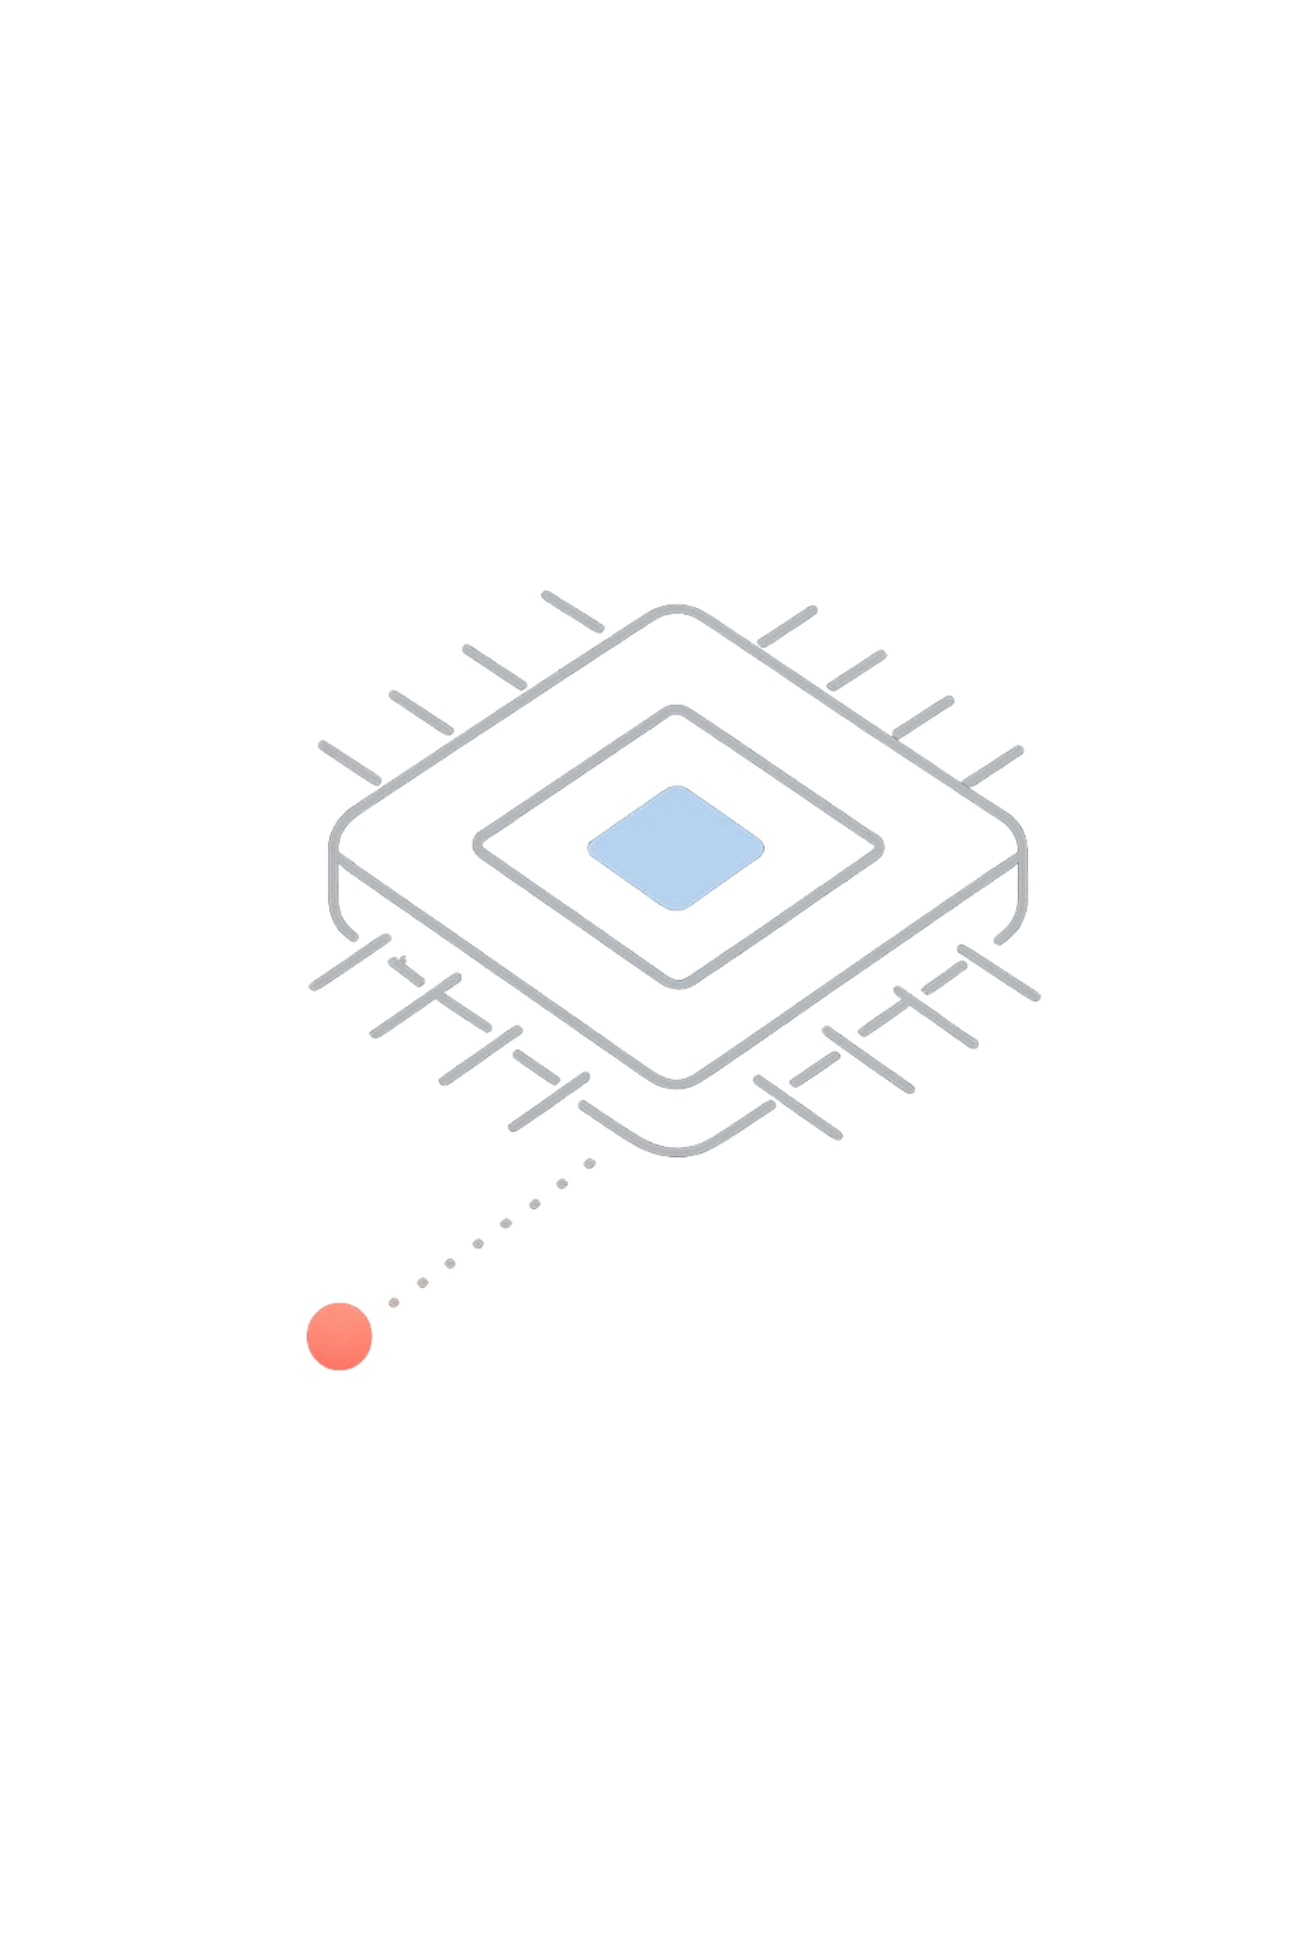
The Foundation: From Basic Logic to FPGAs
1
Fixed-Function Era
Early digital systems relied entirely on fixed-function integrated circuits — inflexible and costly to redesign.
2
The FPGA Revolution
Xilinx's invention of FPGAs in the 1980s transformed digital design, introducing programmable hardware at scale.
3
Programmable Fabric
FPGAs combine programmable logic blocks (CLBs) and interconnects, enabling fully custom hardware implementations.

Slide 3
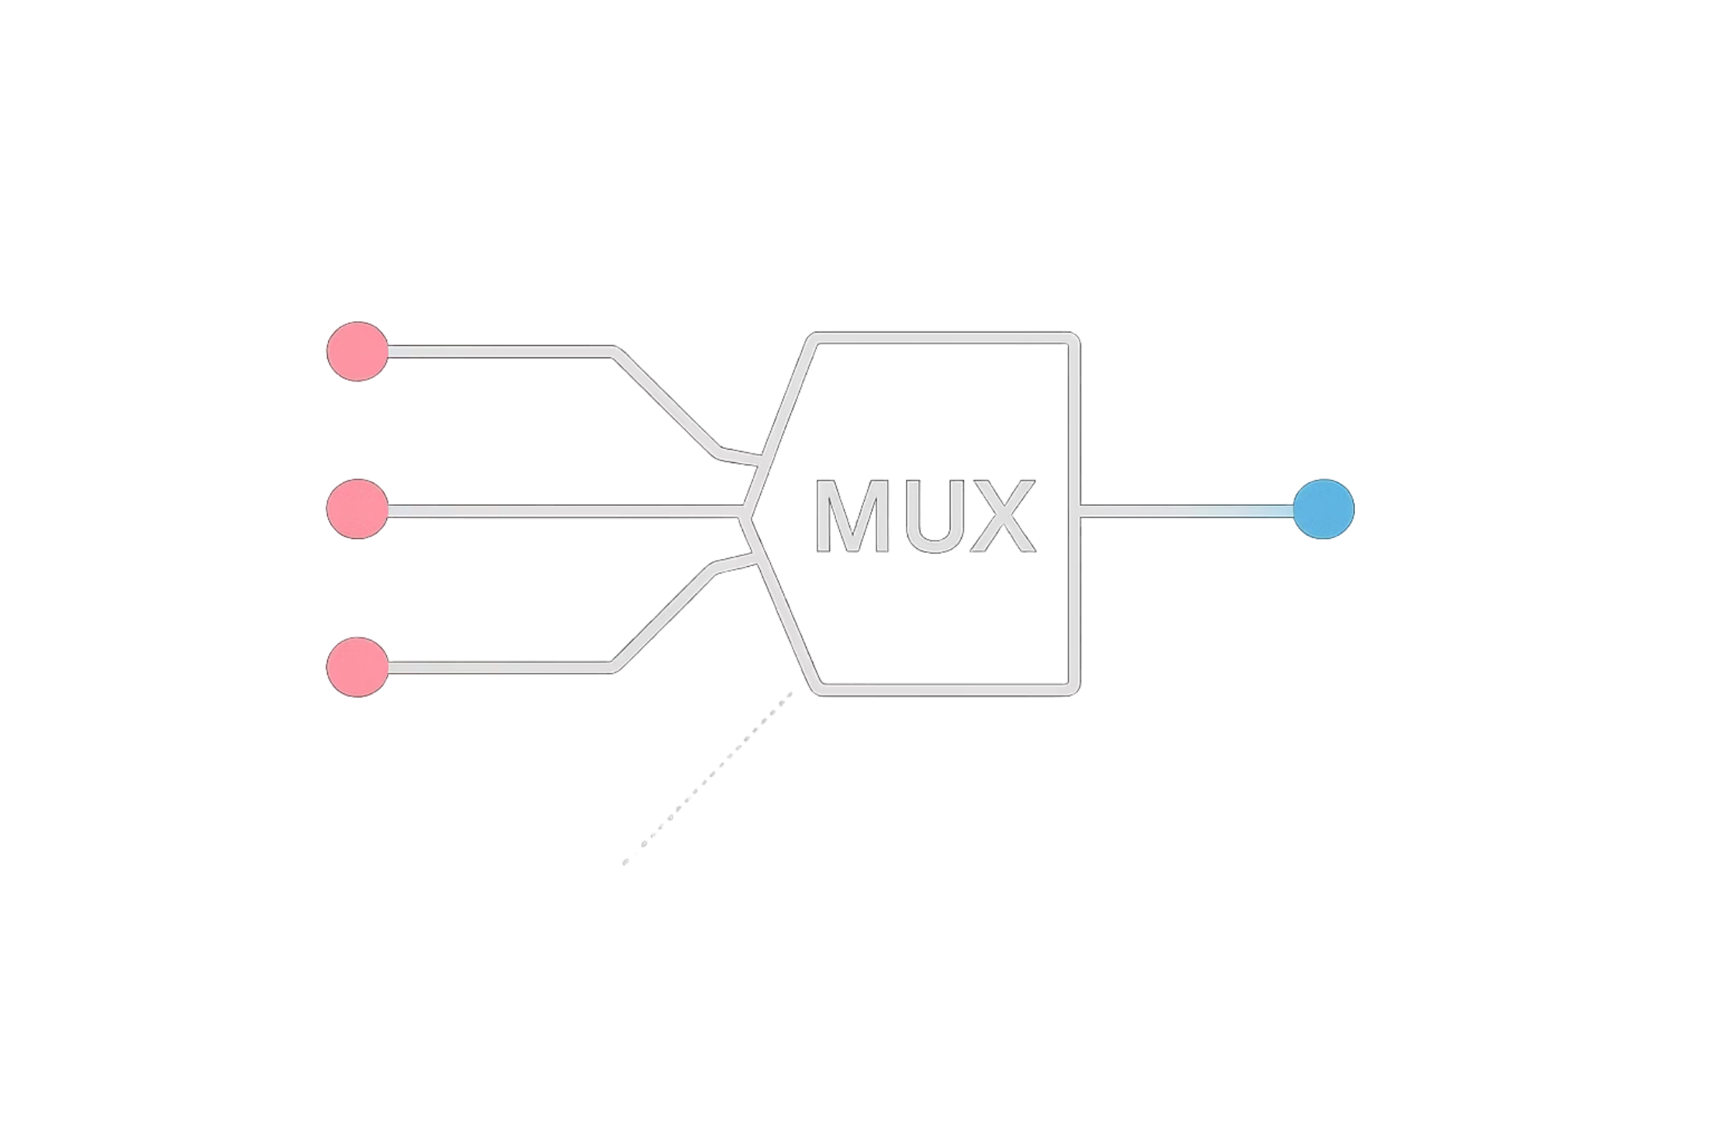

The Core of Reconfigurability: Look-Up Tables (LUTs)
What is a LUT?
LUTs are the fundamental building blocks within CLBs. A k-input LUT functions as a 2k-to-1 multiplexer, capable of implementing any Boolean function of k variables.
SRAM cells store the configuration bits for each LUT — this is what makes them "SRAM-based". Programming the SRAM defines the logic function at runtime.

Slide 4
Optimising the CLB: The Quest for Efficiency
The Challenge
SRAM Table Sharing
Tunable LUTs (TLUTs)
Reducing configuration memory footprint and power consumption without sacrificing logic density or performance.
Negation-Permutation-Negation (NPN) classification enables LUT configuration memory to be shared, achieving up to 30% reduction in memory usage. (Hussain et al., 2022)
TLUT circuits deliver improved memory efficiency and significantly faster reconfiguration, particularly for regularly structured and repetitive designs. (Al Farisi et al.)

Slide 5

Enhancing Robustness: Fault-Tolerant CLB Designs
As FPGAs enter advanced computing paradigms — including optical and quantum systems — reliable operation becomes non-negotiable.
Approach
Benefit
Integrating fault-tolerant (FT) reversible logic gates (RLG) directly into CLB architecture.
FT-RLGs detect circuit-level faults and maintain compatibility with emerging quantum and optical computing platforms. (Naveen K. B. & Ravi L. S., 2024)

Slide 6
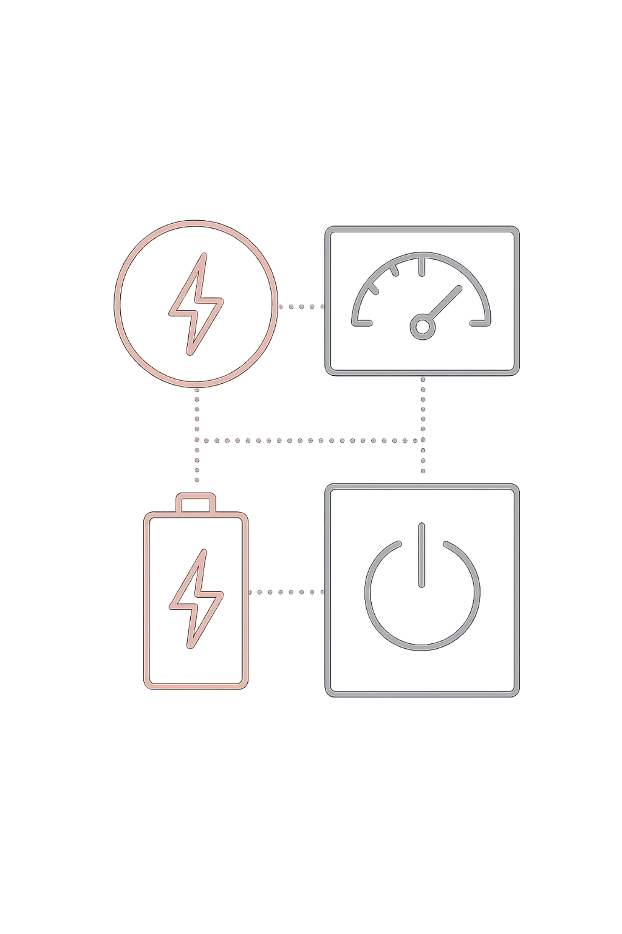
The Power of Reversibility
Integrating reversible fault-tolerant gates into CLB designs delivers remarkable efficiency gains at the silicon level.
95.5%
↓
Power Reduction
Lower Delay
Achieved at 90nm CLB technology using reversible FT gates. (Naveen K. B. & Ravi L. S., 2024)
Reversible gate integration also contributes to significantly reduced propagation delay across the CLB.
90nm
Technology Node
Results validated at this process node, with further gains expected at finer geometries.

Slide 7


Modern CLB Architectures: Xilinx 7 Series
Slice Types
Early CLB
Xilinx 7 Series
Two 4-input LUTs per CLB
Four 6-input LUT6s and eight regs
SLICEL
Logic-only slices — optimised for pure combinational and registered logic functions.
Intermediate
SLICEM
Increased routing and registers
Extended slices supporting logic, shift registers, and distributed memory — offering maximum flexibility. (Xilinx, WP405)
The progression from basic 4-LUTs to the flexible 6-input LUT6 marks a significant leap in logic density and capability.

Slide 8

The Future of Reconfigurable Logic
Advanced CLB designs with SRAM-LUTs are the cornerstone of next-generation FPGA development.
Memory Efficiency
Innovations in SRAM sharing and TLUT circuits continue to reduce overhead, enabling denser, more capable logic fabrics.
Fault Tolerance
Reversible gate integration is paving the way for reliable FPGAs in mission-critical and quantum-compatible applications.
Broader Applications
These advances collectively enable more complex, robust digital systems across industries from aerospace to AI acceleration.

