Slide 1
Power BI for
Business Analytics
Data Analyst Internship
Task 4: Dashboard Design
Sales Performance Dashboard
Created by Power BI

Slide 2
Project Overview
To design an interactive sales dashboard.
To analyse business Performance.
To identify sales and profit trends.
To support business decision-making.

Slide 3
Dataset Description
Dataset: Sample Superstore
Source: Kaggle
Records: 9,994
Columns: 21
Important fields: Sales, Profit, Order Date, Region, Category and Quantity.

Slide 4
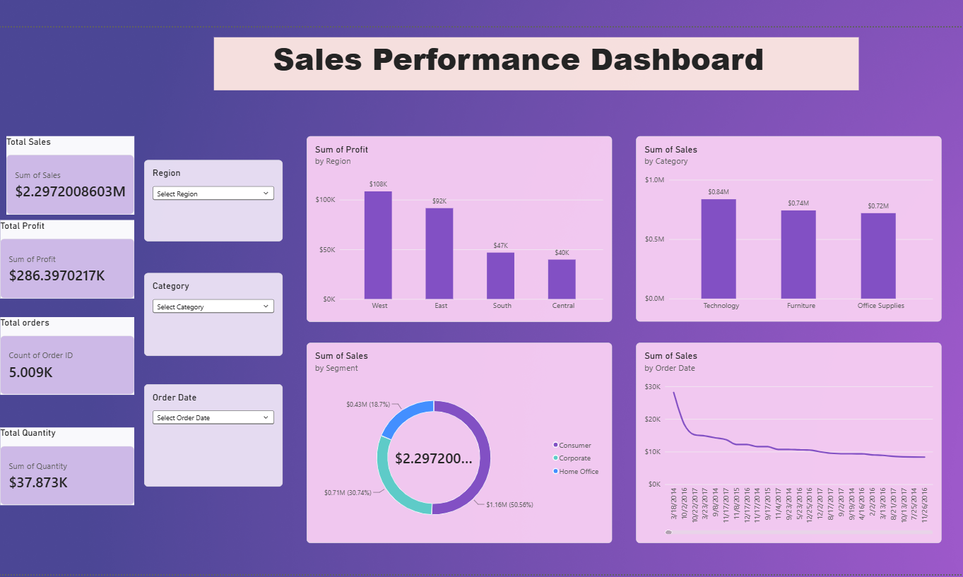
Dashboard Overview
Total Sales
Total Profit
Total Orders
Total Quantity
Sales by Category
Profit by Region
Sales by Segment
Monthly Sales Trend

Slide 5
Conclusion
Created an interactive Power BI dashboard.
Analysed sales and profit performance.
Used slicers for interactive filtering.
Identified trends across categories and regions.
Learned how dashboards support business decisions.

