Slide 1
Flip-Flop Word Game Memory-Based Single Player Word Puzzle
Akhila Thammenenwar
Anjali Talloju
PranathiSai Kalavagunta
Neha Goute
Presented by:

Slide 2

Introduction
The Flip-Flop Word Game is a memory-based single-player game where the player is challenged to recall and reconstruct words shown briefly in a scrambled format. The goal is to test and enhance the player's short-term memory and attention to detail.
.

Slide 3
Abstract
In Flip-Flop Word Game, First, a word will be displayed on the screen for 50 sec and the player has to memorize the word. After 50 sec, the word disappears and reappears but in scrambled order with one letter in each box. The player gets only one minute of time to remember the scrambled order after which it disappears. And now, the player has to write the sequence of the block numbers for the original word i.e., the player has to unscramble and arrange the blocks properly to form the given word and then write the block numbers of the letters when they were scrambled
Example :
Given Word: E D U C A T I O N
Scrambled Word : T E O D N A U I C1 2 3 4 5 6 7 8 9(Block number)
Final Answer:2 4 7 9 6 1 8 3 5

Slide 4
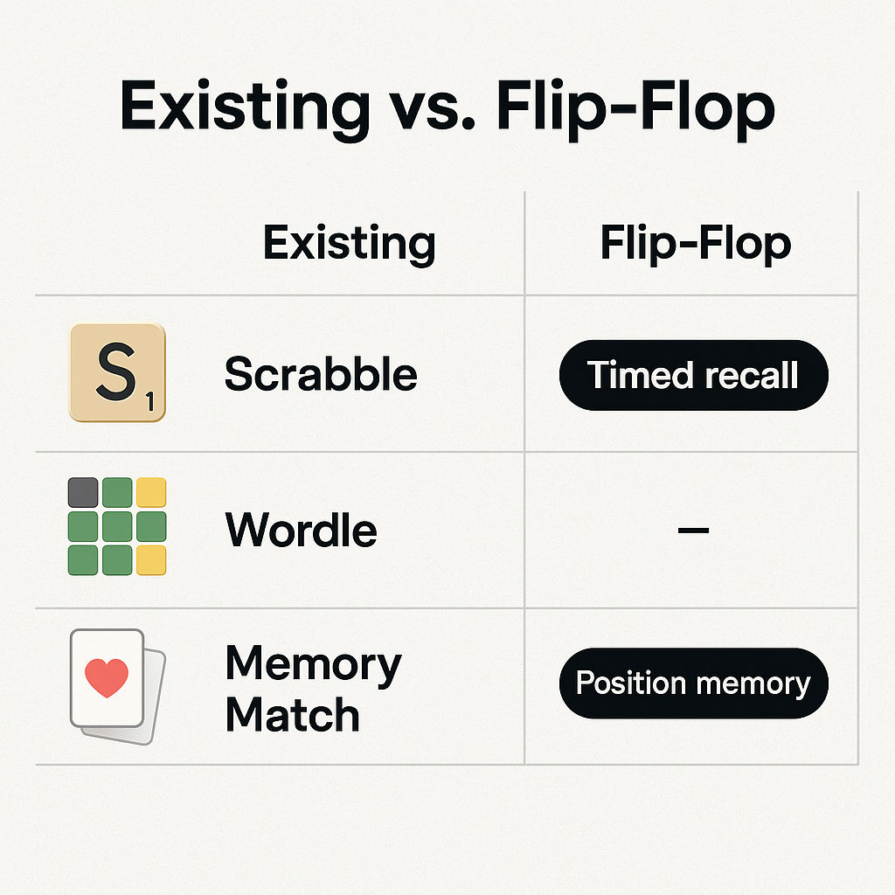
Literature Survey
Several word and memory games exist like Scrabble, Wordle, and Memory Match that test vocabulary or memory skills. However, most do not combine time-based visual memory with scrambling and positioning. This game fills that gap by focusing specifically on recalling scrambled visual patterns under pressure.

Slide 5
Existing System and its Disadvantage
Existing systems like Scrabble and word puzzles are primarily vocabulary-based and do not emphasize memorizing visual positions or block order. They lack dynamic difficulty adjustment and active timed recall, which reduces the cognitive challenge.
Limitations of Existing Systems
Mostly vocabulary-based.
No visual memory focus.
Lacks timed difficulty adjustment.

Slide 6
Proposed System and its Architecture
The proposed Flip-Flop Word Game architecture includes the following stages:
Display Phase – Show the original word for 50 seconds.
Scramble Phase – Shuffle the letters and display them in boxes for 1 minute.
Recall Phase – Hide the letters and ask the player to input the sequence of the original word using the block numbers from the scramble.
The game is built using Python with Kivy for cross-platform mobile deployment, especially targeting Android devices.

Slide 7

Software Stack to be Used
Programming Language: Python
Framework: Kivy (for GUI and Android support)
Platform: Android
IDE: VS Code / Android Studio (via Buildozer for APK generation)
Libraries: Random, Time, Kivy Modules

Slide 8
Conclusion
Combines memory and vocabulary challenge.
Unique recall-based gameplay.
Suitable for Android mobile platforms.

Slide 9
Thank You!
Questions or Feedback?

