Slide 1

Flip-Flop Word Game
Industrial oriented mini project – review 3
PRESENTED BY:
Akhila Thammenenwar – 22P71A0502
Anjali Talloju - 22P71A0503
Pranathi Sai - 22P71A0531
Neha Goute - 22P71A0559
GUIDE:
Mrs. Ch. Hyma, HOD, SVIT

Slide 2
Introduction & Motivation
Project Introduction:
Word-based memory game developed using Python and Flet Framework.
Aimed at Android platform, simulates memory training using word reconstruction tasks.
MOTIVATION:
NEED FOR EDUCATIONAL GAMES THAT IMPROVE ATTENTION SPAN AND COGNITIVE.
SKILLS, INSPRIRED BY THE GROWING USE OF GAMIFICATION IN LEARNING

Slide 3
Game Overview & Mechanics
Memorization: Show original word briefly
Scramble: Letters shuffled, displayed with numbered blocks
Recall: User enters numeric sequence to reconstruct the word
3 Core Phases per round:
Scoring: +20 for correct, −10 for wrong; scores never drop below zero

Slide 4
Difficulty Levels:
Three levels: Easy, Medium, Hard
Each adjusts:
Word length and complexity
Memorization and scramble display durations
Speeds up challenge progression

Slide 5
Architecture:
Modular Design: Enables easy integration of new features like scoring and difficulty levels.
UI Layer (Flet): Built with the Flet framework for a responsive, native-app feel, allowing rapid cross-platform UI development in Python.
Logic Layer (Python): The core game mechanics are written in Python, combining with Flet for efficient development.
Timer Engine (threading): Uses Python's threading module for background timer operations, ensuring the UI remains responsive.
Offline Functionality & Local Storage: Supports offline use, storing game settings, high scores, and user progress locally

Slide 6
Technology Stack
Language: Python (readable, fast prototyping
Framework: Flet (Python-to-Flutter bridge)
Target Platform: Android
Supporting Tools: threading, random, time, enum modules
Suggested Image: Stack diagram showing Python → Flet → Flutter → Android APK

Slide 7
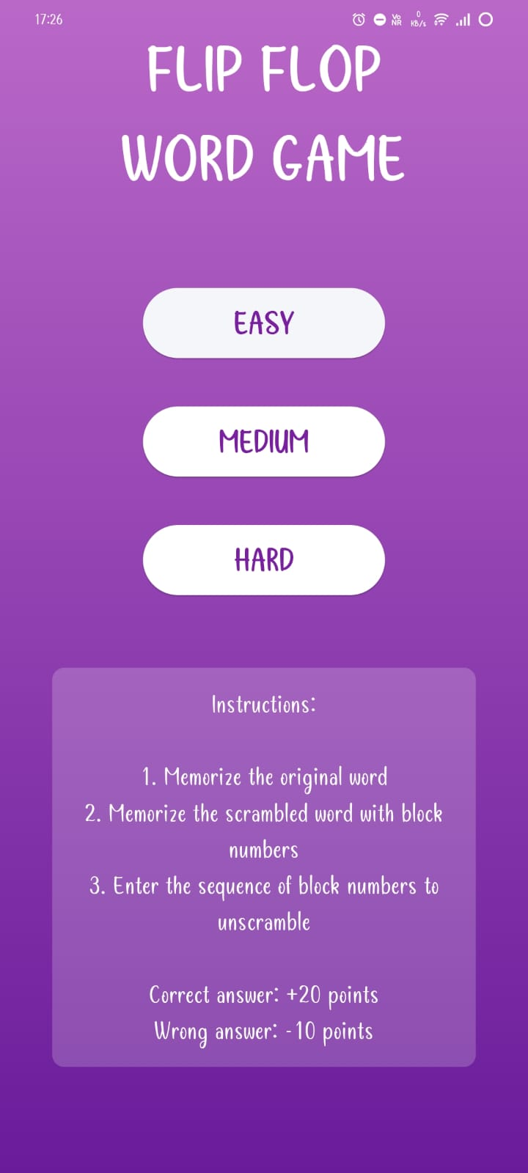
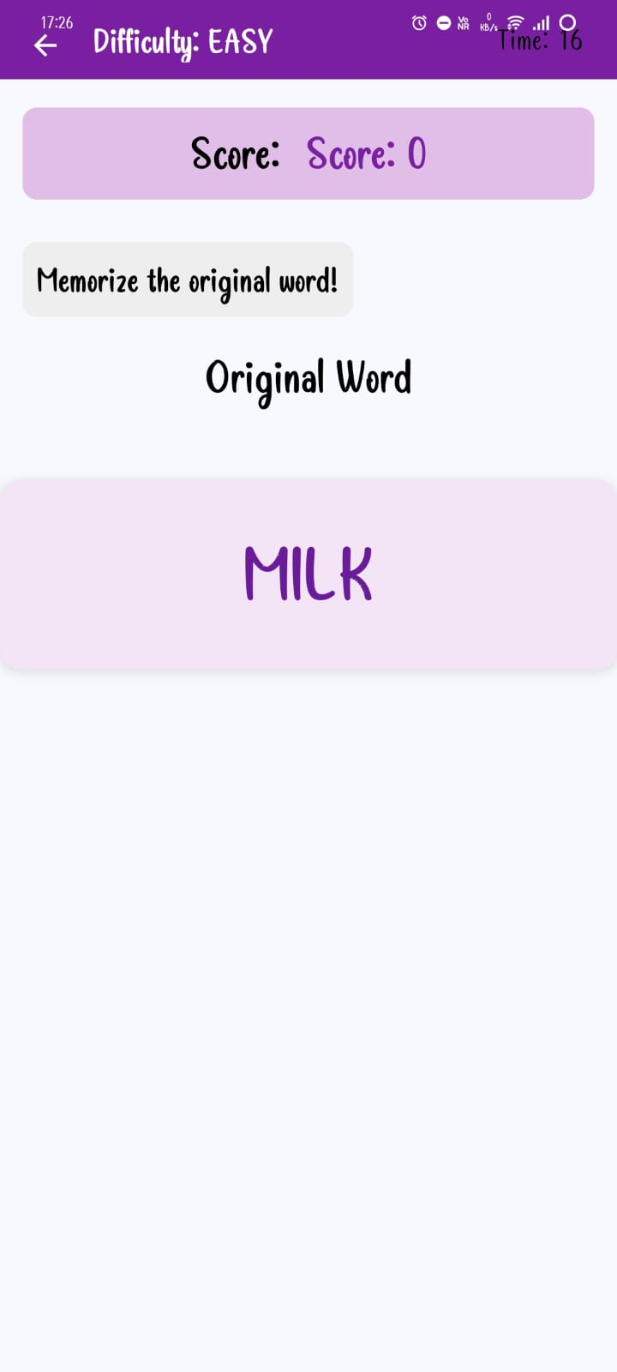
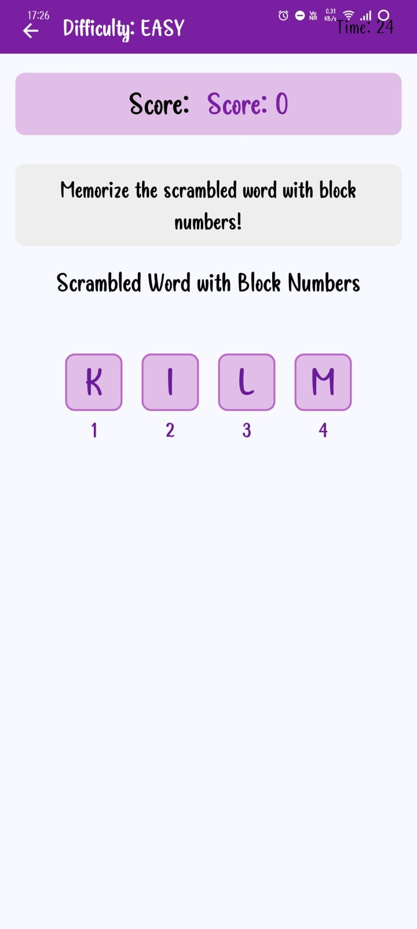
Demo Screenshots:

Slide 8
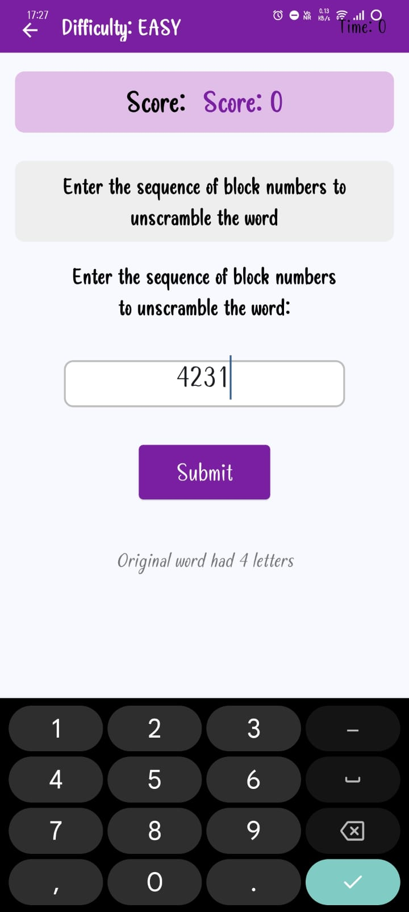
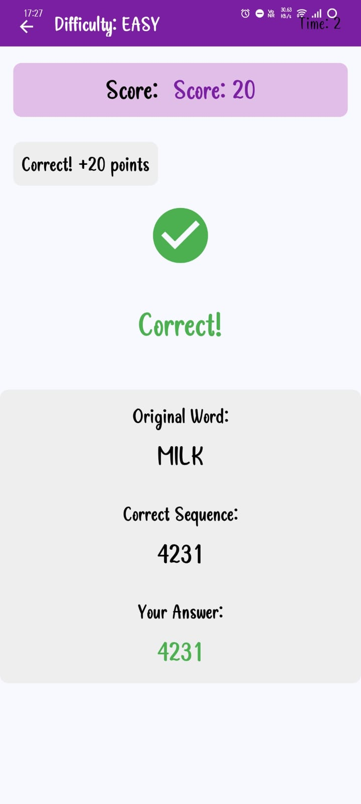

Slide 9
Testing & Results
Manual testing on Android: Verified installation, UI flow, scoring and transitions
Functional validation:
Timers work per level
Score updates correctly (+20/−10), never negative
Auto-round restart after result state
UI responsive, clean alignment on mobile
Performance: Smooth, no lag or crashes on modern devices

Slide 10
Future Scope & Conclusion
Future enhancements:
Larger word database, themed packs
Custom user modes (e.g., untimed, progressive difficulty)
Profiles, high scores, achievements
Sound effects, animations, tutorials
Cross-platform (iOS/web), multiplayer

