Slide 1
Name : Akhila Vodnala Roll. No : 130522862105 Project Title : Characterizing And Predicting Early Reviewers For Effective Product Marketing On Ecommerce Websites. Project Guide : Syed Azam Sir.

Slide 2
Abstract :
Online reviews are essential for consumers making purchase decisions, with early reviews particularly influencing product sales. This study examines the behavior of early reviewers on Amazon and Yelp, categorizing product lifecycles into early, majority, and laggard stages. Early reviewers, defined as those posting in the early stage, tend to give higher ratings and write more helpful reviews. These early reviews significantly impact product popularity. To identify early reviewers, we developed a margin-based embedding model, which outperforms other models in experiments on two large e-commerce datasets.

Slide 3
EXISTING SYSTEM:
Herd Behavior in Online Shopping:
Individuals are influenced by others' decisions, known as herd behavior.
Early reviews act as crucial references, exemplifying a herding effect.
Focus of Study:
Quantitative analysis of early reviewers using large-scale datasets from Amazon and Yelp.
Early reviewer prediction as a competition problem.
Novel Contributions:
First comprehensive study to characterize early reviewers and their impact on product popularity.
Introduction of a novel embedding-based ranking model for early reviewer prediction.
Model addresses the cold-start problem using product side information.
Empirical Validation:
Extensive experiments demonstrate the model's effectiveness in predicting early reviewers.

Slide 4
PROPOSED SYSTEM:
To predict early reviewers, we propose a novel approach by conceptualizing the review posting process as a multiplayer competition game. In this framework, only the most competitive users can become early reviewers with respect to a product. This competition can be broken down into multiple pairwise comparisons between two players. In each two-player competition, the winner is the one who posts their review earlier.

Slide 5
System SpecificationS :
Software Requirements :
Operating System :Windows 10
Coding Language : Python.
Integrated Development Environment : Visual Studio Code
Front-End Technologies : HTML, CSS, Java Script
Data Base : MySQL
Hardware Requirements :
System : Pentium IV 2.2GHz.
Hard Disk : 20GB
Ram : 1GB.

Slide 6
ARCHITECTURE:

Slide 7
MODULES:
Upload Products
Product Review Based Order
Ratings and Reviews
Data Analysis

Slide 8

1.Upload Products:
Admins handle product uploads, adding new items with details like brand, color, and warranty. They can also manage product visibility by blocking or unblocking them as needed

Slide 9

2.Product Review Based Order
Product suggestions are generated based on
user reviews and ratings. The system uses
the Naïve Bayes algorithm to determine whether
a review is positive or negative, and then adjusts
the product listings accordingly.

Slide 10
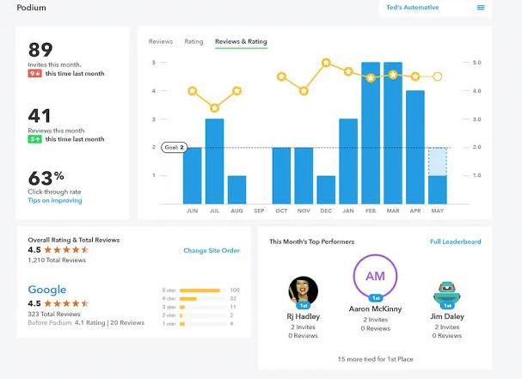
3.RATINGS AND REVIEWS:
Ratings and reviews are crucial for assessing product effectiveness in this project. The goal is to gather user feedback, whether they’ve purchased the product or not, to understand when and why they rate items. This insight helps future buyers make informed decisions based on others' experiences.

Slide 11

4.Data Analysis
Data analysis is central to the project, where user ratings and reviews are examined using various charts like pie charts and bar charts. This approach helps in visually interpreting user feedback and understanding product trends.

Slide 12
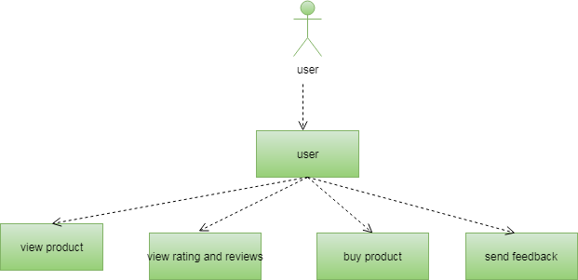
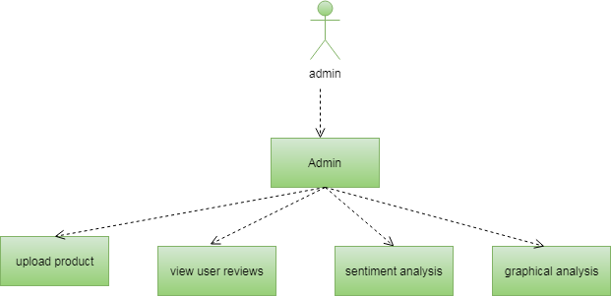
Uml diagrams: 1.use case diagram

Slide 13
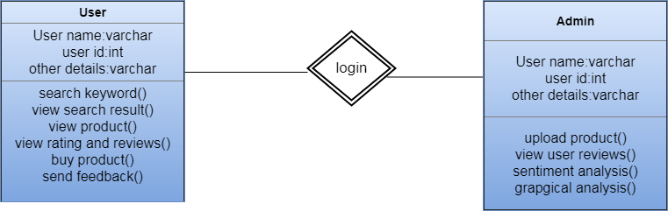
CLASS DIAGRAM:

Slide 14
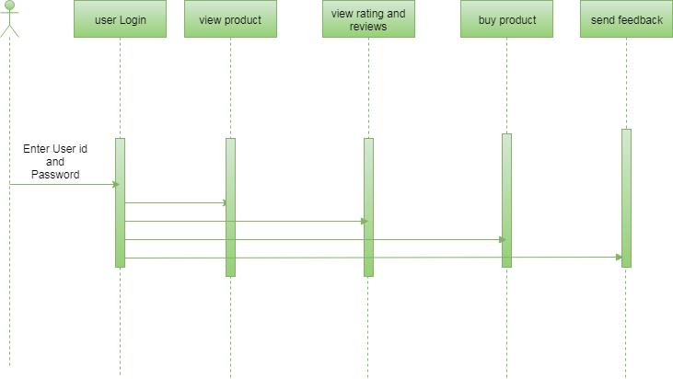
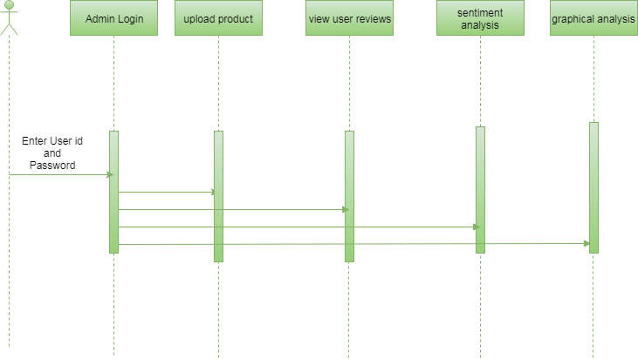
SEQUENCE DIAGRAM:

Slide 15
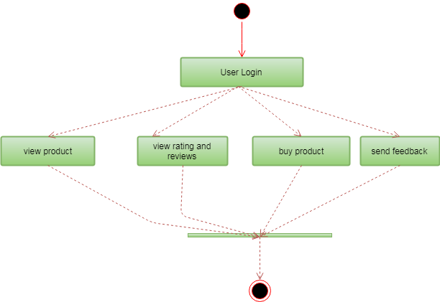
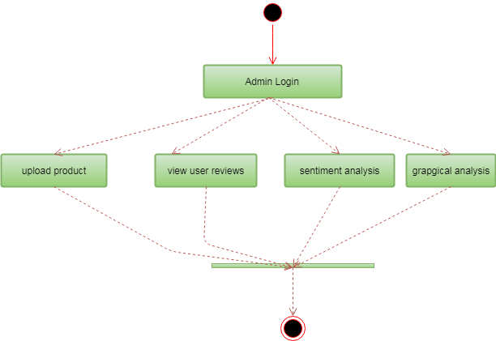
ACTIVITY DIAGRAM:

Slide 16
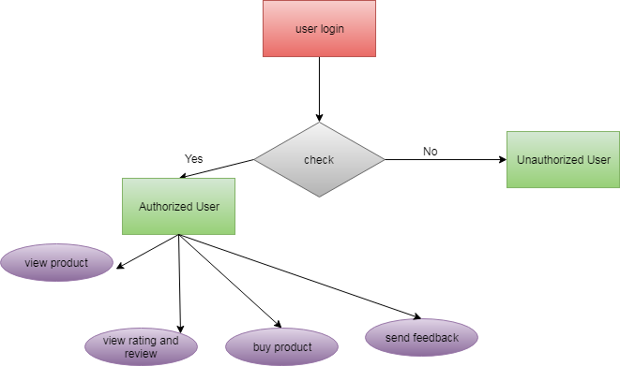
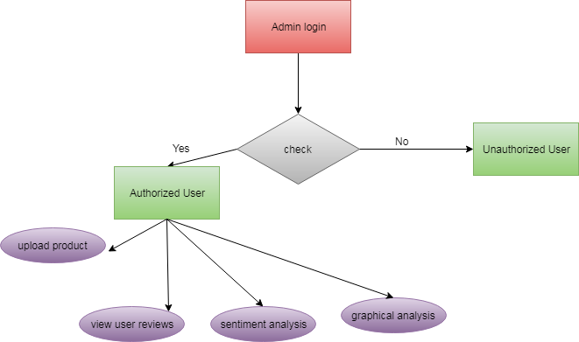
ER DIAGRAM :

Slide 17
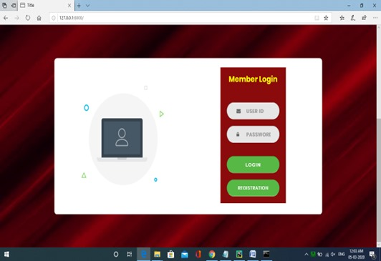
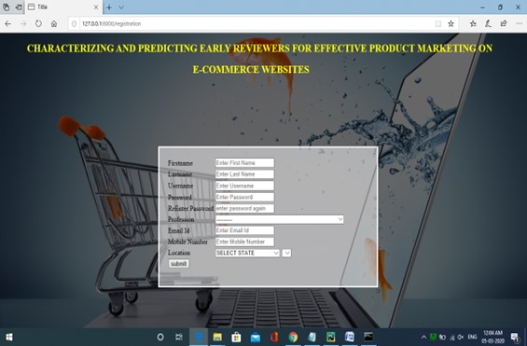
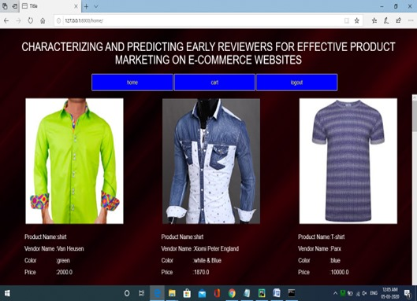
OUT PUT SCREEN

Slide 18
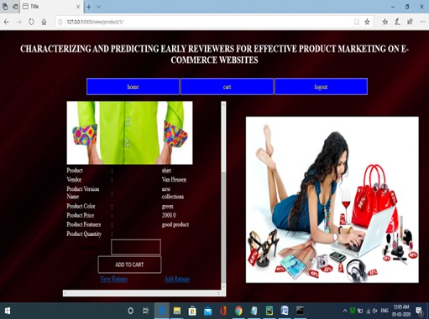
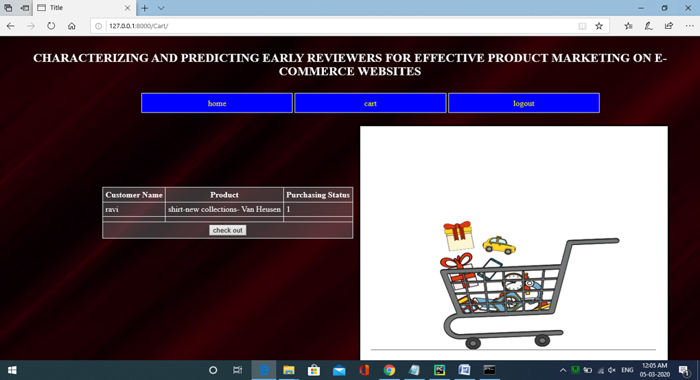
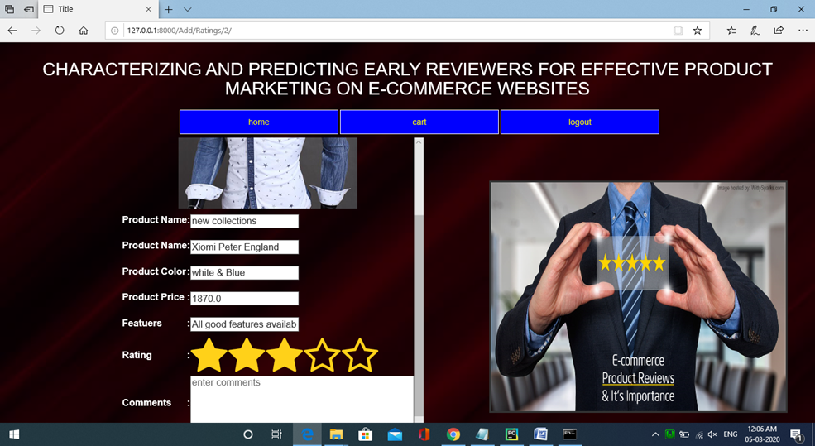

Slide 19
CONCLUSION:
In this paper, we have studied the novel task of early reviewer characterization and prediction on two real-world online review datasets. Our empirical analysis strengthens a series of theoretical conclusions from sociology and economics. We found that (1) an early reviewer tends to assign a higher average rating score; and (2) an early reviewer tends to post more helpful reviews. Our experiments also indicate that early reviewers’ ratings and their received helpfulness scores are likely to influence product popularity at a later stage. We have adopted a competition-based viewpoint to model the review posting process, and developed a margin based embedding ranking model (MERM) for predicting early reviewers in a cold-start setting.

Slide 20
THANK YOU

