Slide 1
I2C Protocol
IMPLEMENTATION ON FPGA

Slide 2
Overview of I2C
Note
Data Handling
SDA should change during negedge of SCL and remain constant during Posedge of SCL
When SCL = 1, Start Stop transition should occur on SDA
SDA = 1 to 0 ➔ Start
SDA = 0 to 1 ➔ Stop
Ninth clock pulse from master = acknowledgement
ACK signal working
Tx releases SDA Line during ACK Clock ➔ 9th clock
Rx can pull SDA Line to Low and remains Low during the HIGH period of this clock
When this High is detected it is called as NACK
SDA
SCL
high
high
SCL =1
SDA = 1 to 0
START
SCL =1
SDA = 0 to 1
STOP

Slide 3
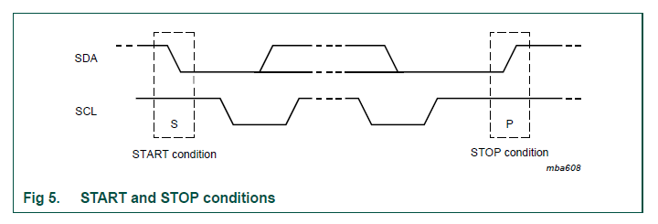
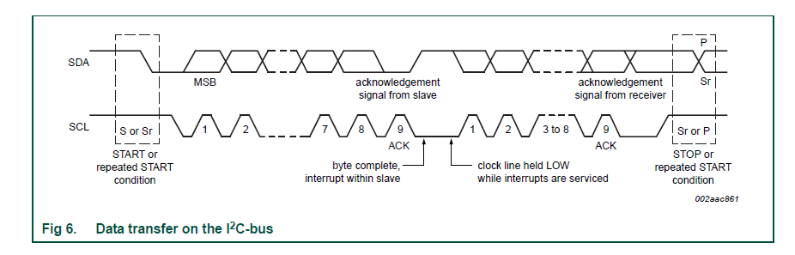
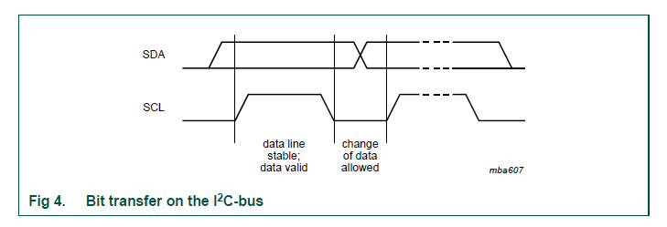
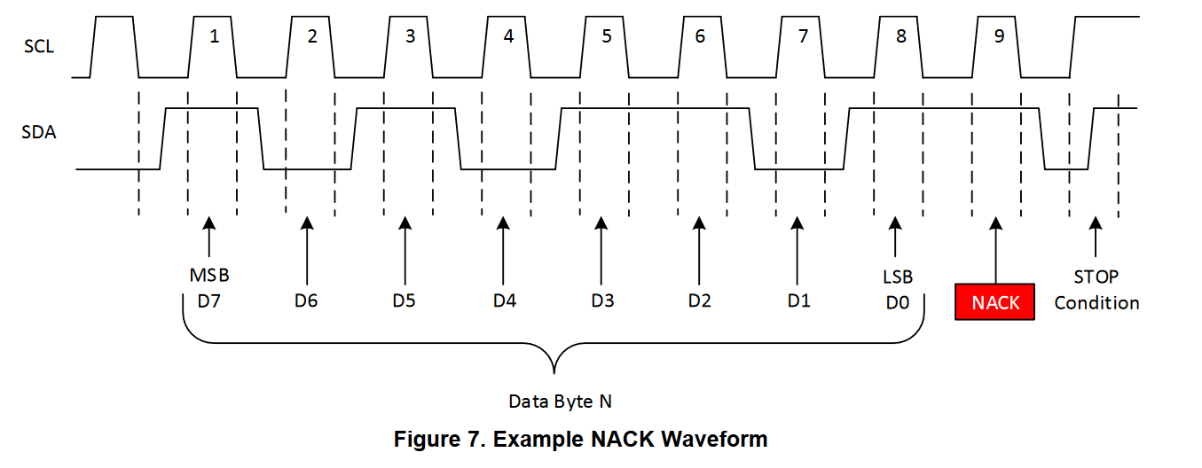
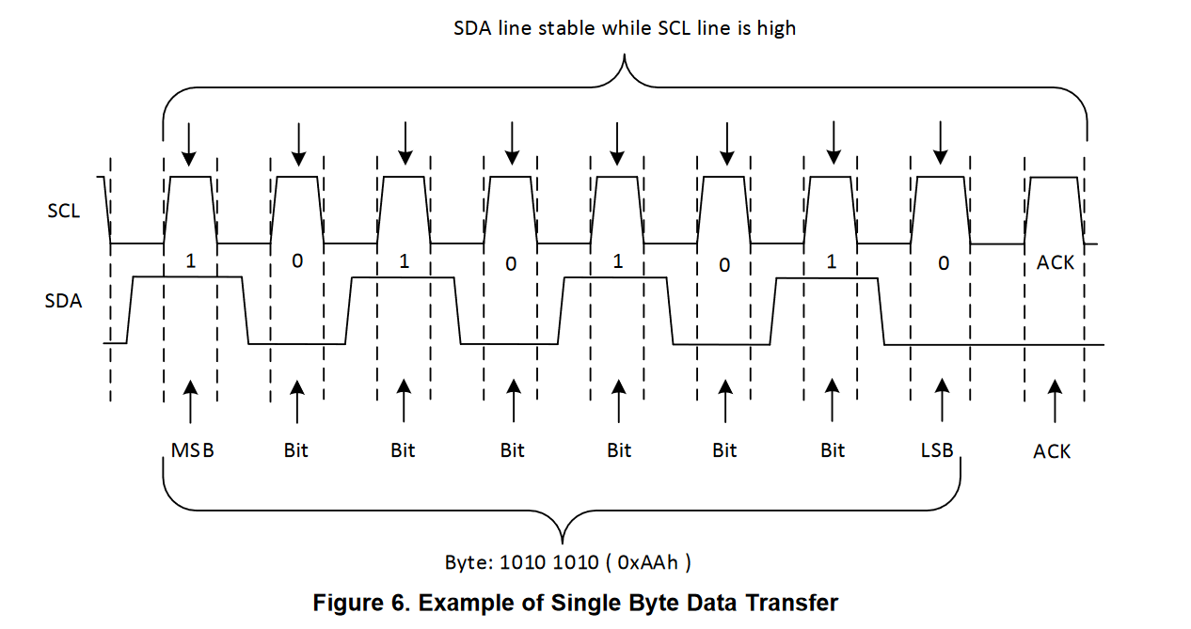
Sample Waveforms from Datasheet

Slide 4
Final Waveform Result

Slide 5
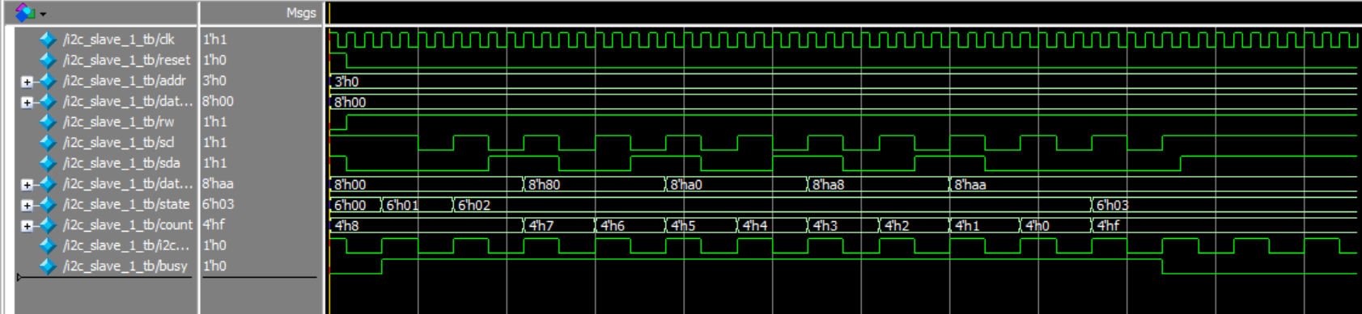
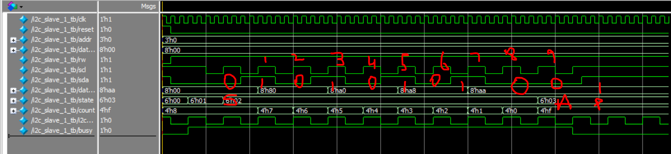
I2C Slave - aah

Slide 6
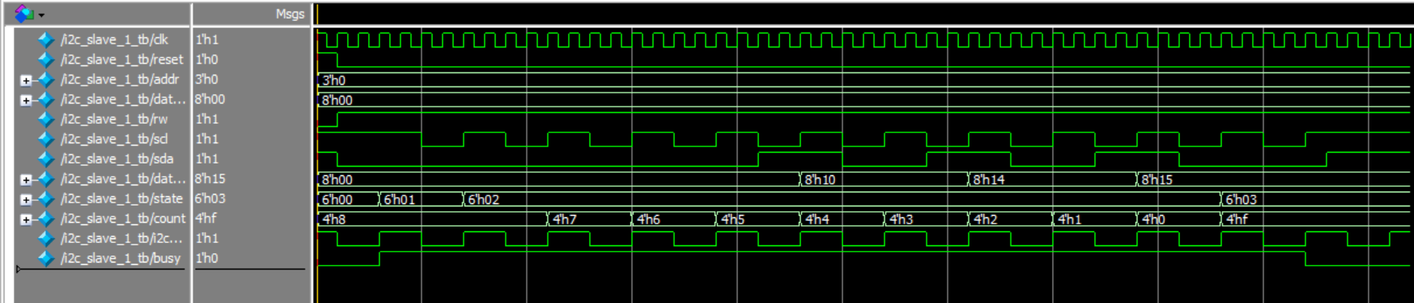
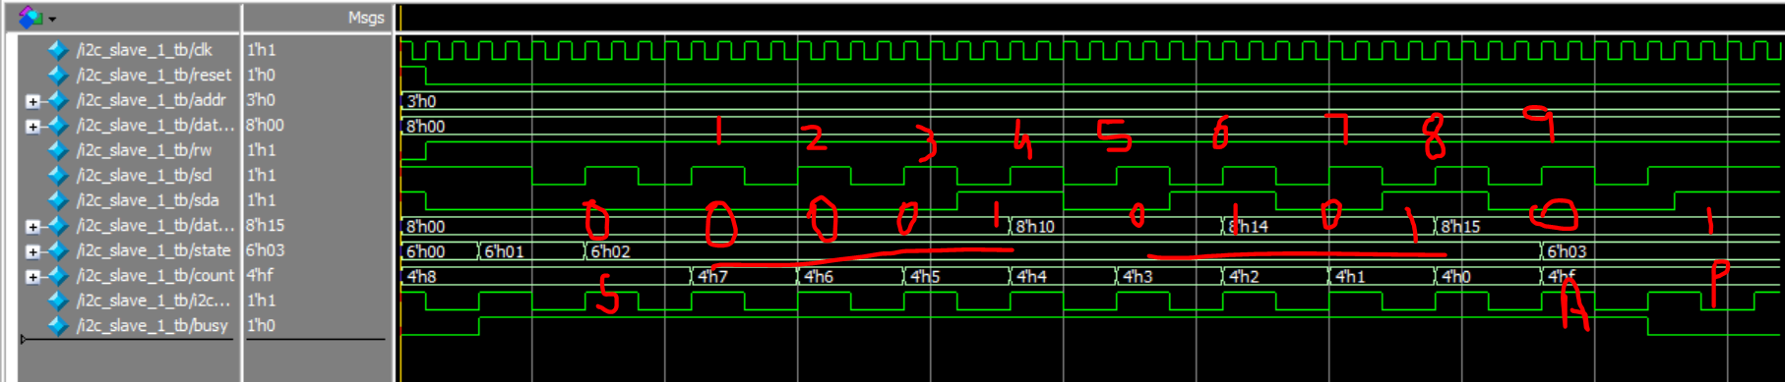
I2C Slave - 15h

Slide 7
References

Slide 8
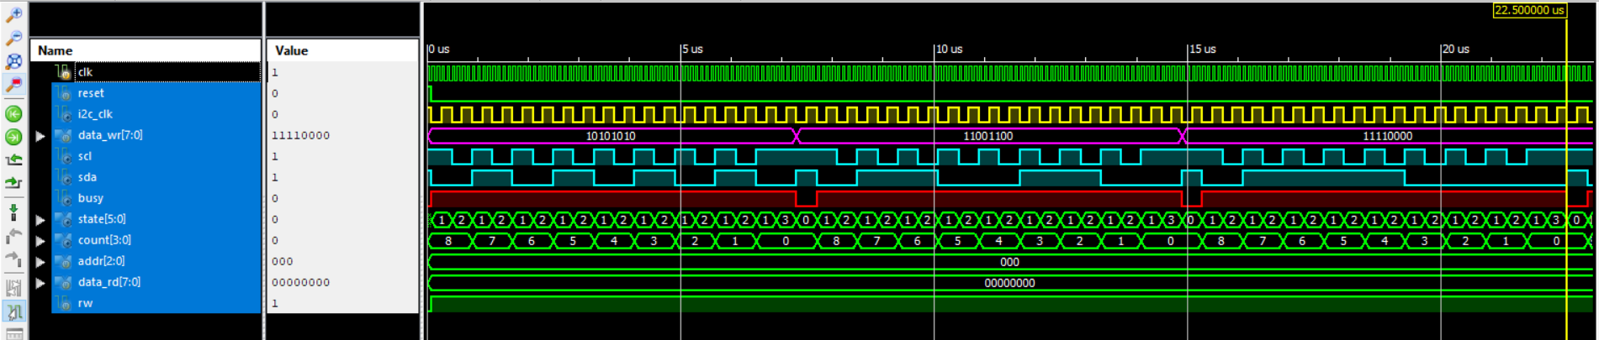
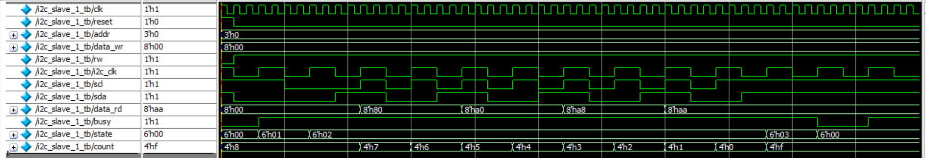
I2C Master
S
1
0
1
0
1
0
1
0
P
S
1
1
0
0
1
1
0
0
P
I2C Slave
0
1
0
1
0
1
0
1
0
1
SCL =1
SDA = 1 to 0
SCL =1
SDA = 0 to 1
Data = 10101010
Pos. = 7654321

