Slide 1



SUPPLY CHAIN PERFORMANCE ANALYSIS
AKHILA

Slide 2

Learning Objectives
Data Preparation: Import, clean, and transform supply chain data for analysis.
Dashboard Creation: Build interactive dashboards to visualize trends and bottlenecks.
Data Modeling: Design relationships between orders, inventory, and suppliers.
Optimize Performance: Use insights to reduce costs, improve efficiency, and predict disruptions.
Real-Time Monitoring: Set up live reports for timely decision-making.
Collaboration: Share reports and enable data-driven teamwork.
GOAL
Source :
www.freepik.com/

Slide 3
Tools and Technology used
Power View: Interactive data visualization and dashboard creation.
Power Map: 3D geospatial data visualization.
Power BI Service: Cloud platform for sharing and collaboration.
Power Query: Data extraction, transformation, and loading (ETL) tool.
Power Pivot: Data modeling and calculations using DAX (Data Analysis Expressions).

Slide 4
Methodology
The graph visualizes the relationship between the average shipping time and shipping cost.
It highlights trends or correlations, helping identify whether higher shipping costs reduce delivery time or if inefficiencies exist in logistics.
Sum of Products Sold (Routers):
This graph focuses on the total number of routers sold over a specific period or across regions.
It provides insights into product performance, highlighting demand patterns or sales trends for routers.
Average Shipping Time and Cost:

Slide 5
Problem Statement:
1. Comparing the shipping cost and shipping time.
2. Understanding the stock level for each product
3. Sum of product sold at the router
4. Sum of stock level of product
5. Sum of order quantities by product type

Slide 6
Solution:
We used the bar chats
(Compare values across categories)
We used pie chart to solve the problem statement
(Display proportions or percentage distribution)
Combo charts can we used to solve the problem
(Combine two chart types)

Slide 7
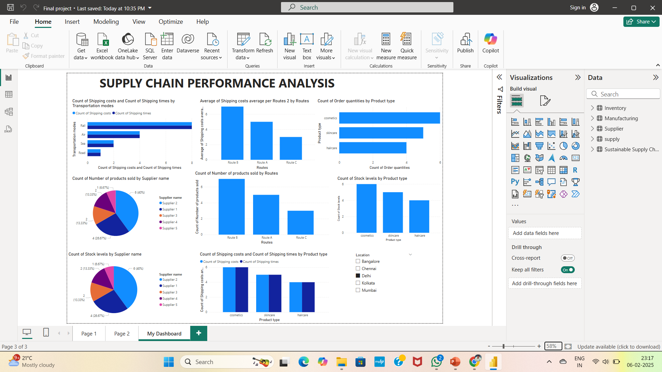
Screenshot of Output:

Slide 8
Conclusion:
Power BI is a powerful tool for analyzing and optimizing supply chain performance. By leveraging its data integration, visualization, and real-time monitoring capabilities, businesses can effectively track key performance indicators like shipping time, costs, inventory levels, and sales trends.
With interactive dashboards and predictive analytics, Power BI enables decision-makers to identify bottlenecks, reduce inefficiencies, and improve overall supply chain efficiency. It fosters data-driven strategies to enhance customer satisfaction, reduce costs, and increase profitability.
In conclusion, Power BI empowers organizations with actionable insights, transforming complex supply chain data into meaningful and accessible information for sustainable growth.

