Slide 1
AgroBot
Team Name: Decision Tree

Slide 2
OUR PRODUCT
Conversational bot to help farmers to find solutions to eradicate the weeds.
The bot provides FAQ's about weed control.
The bot works for all the languages - (user friendly)

Slide 3

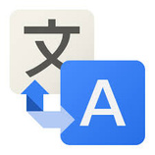









ARCHITECTURE
Tokenization
Stemming
Stopwords
Translate to english
t
s
s
User
Tfidfvectorizer()
Data
Pre-processing
Inference
Data
types of weeds available
weed
solutions
FAQ's
Bot
Actions
Translate to user language
Inference Function
Cosine Similarity

Slide 4
CHALLENGES FACED
Conversation with the chatbot was initially instructive due to issues with ontology matching
Getting a dialog dataset to aid with detecting the similarity between test data and inference data

Slide 5
POTENTIAL FEATURES
A standalone web application/Mobile app
Implementing Image Recognition

Slide 6


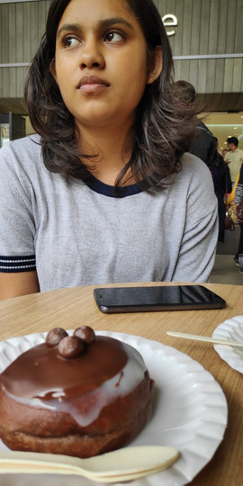
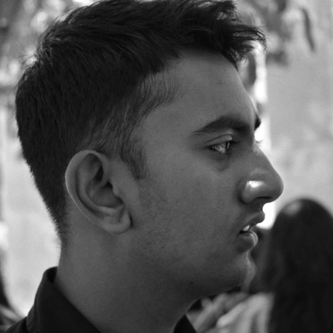
Ashwin
Karthik
Nithya
"Build a team so strong that you don't know who the boss is"
Thank you!

