Slide 1
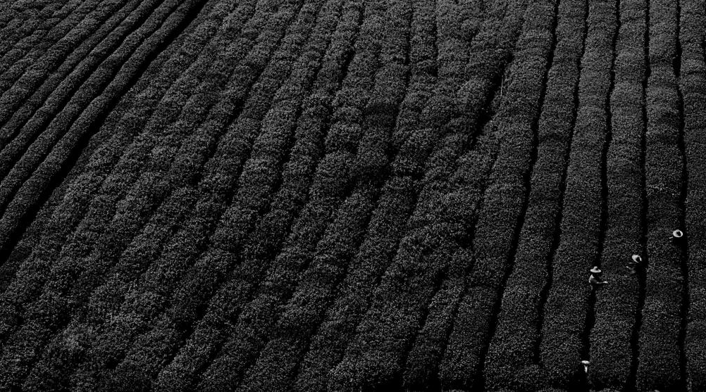
AGROBOT
TEAM NAME:LA_NINA
From New Horizon College of Engineering, Bangalore

Slide 2

Problem Statement
Food and Agri sector Improvement
To detect the plant disease using image processing and provide solutions to treat the disease.

Slide 3
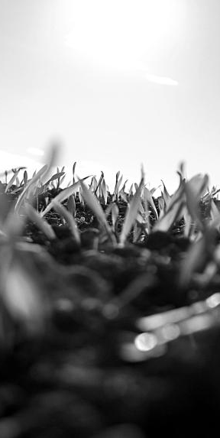
Benefits
Disease detection in plants plays an important role in agriculture field.
Our product detects the disease and provides solutions at the same time.
The workload and time is reduced as both detection and solution is done on the same application.
Our product is made more user friendly and can reach out to many people.

Slide 4
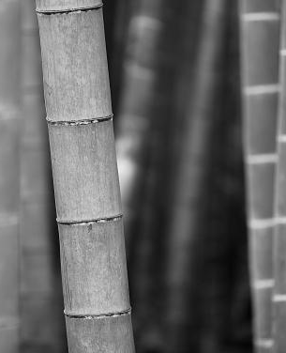
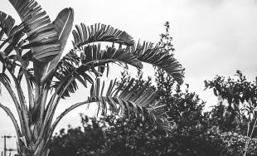
Our Product
A website that predicts the plant disease using image processing.
Conversational bot which provides solutions for the predicted plant disease.

Slide 5
Techstack Used
Django
Tensorflow
Deep Learning
Tkinter
HTML,CSS
Machine Learning
OpenCV

Slide 6








Architecture
Disease Detection
Tokenization
Stemming
Stopwords
t
s
s
Tfidfvectorizer()
User
Find solutions
Data
Pre-processing
Inference
Data
types of plant diseases available
disease
solutions
FAQ's
Bot
Actions
Inference Function
Cosine Similarity

Slide 7
Challenges Faced
Conversation with the chatbot was initially instructive due to issues with ontology matching.
Getting a dialog dataset to aid with detecting the similarity between test data and inference data.
Integrating the chatbot with the webpage initially was challenging.

Slide 8
Potential Features
A standalone Mobile app.
Implementing Speech Recognition.
Incorporating disease ontologies to get wide range of information.
Incorporating language translation to make the bot more user friendly.

Slide 9

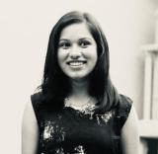
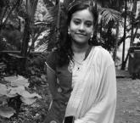
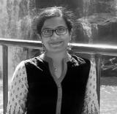
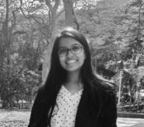
Team Members
Nithya
8553682809
nithyashr99@gmail.com
Varna
9742885120
varnamuralidhar9@gmail.com
Akhila
8105615006
akhila.hema@gmail.com
Vaishnavi
8861231940
vaishnavirk.2098@gmail.com
From New Horizon College of Engineering, Bangalore

Slide 10
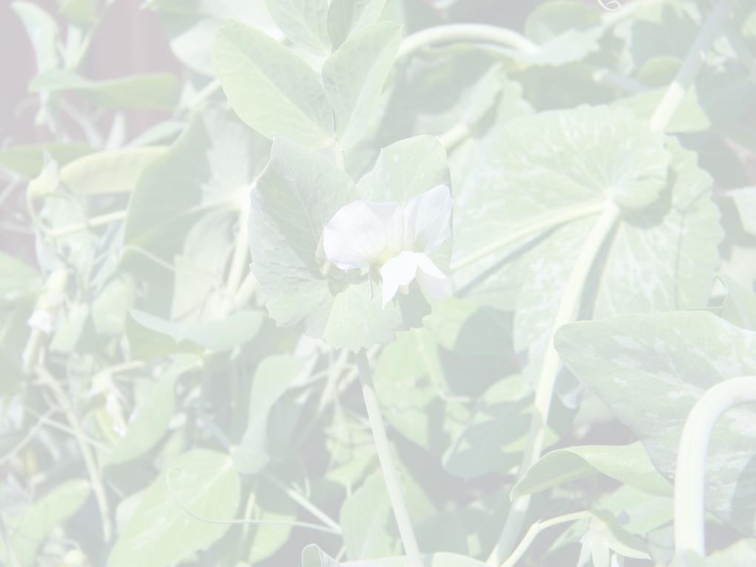
Github Link for Code:
https://github.com/NithyaShree30/Accelathon_La_Nina
Datasets used
Plant village dataset-kaggle
Alexnet Model (for training):-https://drive.google.com/file/d/1FZXraDDPqbRTXQeiQclfojgtoLddxQ_/view
Solutions for the diseases:- https://www.planetnatural.com/
Link for Video
https://drive.google.com/file/d/1ks9ci5NEWBoP2H0FlOGcvQlrco0ZsMN2/view?usp=sharing

Slide 11
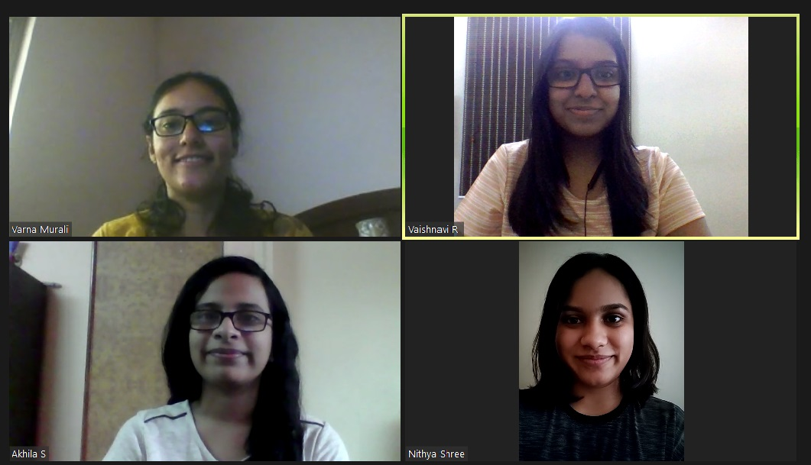
TEAM SELFIE

Slide 12
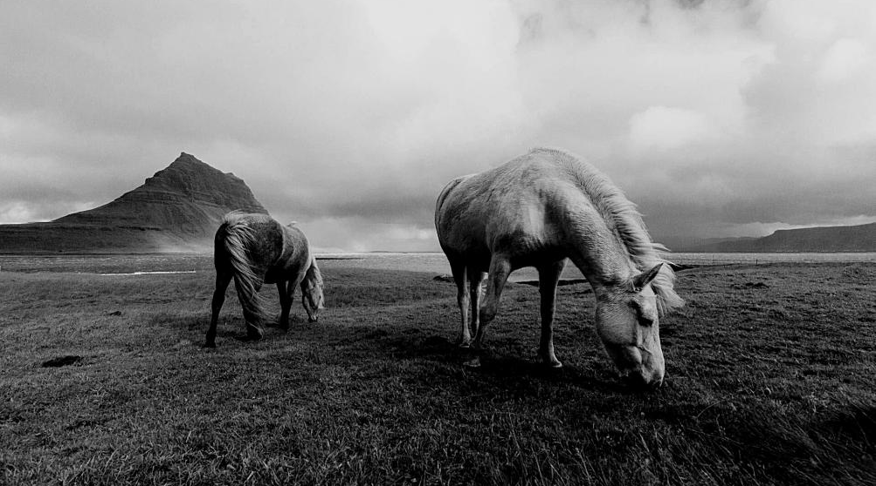
TEAM LA_NINA
Thank you!
"Build a team so strong that you don't know who the boss is"

