Slide 1
Course: Human-Computer Interface
QR Code Generator
Using HTML, CSS javaScript.
Batch No.[52] Group No. []
[2403A51L40 G. Akhila]
[2403A51L41 S. Sankeerthana]
Instructor: [Dr. Sasanko Sekhar Gantayat]
Date: [29/10/2024]

Slide 2
Introduction
What is a QR Code?
A type of matrix barcode (or two-dimensional barcode).
Stores information like URLs, text, and more.
Applications of QR Codes
Marketing, ticketing, payments, and product information.
Use Case: Event Registration
Scenario:
An event organizer wants to simplify the registration process for attendees.
Solution:
Generate a unique QR code for each registrant that links to their personalized event page.
Benefits:
Faster check-in process.
Reduced paper usage (digital tickets).
Easy sharing and scanning.

Slide 3
Introduction
• Overview of the Project:
QR Code Generator Project OverviewObjective: Develop a customizable QR code generator for URLs, Texts, Product Links etc..
Key Features:
Input: Text, URLs, contact info, Wi-Fi.
Customization: Colors, size, error correction, logo integration.
Output: High-resolution formats (PNG, SVG, PDF).
History: Save recent QR codes, templates for common uses.Tech Requirements:
Frontend: Responsive UI with live preview (React/Vue.js).
Backend: Secure code generation (Node.js/Flask).
Database: MongoDB or MySQL if saving data.
Timeline: 1 week planning, 2-3 weeks development, 2 weeks testing and launch.

Slide 4
Introduction
• Objective
The objective of creating a QR code generator using HTML, CSS, and JavaScript is to develop a user-friendly web application that allows users to easily generate QR codes for various types of data, such as URLs, text, or contact information. The application should provide an intuitive interface that enables users to input their data, customize QR code appearance, and download or share the generated codes seamlessly. By leveraging JavaScript libraries for QR code generation, the tool will ensure fast processing and high-quality output, catering to both personal and professional use cases, such as event promotion, marketing, and contact sharing.
• Target Audience
Small Business Owners: For marketing and promotional materials.
Event Organizers: To create QR codes for tickets and schedules.
Marketers: For tracking engagement in campaigns.
Educators/Students: To share resources and assignments.
Individuals: For easily sharing contact information.
Nonprofits: To enhance outreach and facilitate donations.

Slide 5
Problem Statement
• Challenges Faced
Common Issues:
Handling invalid inputs.
Adjusting QR code size and error correction levels.
Solutions Implemented:
Input validation checks.
Customizable options for users.

Slide 6
Problem Statement
Mention challenges in existing systems
Complexity: Confusing interfaces for non-tech-savvy users.
Limited Customization: Minimal options for branding and design.
Lack of Analytics: No tracking features for QR code performance.
Slow Performance: Delays in loading and processing.
Mobile Compatibility: Not optimized for mobile devices.
Security Concerns: Inadequate privacy protections.
File Format Limitations: Few export options for different applications.
These challenges highlight the need for a more effective QR code generator.

Slide 7
Conceptualization of the Interface
• Initial Idea
The initial idea for the QR code generator is to create a user-friendly web application that allows users to easily generate customized QR codes for URLs, text, and contact information. Key features will include customization options, multiple download formats, social media sharing, and analytics to track engagement. The application will be optimized for both desktop and mobile use, ensuring accessibility for all users.
• Inspiration
The inspiration for the QR code generator stems from the growing need for seamless digital interactions and the popularity of QR codes in various industries. Observing how businesses, event organizers, and individuals utilize QR codes for marketing, sharing information, and enhancing user engagement highlights their versatility. Additionally, the success of existing user-friendly applications motivates the creation of a tool that combines simplicity, customization, and analytics. The aim is to empower users with an intuitive solution that enhances their ability to create and utilize QR codes effectively in an increasingly digital world.

Slide 8
Conceptualization of the Interface
Core Features
User-Friendly Interface: Simple and intuitive design for easy navigation.
Customization Options: Ability to change colors, shapes, and add logos.
Multiple Data Types: Generate QR codes for URLs, text, emails, and contact info.
Download Formats: Export QR codes in PNG, SVG, and other formats.
Social Media Sharing: Quick options to share generated codes on social platforms.
Analytics Tracking: Monitor QR code scans and engagement metrics.
Mobile Responsiveness: Fully functional on both desktop and mobile devices.

Slide 9
User Personas
Persona 1:
Small Business OwnerAlice, a small bakery owner, seeks to enhance customer engagement. She wants to create custom QR codes linking to her menu and promotions, aiming to streamline ordering and boost sales.
Persona 2:
Event OrganizerMark organizes local events and needs QR codes for tickets and schedules. He values quick generation and easy sharing to improve attendee experience and streamline logistics.

Slide 10
User Personas
• How personas will use the interface?
Alice (Small Business Owner):
Alice will access the QR code generator on her laptop. She'll input her bakery's menu URL, customize the QR code with her brand colors and logo, and download it as a PNG file. Alice will then print the QR code for display in her shop, encouraging customers to order online.
Mark (Event Organizer):
Mark will use the QR code generator on his smartphone to create codes for event tickets and schedules. He will quickly input the relevant information, select a design, and generate multiple QR codes in different formats for printing and sharing. Mark will share these codes via email and social media to ensure easy access for attendees.

Slide 11
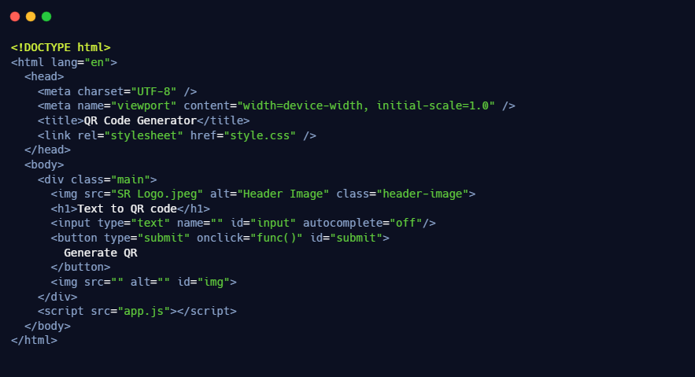
Information Architecture
HTML Structure
Basic Layout:
Explanation of Layout
Input field for user data.
Button to trigger QR code generation.
Div to display the generated QR code

Slide 12
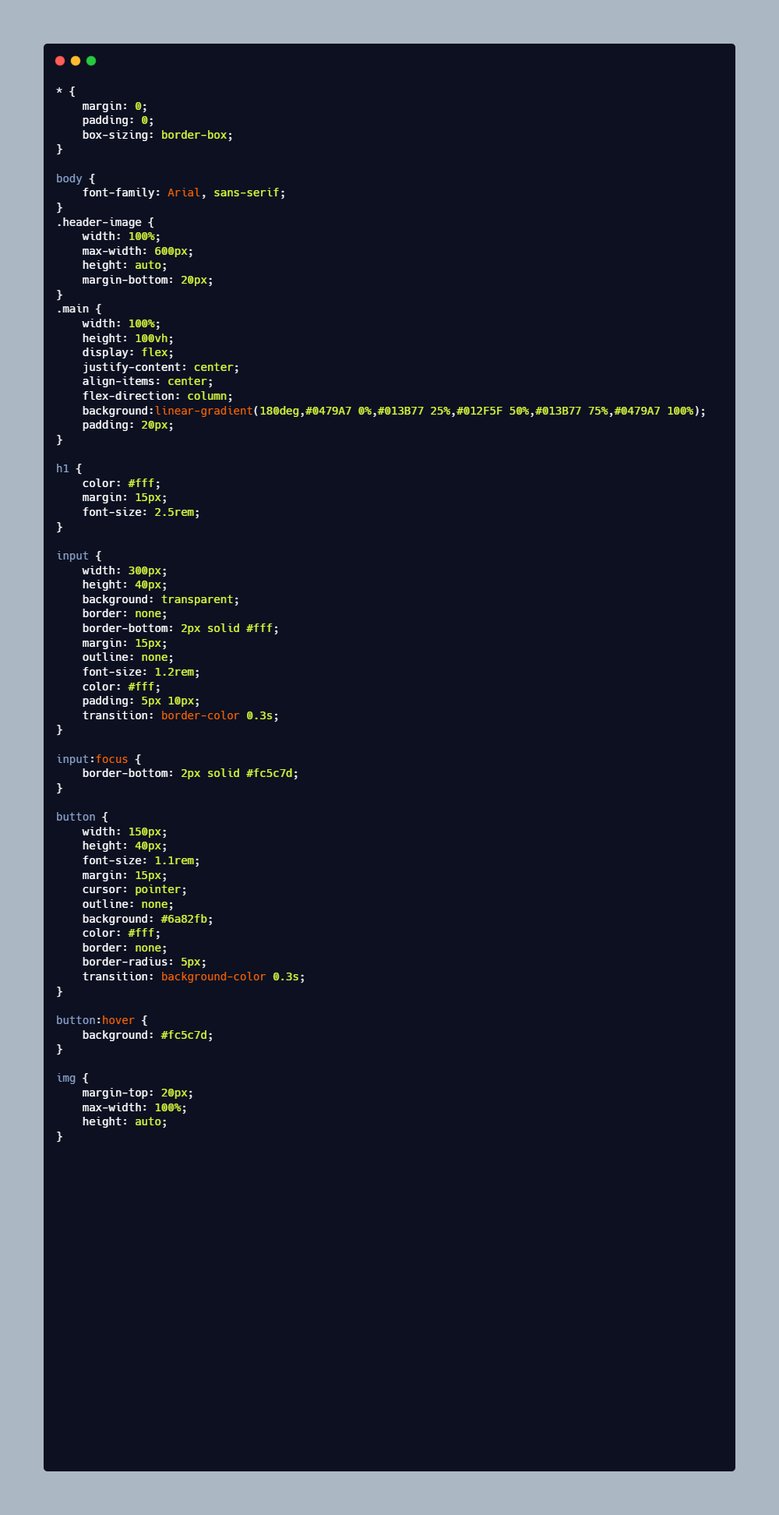
Information Architecture
CSS Styling
Basic Styles:
Considerations:
Responsive design.
User-friendly interface.

Slide 13
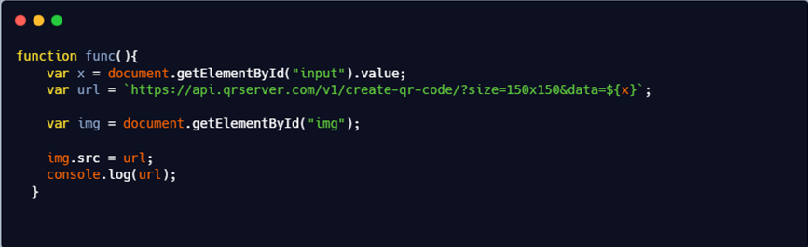
Information Architecture
JavaScript Functionality
Key Functions:
Capture input from the user.
Generate QR code using the library.
Sample Code:

Slide 14
Tools Used
• Tools Used:
HTML5: Basic structure and elements.
CSS3: Styling the application for better user experience.
JavaScript: Core logic for QR code generation.
Library Used: Example: qrcode.js or QRCode.js (for simplicity).

Slide 15
Design Considerations
• User Experience (UX):
Intuitive Onboarding: Clear introductions guide users through the features of the tool.
Streamlined Input and Customization: Easy data entry with a single field and real-time visual customization options.
Instant Feedback: Immediate confirmations and error notifications enhance user confidence.
Mobile Responsiveness: Optimized for smartphones and tablets, ensuring accessibility on the go.
Access to Analytics and Support: Users can view performance metrics and access a help section for assistance.

Slide 16
Design Considerations
Usability Principles
Learnability: Users can quickly understand how to use the generator.
Efficiency: Tasks are completed quickly with minimal steps.3.
Memorability: Users can easily return and use the tool without relearning.
Error Handling: Clear messages and recovery options help users fix mistakes.
Satisfaction: Users find the experience enjoyable and effective in meeting their needs.

Slide 17
Design Considerations
Accessibility:
Keyboard Navigation: Ensure all functions can be accessed using a keyboard for users who cannot use a mouse.
Screen Reader Compatibility: Use semantic HTML and ARIA attributes to ensure that visually impaired users can navigate and understand the interface.
Color Contrast: Maintain high contrast between text and background to enhance readability for users with visual impairments.
Alt Text for Images: Provide descriptive alt text for all images and icons to convey information to screen reader users.
Adjustable Font Sizes: Allow users to modify text size easily to accommodate different visual preferences and needs.

Slide 18
Interactions
• Key Interactions:
Access Generator: Navigate to the web application.
Input Data: Enter data (e.g., URL, text) in the input field.
Customize QR Code: Select colors, shapes, and add logos.
Generate Code: Click “Generate QR Code” to create it.
View and copy: View the QR code and copy.
Share Options: Share directly to social media or via email.
Access Analytics: View scan metrics in a dedicated section.
Return to Input: Easily go back to generate more QR codes.

Slide 19
Demonstration
• Demo Link
file:///C:/Users/cc/AppData/Local/Temp/Rar$EX71.406/QR-Code-Generator-master/index.html

Slide 20
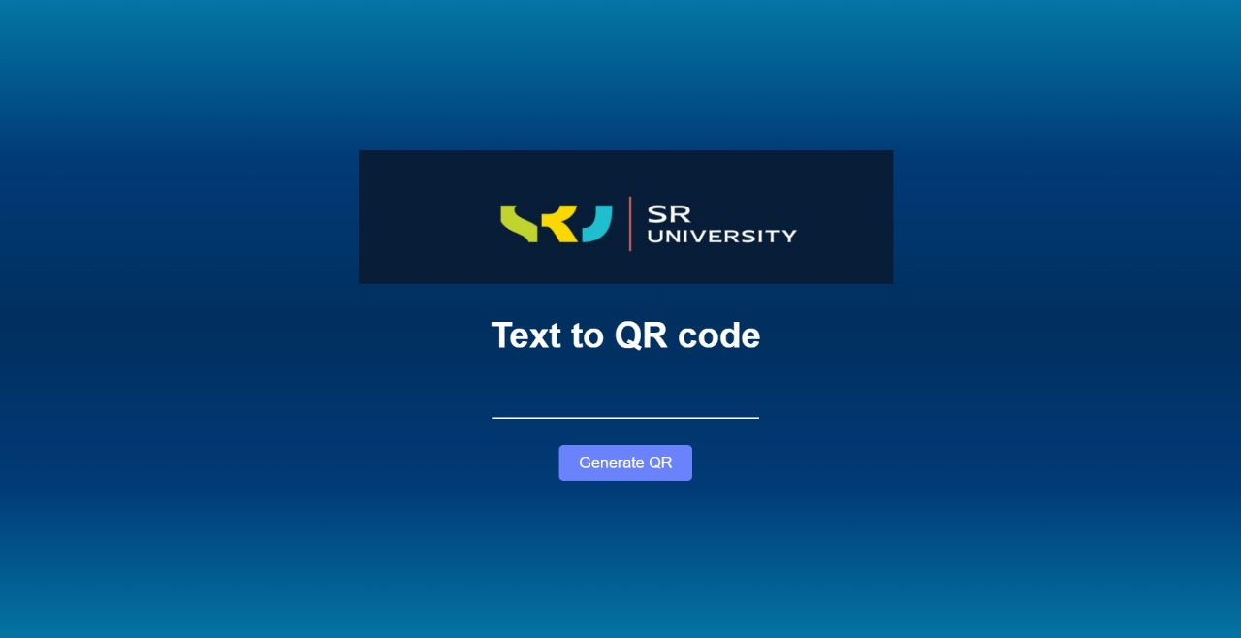
Figma

Slide 21
Conclusion
•Conclusion:
Summary of Learning:
Understanding how to manipulate the DOM with JavaScript.
Integrating third-party libraries.
Future Enhancements:
Adding download functionality for QR codes.
Storing generated codes in local storage.

