Slide 1
INVENTORY MANAGEMENT SYSTEM FOR FOODEX
By
AKHILA MALLA

Slide 2
TABLE OF CONTENTS
01 INTRODUCTION
02 PROJECT OVERVIEW
03 PRODUCT FRAMEWORK
04 SYSTEM ARCHITECTURE
05 METHODOLOGY & RESULTS
07 CONCLUSION

Slide 3
INTRODUCTION
Our project focuses on the development of an Inventory Management System for FoodEx using the Django framework. ​​
In response to the growing needs of modern businesses, particularly in the food industry, we recognized the importance of an efficient inventory system. ​​
This project aims to streamline FoodEx's inventory processes, enhancing overall management and operational efficiency.​​

Slide 4
PROJECT OVERVIEW
Our project focuses on the development of a robust Inventory Management System tailored for Foodex, a leading player in the food industry. ​​
This system is designed to streamline and optimize the tracking, monitoring, and control of Foodex's vast inventory of food products. ​​
By implementing cutting-edge technology, our aim is to enhance efficiency, minimize errors, and provide real-time insights into the inventory management process.​

Slide 5
PRODUCT FRAMEWORK
To overcome the identified challenges, we propose the development of an advanced Inventory Management System using the Django framework.​
Our solution involves initiating the project with a focus on structured views and URLs, implementing template inheritance for code reusability and consistency, customizing the Django Admin Panel for efficient data management, enriching the user registration form with additional features like email fields, and establishing a secure login and logout system.​
Furthermore, we aim to empower users with a robust password reset functionality. These strategic steps, collectively forming our methodology, ensure the creation of a comprehensive, tailored, and secure inventory management system that aligns seamlessly with Foodex's operational requirements.​

Slide 6
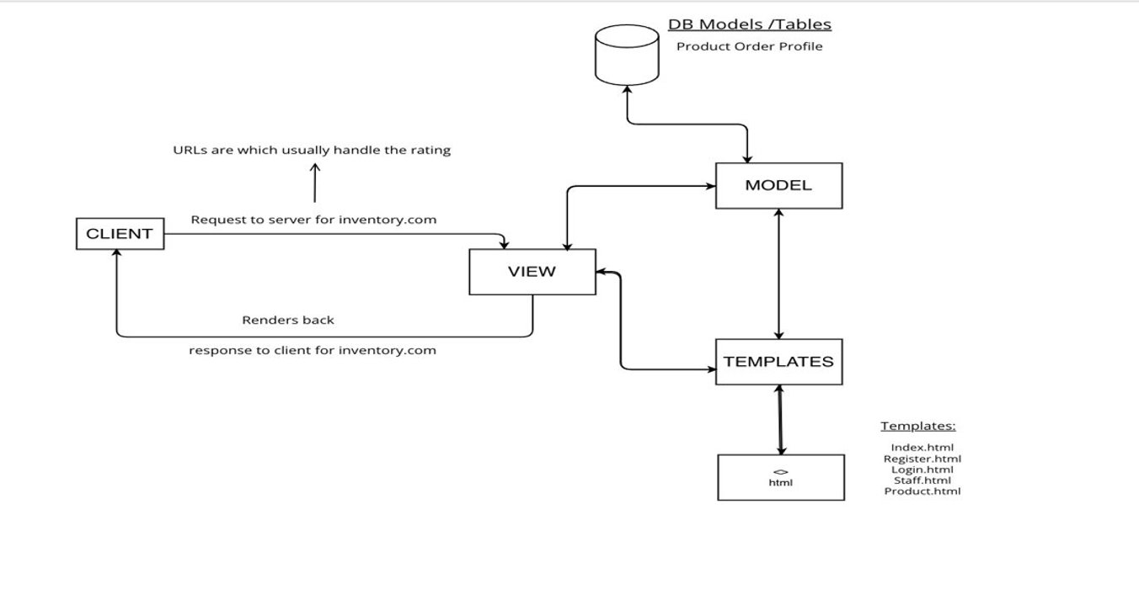
DJANGO SYSTEM ARCHITECTURE

Slide 7
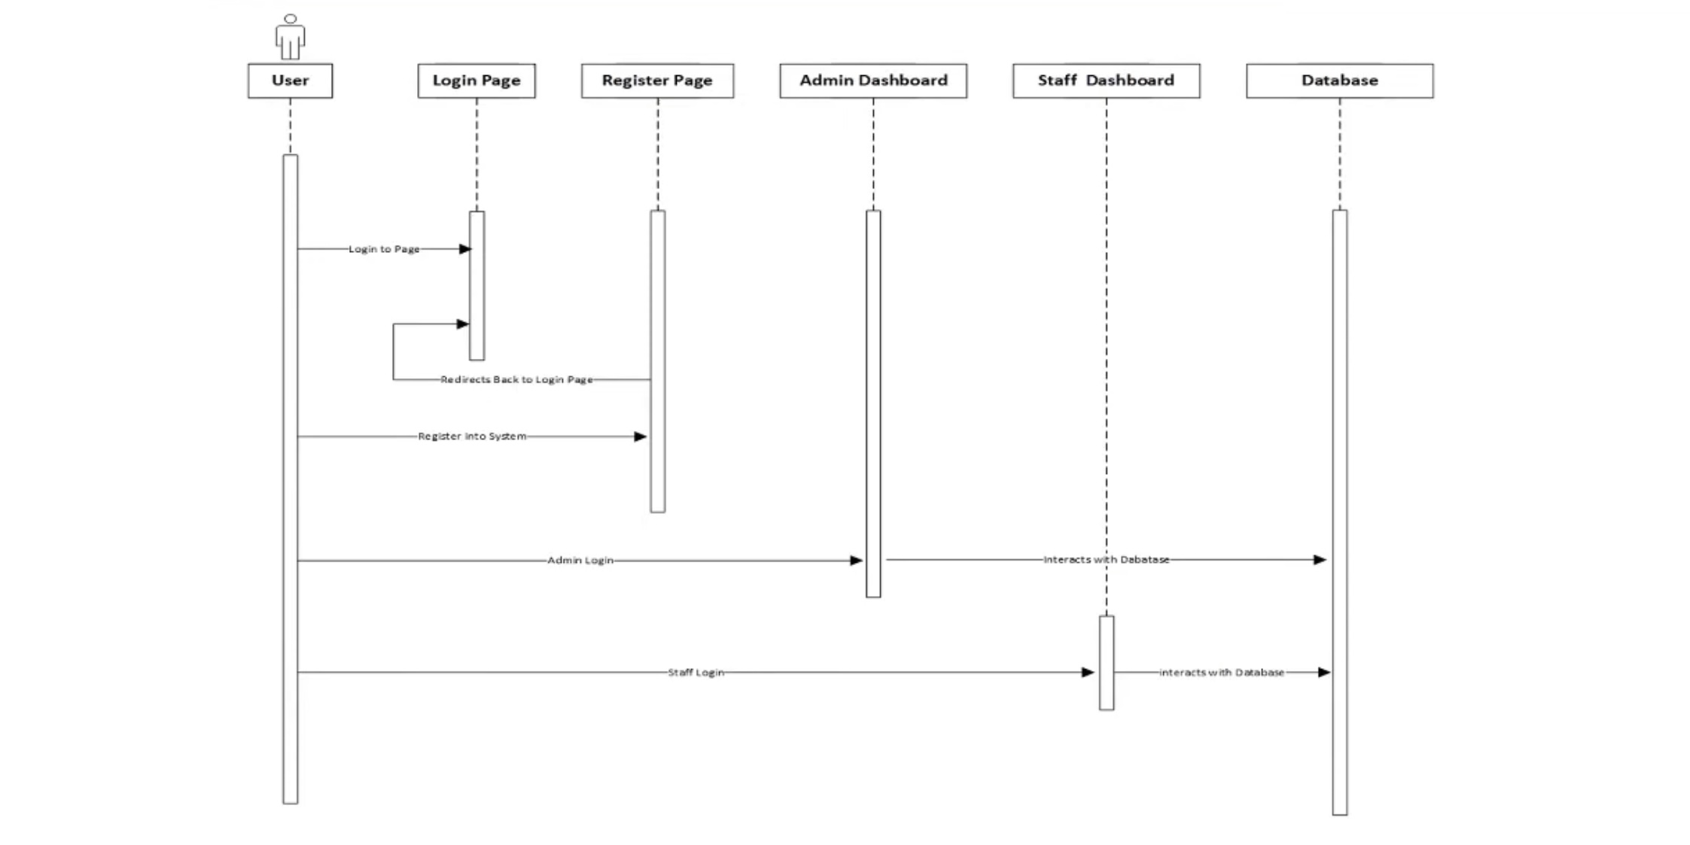
SYSTEM DESIGN

Slide 8
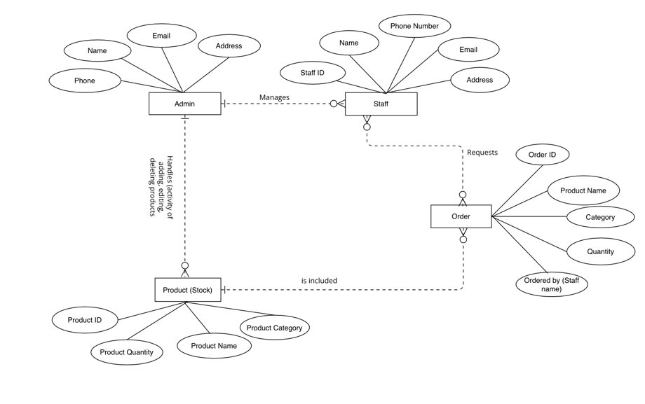
ER DIAGRAM

Slide 9
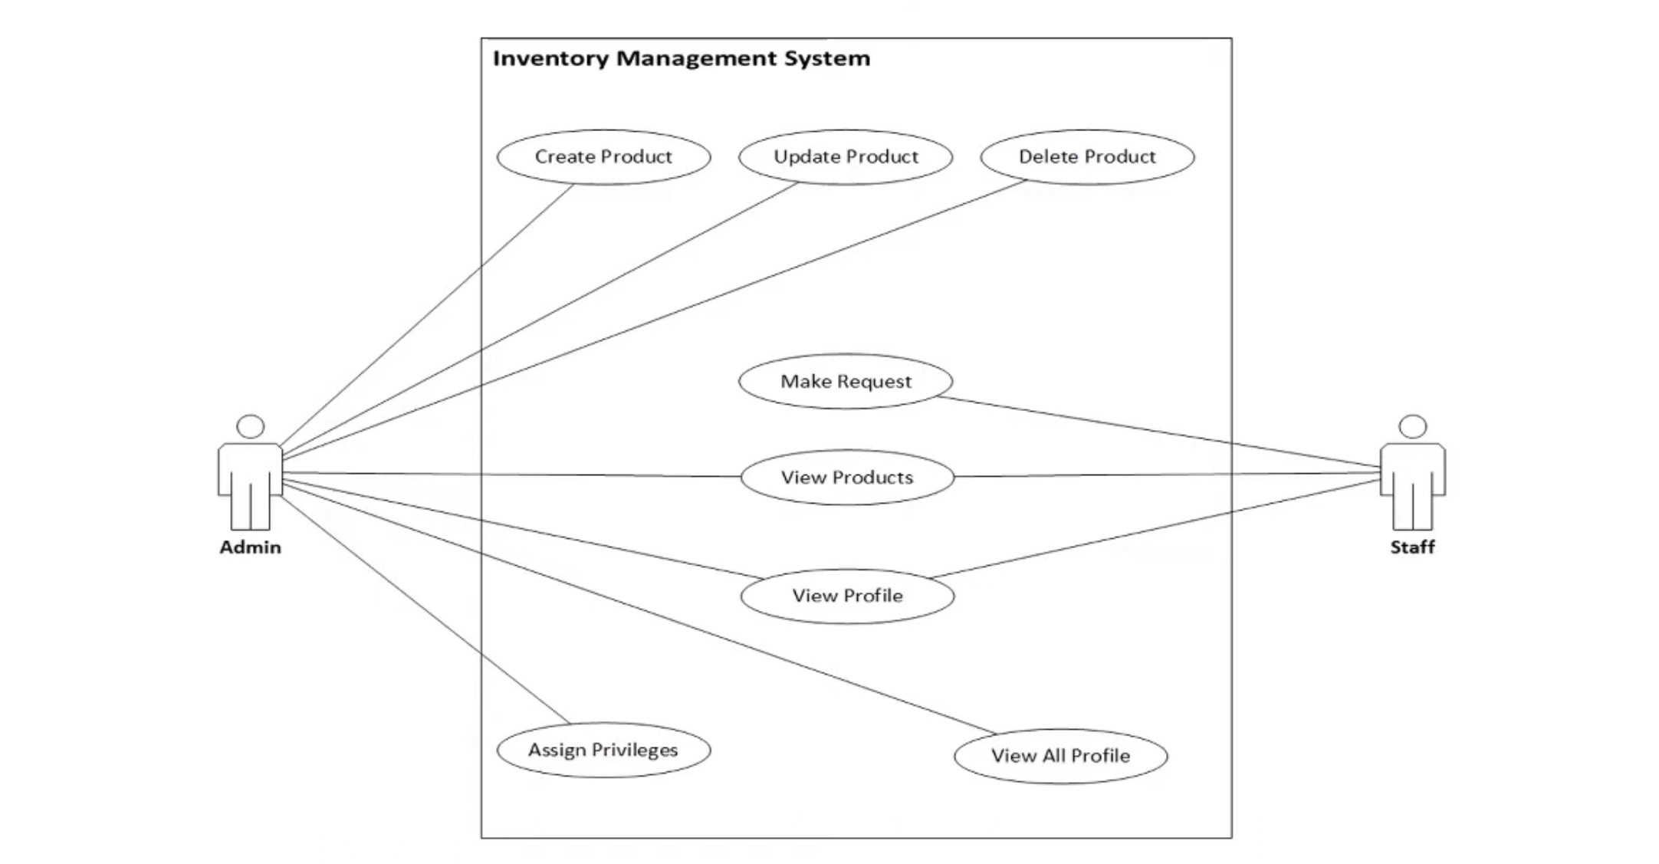
WEBSITE DESIGN

Slide 10
ORM FOR THE INTERACTION WITH DATABASE
Object Relational Mapping allows us to interact with the database using object-oriented programming concepts without having to write raw SQL queries.
Conventionally, database queries are associated to CRUD functions.
C – Create
R – Read/Retrieve,
U – Update
D – Delete
A queryset represents the collection of objects of a particular model accessed from the database based on given criteria.

Slide 11
FUNCTIONAL IMPLEMENTATIONS
Established Views and URLs
Leveraged Template Inheritance
Employed User Registration forms
Engineered a Secure Login and Logout System in Django
Implemented different accessibility levels
Database Interaction using ORM
Empowered users with Password reset functionality in Django
Added Flash Messages in the pages
Visualized data with charts

Slide 12
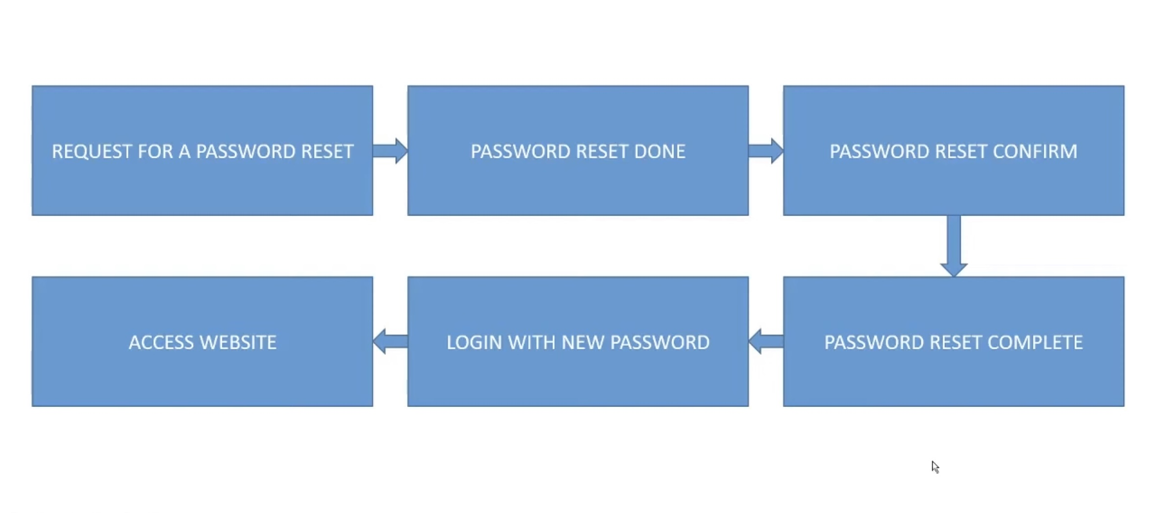



PASSWORD RESET FUNCTIONALITY

Slide 13
CONCLUSION
In concluding our journey of developing the Inventory Management System for Foodex using Django, we have successfully tackled key challenges in traditional inventory methods. ​
Through strategic steps and collaborative efforts, we've laid the foundation for a robust, efficient, and user-friendly system. The implementation of Django's features, such as template inheritance, customized Admin Panel, and secure authentication mechanisms, ensures a seamless user experience. ​
Our commitment to enhancing user registration and providing a reliable password reset mechanism further empowers users. As we wrap up this phase, we look forward to witnessing the positive impact of our Inventory Management System on Foodex's operations, streamlining processes, optimizing control, and setting the stage for future enhancements.​

Slide 14
DEMO? CLICK HERE

Slide 15
THANKYOU!

