Slide 1
Real-Time Web Chat Application
Presented By:
23951A6709 – M.Akhila
239516760 – M.Keerthana

Slide 2
Introduction
In today’s digital era, users expect instant communication — whether through messaging apps, customer support, or collaboration tools.
Traditional HTTP request–response models are not suitable for continuous data exchange.
WebSockets allow real-time, full-duplex communication, eliminating the need for constant polling.
This project showcases how WebSockets can be integrated with Spring Boot and React for a seamless chat experience.

Slide 3
Technologies Used
Category | Technology / Tool | Purpose
Frontend | React.js, HTML, CSS, JavaScript | User Interface
Backend | Spring Boot (Java) | Real-time message processing
Communication | WebSocket, STOMP, SockJS | Live message transmission
Build Tools | Maven, npm | Dependency and build management
Optional | MongoDB / MySQL | Message storage (future enhancement)

Slide 4
Problem Statement
Traditional chat systems using HTTP polling or AJAX repeatedly request updates from the server.
This results in:
High network usage.
Delayed message updates.
Poor scalability when multiple users are active.
Proposed Solution:
Implement WebSocket-based communication to:
Maintain a continuous, open connection.
Push new messages instantly from server to clients.
Provide a real-time, synchronized user experience.

Slide 5
System Architecture
Architecture Flow:
Frontend (React):
  Captures user input and displays chat messages.
  Establishes WebSocket connection to the backend.
Backend (Spring Boot):
  Listens for incoming messages via WebSocket.
  Broadcasts the received messages to all connected clients.
STOMP Protocol:
  Defines message destinations (/app and /topic).
  Ensures structured, reliable communication.
SockJS:
  Provides fallback options for browsers not supporting native WebSockets.
  Result: A continuous, two-way communication channel between all users and the server.

Slide 6
Components Overview
Frontend (React.js):
Simple chat interface with input and message display.
Connects to the backend using SockJS and STOMP client.
Automatically updates messages in real time.
Backend (Spring Boot):
Handles WebSocket connections using @EnableWebSocketMessageBroker.
Listens to messages from /app/message and broadcasts to /topic/messages.
Manages user sessions efficiently.

Slide 7
Interface & Demonstration
User Interface Features:
Clean chat window.
Live message updates without page refresh.
Instant broadcast between multiple browser clients.
Demonstration Flow:
User A and User B open the chat in two browsers.
User A sends a message.
Message instantly appears in both chat windows.

Slide 8
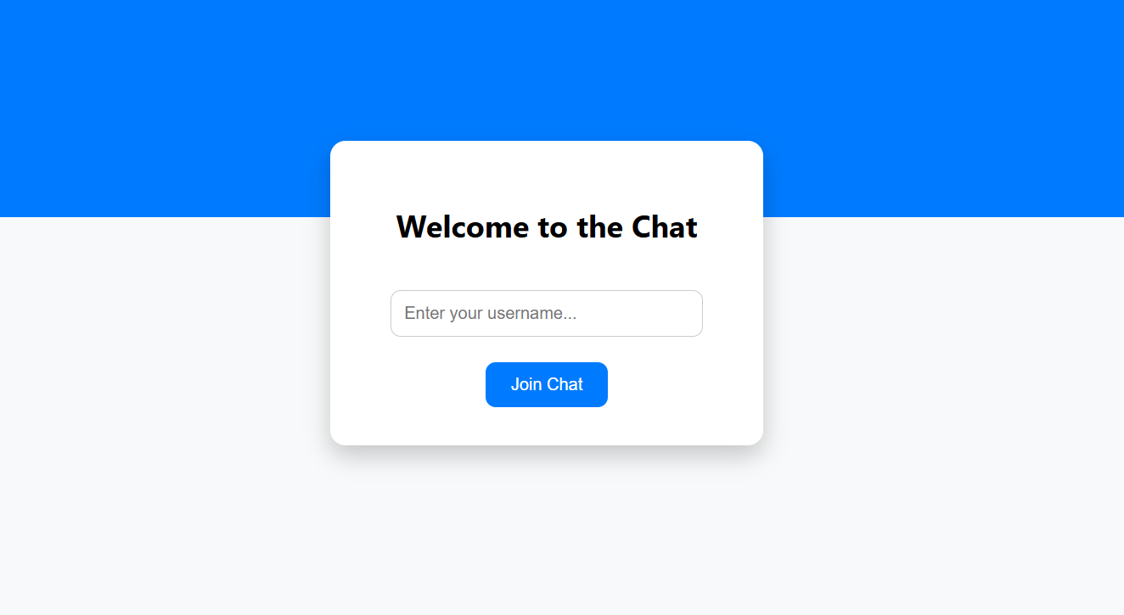
Welcome page

Slide 9
Features
Real-time messaging between multiple users.
✅ Lightweight and responsive user interface.
✅ Fully asynchronous communication.
✅ Scalable backend design using WebSocket brokers.
✅ Built with open-source technologies.
✅ Simple deployment on any Java-based server.
User Benefits:
Instant communication.
No need to reload or refresh pages.
Efficient performance for large numbers of users.

Slide 10
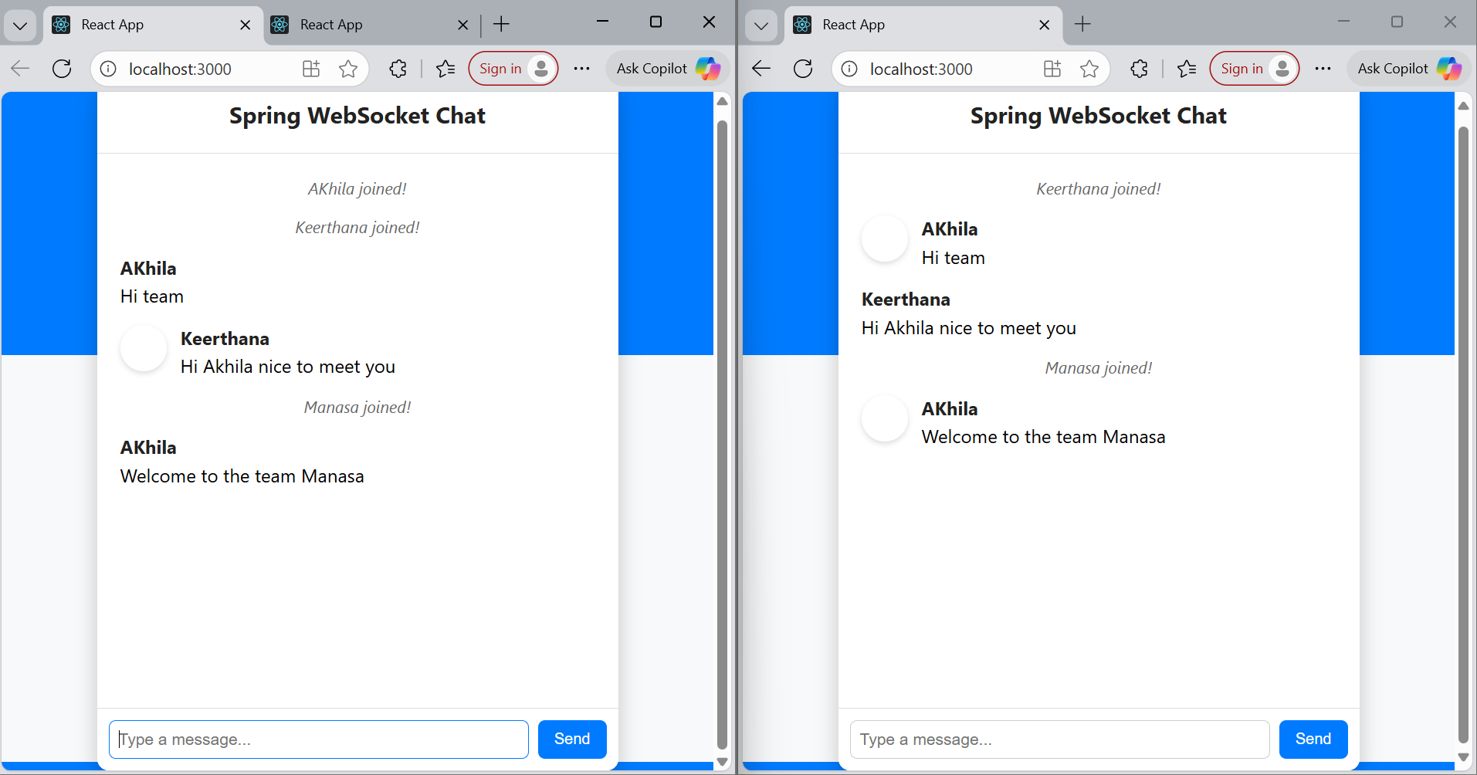

Slide 11
Future Enhancements
User Authentication:
Add login/registration to identify users.
Private Chat:
Allow one-to-one conversations.
Message History:
Store chat logs in a database.
Typing Indicators:
Show when another user is typing.
File Sharing and Emojis:
Enhance the user experience.
UI Redesign:
Add themes, message bubbles, and timestamps.

Slide 12
Testing & Results
Testing Approach:
Verified simultaneous messaging from multiple browsers.
Checked latency between message send and receive.
Validated connection recovery after server restart.
Results:
Latency: Less than 1 second between message send and receive.
Connection stability: Persistent WebSocket connection throughout.
Performance: Smooth message exchange with multiple users.

Slide 13
Conclusion
The project successfully demonstrates the power of WebSockets for modern web communication.
It eliminates the need for continuous polling and improves efficiency and speed.
With a React frontend and Spring Boot backend, this architecture provides a strong foundation for scalable chat systems.
The system can be easily extended to real-world applications such as customer support, group chats, or team collaboration tools.

Slide 14
THANK YOU

