Slide 1

US Road Accidents Data Analysis
Akhila Pulipati
Regis University

Slide 2
Introduction
Road accidents are one of the major concerns in the country.
The economic impact of traffic accidents cost hundreds of billions of dollars for US citizens every year.
Reducing the traffic accidents has always been a challenge.

Slide 3
Problem Statement
Analyze the factors increasing Road Accidents
Predict the Severity of accidents.

Slide 4

About Dataset
The dataset contains about 4.2 million records with 49 columns.
The data is collected from February 2016- December 2020.

Slide 5
Data Analysis Process Flow
Data Preprocessing
Data Visualization
Feature Selection
Modeling
Evaluation

Slide 6
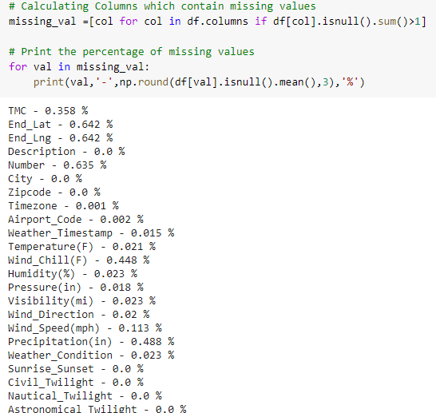
Data Preprocessing
Handled the missing values of few columns by filling with mean, mode, or with zero
Dropped null values for certain rows.

Slide 7
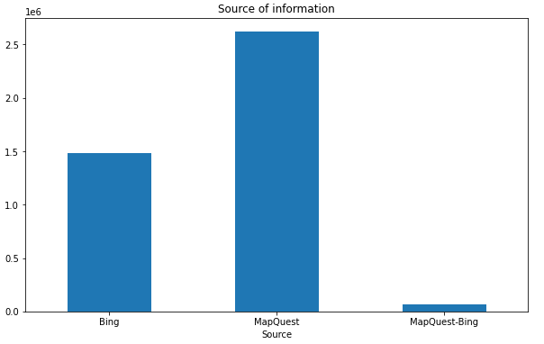
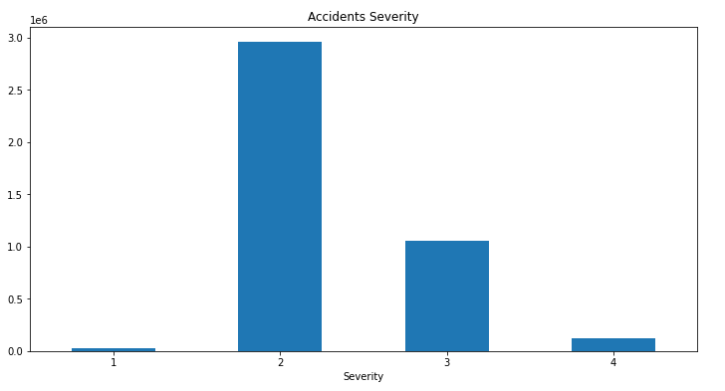
Data Visualization

Slide 8
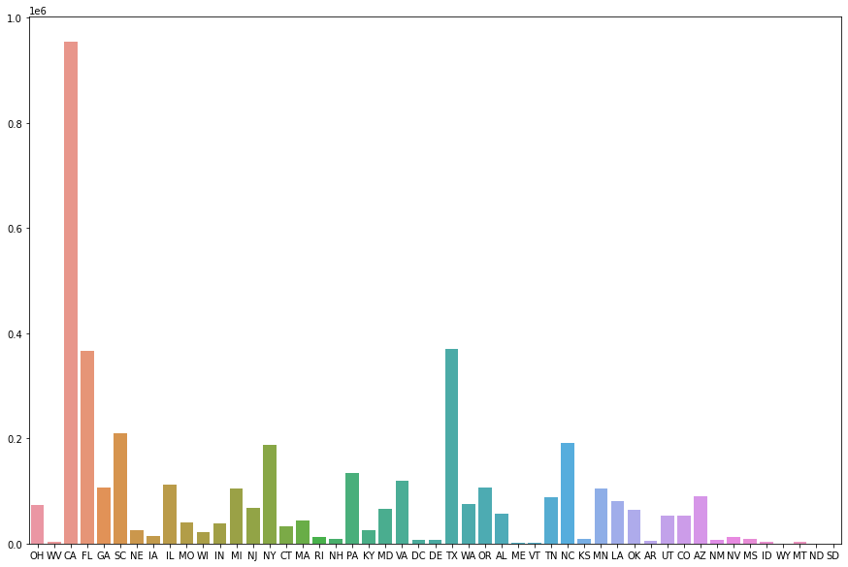
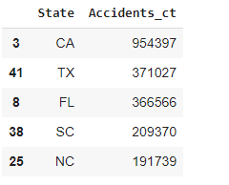

Slide 9
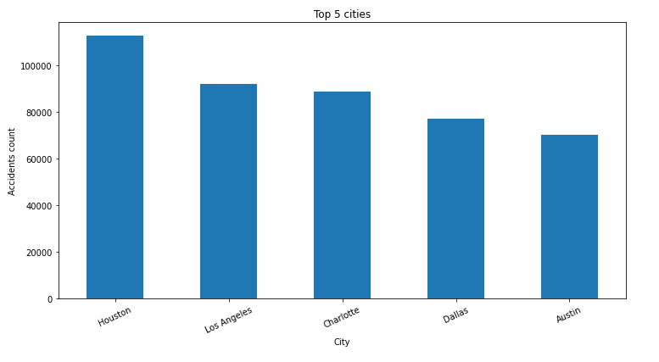

Slide 10
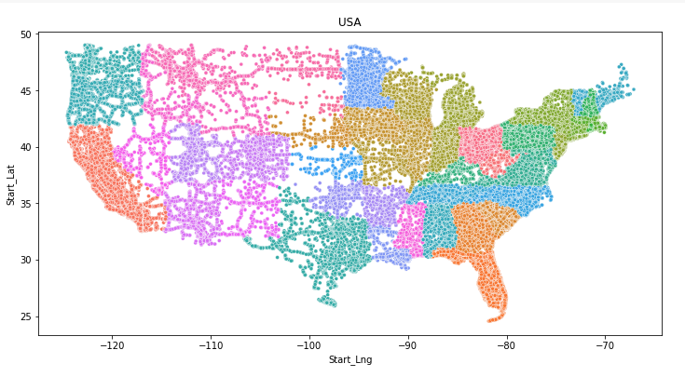

Slide 11
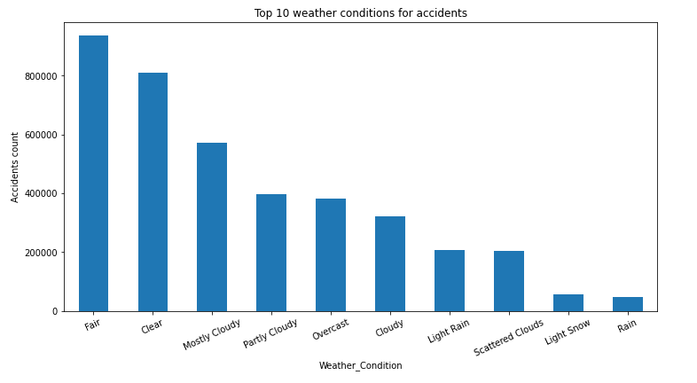

Slide 12
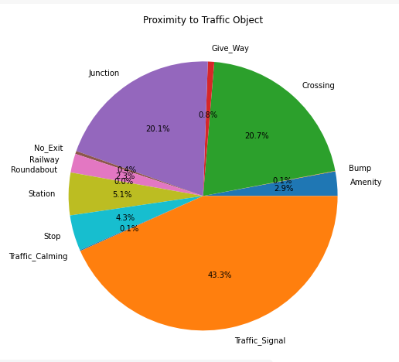

Slide 13
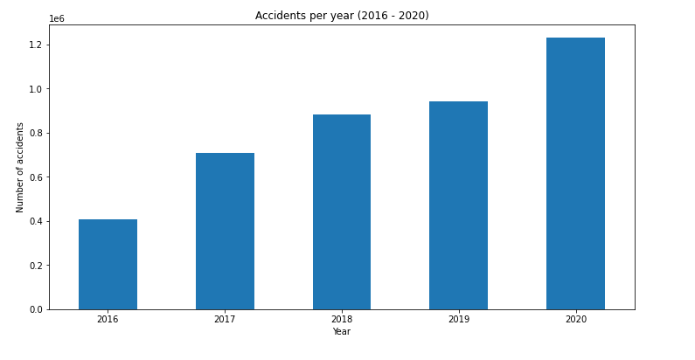
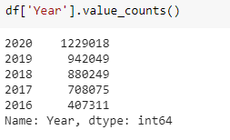

Slide 14
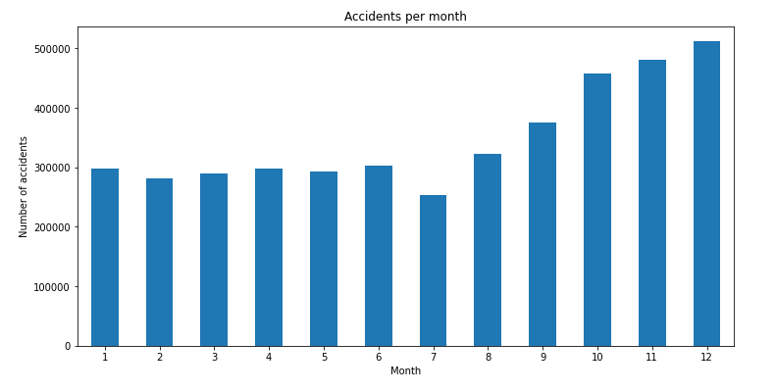
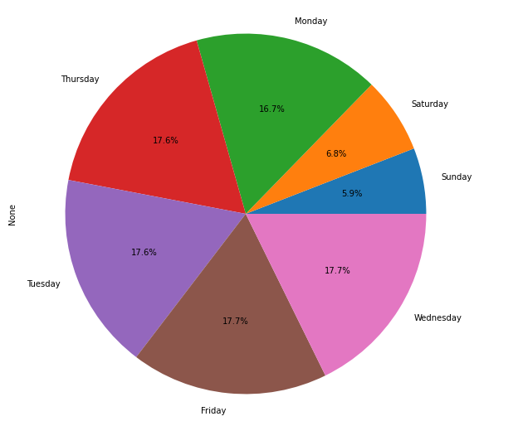

Slide 15
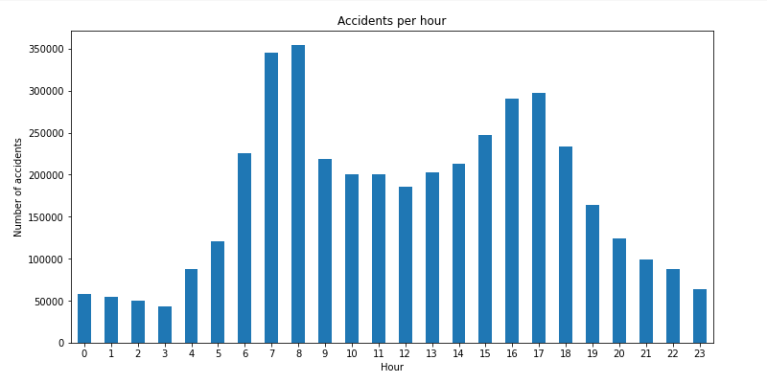

Slide 16
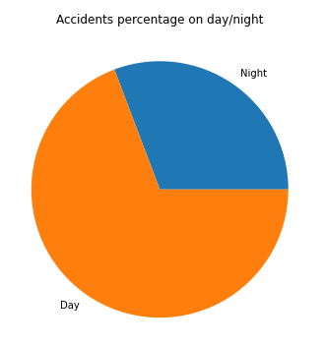
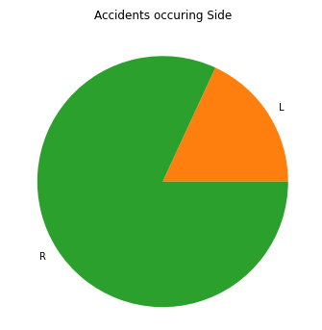
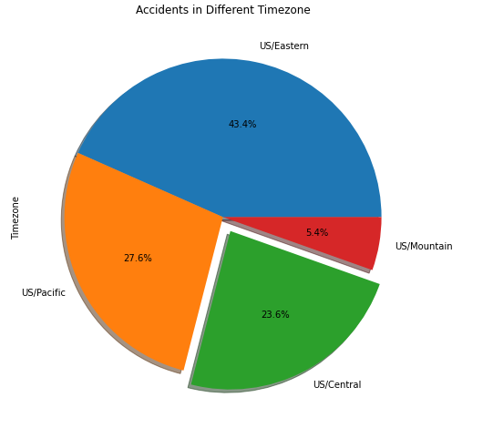

Slide 17
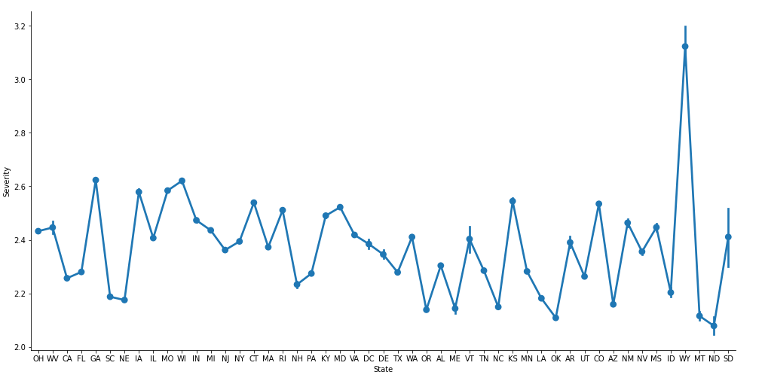
Severity vs States

Slide 18
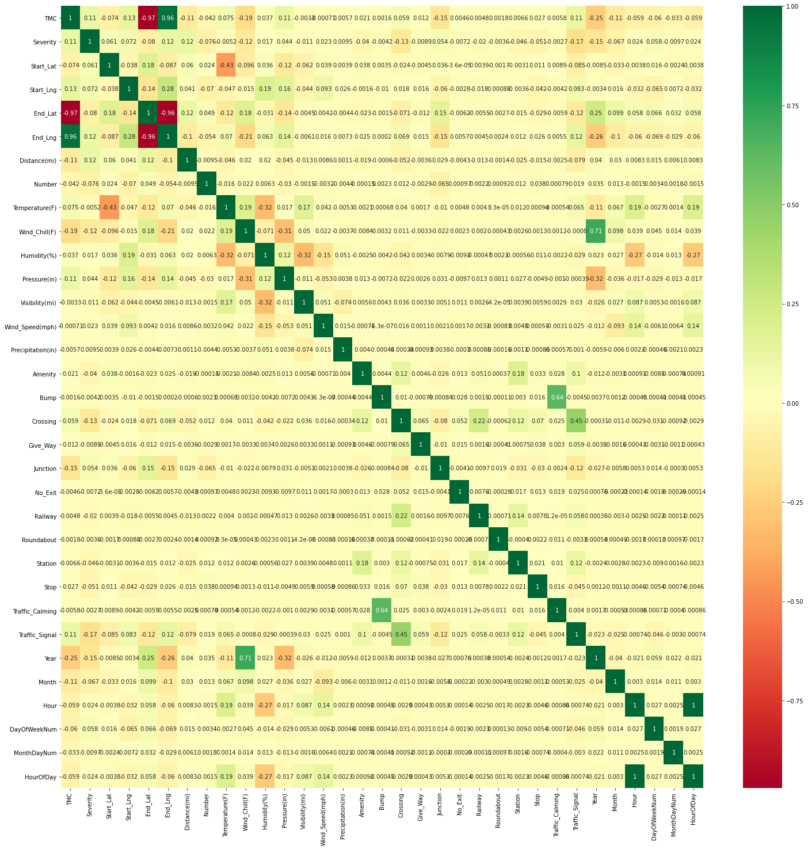

Slide 19
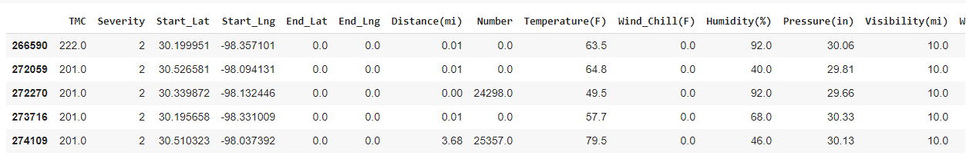
Features Selection

Slide 20
Modeling & Evaluation

Slide 21
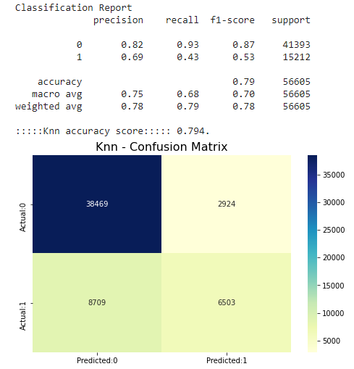
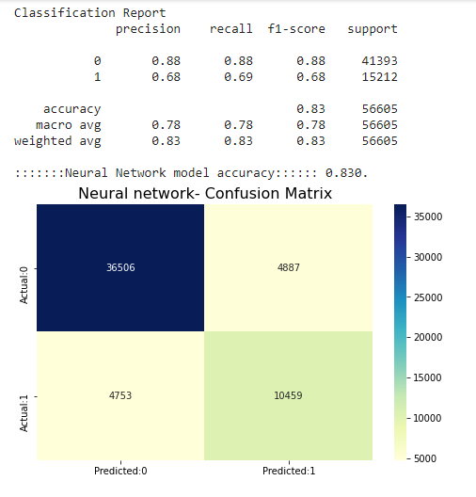
Knn & Neural network

Slide 22
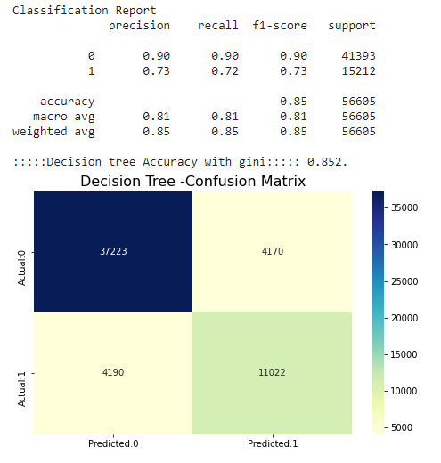
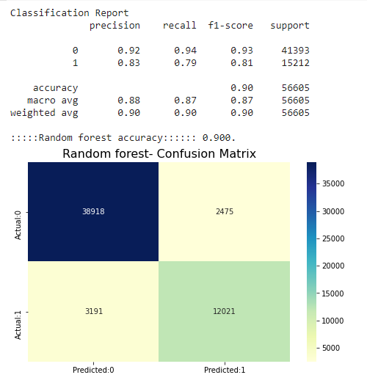
Decision Tree & Random Forest

Slide 23
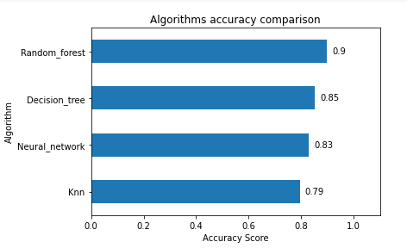
Algorithm accuracy comparison

Slide 24
Conclusion
The Severity of accidents is predicted with various machine learning algorithms. Highest accuracy achieved is 90% for Random forest model.
Future Scope – We can incorporate this model in implementing real world accidents risk prediction on grid cells. And we could implement other machine learning algorithms like support vector machine.

Slide 25

Thank you

