Slide 1
Recurrent Neural Networks for Sequence Data
ADTA 5560-Final Project
Instructor: Thuan L Nguyen, PhD
Student Name: Vipin Katakam

Slide 2
Overview
A time-series dataset Simple RNN neural network with Sine Wave Data RNN: LSTM Cells: Core Concepts LSTM neural network with Time-series Data Redesign the LSTM Neural Network to improve performance Compare Network Performance Project Report
02
05
07

Slide 3
A Time-series Dataset
The winning Mega Millions numbers from 2002 to the present are included in the dataset. One of the most well-known lottery games in the US is called Mega Millions. Five numbers are chosen at random from a pool of 70, and one Mega Ball number is chosen at random from a pool of 25.
There are a total of 8 columns and 1,846 rows in the dataset. The dataset contains data from 2002 to 2022.
LINK: https://catalog.data.gov/dataset/lottery-mega-millions-winning-numbers-beginning-2002

Slide 4
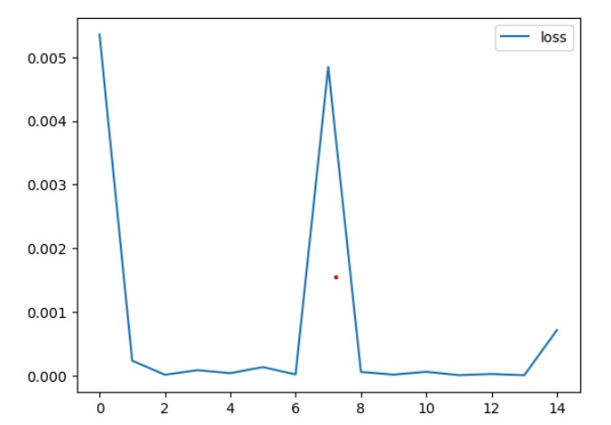
RNN: Simple RNN with Sine Wave Data
The core components of a neural network are an input layer, one or more hidden layers, and an output layer. The RNN architecture depicted below has layers made up of 70 neurons.
The hidden layer contains 70 neurons, the input layer contains 4, and the output layer contains 1 neuron. The input layer receives data, the hidden levels process it, and the output layer finally produces it.

Slide 5
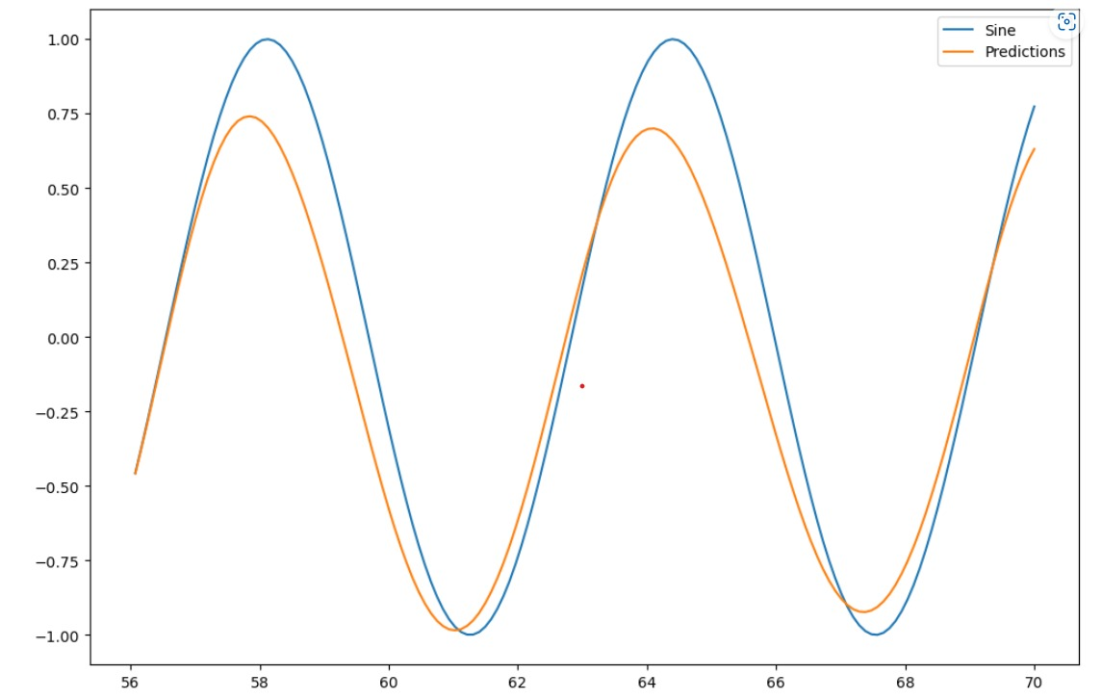
RNN: Simple RNN with Sine Wave Data
By dividing the range, a sine wave dataset was created, which was then plotted to display a fit between -1 and +1 on the graph. We then imported the necessary libraries. Before being split into training and test datasets, 20% more of the dataset was set aside for testing.
Two layers make up the SimpleRNN model: a SimpleRNN layer with 70 neurons and a fully-connected layer with one neuron. With a batch size of 1, we used a TimeseriesGenerator with a lookback of time steps.

Slide 6
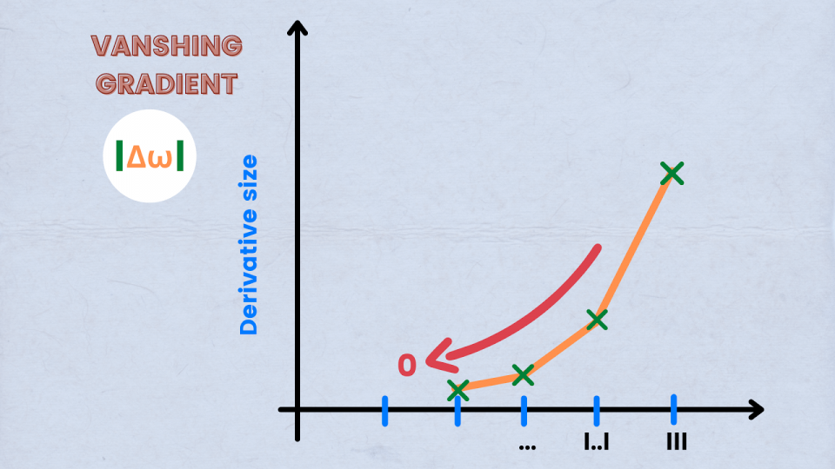
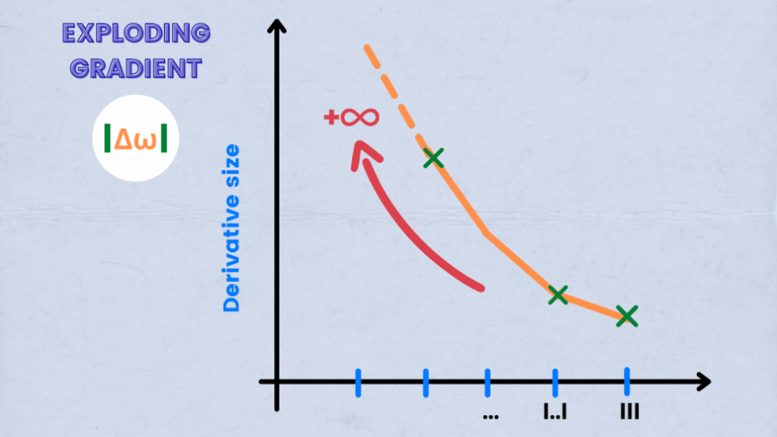
RNN: LSTM Cells: Core Concepts
Backpropagation can lead to a phenomena known as the vanishing gradient problem, in which the gradients of the loss function with respect to the weights get progressively smaller as they are transmitted back through the network.
When the gradients grow excessively large, weight updates tend to deviate from the ideal values, which is known as the exploding gradient problem. This problem may lead to training that is unsteady and ineffectual.
Image source: URL

Slide 7
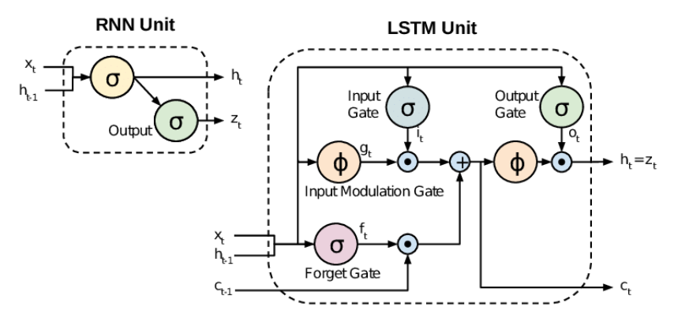
RNN: LSTM Cells: Core Concepts
Limitations of the SimpleRNN
Vanishing Gradient
Exploding Gradient
Short-Term Memory
Difficulty with non-linear data
Difficulty with high-dimensional input data
Image source: URL

Slide 8
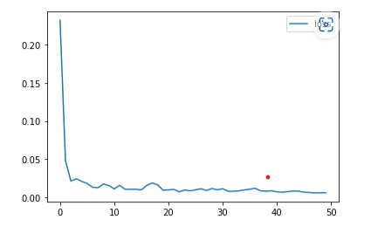
RNN: LSTM with Time-Series Data
Summary of Core Parameters
How much of the data (20%) will be used for testing?
How many LSTM layers are there? LSTM 3 layers
Number of neurons in each layer of the LSTM? 40 neurons are present in each LSTM layer.
Is there a DropOut layer? Yes.
The proportion to decrease is 0.2 if the layer is DropOut.
Time-series input sequence length: 45
For testing and forecasting, the batch size must be ONE.
The number of epochs for training must be 50.

Slide 9
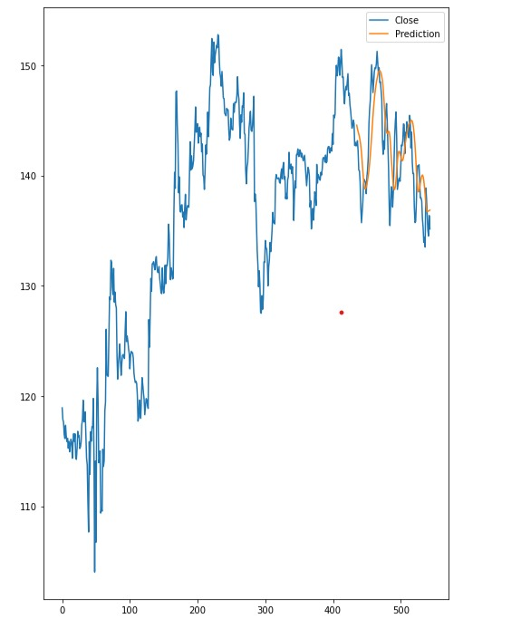
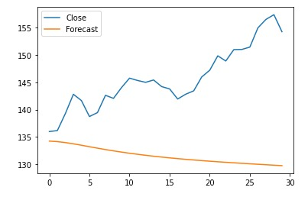
RNN: LSTM with Time-Series Data
Predicted vs Actual Close Price
Forecast vs Actual Close Price

Slide 10
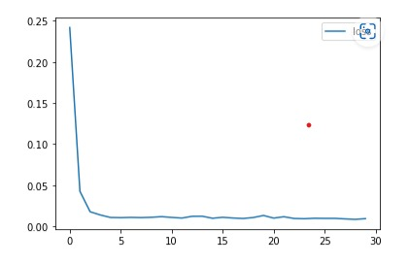
Redesign the LSTM Neural Network to improve performance
Summary of Core Parameters
How much of the data (20%) will be used for testing?
How many LSTM layers are there? LSTM 3 layers
Number of neurons in each layer of the LSTM? 50 neurons are present in each LSTM layer.
Is there a DropOut layer? Yes.
The proportion to decrease is 0.2 if the layer is DropOut.
Time-series input sequence length: 45
For testing and forecasting, the batch size must be ONE.
The number of epochs for training must be 30.

Slide 11
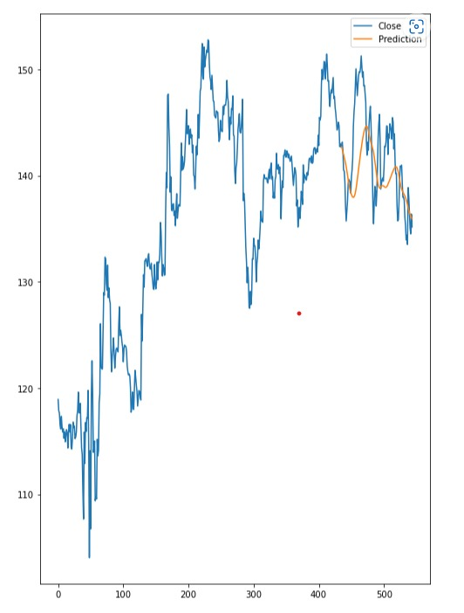
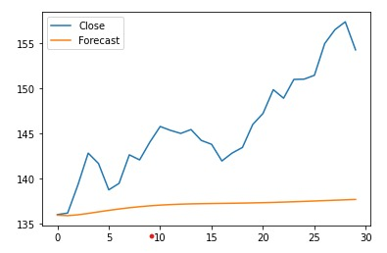
Redesign the LSTM Neural Network to improve performance
Predicted vs Actual Close Price
Forecast vs Actual Close Price

Slide 12
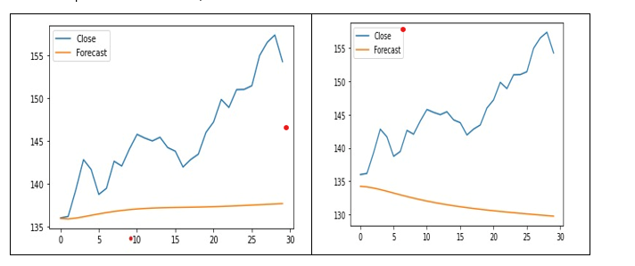
Compare Network Performance
What we have changed and how they affect model’s performance?
Number of neurons: In Project # 2, each LSTM layer has 50 neurons, which is a smaller number than in Project # 1 (40 neurons). This can help to reduce the model's complexity, making it easier to train and less prone to overfitting.
Length of input sequence: In Project # 2, the length of the time-series input sequence is 20, which is shorter than in Project # 1 (45). A shorter input sequence can capture more recent trends and reduce the impact of older data, which may no longer be relevant. This can help the model better adapt to changes in the data.
Number of epochs: In Project # 2, the number of epochs for training is 50, which is smaller than in Project # 1 (300). More epochs can allow the model to learn more complex patterns in the data, improving its accuracy and reducing the risk of underfitting.

Slide 13
Project Report
We were aware of the potential impacts these changes could have on a model's functionality. Adjustments were made to the batch size, the number of input time steps, and the number of neurons in each layer.
In conclusion, the topics covered above are essential to our comprehension of RNNs. They provide a strong foundation in neural network architecture and operation as well as the techniques and equipment required to design and successfully train neural networks. We may apply these concepts and techniques to a number of problems

Slide 14

Thank You.!

