Slide 1
Placements Portal using React.js
Team details
S. Akhila (24255A514)
D. Himabindu (24255A0516)
M. Srinidhi (24255A0517)

Slide 2
About the project
The project aims to develop a placement portal that provides regular updates on upcoming campus drives and helps students stay informed about placement activities.
It also offers alumnae experiences and essential interview preparation resources, enabling students to prepare effectively for recruitment processes.
The portal includes the following key sections :
Navbar & Footer: provides basic navigation and contact details.
Home: Displays the main banner and highlights upcoming placement drives.
Alumni: Showcases alumnae experiences, interview insights, and preparation tips.
References: Lists tools, websites, and learning platforms for interview and coding practice.
Notifications: Dedicated button on the top navigation bar to display latest alerts and placement updates for quick access.

Slide 3
React Concepts Used
React Concept | Description | Usage in the Project
Functional Components | Reusable JavaScript functions that return JSX to render UI. Easier to manage and preferred in modern React. | Used in all files like Navbar.js, Home.js, Alumni.js, and References.js to build separate sections of the Placement Portal.
JSX (JavaScript XML) | Syntax extension allowing HTML-like code in JavaScript, supporting embedding of dynamic data using {}. | Used in all components — e.g., Home.js renders <section> and uses {nextDrive.company} to dynamically show the upcoming company name.
Props (Properties) | Allow passing data from parent to child components for reusability. | Used in Alumni.js to pass and display alumni details (like name, company, role) in cards using the imported data file.
useState Hook | Used to manage and update component state dynamically without reloading the page. | Implemented in Alumni.js to handle search and filter for companies; also used for hover effects in References.js.

Slide 4
React Concepts Used
React Concept | Description | Usage in the Project
Lists and Keys | Help efficiently render multiple elements using .map() with unique keys. | Used in Home.js to display multiple upcoming drives and in Alumni.js to show alumni experiences.
Event Handling | Enables interactivity by responding to user actions like clicks or input changes. | Used in Home.js button (onClick) to open drive details, and in Alumni.js for filtering companies or searching alumni.
React Router | Used for navigating between pages without reloading the entire app. | Implemented in App.js and Navbar.js to navigate between Home, Alumni, and References pages.
CSS Styling & Modular Design | Each component has its own CSS file for better maintainability and clean UI. | Files like Navbar.css, Home.css, and Alumni.css are used to style individual sections and add hover/animation effects.

Slide 5

Results
Fig 1: User Interface (Navbar, Home Page)

Slide 6
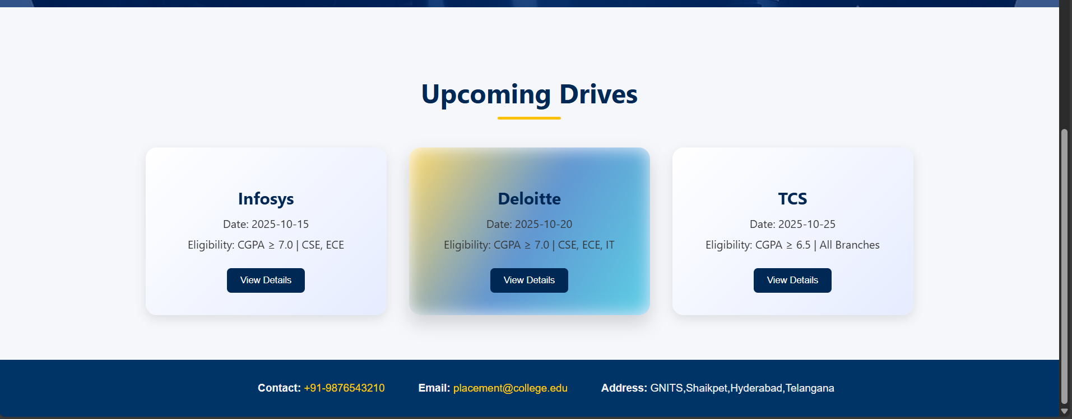
Results
Fig 1: User Interface (Home Page, Footer)

Slide 7
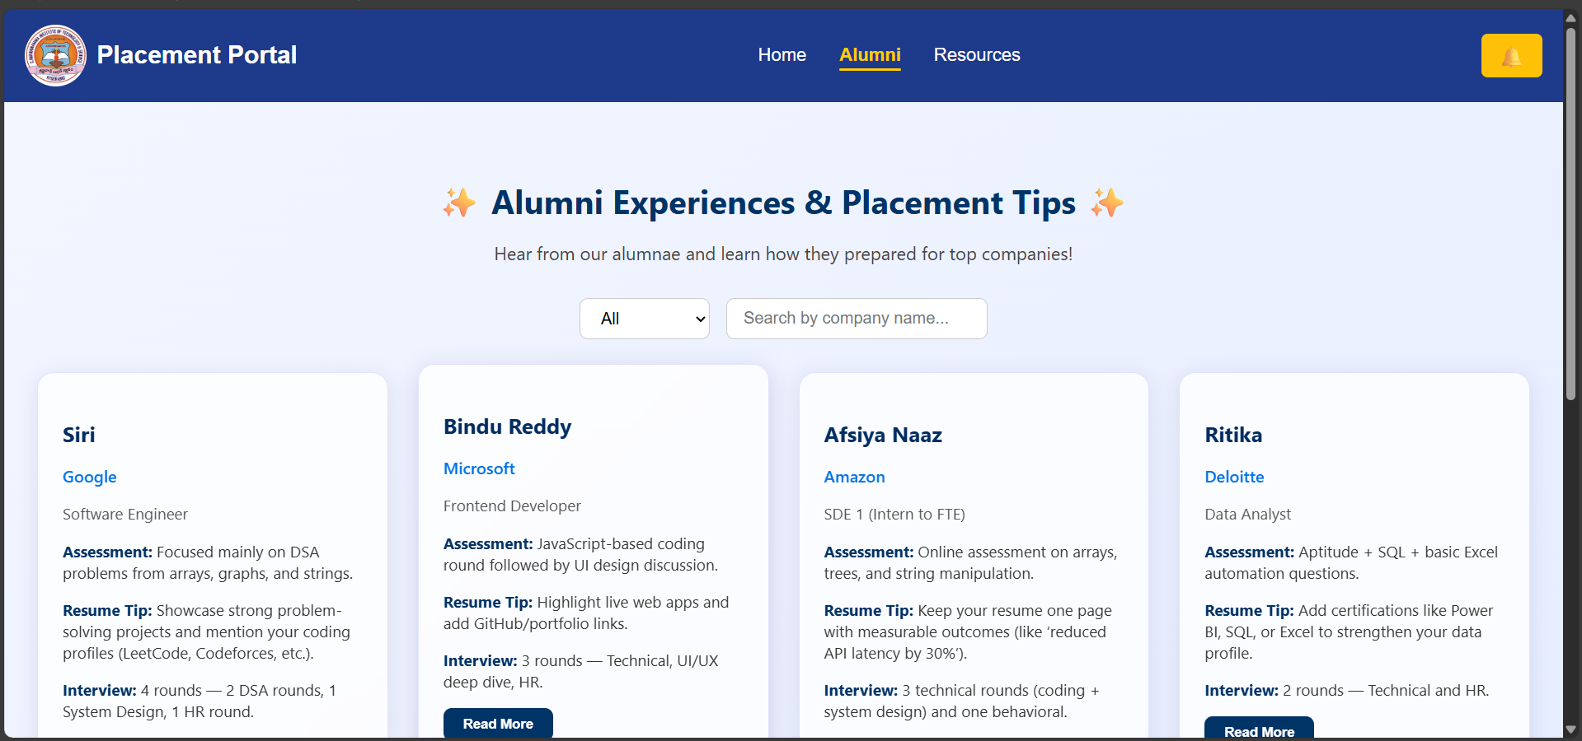
Results
Fig 1: User Interface (Alumni Page)

Slide 8
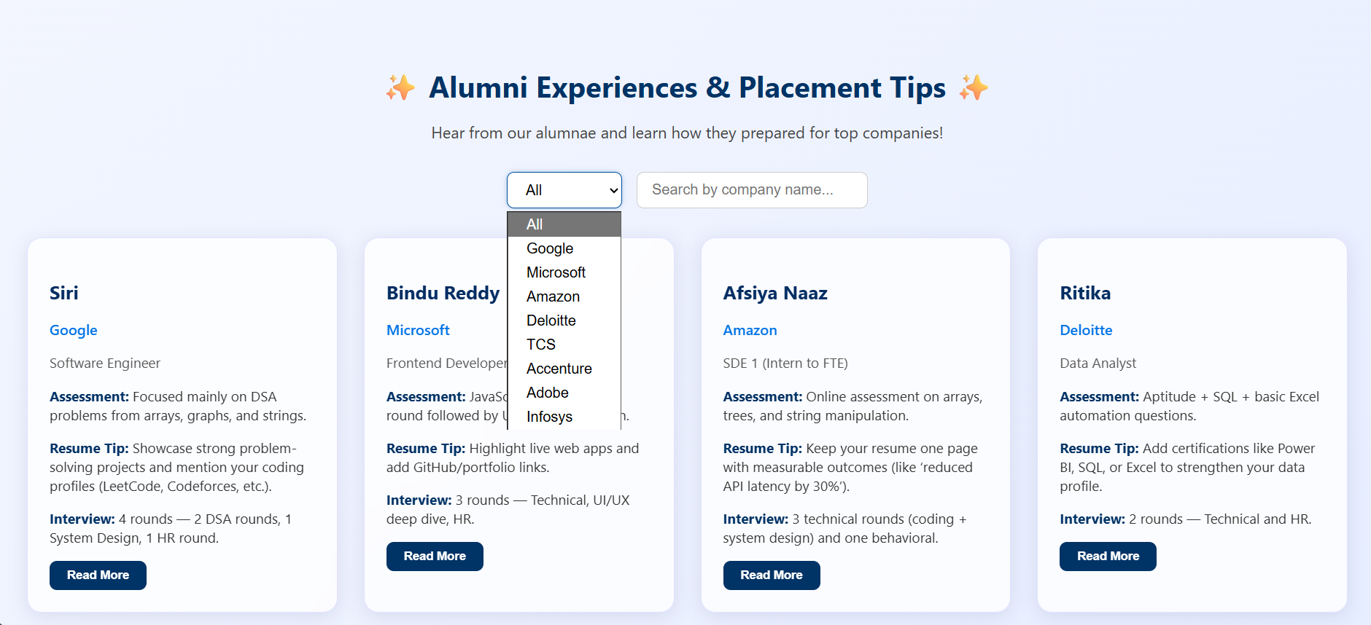
Results
Fig 1: User Interface (Alumni Page – Dropdown)

Slide 9
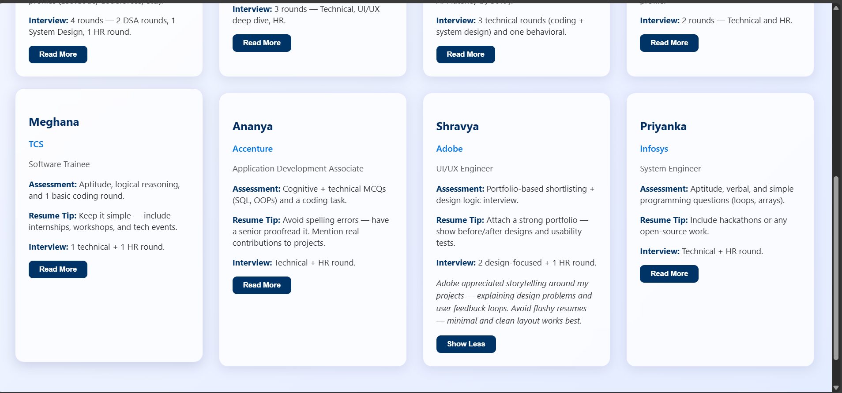
Results
Fig 1: User Interface (Alumni Page)

Slide 10
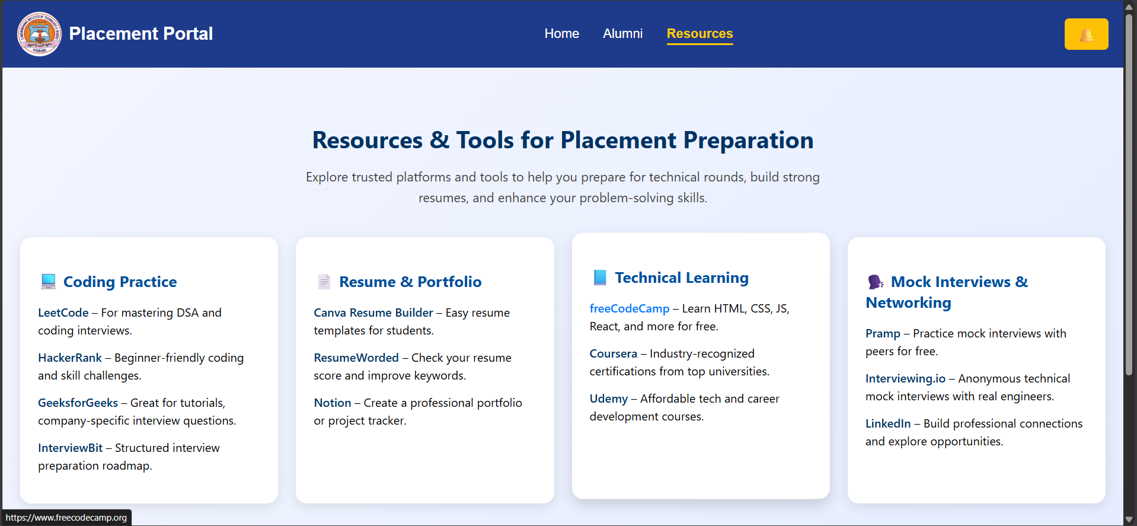
Results
Fig 1: User Interface (Resources Page)

Slide 11

Results
Fig 1: User Interface (Notification Button Click Event)

Slide 12
Learning Outcomes from Project
Structured react project using components: Divided the web app into modular and reusable parts like navbar, home, alumni, and references — improving clarity and maintainability.
Hands-on with react router: Implemented smooth navigation between pages using react-router-dom without reloading the site.
State management using useState: Managed dynamic data efficiently; built search and filter features in the alumni section.
Enhanced css styling & responsiveness: Designed clean, responsive layouts with gradients, hover effects, and better overall ui/ux.
Code reusability & component architecture: Reused and customized components to ensure design consistency and reduce code redundancy.

Slide 13
Thank You !

