Slide 1
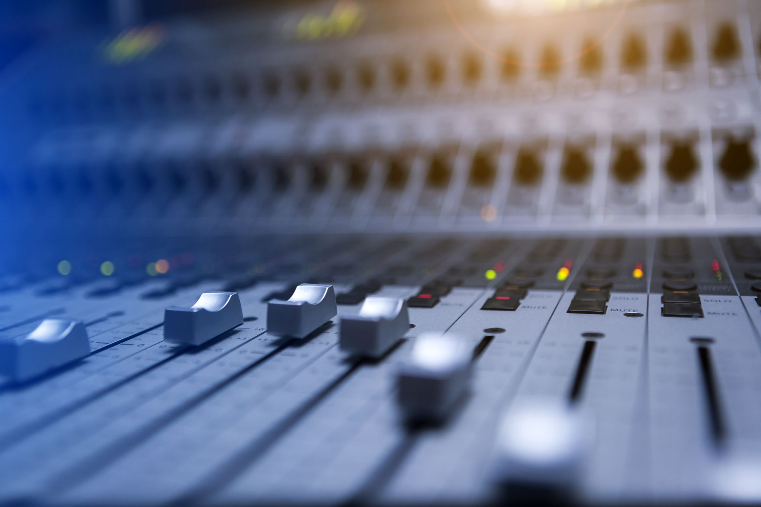
Music generation using deep learning
Akhila Vangara
Leon Leitao
Marc Vigneron
Pragya Singh

Slide 2
MOTIVATION
The Music industry is exploring the opportunities in AI:
Magenta: a research project within Google that explores how machine learning tools can help artists create art and music in new ways.
MuseNet: deep neural network that can generate 4-minute musical compositions with 10 different instruments
The Goal is to generate new music from the data that the model is trained on.
This means that the model has to understand the sequence of notes and its patterns.

Slide 3
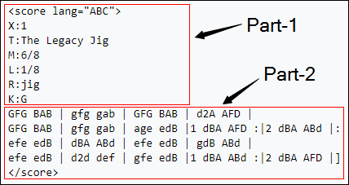
DATASET
The data for this model will be based on ‘Jigs’ and ‘Hornpipes’.
The Jigs have 340 tunes and the hornpipes have 65 tunes
The data is available in the form of text files and in ‘ABC’ format.
The notation has two parts:
Part 1, where there are details of the index, time signature,type of tune etc
Part 2 represents the sequence of characters or notes.

Slide 4
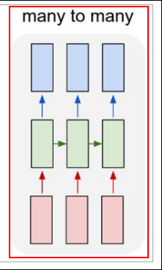
POTENTIAL ALGORITHMS
Char – RNN
RNN Network to predict the next character(or in our case, a musical note) given the previous characters
Each input to generates an output which is the ‘next note’ of the sequence.
Many - to – Many RNN
LSTMs & GRUs
Based on performance, cost and flexibility, a choice would be made on RNN or its variations such as LSTMs and GRUs.

Slide 5
ROADMAP
Phase 1
Phase 1
preview/exploration of the dataset
Phase 2
Phase 2
Designing the model
Phase 3
Phase 3
Trying different architectures
Phase 4
Phase 4
Fine tuning of the model
Phase 5
Phase 5
Presentation of the working model

Slide 6
REFERENCES
https://hal.sorbonne-universite.fr/hal-01660772/document
https://medium.com/datadriveninvestor/music-generation-using-deep-learning-85010fb982e2

