Slide 1
REAL TIME PROJECT
1

Slide 2



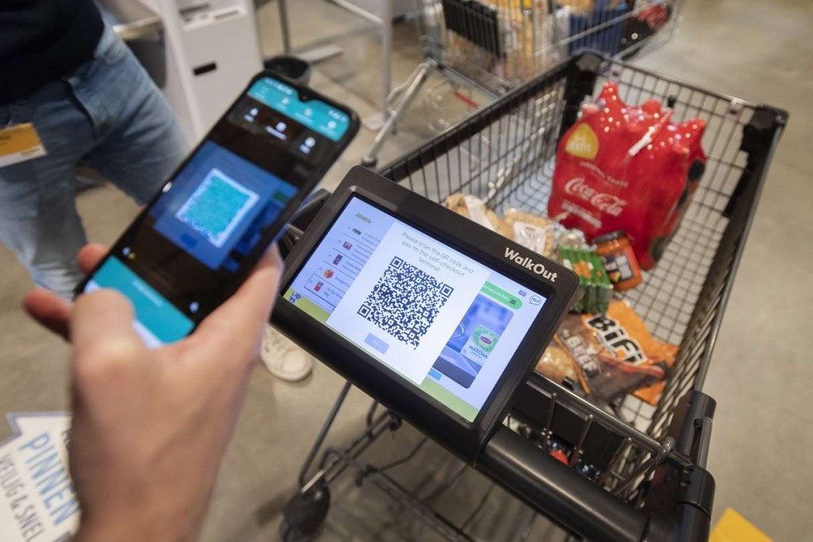






SMART SHOPPING CART
Presented by
Guided by
V. AKHILAN (23P61A12C4)
R. UDAY (23P61A1295)
M. PRUTHVIK (22P61A1275)
Mrs. T. SREELALITHA
INFORMATION TECHNOLOGY

Slide 3

Contents
literature survey on automatic street light system iot project
Abstract
Introduction
Problem Statement
Objective
Review of Existing System
Proposed Solution
Architecture
Technologies and Tools/Components Required
Conclusion
SMART SHOPPING CART

Slide 4



1. Abstract
The shopping and grocery industry has been associated with inefficiencies, especially when it comes to the checkout process. Long queues at billing counters, manual billing methods, and limited real-time visibility into purchase costs can lead to frustration and wasted time for consumers. This project, Smart Shopping Cart, aims to address these issues by integrating Internet of Things (IoT) and RFID technology into the shopping process.
By removing the need for traditional checkout lines, this system enhances the shopping experience by saving time and reducing frustration. It allows customers to keep track of their budget as they shop, ensuring that they are aware of their total expenditure at any point in the process. Furthermore, this system eliminates human errors in billing and provides a more efficient, seamless shopping experience.
SMART SHOPPING CART
5

Slide 5

2. Introduction
Supermarkets face long queues, time wastage, and customer dissatisfaction.
Manual billing processes are inefficient and lead to frustration.
Customers worry about total costs while shopping.
Time-consuming checkout process.
Lack of real-time pricing information.
Improve shopping efficiency and reduce wait times for customers.
Enhances customer satisfaction and improves overall shopping efficiency.
SMART SHOPPING CART
7

Slide 6
3. Problem statement
Traditional shopping carts lack smart integration.
The proposed Smart Shopping Cart system aims to solve the problems by automating the billing process, providing real-time updates on cart items, and creating a more efficient and enjoyable shopping experience for customers.
SMART SHOPPING CART
7

Slide 7
4. Objective
Automatically display the price of an item
Provide an efficient and real-time display of the items in the cart
Eliminate long billing queues
SMART SHOPPING CART
7

Slide 8
5. Review of existing system
In traditional retail stores, the checkout process is entirely manual, requiring a cashier to scan each product and enter the price. This process can lead to delays and errors.
Customers often have to wait in long queues, especially during peak shopping hours, which is time-consuming and frustrating.
Shoppers are unable to track the total cost of their purchases while shopping, which can lead to budget concerns when reaching the checkout counter.
Mistakes during manual scanning or data entry can result in incorrect billing, causing customer dissatisfaction and requiring additional time to resolve.
Shoppers typically have to rely on store employees for information about products, such as price comparisons or discount details.
SMART SHOPPING CART
7

Slide 9
6. Proposed solution
The Smart Shopping Cart uses RFID technology and Arduino Board to automatically scan items as they are added to the cart, eliminating the need for manual input by a cashier. This ensures accuracy and speeds up the billing process.
The cart’s LCD screen displays the real-time total cost and product details as items are added or removed, allowing customers to manage their budget throughout the shopping process.
The cart automatically provides product details like price, quantity, and any other relevant information via RFID, so shoppers do not need to ask store employees for help.
SMART SHOPPING CART
7

Slide 10
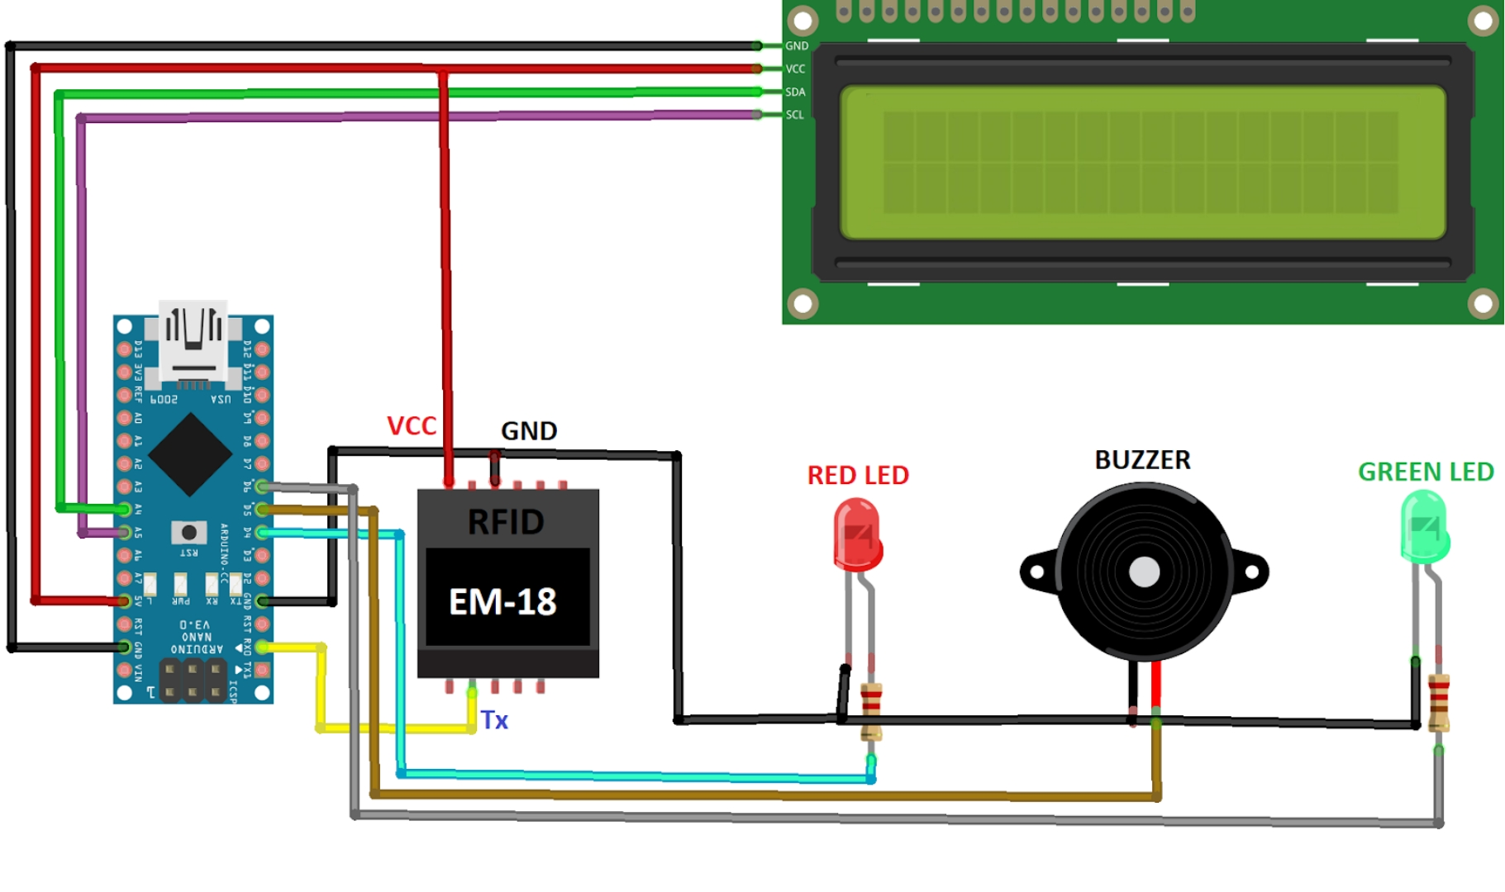
7. Architecture
SMART SHOPPING CART
7

Slide 11
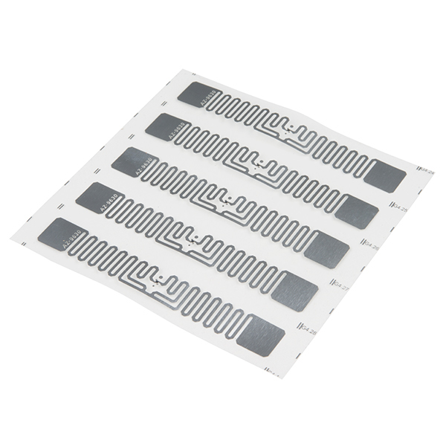
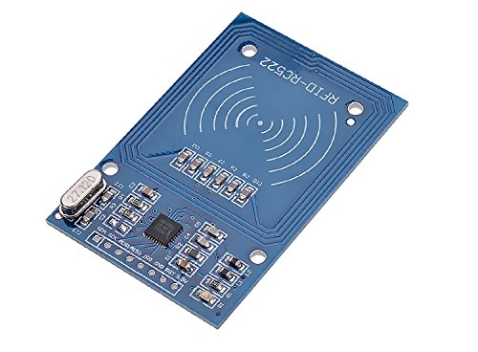
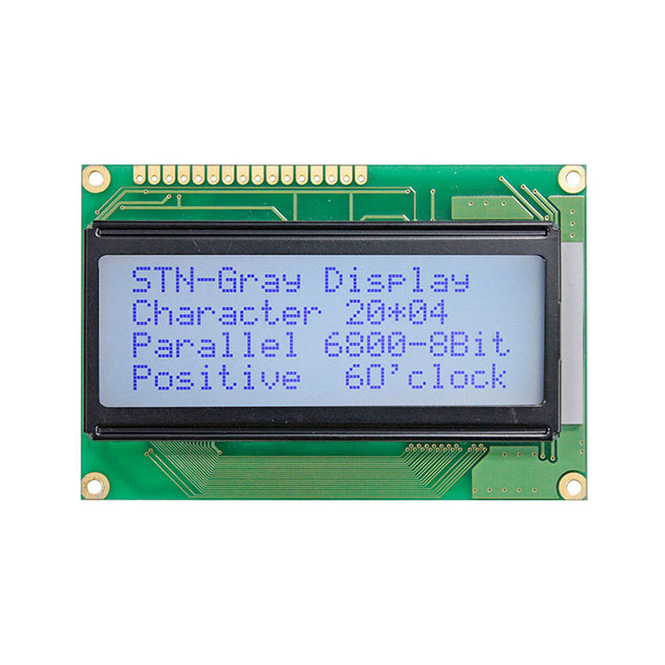
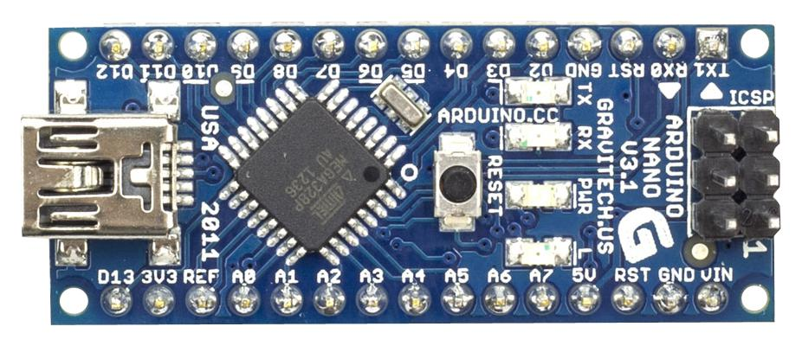
8. Technologies and Tools/ Components Required
RFID Tags
RFID Reader
LCD Display
Arduino Board
Power Supply
SMART SHOPPING CART
7

Slide 12
9. Conclusion
The Smart Shopping Cart project has successfully addressed key challenges in the traditional shopping experience by introducing an automated, efficient, and real-time solution to the checkout process. The project has been developed with the aim to enhance the overall shopping experience while reducing time spent in queues and increasing the accuracy of billing.
This proposed system not only benefits consumers by reducing waiting times but also enhances operational efficiency for retailers by streamlining the checkout process and minimizing human errors.
In conclusion, the Smart Shopping Cart system offers a promising future for the retail industry by providing an efficient, customer-friendly solution that streamlines shopping, enhances accuracy, and reduces operational overhead. Its implementation will have far-reaching benefits for both customers and businesses, marking a significant step toward the future of smart shopping.
SMART SHOPPING CART
7

Slide 13
THANK
YOU !

