Slide 1
Dog Breed Classification
Authorization by: Middi Venkata Sai Rishita ,
Tanvir Ahmed Harris Presentation by: Akhila Siddamsetti
School ID : 700759000

Slide 2
Motivation
The majority of dogs are often difficult to classify by simply looking, and breed identification is important when rescuing dogs, finding them forever homes, treating them, and various other furry situations.
This project classifies purebreds since mixed breeds are, as mentioned, often indistinguishable from purebreds, but the hope is that even classifying a purebred dog or a mixed breed one as one of the breeds it belongs to will help give more information about the dog’s personality, full-grown size, and health.
I was motivated by our love of puppies to chose this project. Breed predictions may also helps veterinarians treat breed specific ailments for stray, unidentified dogs that needs medical care.

Slide 3
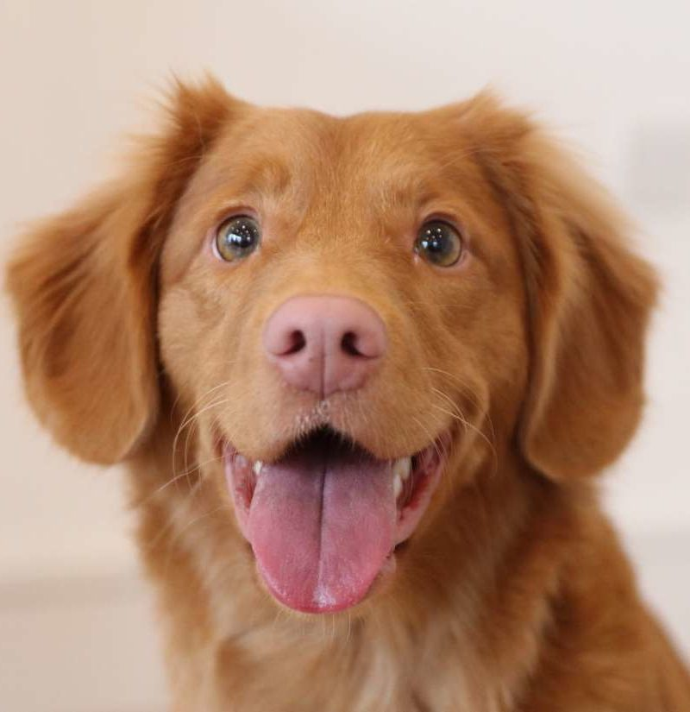
Problem Statement
Dogs are most common domestic animals.
There are large number of dogs which results in issues such as population control, diseases out break such as rabies, vaccination control and legal ownership.
There are more than 100 dog breeds. Each dog has specific characteristics and health conditions.
In order to provide appropriate treatments and training, it is essential to identify individuals and their breeds.

Slide 4
Objectives
In this project we will develop ideas for a dog identification app using deep learning concepts. The software is intended to accept any user-supplied image as input. If a dog is detected in the image, it will provide an estimate of the dog’s breed. If a human is detected, it will provide an estimate of the dog breed that is most resembling.
Our project involves the following steps which will be covered in detail in the subsequent sections of this blog post.
Step 0: Import Datasets
Step 1: Detect Dogs
Step 2: Create a CNN to Classify Dog Breeds (from Scratch)
Step 3: Use a CNN to Classify Dog Breeds (using Transfer Learning)
Step 4: Create a CNN to Classify Dog Breeds (using Transfer Learning)
Step 5: Write your Algorithm
Step 6: Test Your Algorithm

Slide 5
Contribution:
Dog breed classification contains dataset as images.
For classifying images deep learning algorithms are used.
Deep learning Provides the ability to train algorithms(model) that can tackle the problems of data classification and prediction based on deriving(learning) knowledge from raw data.
Dog breed classification is done by using Convolution Neural Network(CNN).
CNN is one commonly used approach for image classification.

Slide 6
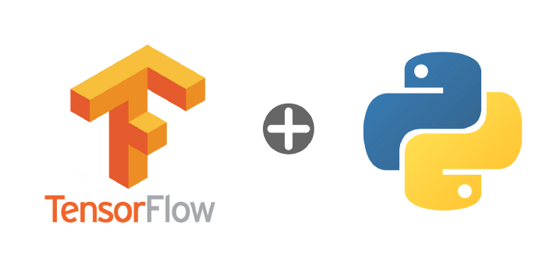
Software Requirements
Project is implemented in python.
project is executed in Google colab.
GPU is used as runtime.
Packages used:
Tensorflow
Pandas
Numpy
Matplotlib
Hardware Requirements
Windows 7/8/10
Minimum of 4GB RAM

Slide 7
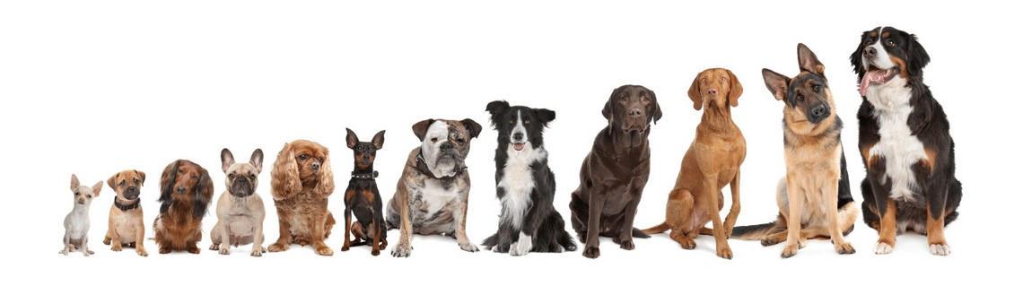
Method Used- CNN
When compared to other image classifying algorithms CNN can classifies images more accurately than others.
Many dogs looks similar, so classifying dog images become more harder to train.
Even Minute details in images plays an important role in classifying dog breed.

Slide 8
Continue..
CNN takes just the image's raw pixel data as input and "learns" how to extract these features, and ultimately infer what object they constitute.
CNN receives an input feature map as three-dimensional matrix where the size of the first two dimensions corresponds to the length and width of the images in pixels. The size of the third dimension is 3 (corresponding to the 3 channels of a colour image: red, green, and blue).

Slide 9
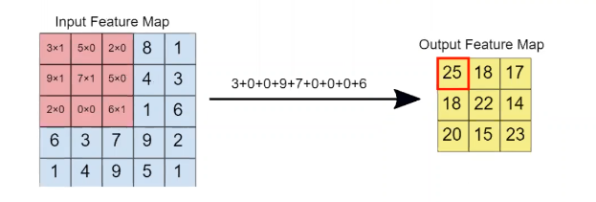
Convolution
The primary purpose of Convolution is to extract features from the input image.
Filters act as Feature detectors. The value of the filter, is in fact, not manually provided, but the machine chooses the suitable value by training and changing its weights.

Slide 10
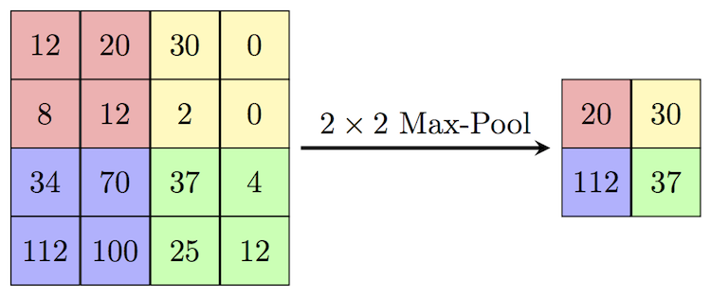
Parameters used:
Non-Linear (ReLU):ReLU is an element wise operation (applied per pixel) and replaces all negative pixel values in the feature map by zero. It introduces non-linearity in our model.
Pooling: It reduces the dimensionality of each feature map but retains the most important information. Spatial Pooling can be of different types: Max, Average, Sum etc.
Fully-Connected: Finally, after several convolutional and max pooling layers, the high-level reasoning in the neural network is done via fully connected layers. A fully connected layer takes all neurons in the previous layer and connects it to every single neuron it has.

Slide 11
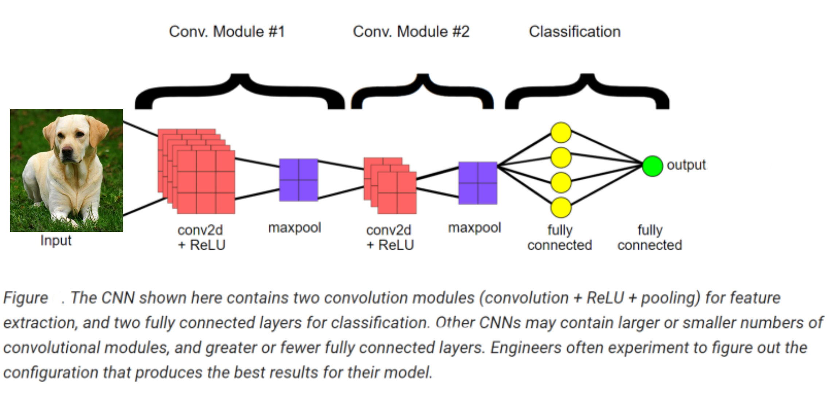
Project Architecture

Slide 12
Project Design
Loading Data
Visualization of data
Scaling
Model building
Training
Compiling
Prediction

Slide 13
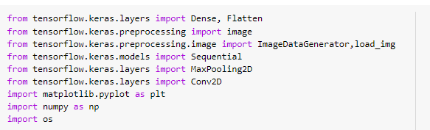
Packages
Tensor flow, numpy, matplotlib,os packages are imported and respective functions are imported using these packages.

Slide 14
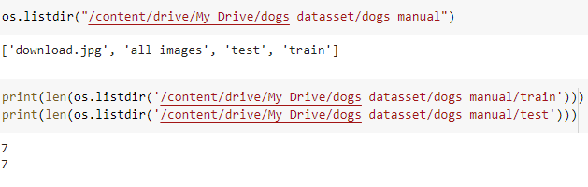
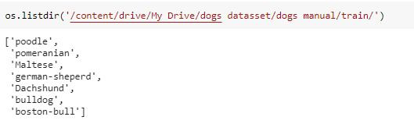
Loading Data
Dataset is taken from https://s3-us-west-1.amazonaws.com/udacity-aind/dog-project/dogImages.zip which is having 7 dog breeds .
Contents in folder
Contents in Train and Test folders

Slide 15
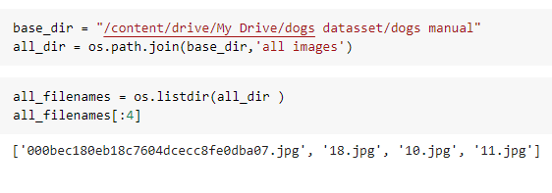
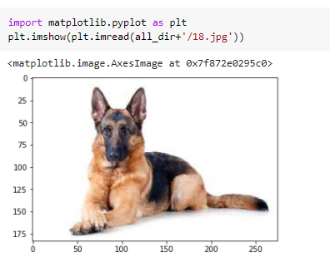
Visualization of Data
List of images in the folder
Displaying a sample dog image

Slide 16
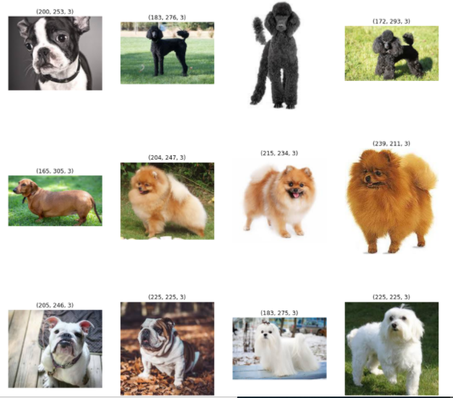
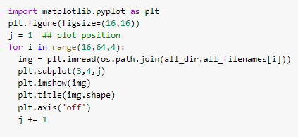
Displaying different types of dogs with size of the image

Slide 17
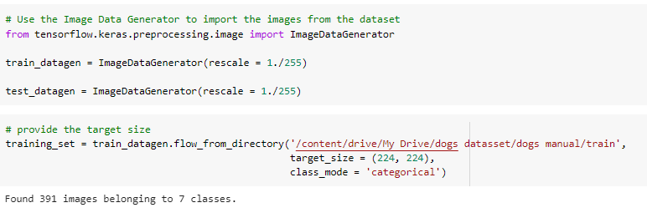
Generator Creation
Scaling and reshaping to 224*224 image size for Train data set

Slide 18
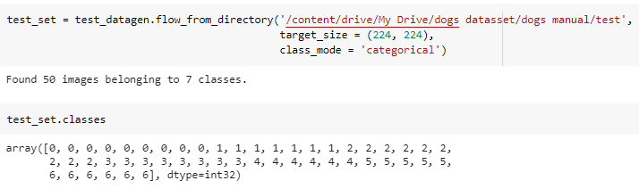
Continue..
Reshaping to 224*224 image size for Test data set

Slide 19
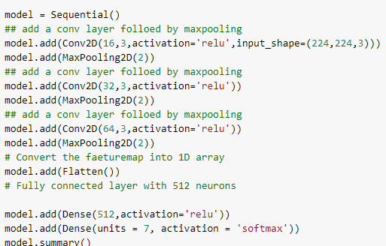
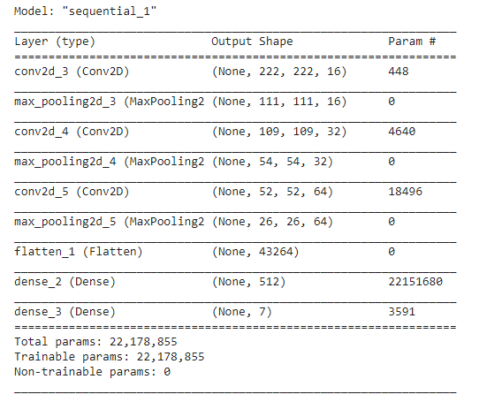
Model Building
By using sequential model we are creating layers for the model
Here we use Softmax as activation function because there are more than 1 classes

Slide 20
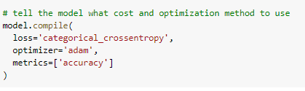
Compiling
Here loss function is taken as categorical crossentropy because there are multiple classes in the model.

Slide 21
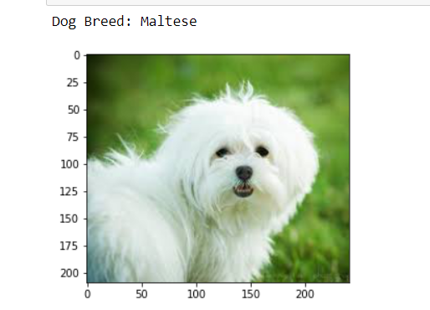
Results:
Here we can visualize the dog breed after compiling the code.

Slide 22
Further Implementations
Training the Model
Make Predictions
Try to develop model which is not overfitting or under fitting.
Improve accuracy

Slide 23
References
[1] Alex Krizhevsky, Ilya Sutskever “ImageNet classification with Deep Convolutional Neural Networks”
[2] Kaiming He et al., 2015 on “Delving Deep into Rectifiers”.
[3] Andrew G. Howard et al. on “Efficient Convolutional Neural networks for Mobile Vision Applications(2017)
[4] Jonas Gehring et al. on “ Convolutional sequence to sequence learning(2017)”
[5] Priya Goyal et al. on “Accurate, Large Minibatch SGD:Training ImageNet in one hour (2017)”.
[6] C. Zhang et al. on “Understanding deep learning requires rethinking generaization”.
[7] Y. Lechun et al. on “Gradient-based learning applied to document recognition (1998)”.
[8] Y. Lechun, Y. Bengio and G.Hinton on “ Deep learning (2015)
[9] A. Conneau t al. on “Very deep Convolutional networks for natural language processing (2015)”

Slide 24
THANK YOU

