Slide 1
Experiential project
Group – 3
Akhila Sulgante
Shital Waters
Kasi Viswanath
Under the Guidance of Prof. Lama Hamandi

Slide 2

Project Introduction
Given two files, Avalara_goods_and_services.xlsx and UNSPSC_English.csv. UNSPSC file data is organized in a hierarchy for a product whereas Avalara data is Tax code description of a product.
Outcome: This will help the organization to easily match Avalara Tax code description of a product to its UNSPSC code.

Slide 3
Data Set
Segment title : 57 unique values
Family title: 546
Class title: 7902
Commodity title: 147893

Slide 4
Specifications
Coding language: Python
Libraries Used: Any tree Python library (To store the data into Tree) , NLTK , Inflect engine, Multithreading for parallel processing.
Validation: Create test data set with 30 records from the UNSPSC and map the corresponding Tax code which is used for measuring the precision of the algorithm
Notes:
Coding language: Python
Data Structures: Any tree Python library (To store the data into Tree)
Validation: Create test data set with 100 records from the UNSPSC and map the corresponding Tax code which is used for measuring the precision of the algorithm

Slide 5
High-Level Approach
Step 1
Load the UNSPSC and AVALARA File
Step 2
Text Preprocessing for removing string literals, converting words from plural to singular
Step 3
Create the Key for each title at all levels which will increase string matching performance
Step 4
Store the UNSPSC data using Any Tree Library and Avalara data using pandas with the help of keys created
Notes:
Step 1: Store the Avalara and UNSPSC data in the Tree structure using the Python library Any tree
Step 2: Create the maximum common Subsequence(MCS) Program in python to perform string Matching. Create the Manual test sample dataset to measure the precision of the algorithm
Step 3: Create the algorithm to identify the tax code from Avalara to UNSPSC data using MCS Program. Continue the implementation of creating the manual test data set
Step 4: Finding the precision of the algorithm and optimizing the algorithm.

Slide 6
High-Level Approach
Step 5
For each Avalara desc filter the UNSPSC titles based on the key
Step 6
Compare the filtered records and measure the matching accuracy using Longest Common Sequence b/w Avalara desc and UNSPSC titles
Step 7
Filter the matching accuracy records based on the thresold
Step 8
Fetch the max matching record based on level priority
Notes:
Step 1: Store the Avalara and UNSPSC data in the Tree structure using the Python library Any tree
Step 2: Create the maximum common Subsequence(MCS) Program in python to perform string Matching. Create the Manual test sample dataset to measure the precision of the algorithm
Step 3: Create the algorithm to identify the tax code from Avalara to UNSPSC data using MCS Program. Continue the implementation of creating the manual test data set
Step 4: Finding the precision of the algorithm and optimizing the algorithm.

Slide 7
Step 1 Loading Data
Load the UNSPSC data with the help of the csv reader to get data in a dictionary format.
Load the Avalara file with the help of Pandas.read_exel

Slide 8
Step 2 Text Preprocessing
The text is preprocessed to increase the matching accuracy with the help of NLP Libraries
Preprocessing steps:
All Plural words are converted to Singular
Eliminating punctuations
Converting all letters to lower case
Eliminating whitespaces
Eliminating Stop words(Ignored generic words such as Kits, Accessory)

Slide 9
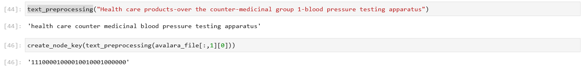
Step 3 Creating Keys
We created keys based on the below steps
Broke individual sentences into words
Extracted first character of every word and stored the unique character in a 26-bit array based on character index
Purpose:
To optimize comparisons

Slide 10
Step 4 Storing UNSPSC Data
Part A: UNSPSC
Storing UNSPSC data with the help of Anytree library in the following order:
Level 0 – Root
Level 1 – All 4 hierarchy levels of UNSPSC
Level 2 – Keys
Level 3 – Titles with level key

Slide 11
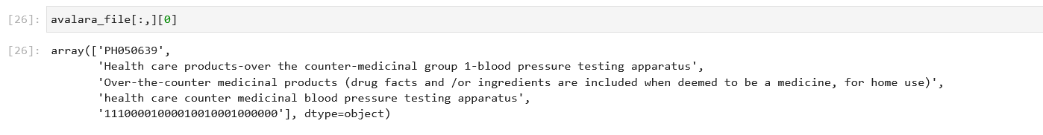
Step 4 Storing Avalara
Part B: Avalara
Storing the data with the help of Pandas in the following way:
Avalara code, Avalara description, Additional description, pre-processed Avalara description, and key for pre-processed Avalara description

Slide 12
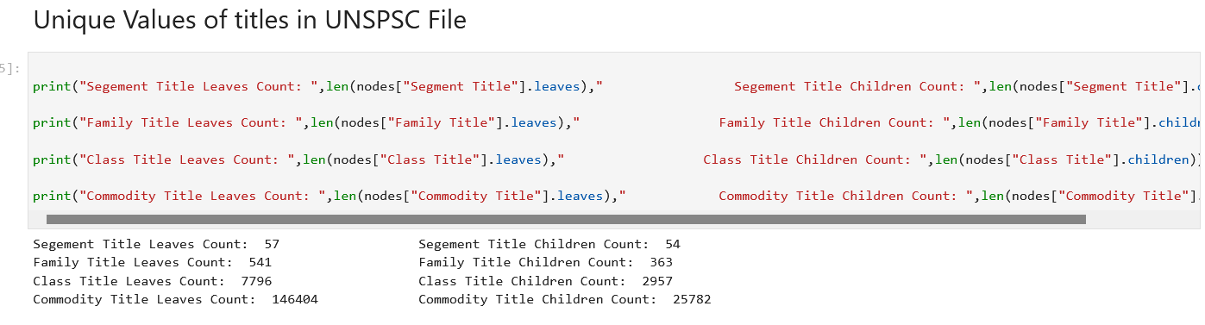
UNSPSC Stats

Slide 13
Step 5 UNSPSC Key Comparison
The goal of the key comparison is to ignore the unnecessary Comparisions b/w the UNSPSC and the Avalara which will increase the performance
10101518 | Alpaca
PH050677 | Over-the-counter medicinal products - foot pads, insoles
A
10000000000000000000000000
&
00100100100010010000000000
The comparison will not occur because in the commodity level of the UNSPSC file, the first letter is 'A' which is not seen in any of the first letters of the Avalara file, 'O', 'T', 'C', 'M', 'P', 'F', 'P', 'I'

Slide 14
Step 6 Matching Strings using Longest Common Sub-Sequence
Algorithm used to compare UNSPSC, and Avalara strings is the Longest Common sub-sequence.
Longest Common Subsequence is applied on words and not on characters to obtain meaningful match
UNSPSC Commodity title Personal digital assistant PDAs or organizers
Avalara String Product / consumer electronics / portable electronics / personal devices / personal digital assistant (pda)
The above comparison between UNSPSC and Avalara string produces an accuracy of 0.75

Slide 15
Step 7 Filter the records above the threshold
lcs = longestCommonSubsequence(unspsc_desc, avalara_desc)
match_perc_min = lcs/max_length(unspsc_desc, avalara_desc)
match_perc_max = lcs/min_length(unspsc_desc, avalara_desc)
Filter the records where match_perc_min greater than threshold.
Considering the threshold as 50%

Slide 16
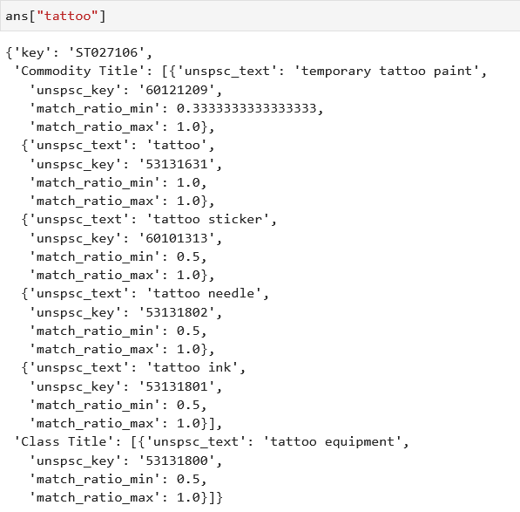
Possible outcomes from the step 7

Slide 17
Step 7 Getting the most Accurate match
Steps :
1) compute 1-x["match_ratio_min"])*(x["match_ratio_min"]-x["match_ratio_max"]
2) Sort the computed value from level 1 ascending in each
3) If there are multiple possibilities in each level pick the max(match_ratio_min)
4) Get the min from step 1 computed for all levels and max(match_ratio_min)
For all the levels and take the 1st record

Slide 18
Testing
We created a test sets of 30 records by manually mapping the corresponding UNSPSC code to Avalara Strings
We obtained possible matches for 23 out of 30 test records

Slide 19
Test records
Avalara Key | Avalara Desc | UNSPSC Level | UNSPSC KEY | UNSPSC TITLE | Match Ratio | Test Status
SL090200 | Lodging accommodations | Commodity level | 90111502 | Lodges or resorts | 0.5 | Failed
SW117218 | Warehouse storage - storage of refrigerated goods | Commodity level | 78131801 | Refrigerated storage | 1 | Passed
SW090000 | Word processing | Commodity level | 43232104 | Word processing software | 0.66 | Passed

Slide 20
Performance Optimization
Multi-Threading
Used the multiprocessing library for parallel processing to increase the performance of the algorithm.
Execution Stats:
Thread count : 16
Execution Time : 30 min

Slide 21
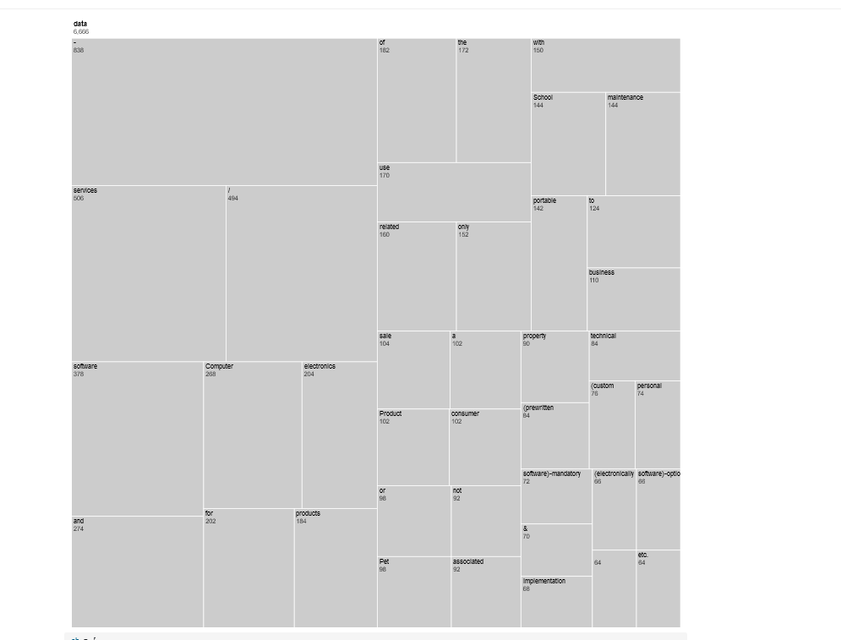
Data Visualization Tree Map – Stop Words

Slide 22
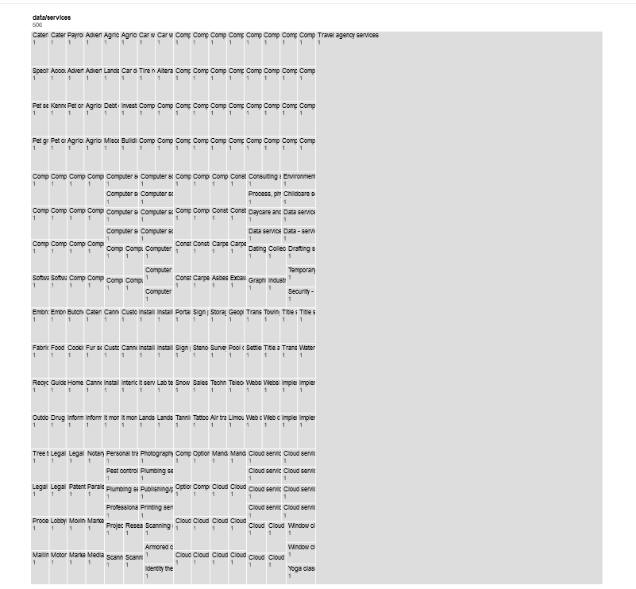
Sentences for each stop word

Slide 23
Next Steps
Handling the test case 1 due to difference in Parts of Speech
Synonyms Match to increase the meaningful o/p and increase the accuracy

Slide 24

Thank you!

