Slide 1

Smart Greenhouse IoT System for Real-Time Monitoring and Alert
Presented By: Akhil Rawat
Class Roll No.: 09
Roll No.: 2318259
Section: E1
Semester: III
Submitted To: Mr. Shushant Chamoli

Slide 2
Project Overview
Description
Objective
This project automates the monitoring of greenhouse conditions using IoT technologies. It integrates sensors to measure temperature, humidity, soil moisture, light intensity, and proximity. Real-time data is sent to the Blynk app for monitoring and alerts.
Ensure optimal plant growth through real-time data analysis.
Provide timely alerts for critical conditions like low moisture or nearby object detection.
Simplify plant care with minimal manual intervention.

Slide 3
Tools and Technologies Used
Hardware
Software
ESP8266 (NodeMCU): IoT microcontroller
Arduino IDE: For programming
DHT11 Sensor: Measures temperature and humidity
Blynk IoT Platform: For remote monitoring
Soil Moisture Sensor: Tracks soil water content
Programming: C++
LDR: Monitors light intensity
Ultrasonic Sensor: Detects proximity
Buzzer & LED: Alerts for critical conditions

Slide 4
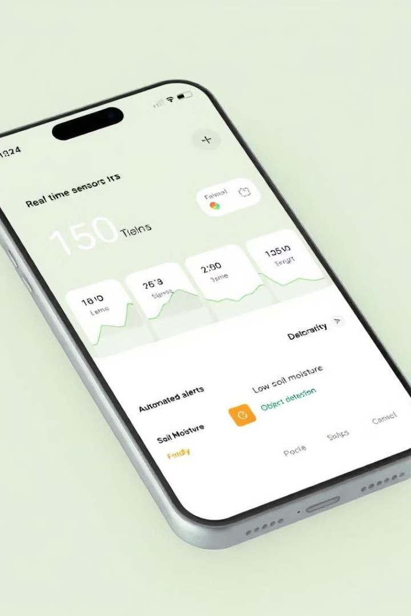
Key Features
1
Real-Time Monitoring
2
Automated Alerts
Temperature, humidity, soil moisture, light intensity, and object proximity.
Low soil moisture triggers LED and app notification. Proximity detection activates a buzzer and sends an alert.
3
IoT Integration
Data uploaded to Blynk cloud for remote access. Accessible via mobile app.
User Benefits:
Efficient plant care with minimal manual effort.
Improved plant health and optimized resource usage.

Slide 5
Results and Limitations
Results
Limitations
Achieved successful real-time monitoring of critical parameters.
Reliant on Wi-Fi connectivity for cloud data transmission.
Prompt alerts ensured timely interventions.
Initial setup requires calibration for sensors.
Enhanced greenhouse efficiency and plant health.
System not optimized for large-scale greenhouses yet.

Slide 6





Future Scope
1
Enhanced Functionality
2
Advanced Analytics
3
Scalability
4
User-Friendly Interface
5
Smart Home Integration
Add sensors for pH, CO₂, and water quality. Automate irrigation and light adjustments. Integrate machine learning for predictive insights. Adapt the system for larger greenhouses with multiple nodes. Improve the mobile app with graphical data and historical trends. Enable voice commands via Alexa or Google Assistant.

