Slide 2
Problem Statement
Expedite learning in neural networks
- with similarity check
Regularizing a model
- by training the model with feature maps
Notes:
As a part of our project we mainly focused to find a way to expedit learning in Convolution Neural Networks using a new technique. Furthermore we aimed to find new regularization technique using the feature maps.
1. Expedite learning in neural networks
- similarity check
- To acceralate the learning in neural networks, we used a technique of similarity check. As a part of this, we first calculated similarity measure between the feature maps extracted from previous batch trained images and the input images in current batch. We then passed only those images that aren't similar further to the deeper layers of CNN.
2. Regularizing a model
- To find a new regularization technique, we experimented by training a model with feature maps generated by first convolution layer.
In all our experiments we have used MNIST and fashion MNIST datasets.

Slide 3
Expedite learning in neural networks with similarity check
Feature Vector Extraction
Feature Vector Caching
Cosine Similarity Check
Dynamic Threshold

Slide 4
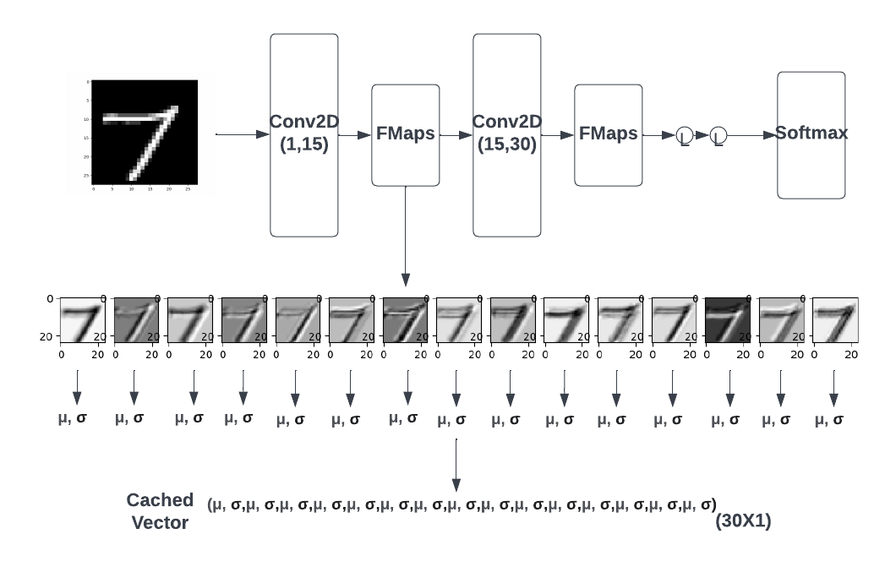
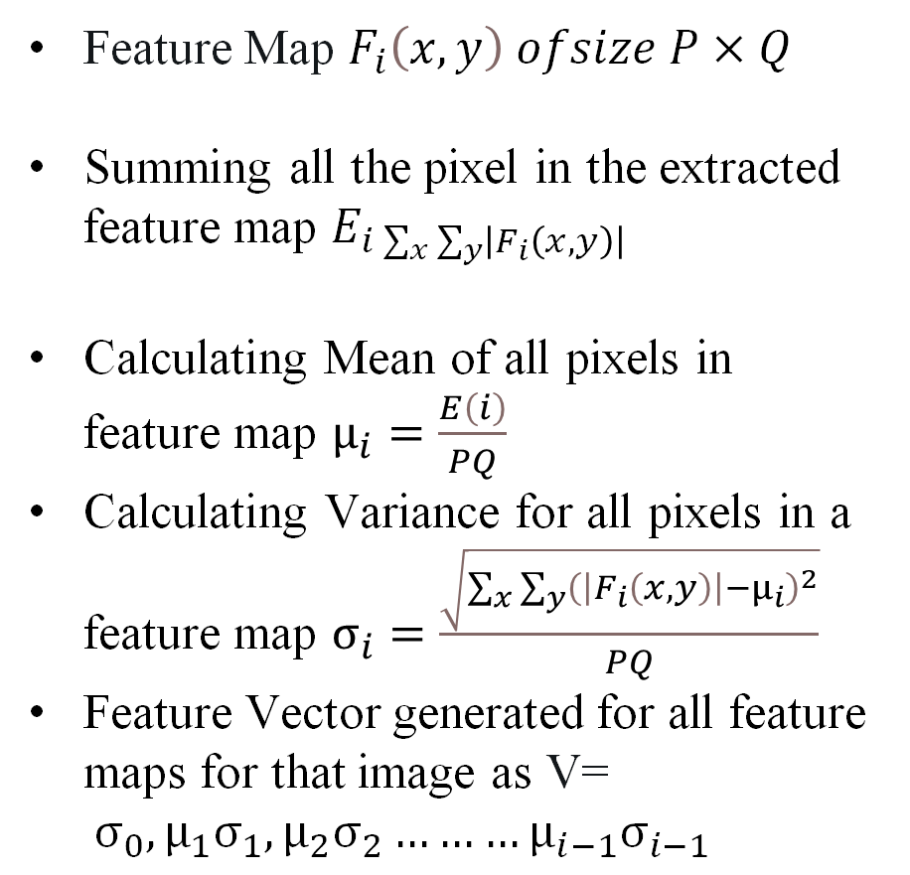
Feature Vector Extraction
Feature Map $F_{i}\left(x,y\right) ofsize P×Q$
Summing all the pixel in the extracted feature map $E_{i\sum_{x}{\sum_{y}{\left|F_{i}\left(x,y\right)\right|}}}$
Calculating Mean of all pixels in feature map $μ_{i}=\frac{E\left(i\right)}{PQ}$
Calculating Variance for all pixels in a feature map $σ_{i}=\frac{\sqrt{\sum_{x}{\sum_{y}{{\left(\left|F_{i}\left(x,y\right)\right|−μ_{i}\right)}^{2}}}}}{PQ}$
Feature Vector generated for all feature maps for that image as V= $σ_{0},μ_{1}σ_{1},μ_{2}σ_{2}………μ_{i−1}σ_{i−1}$
Figure 1: Diagram that shows how feature vector is calculated.
Keunyoung Park and Doo-Hyun Kim. Accelerating image classification using feature map similarity in convolutional neural networks. Applied Sciences, 9(1):108, 2019

Slide 5
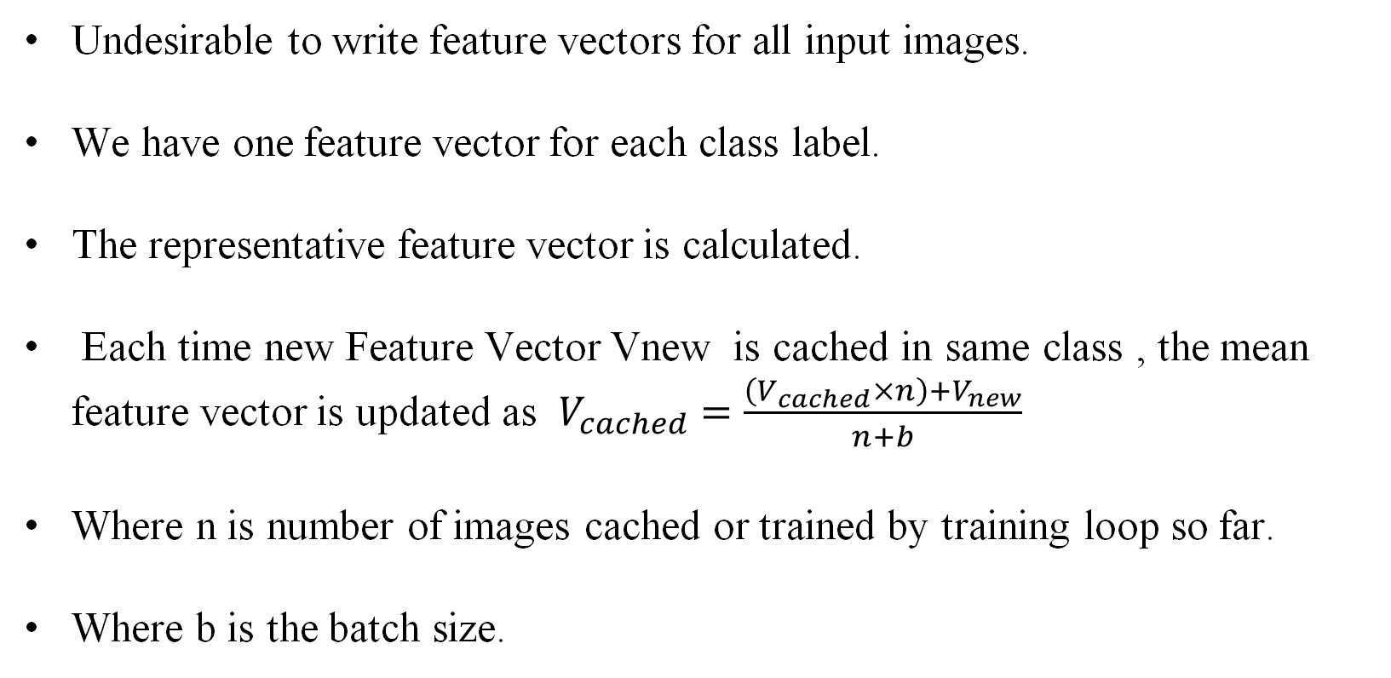
Feature Vector Caching
Undesirable to write feature vectors for all input images.
We have one feature vector for each class label.
The representative feature vector is calculated.
Each time new Feature Vector Vnew is cached in same class , the mean feature vector is updated as $V_{cached}=\frac{\left(V_{cached}×n\right)+V_{new}}{n+b}$
Where n is number of images cached or trained by training loop so far.
Where b is the batch size.

Slide 6
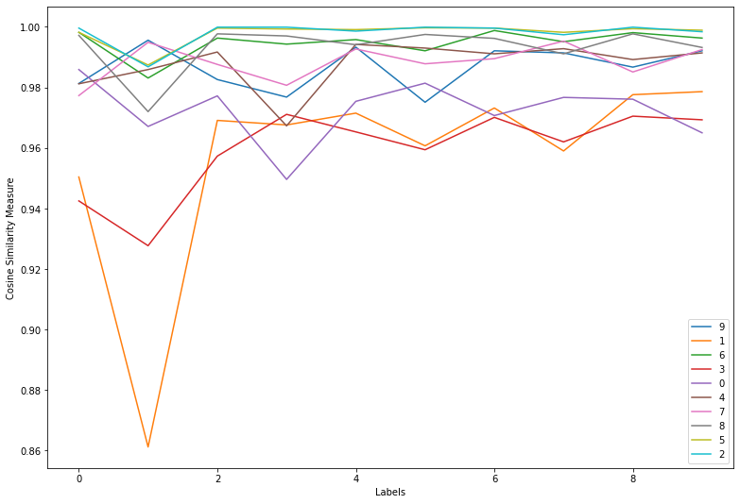
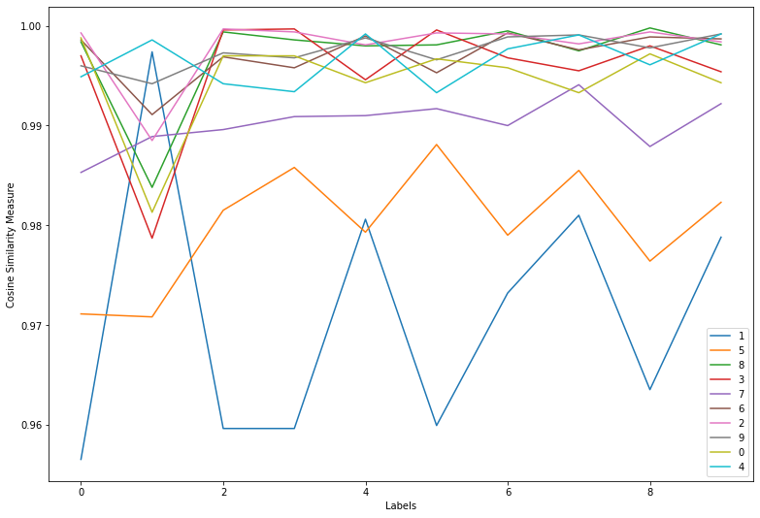
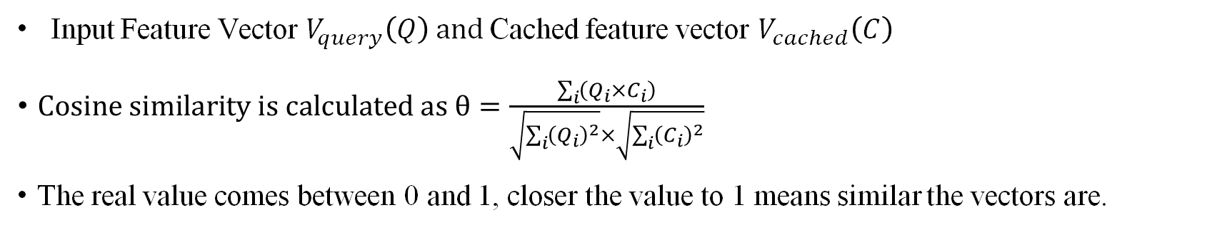
Cosine Similarity Check
Input Feature Vector $V_{query}\left(Q\right) and$Cached feature vector $V_{cached}\left(C\right)$
$Cosine similarity is calculated as θ=\frac{\sum_{i}{\left(Q_{i}×C_{i}\right)}}{\sqrt{\sum_{i}{{\left(Q_{i}\right)}^{2}}}×\sqrt{\sum_{i}{{\left(C_{i}\right)}^{2}}}}$
The real value comes between 0 and 1, closer the value to 1 means similar the vectors are.
Figure 2: Cosine Similarity Visualization at a very early stage of training.
Figure 3: Cosine Similarity Visualization at later stage of training.

Slide 7
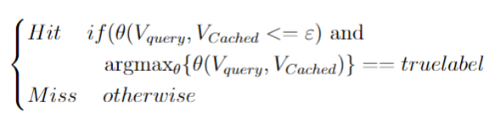
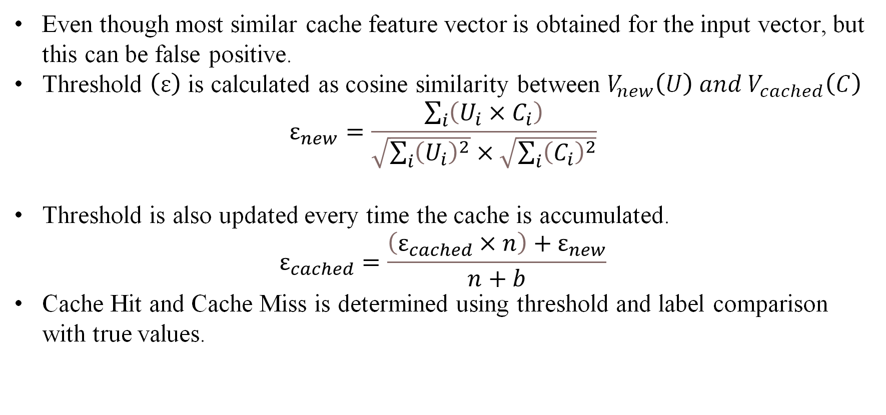
Dynamic Threshold
Even though most similar cache feature vector is obtained for the input vector, but this can be false positive.
Threshold $\left(ε\right)$ is calculated as cosine similarity between $V_{new}\left(U\right) and V_{cached}\left(C\right)$
$$ε_{new}=\frac{\sum_{i}{\left(U_{i}×C_{i}\right)}}{\sqrt{\sum_{i}{{\left(U_{i}\right)}^{2}}}×\sqrt{\sum_{i}{{\left(C_{i}\right)}^{2}}}}$$
Threshold is also updated every time the cache is accumulated.
$$ε_{cached}=\frac{\left(ε_{cached}×n\right)+ε_{new}}{n+b}$$
Cache Hit and Cache Miss is determined using threshold and label comparison with true values.

Slide 8
Training model on Feature maps
Simple Network architecture
conv – maxpool – relu – conv – maxpool – relu – linear – relu – linear – softmax
Train a model on original images
Extract feature maps from first convolution layer
Train the same model on feature maps
8

Slide 9
Testing perturbed images with the model trained on feature maps
Extension of previous experiment
Intension behind this experiment
Generated perturbed images using Fast Gradient Signed Method
Test the model against the perturbed images
9

Slide 10
Results and Analysis

Slide 11
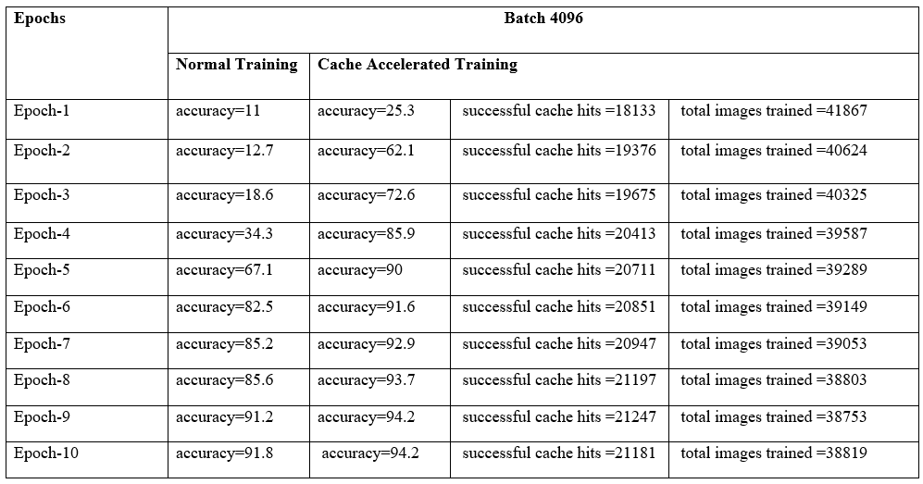
Results of accelerating learning
Experimented with various batch sizes
Model trained with batch size 4096 out-performed
Average cache hits is around 18k.

Slide 12
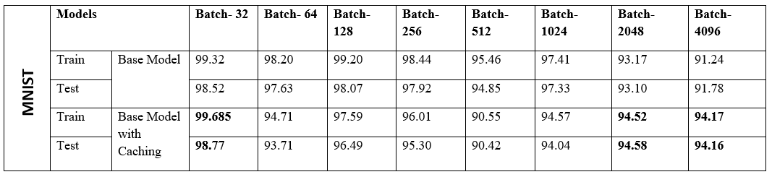
Contd...
Accuracies are either better or equal to original values comparatively.

Slide 13
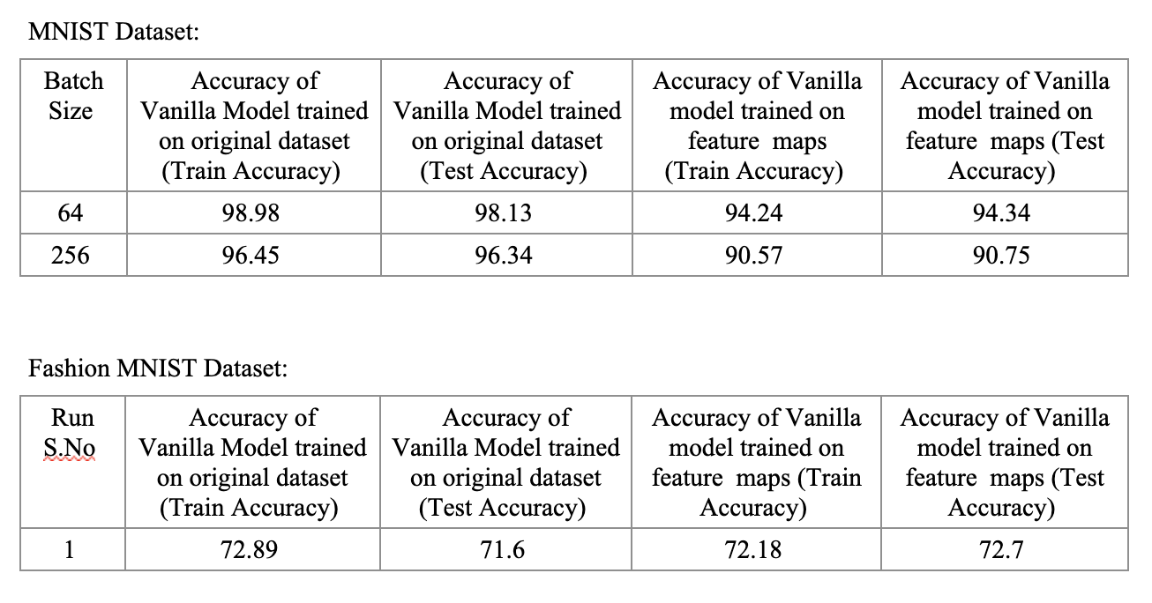
Results of model trained on feature maps
Better accuracies observed on the testing set compared to the training set.
Regularized only a bit.

Slide 14
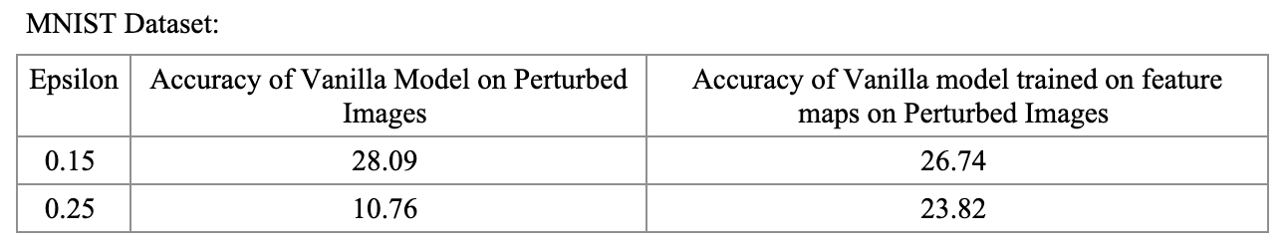
Results of model trained on feature maps on Perturbed images
Model trained on feature maps performed better on perturbed images

Slide 15
Thank you!!

