Slide 1

Credit Card Fraud Detection: Predict the likelihood of credit card fraud using transaction data using R
AKHILESH KUMAR
20BCS9907

Slide 2

Agenda
Library Installation and Loading
Library Installation
Installed necessary R libraries, including caret, rpart, dplyr, randomForest, rpart.plot, pROC, and ROSE.
Library Loading
Loaded the required libraries using the library function.

Slide 3
Data Loading
Read the credit card transaction dataset from a
CSV file into a data frame using read.csv.
Data Exploration
Explored the dataset by viewing its structure, columns, and initial observations using functions like View, names, str, and head.
Data Preprocessing
Converted the 'Class' variable into a factor and checked for any missing values using summary and sum(is.na()).

Slide 4
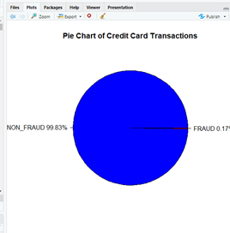
Data Visualization Density Plots Created density plots for visualizing the distribution of fraud and non-fraud transactions. Pie Chart Generated a pie chart for comparing the number of frauds and non-frauds.
Split the dataset into training and testing sets
80% for training and 20% for testing.

Slide 5
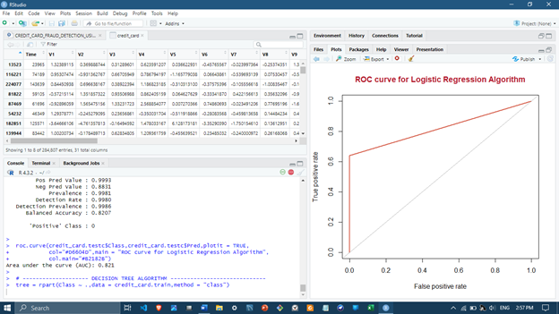
Model Building - Logistic Regression
ACCURACY:
89.92

Slide 6
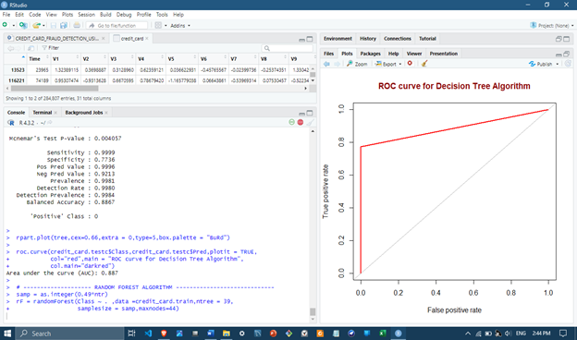
Model Building – Decision Tree
ACCURACY:
89.95

Slide 7
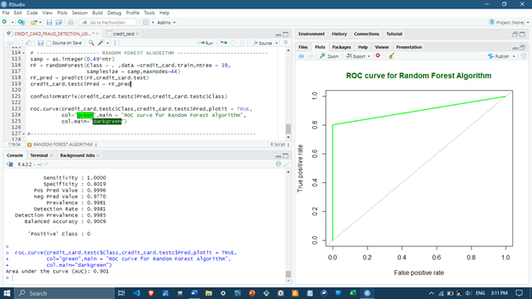
Model Building- Random Forest
HIGHEST ACCURACY:
90.06

Slide 8

Thank you

