Slide 1
AI/ML for Networking
Under The Guidance Of
Dr. Chintoo Kumar
DEPARTMENT OF COMPUTER SCIENCE ENGINEERING
GITAM School of Technology, GITAM (Deemed to be University),
Bengaluru, Karnataka, INDIA.
GONGADI AKHILESH-BU22CSEN0100426
SIRIVELLA VAMSI KRISHNA-BU22CSEN0100600
BAVIGADDA MANI KUMAR REDDY-BU22CSEN0101820

Slide 2
Abstract
Traditional rule-based security systems are no longer effective for modern encrypted and dynamic network traffic.
This project uses AI/ML to automate threat detection and traffic classification through two key models:
URL-based Threat Detection using Random Forest
Real-time Packet Classification using live network features
Both models are integrated into a Streamlit-based UI that enables URL analysis and live monitoring with a PyShark-based packet sniffer.
Achieved high detection performance (F1-score: 0.98–0.99) while preserving privacy, making the solution suitable for real-time threat response in modern networks.

Slide 3
Contents
Motivation
Literature Review
System Overview
Dataset Description
Methodology
User Interface
Results
Discussion
Conclusion & Future Work
References
Appendices

Slide 4
Motivation
Modern network infrastructures are increasingly challenged by encrypted communications, complex attack patterns, and data overload. Traditional DPI (Deep Packet Inspection) and rule-based systems lack adaptability and often fail in detecting zero-day attacks or handling encrypted payloads. Therefore, intelligent, self-learning solutions are necessary to maintain effective cybersecurity in evolving environments.

Slide 5
Literature Review
Previous works relied heavily on signature-based threat detection and rule matching. However, these techniques are ineffective for encrypted or novel traffic patterns. Machine Learning, particularly Random Forest and Deep Learning models, has demonstrated success in anomaly detection, traffic classification, and identifying phishing URLs. Integrating ML with real-time packet capture tools (e.g., PyShark) is still a growing research area.

Slide 6
System Overview
The system consists of the following components:
Feature Extraction Modules for URL and packet data
Two ML Models: one for URL classification and another for traffic analysis
Streamlit-based UI for visualization and real-time control
Packet Sniffer powered by PyShark for live traffic capture
These components work together to analyze and classify incoming traffic and provide real-time security alerts.

Slide 7
Dataset Description
URL Dataset: malicious_phish.csv
Labels: Benign, Phishing, Malware, Defacement
Features: URL length, domain length, special characters, presence of keywords, HTTPS check
Traffic Dataset: Thursday-WorkingHours-Morning-WebAttacks.pcap_ISCX.csv
Source: CICIDS2017
Features: Flow Duration, Total Packets, ACK/URG/PSH Flags, Avg Segment Sizes, Packet Length
Labels: BENIGN or MALICIOUS

Slide 8
Methodology
URL Classification:
Feature extraction using URL parsing and keyword checks
Random Forest model training with high performance (98% F1-score)
Real-Time Traffic Classification:
Feature extraction from NetFlow stats using PyShark
Real-time prediction using trained Random Forest model
Streamlit UI Integration:
Interface to input URLs or monitor live predictions from network traffic
Packet Sniffer:
Captures live packets, transforms to feature vector, and predicts clas

Slide 9
Model Training & Evaluation
URL Classification Model:
Precision: 0.98
Recall: 0.98
F1-Score: 0.98
Traffic Detection Model:
Precision: 0.99
Recall: 0.99
F1-Score: 0.99

Slide 10
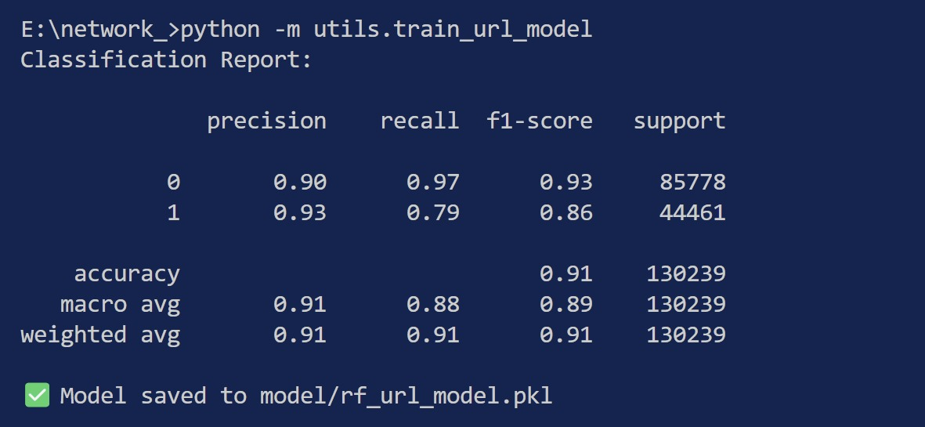

Dept of Computer Science & Engineering

Slide 11
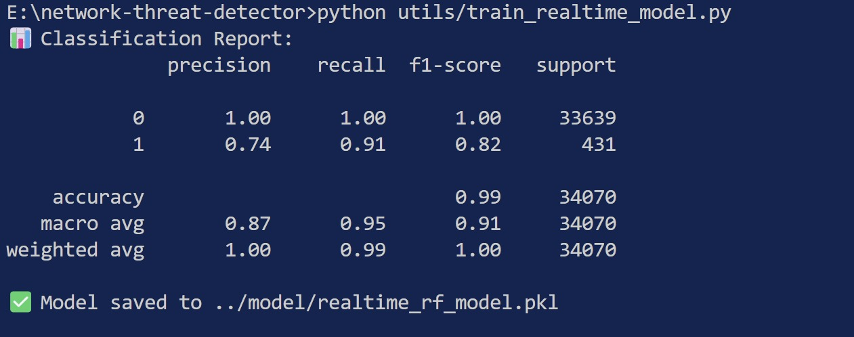
Model Training & Evaluation
Dept of Computer Science & Engineering

Slide 12
User Interface
Developed using Streamlit, the UI allows:
URL-based threat detection (manual or CSV upload)
Real-time network packet monitoring
Auto-refresh functionality every 2 seconds
Log clearing and live display of predictions

Slide 13
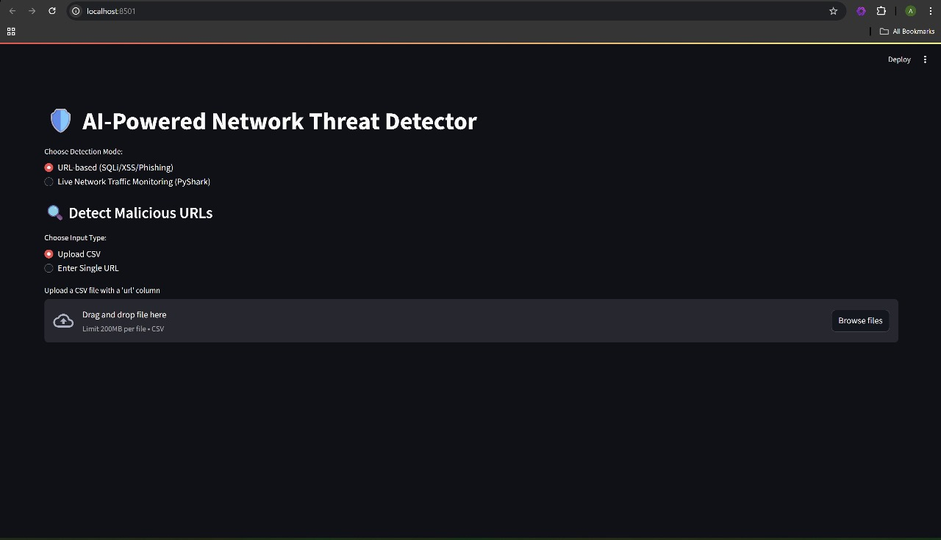

Slide 14
Results
URL Model Accuracy: 98%
Real-time Packet Model Accuracy: 99%
Real-time prediction logs saved to sniffer_output.txt
Streamlit Dashboard provides live, interactive visualizations

Slide 15
Discussion
Strengths:
High detection accuracy
Lightweight and real-time
Works on encrypted traffic without decryption
Limitations:
Feature extraction on live traffic is minimal
Model doesn’t handle unknown traffic types well
Scalability:
Easily scalable with Docker or Kubernetes
Suitable for edge deployment or cloud monitoring systems

Slide 16
Conclusion & Future Work
Conclusion: This system demonstrates how AI and ML can automate traffic classification and threat detection, offering a privacy-preserving and scalable solution for modern networks.
Future Work:
Integrate anomaly detection using unsupervised learning
Include TLS fingerprinting for encrypted session analysis
Enhance with lightweight models like XGBoost or LightGBM

Slide 17
References
CICIDS 2017 Dataset
scikit-learn Documentation
Streamlit & PyShark Documentation
Research Papers on AI for Network Security

Slide 18
Appendices
Source code files and structure
Model training logs
Sample CSV for URL detection
Real-time packet logs
Screenshot of Streamlit interface

Slide 19
Thank You

