Slide 1
Furniture Ergonomic Explainer Video
June 21, 2022

Slide 2
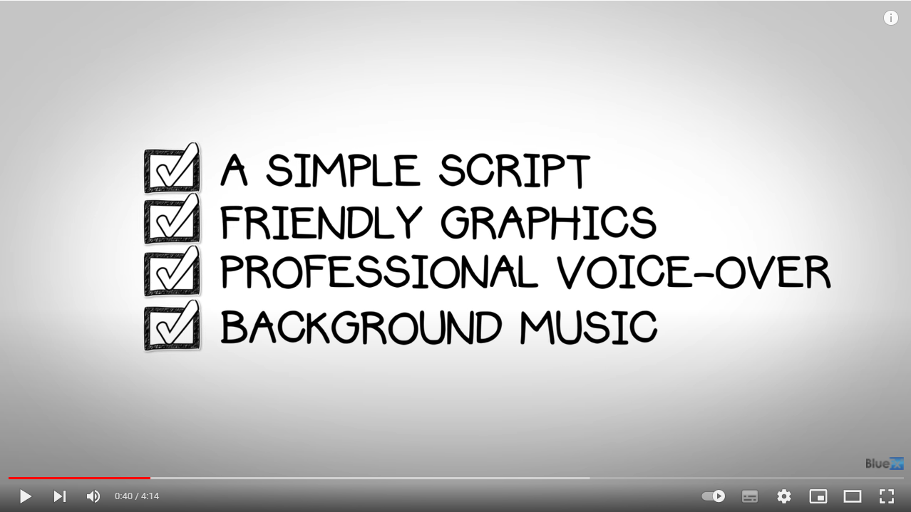
Reference (https://youtu.be/WwSJFihsdjs)

Slide 3
Script
In a corporate setting e.g., “Board Room”, “In front of a Computer” etc.
Chief Marketing Officer
How do I increase brand-value of my company
Chief Revenue Officer
How do I increase sales for my company
Chief Financial Officer
Pacing an office corridor, thinking … How do I increase profitability of my company
Chief Happiness Officer
How do get my customer’s to be happy with my company
Can be mix of men & women
Background should be clean. Current background reduces focus. How about some pastel-color with gradient ?

Slide 4
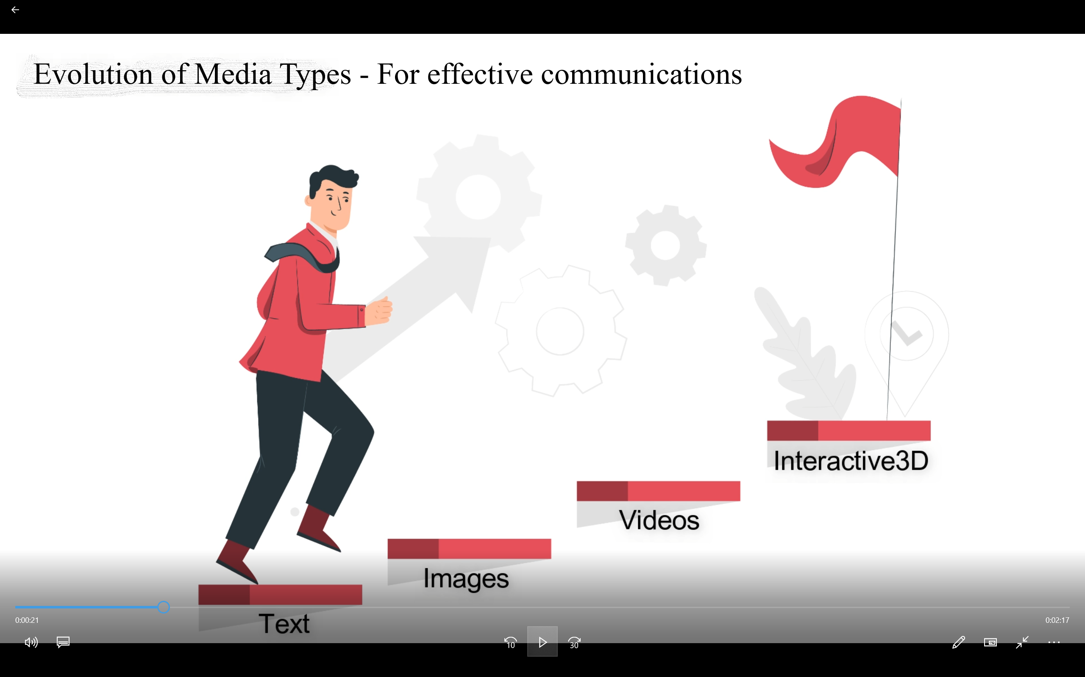
Voice - Let us study the evolution of media types for effective communications

Slide 5

How about Interactive3D Apps ?
Zoom
Rotate
Pan
Customize Materials
Animation
Lighting
Viewpoints
Many major eCommerce players like Shopify are advocating and promoting 3DCommerce through the organization khronos.org
With a user-experience that includes “Zoom”, “Rotate”, “Pan”, “Customization of Materials”, “Animation”, “Lighting”, “Viewpoints” etc.

Slide 6

Voice - Introducing Interactive3D Marketing Solutions from VisCommerce

Slide 7
Features (Graphics)
Basic Controls
Zoom, Pan, Rotate
Ergonomic Table Material Customization
Cedar Wood, Deodar Wood, Mahogany Wood, Satin Wood, Walnut wood
Ergonomic Table Height settings
Level 1, Level 2, Level 3
Ergonomic Chair Features
Adjust Height, Rotate , Backrest alignment
Lighting controls
Desktop Lamp, Ceiling Light, Sunlight via Shades
Viewpoints
Viewpoint 1, Viewpoint 2, Viewpoint 3
Reset
View, Scene
Dimensions
Standard, Between two points

Slide 8
Happy CXO
Chief Financial Officer
Happy
Wow VisCommerce offers a good Return On Investment
Chief Revenue Officer
Happy
Finally found a great solution in VisCommerce to increase revenues
Chief Happiness Officer
Happy
Customer satisfaction is finally in sight due to VisCommerce
Chief Marketing Officer
Happy
VisCommerce is the right solution to increase my company’s brand value

Slide 9
Graphs
Revenue up
Product returns reduced
Happy customers (average consumers)

Slide 10
Join the 3D Commerce revolution

Slide 11

VisCommerce
Visualization Powered Commerce
https://viscommerce.com
info@viscommerce.com

Slide 12
Professional Voice Over
Sub-Title would be the “feature”
Sub-Titles converted into voice using text-to-speech software
US male voice

Slide 13
Background music
Nice upbeat music
Music volume lowered when sub-title is shown with voice

