Slide 1
Paints Explainer Video
July 2022

Slide 2

Reference (https://youtu.be/WwSJFihsdjs)

Slide 3
Script
In a corporate setting e.g., “Board Room”, “In front of a Computer” etc.
Chief Marketing Officer
How do I increase brand-value of my company
Chief Revenue Officer
How do I increase sales for my company
Chief Financial Officer
Pacing an office corridor, thinking … How do I increase profitability of my company
Chief Happiness Officer
How do get my customer’s to be happy with my company
Can be mix of men & women
Background should be clean. Current background reduces focus. How about some pastel-color with gradient ?

Slide 4
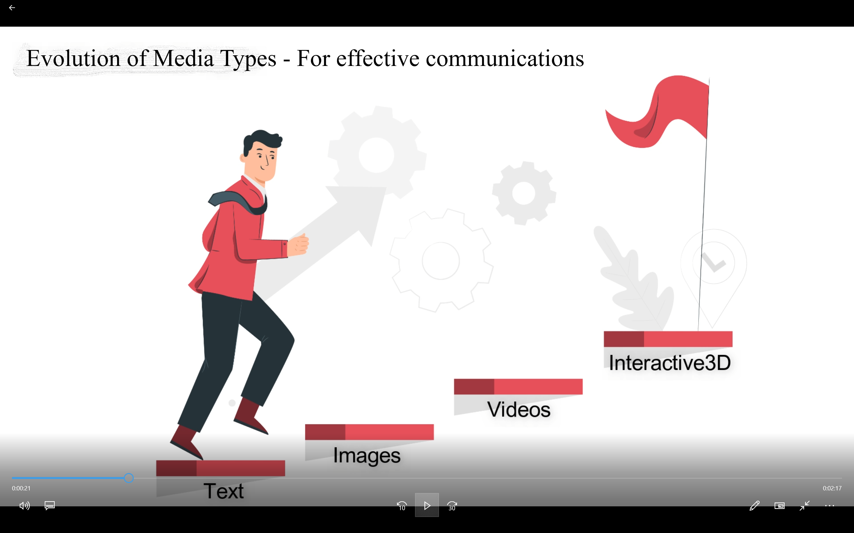
Voice - Let us study the evolution of media types for effective communications

Slide 5

How about an Interactive3D App for Paints
Colors
Textures
Stencils
Zoom
Pan
Rotate
Lighting
Personalize
Photorealistic Image
Collaboration
Major eCommerce players like Shopify, Wayfair are actively advocating and promoting 3D Commerce along with khronos.org

Slide 6

Voice - Introducing Interactive3D Marketing Solutions from VisCommerce

Slide 7
Features
Basic Controls
Zoom, Pan, Rotate
Paint Styles
Colors, Textures, Styles
https://www.asianpaints.com/online-shop/wall-stickers.html?cid=DI_GPmax_DM_A_WS&utm_source=Google_Pmax&utm_medium=CPC&utm_campaign=Wallsticker_PMax&utm_content=PMaxAds&gclid=CjwKCAjwoMSWBhAdEiwAVJ2ndmEa77ZIIt--JhUn3bogIoMOHAz9Y_eOB73VkRKSLDWQfJEPhPPR8RoC4s0QAvD_BwE
Lighting
Turn lights on/off, Intensity controls, Color controls
Collaboration
Two or more persons experience activity together. (e.g Seller & Buyer).
Video Chat along with 3D Collaboration resulting in highly engaging sessions
Personalization
Try Colors, Textures, Stencils in your own Space in 3D.

Slide 8
Happy Executives
Chief Financial Officer
Happy
Wow VisCommerce offers a good Return On Investment
Chief Revenue Officer
Happy
Finally found a great solution in VisCommerce to increase revenues
Chief Happiness Officer
Happy
Customer satisfaction is finally in sight due to VisCommerce
Chief Marketing Officer
Happy
VisCommerce is the right solution to increase my company’s brand value

Slide 9





Graphs
Revenue up
Product returns reduced
Happy customers
New Revenue Streams
Photorealistic Rendered Images
Photorealistic Rendered Videos

Slide 10

Welcome to the 3DCommerce Revolution
VisCommerce
Visualization Powered Commerce
https://viscommerce.com info@viscommerce.com 91-9063243163

Slide 11
Professional Voice Over.
Sub-Title would be the “feature”
Sub-Titles converted into voice using text-to-speech software
US male voice

Slide 12
Background Music
Nice upbeat music
Music volume lowered when sub-title is shown with voice

