Slide 1
Excel capstone-1
A.SAI AKHILESH

Slide 2
TOPIC : hunger dataset vISUALISATION

Slide 3
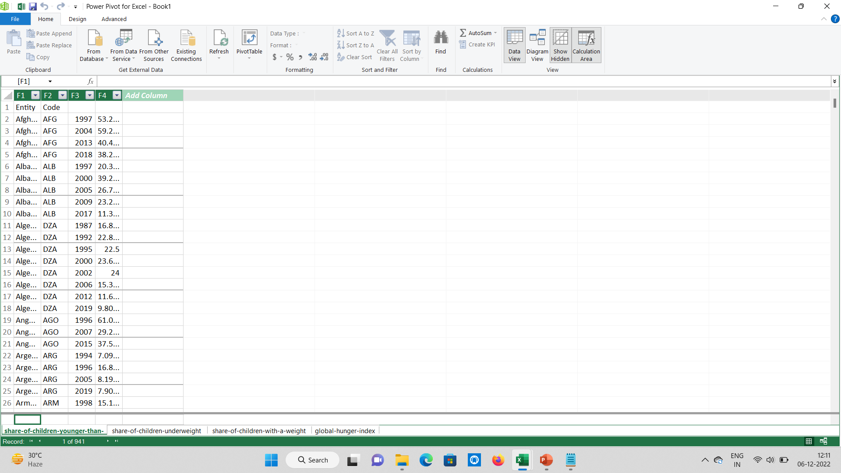
1. Import the data using power pivot?
1.Check the extension of the file which you want to import.
2.Go to Power Pivot select manage go to “from other sources” in home rebbion
and choose the option according to the file extension.
3.Select the file type>select the file.
4.Import the data in Power Pivot in Excel.

Slide 4
2. Which country’s hunger index decreased from the year 2000 to 2021 and how
much decreased?
Ans: Belarus,Chile,Croatia,Cuba,Estonia,Kuwait,Lithuania,Moldova are the countries
has been occurred the hunger index decreased from the year 2000 to 2021
and 93.36% is decreased.

Slide 5
3. Which country is having more percentage prevalence of underweight
compared to all the countries and what is the percentage?
Ans. Import the data from power pivot>pivot table then arrange the
countries in rows and prevalence of underweight in values and
applied the conditional formatting with top 1 value then we get the
highest percentage value. Then Bangladesh country is having more
percentage prevalence of underweight compared to all the
countries with having 1101.1%

Slide 6
4. What is the rank of Prevalence of wasting in the year 2002?
Ans. From power pivot>pivot table arrange the years in rows then
then applied the rank formula for the years apply the filters for
both the columns and filter the year then we get the rank of the year
2002.The rank of Prevalence of wasting in the year 2002 is 19
Years | Ranks
2002 | 19

Slide 7
5. What are the countries where the sum of prevalence of stunting is between
500 to 1200 and represent the visualisation?
Ans. From Power pivot>pivot table arrange the countries in rows and sum of
prevalence into values and apply the filter to the countries filter values
between 500 to 1200 we get the countries.
Malawi , Niger and Vietnam are the countries sum of prevalence of stunting is
between 500 to 1200.
Row Labels | Sum of Prevalence of stunting, height for age (% of children under 5)
Malawi | 723.5
Niger | 789.0000038
Vietnam | 768.3000011

Slide 8
6. From which year the prevalence of stunting has increased?
Ans. Power pivot>pivot table arrange the years in rows and prevalence
of stunting in values.Create a line chart for the data, from the below
chart we can observe that from the year 1986 the prevalence of stunting
has increased.

Slide 9
7. What is the average of the top 5 years in prevalence of wasting?
Ans. Power pivot>pivot table arrange the years in rows and prevalence of
wasting in values and apply the filter to the prevalence of wasting
then filter values in top 5 items then we get the top 5years with
sum of prevalence of wasting then apply average formula for the
top 5years then we get the average.
The average of the top 5 years in prevalence of wasting is 218.9466664.
Row Labels | Sum of Prevalence of wasting, weight for height (% of children under 5)
2000 | 435.6000005
2006 | 306.9000002
2010 | 276.5000006
2014 | 270.099999
Grand Total | 6318.981576
AVERAGE | 218.9466664

Slide 10
T
H
A
N
K
Y
O
U

