Slide 1
Excel EndCapstone-1
A. Sai Akhilesh

Slide 2
Amazon Dataset

Slide 3

1. Import the data using web scrapping.
Generate a python code using selenium to download the amazon data set and make some exploratory data analysis and take the code from it
df1.to_csv(‘Amazon.data’,index=False).

Slide 4
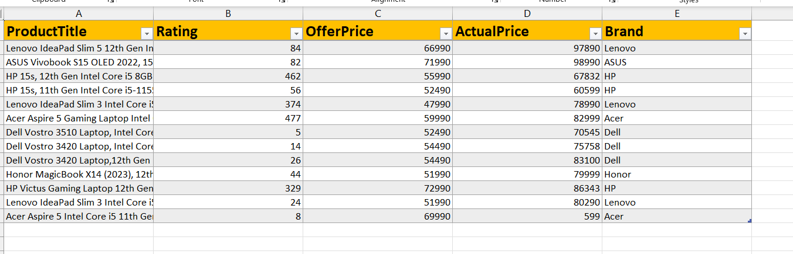
2. Import the amazon data after cleaning in python
Here the data consists of ProductTitle, Rating, OfferPrice, ActualPrice, Brand shape of 13rows and 5columns.

Slide 5
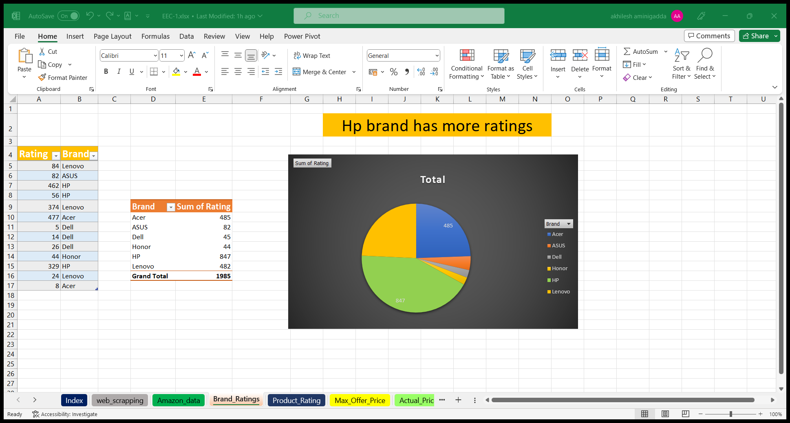
3. Which brand has more ratings?
Create a pivot table on two columns brand and ratings and drag the brand column into the rows and ratings into the sum of ratings .
And create the pie chart regarding to the data.
Here we can see the Hp brand has more ratings when compared to all the brands.

Slide 6
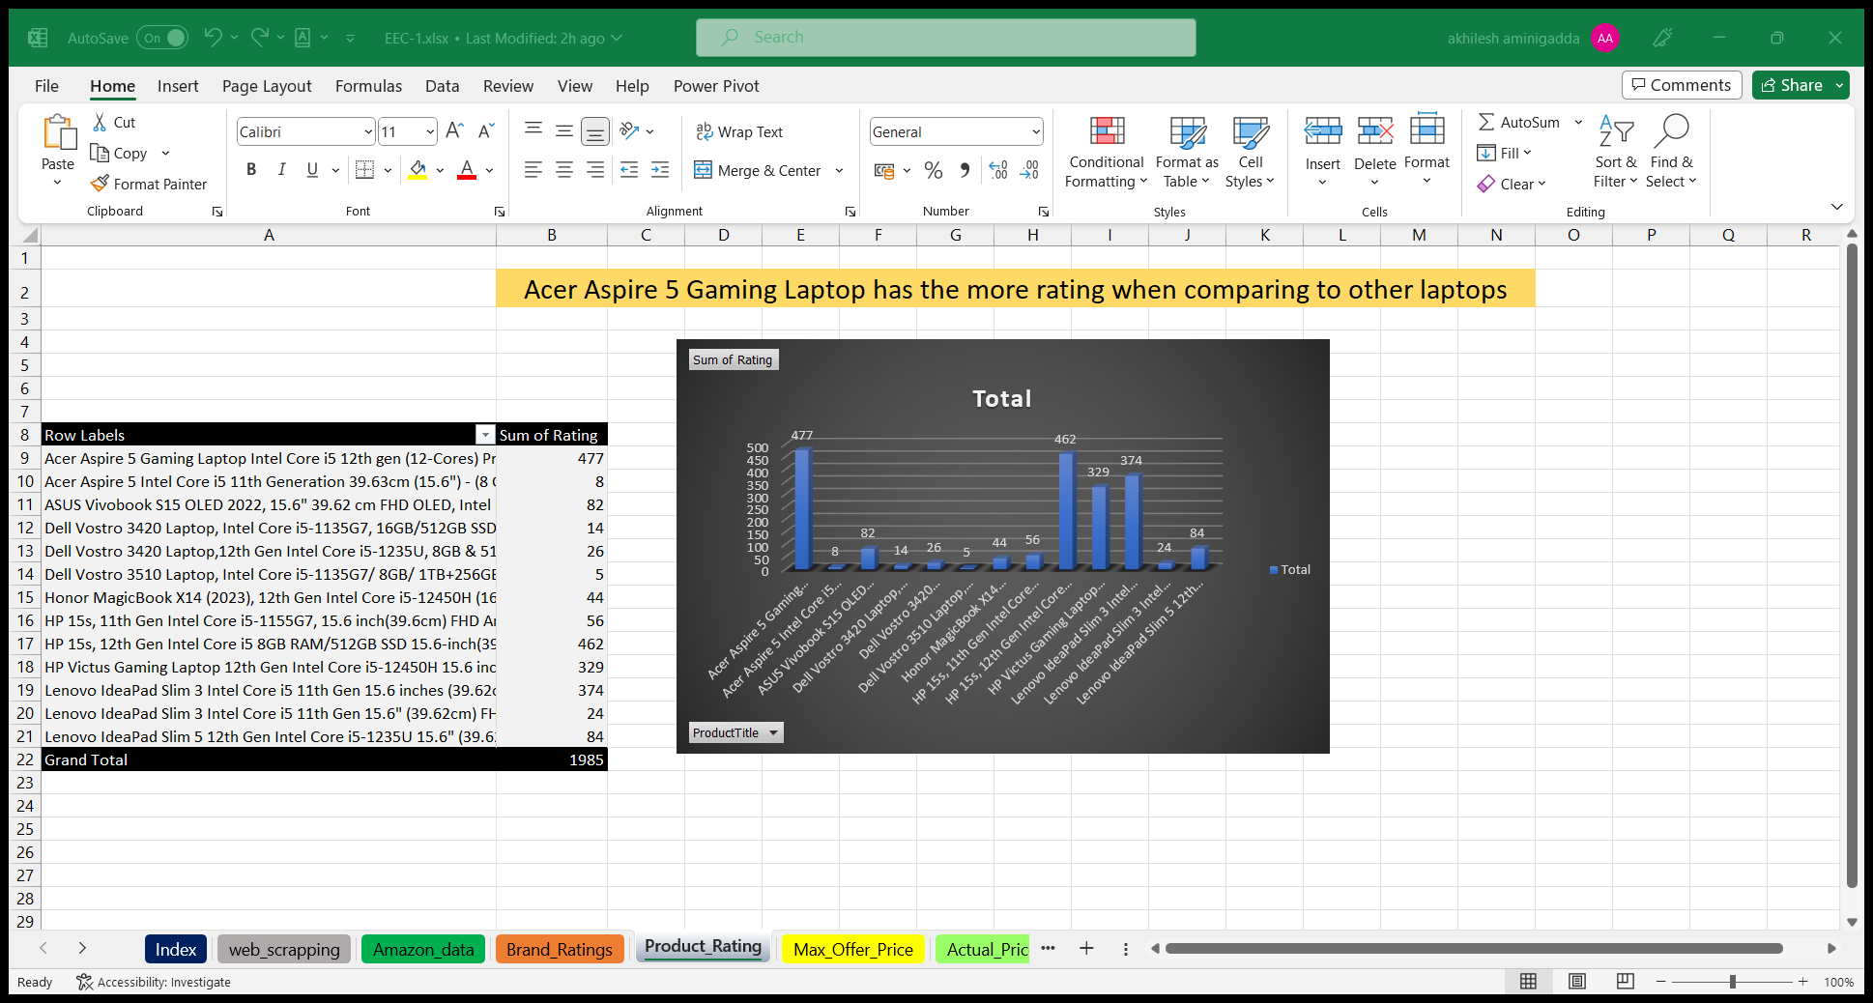
4. Which laptop has more ratings compared to all laptops?
Create a pivot table on Product title and ratings drag the product title column into the rows and ratings into the sum of the ratings.
Here Acer Aspire 5 Gaming laptop has more ratings compare to all the models.

Slide 7
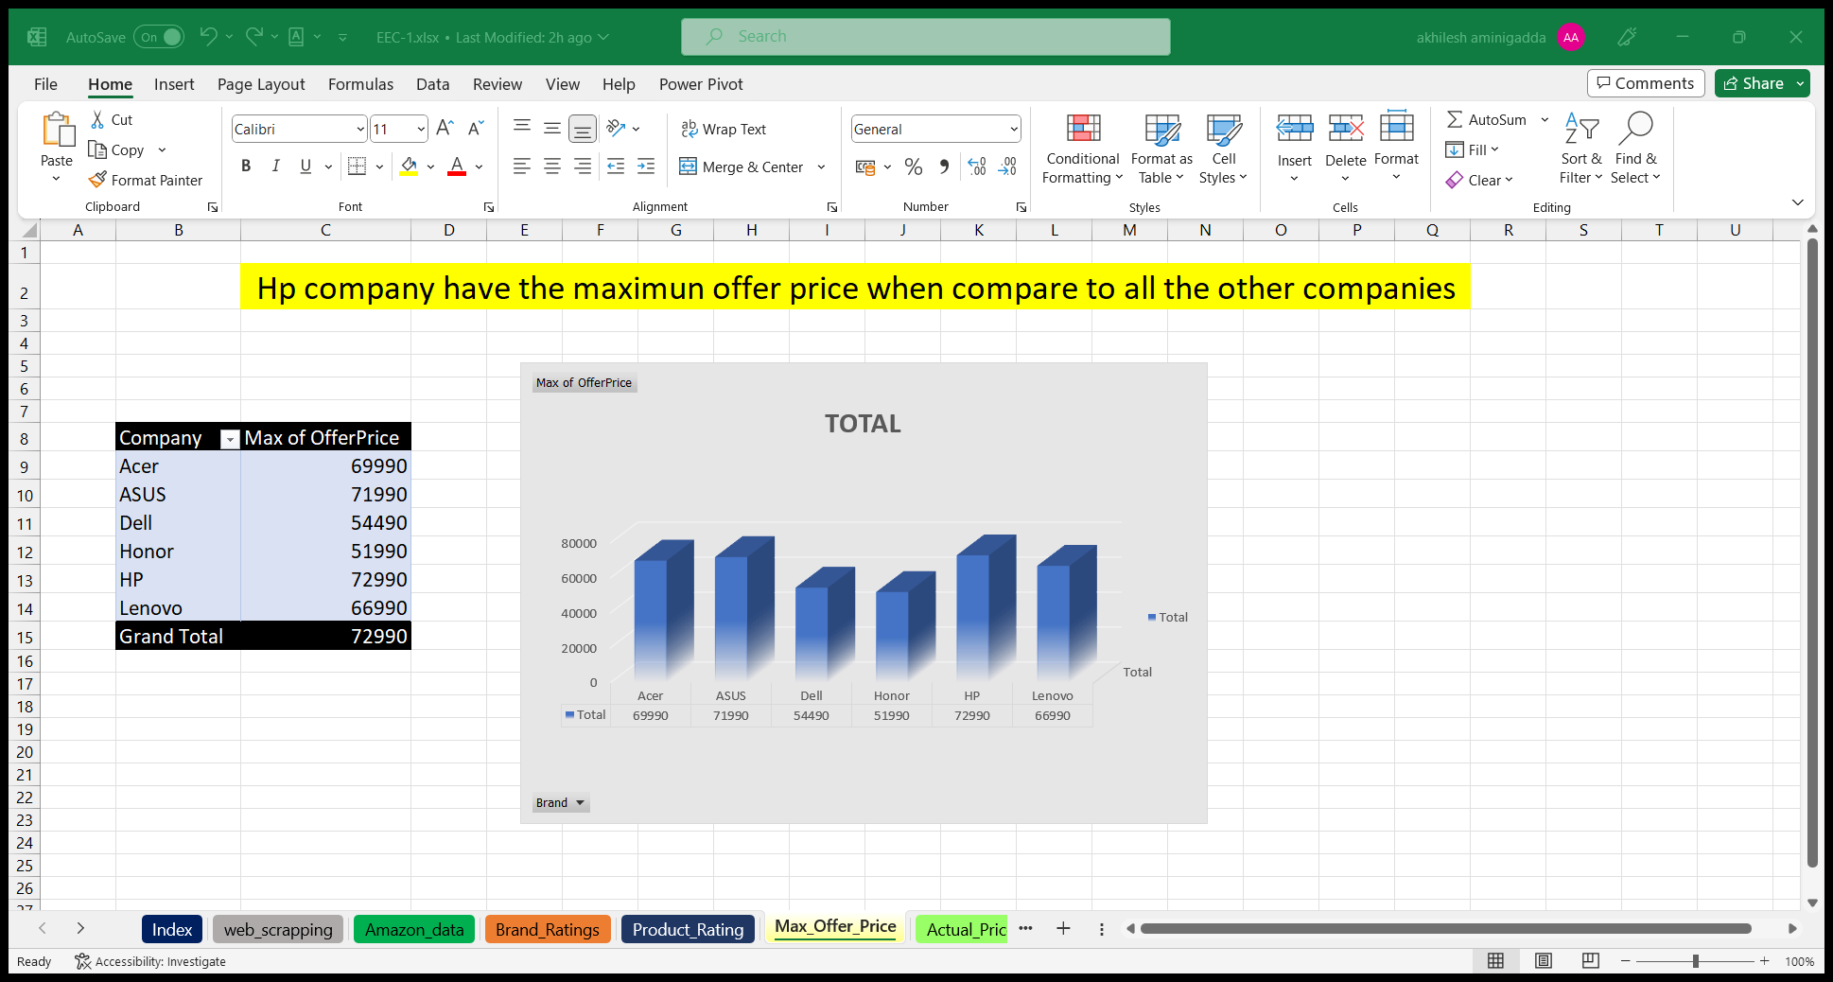
5. Which company has maximum offer price compared to all the brands ?
Create a pivot table on brands and offer price columns drag the brands into rows and offer price set in the max offer price .
Here Hp brand has the max offer price compared to all the brands.

Slide 8
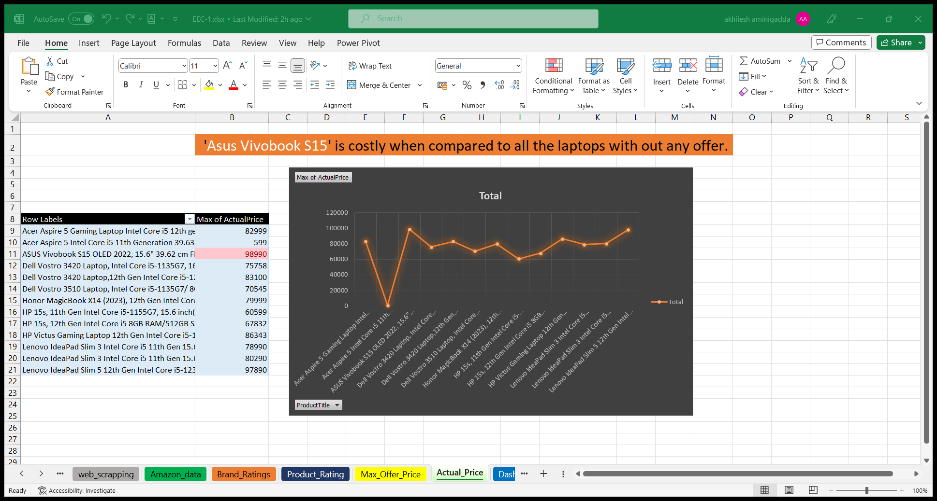
6. Which model is costly compared to all the models with out offer ?
Create a pivot table on product title and actual price drag the product title into the rows and actual price into the max of actual price .
Here ‘Asus Vivobook s15’ is costly compared to all the models . And apply the
Conditional formatting with top 1 then we will hightlight the price of the costly model.

Slide 9

Thank
you

